Slide 1
Note 5
Labels & Addresses
Reading: https://en.wikibooks.org/wiki/X86_Assembly
Sections:
x86 Basics
x86 Instruction Set
Syntaxes and Assemblers
CSC 2210 Procedural and Object-Oriented C++
Copyright © 2023-24 Robert W. Hasker

Slide 2
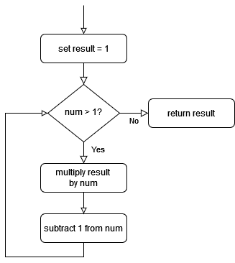
How to handle a loop?
This is a flowchart
  Diamond: decision with yes/no answer
  Rectangle: an action
  Arrows: possible paths
Simple to follow
Was seen as the design tool in the 60s
Issue: big programs → very big charts!
  And no one wrote them until after writing the code…
But, good for understanding assembly

Slide 3
How to handle a loop?
Here: computes factorial:
    long long result = 1;
    while ( num > 1 ) {
    result *= num;
    num--;
    }
    return result;
How to implement in assembly?
  There is no while
  Solution: label particular instructions
  Will jump to this location

Slide 4
How to handle a loop?
Basic elements in a solution:
  label: - names a memory location
  jmp label – jump to specified location
But what if jump is conditional?
  cmp a, b – compare a and b, setting flags indicating whether a < b, a == b, a > b, etc.
  je label: jump if comparison was equal
  jne label: jump if comparison was not equal
  jg label: jump if a was greater than b
  (among others)

Slide 5
Assembly solution
long long result = 1;
while ( num != 0 ) {
result *= num;
num--;
}
return result;
Note the form:
One instruction per line
Colon after labels
#: comment to end of line
Whitespace within line: generally optional
  Line up in columns for readability
  offset labels
assembly is typically not case-sensitive, but no one would use all caps!
  mov $1, %rax # result
  cmp $0, %rcx # while num != 0
  je done # if ==, go to end
  loop_top:
  imul %rcx, %rax # result *= num
  sub $1, %rcx # num -= 1
  cmp $0, %rcx # compare num to 0
  jne loop_top # if !=, go back
  done:
  ret # return rax/result
These names are arbitrary;
could have been X: and Y:

Slide 6
Assembly solution
long long result = 1;
while ( num != 0 ) {
result *= num;
num--;
}
return result;
mov $1, %rax # result
cmp $0, %rcx # while num != 0
je done # if ==, go to end
loop_top:
imul %rcx, %rax # result *= num
sub $1, %rcx # num -= 1
cmp $0, %rcx # compare num to 0
jne loop_top # if !=, go back
done:
ret # return rax/result
Note pseudocode comments
  Very difficult to read assembly code without them!
What are loop_top, done?
  Names for memory locations
  loop_top: address of imul
  done: address of ret
  These addresses depend on how instructions are converted to machine code (bytes, words)
Note: the maximum unsigned, 64-bit integer is ~18e18
factorial of 20 = 2432902008176640000, or ~2e18.
Could simply have an array of constants for all useful factorials…
Notes:
Assumption: %rcx is always >= 0

Slide 7
Details
(See also the assembly textbook)
jmp: jump to label (unconditionally)
cmp: compare values for conditional jumps
  cmp X, Y: sets flags based on Y - X
  SF: sign bit from result (MSB) - allows testing for negative
  ZF: Y - X == 0
  OF: overflow flag
  CF: carry flag - would be 0 in this case
Conditional jumps, ignoring overflow cases:
je: jump if ZF = 1, also jz
jne: jump if ZF = 0
jg: jump if SF = 0 and ZF = 0
  cmp a, b: if b – a > 0, or b > a
jge: jump if SF = 0 or ZF = 1; that is, b >= a
jl: jump if SF = 1 and ZF = 1; that is, b < a
jle: jump if SF = 1 or ZF = 1; that is, b <= a
mov $1, %rax # result
cmp $0, %rcx # while num != 0
je done # if ==, go to end
loop_top:
imul %rcx, %rax # result *= num
sub $1, %rcx # num -= 1
cmp $0, %rcx # compare num to 0
jne loop_top # if !=, go back
done:
ret # return rax/result
je after cmp a, b: jump if b == a
Think of the compare, conditional jump combination as putting the operator between the values
However, they are backwards from what you expect!
That is, read
    cmp %rcx, $1
    jle done
jump if $1-%rcx <= 0
THAT IS, “jump to done if $1 <= %rcx”
Arithmetic, logical operations also set these bits
  that is, add, sub, imul, div, etc.
  also, and, or, xor
the difference: cmp ignores the result, keeps SF/ZF/PF/CF
Notes:
See https://en.wikibooks.org/wiki/X86_Assembly/Control_Flow for instructions
Ignore PF

Slide 8
Other Control Instructions
See https://en.wikibooks.org/wiki/X86_Assembly/Control_Flow
For general interest – you won’t be tested on these:
  loop – specialized operations for specific loops – don’t use in this course
  lock – multi-thread support
  hlt – halt the processor until next interrupt
  wait – halt until floating point unit (FPU) finishes a calculation
Do know:
  nop – no operation; does nothing; useful for timing
  But it’s not a real instruction – there is no point in having an instruction to do nothing
  Typically implemented as xchg %eax,%eax – short and does not affect flags
  This is a pseudo-instruction – one that’s translated to other instructions by assemblers
  Like many processors, there are several pseudo-instructions in the x86 family

Slide 9
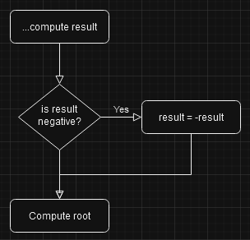
Decisions
How to handle if?
  Consider the code to the left
Extend to two-legged if
  set %ebx to larger of %ecx, %edx
Example:
  if x > y
  largest = x
  else
  largest = y
Notes:
# assume result in %rbx
cmp $0, %rbx
jge skip_negation # jump if %rbx >= 0
neg %rbx
skip_negation:
… code to compute square root
*******************************
cmp %ecx, %edx
jg take_edx # jump if %edx > %ecx
mov %ecx, %ebx
jmp found_largest
take_edx:
mov %edx, %ebx
found_largest:
….

Slide 10
Combining loops and if
Goal: count the number of bits that are set in an integer
Example: 0xA3 (10100011) has four bits set
Assumption: %ebx is the value to count bits in, result in %ecx
Algorithm:
%ecx = 0 # no bits so far
while %ebx != 0
if lsb(%ebx) == 1, add 1 to %ecx
shift %ebx right by one position
See samples/counting_bits.asm for an assembly solution
C++ solution: samples/counting_bits.cpp
  Note how nesting done: just track the labels

Slide 11
Using labels for data
Full program:
.data
.global source
.global count
.bss
.align 8
source:
.space 4
count:
.space 4
.text
.global main
main:
mov $35, %ebx
mov %ebx, count
mov count, %eax
ret
Can use labels to store data in the .data section
For example, suppose want to store two variables, source and count
  .data
  .global source
  .global count
  .bss
  .align 8
  source:
  .space 4
  count:
  .space 4
Copying data to count:
mov %ecx, count
mov count, %edx
Note: no colon after the address name
The size of count must match the size of the register!
  mov %rcx, count would overwrite memory!
Some assemblers (eg OnlineGDB), disallow moves to hard-coded addresses
  These make it difficult for loaders
Solution: use relative addresses
mov %ebx, count(%rip)
mov count(%rip), %eax
Notes:
loader: the application that loads a program into memory before it executes

Slide 12

Where is data stored?
On chip: registers, cache
.DATA: preset memory location
Runtime stack: Frames

Slide 13
Stack Frame
Review also the body of fact overall - note that we set up space for local data at the start and return it at the end
Note the same in main
This is setting up a stack frame
This is a critical concept in programming, especially in languages like C & C++
Memory: heap (growing up), stack (growning down), stack broken into stack frames with depth = current nesting depth of function calls
Each frame: return address, arguments, saved registers, local variables
  The full frame may be allocated at the start of the called function, but it also can be extended in the middle of the call
  In most, popular programming languages, all data is either global, on the heap, or in a stack frame
Typically, %ebp or %rbp (depending on 32-bit or 64-bit model) is the base address of a function's frame
The current frame size (in 32-bit): %ebp - %esp (stack grows towards address 0, so %ebp is always larger than %esp)

Slide 14
Addresses
Note last_number(%rip) computes an address - it's where to store a result, not a register that holds the result
This distinction between an address and a value is also critical
All data (i.e., a variable, array, etc.) has an address
The address can be well-defined even if the value at that address is not
For example, int x; declares x and defines its address, but does not define its value
int x; cout << x; prints a "random" value!
  The value depends on what was at that memory location before executing the print statement
  It's random in that it's unpredictable
  Changing computers, changing code, using different versions of libraries can all affect the value
  A variable value's defined if it is guaranteed to be a particular value (ignoring machine failures!)
  undefined: no guaranteed value
  The key is that undefined values lead to unpredictable results; something users rarely care for...
  Note that it is not truly random: you can get the same result on every run, and you can often predict possible values
  Illustrate: create an empty assembly program in OnlineGDB with breakpoint at return, note values of registers

Slide 15
Key takeaways
Data declared in a function, and the function's arguments, exist in a stack frame
A value is (well-)defined if it is predictable based on the code and the rules of the programming language
Saying something is undefined means it is not useful for computation
See this Rutgers page for another discussion of stack frames
  The concept of a call stack ("run time stack") and stack frames took decades to understand and popularize!
  Don't be surprised if you don't quite understand it all in one go!
  This course: figuring out how to use logic and organization to make sure computations are well-defined
  All of us have to struggle against our less logical selves!
  This is our (joint) mountain to climb: building efficient, working, maintainable programs while wading past our desire to "just get it done"

Slide 16
Building a processor from the bottom up
How to build simple gates
Using gates to create multiplexors
Using multiplexors to create control circuits
Microcode
The basic design of a processor

Slide 17
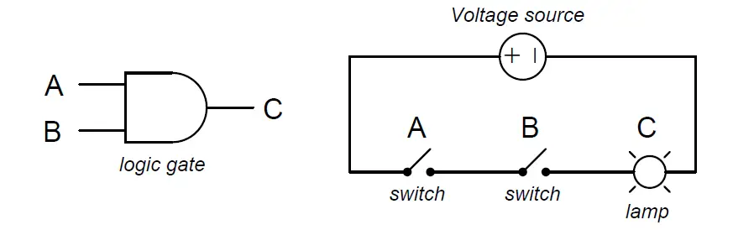
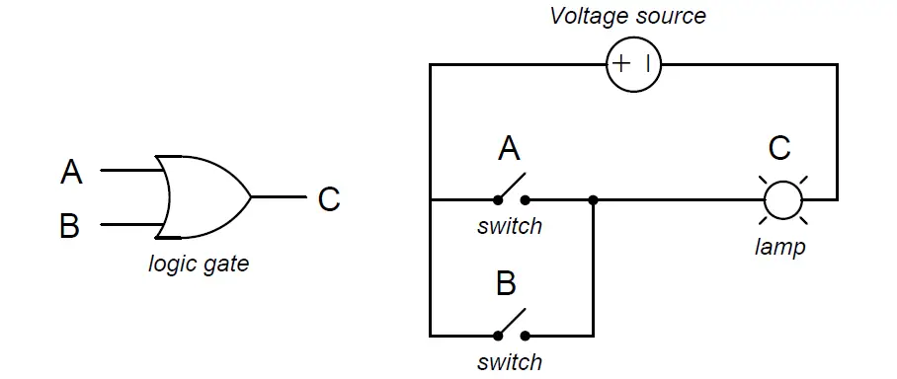
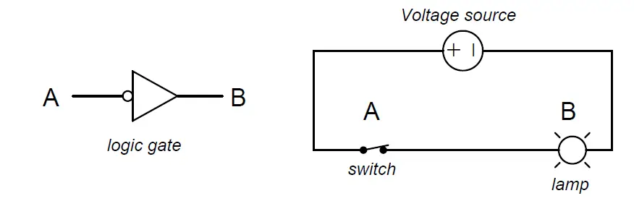
Logic Gates
Core circuit element
Top to bottom:
  AND
  OR
  NOT
Careful “doping” of silicon can build each
Can also implement each with transistors, resistors, diodes
https://instrumentationtools.com/logic-gates/
Notes:
Images from https://instrumentationtools.com/logic-gates/

Slide 18
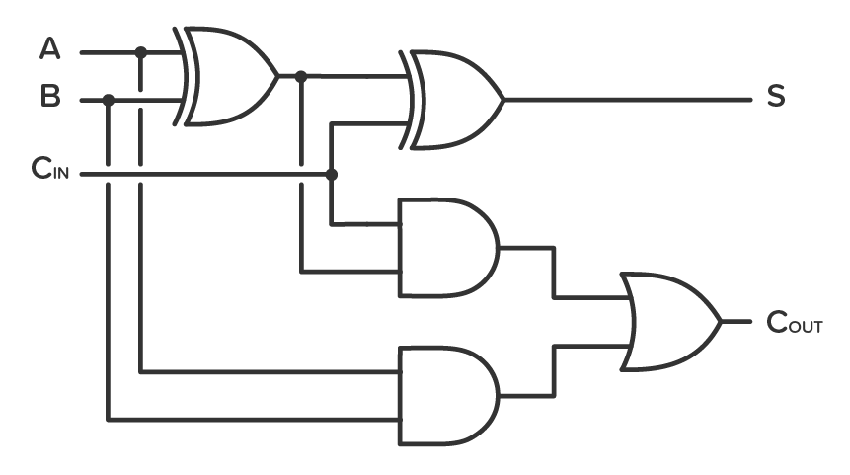
1-bit full adder
XOR gate
A, B: input bits
C_{in}: carry from previous addition
S: result (sum)
C_{out}: Carry out
String multiples together for a full adder
Notes:
Try cases: A = 0, B = 1, Cin = 1; etc
Diagram available many places, but this one from https://www.build-electronic-circuits.com/4000-series-integrated-circuits/ic-4008/

Slide 19

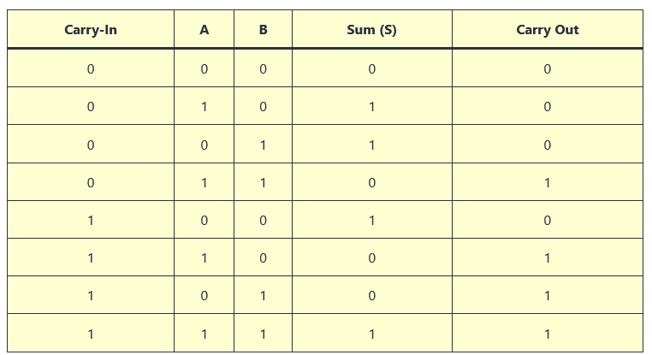
Using the full adder
Notes:
From same site as previous

Slide 20
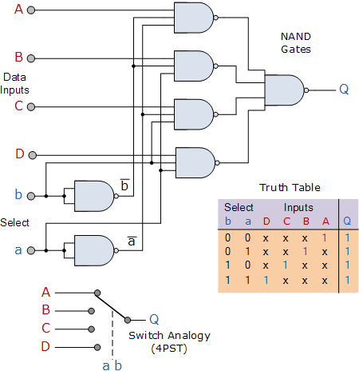
Multiplexor Circuit
NAND
gates
Data Inputs
Key issue in CPU: how to route data
  Between registers, to ALU, to bus, etc.
Solution: MUX (multiplexor)
  Select from alternative inputs
And gate with circle: NAND
  Convenient shorthand
a, b: select between A/B/C/D
This scales to any power of 2
Mirror image: 1 to many
  Demultiplexor (DEMUX)
Truth table
Select
Switch Analogy
(4 positions)
Notes:
Image from https://www.electronics-tutorials.ws/combination/comb_2.html
See https://en.wikipedia.org/wiki/Multiplexer for additional discussion

Slide 21
Constructing a processor
Elements
  Circuits to store data
    For registers, these are typically feedback circuits that refresh on each cycle
  ALU: essentially add/subtract with loops for multiplication
    Optimized to reduce gate delay between input and output
  Selectors: route data in CPU as required by instruction
  Additional element: clock line so circuits can “settle” to get predictable output
Selectors controlled by instruction decoder
  This can be a table of settings for each instruction
  It can even be programmable: “microcode”

Slide 22
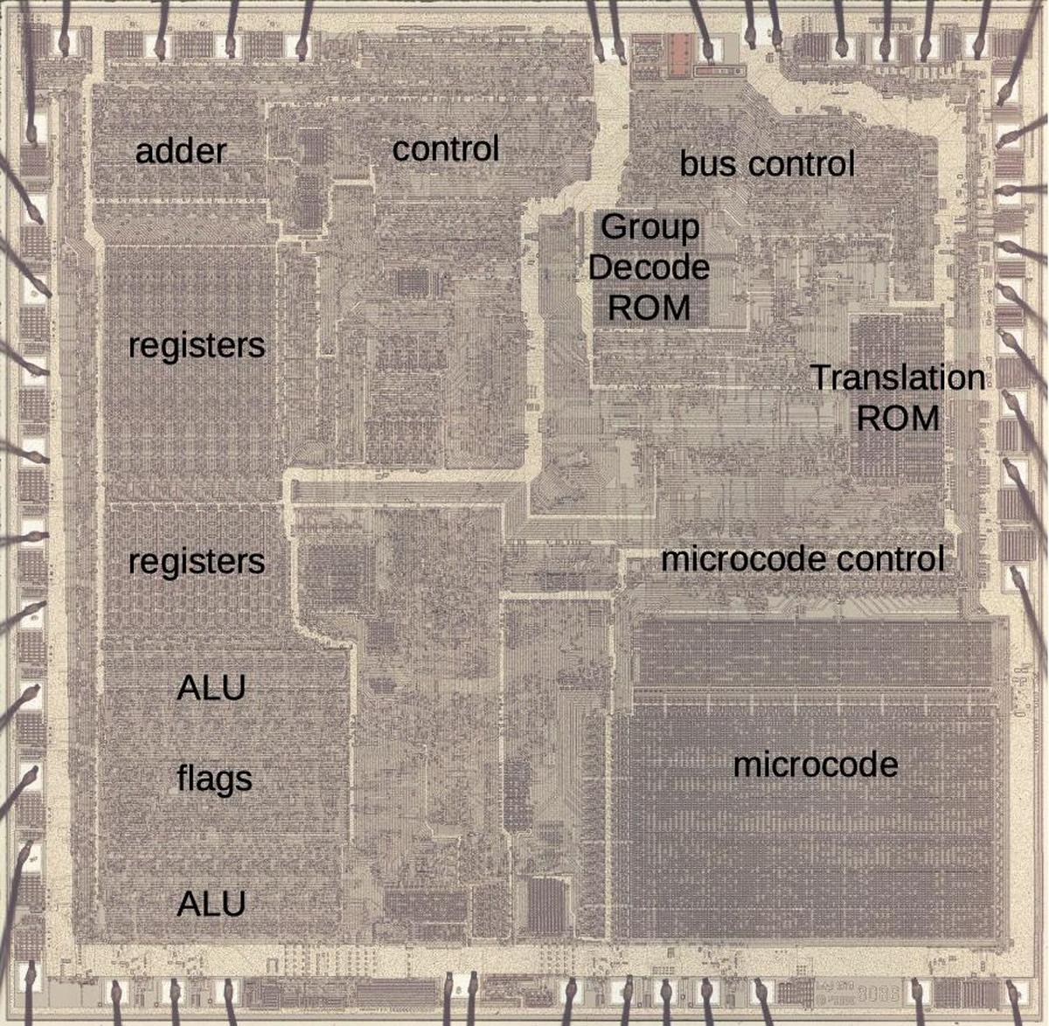
8086 Layout
Note registers, adder
Control: generally MUX/DEMUX circuits
  Also contains clock
ALU: logic circuits
Flags: neg, overflow, etc.
Microcode: decode instructions to set MUX/DEMUX circuits

Slide 23
Review
Flowcharts: capture sequence at machine level
Using labels to implement flowcharts
cmp, jump instructions
  cmp a,b: computes b – a
  jl: jump if b – a < 0, that is b < a?
  Likewise, jz, jnz, jg, jle, jge
Labels for data
Microcoded instructions

