Slide 1
1. Software Design
SWE 2410 Design and Cloud Patterns
Dr. Rob Hasker
Notes:
Reading: Java Design Pattern Essentials, Chapter 1

Slide 2
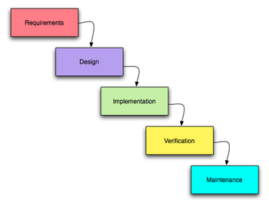
Software Design
Known as waterfall model
Each element feeds into next
Once upon a time: key model for developing software systems
Problem: didn’t allow for refinement
Relevance: requirements drive design, design drives implementation
What do you think design means?
How does design fit in the software development?
Basic elements of software development:
Requirements: what the client needs the system to do
Design: how system meets goals
Implementation: writing the code
Verification: checking it works
Maintenance: changes after initial completion
Key words!
Notes:
Each part feeds into the next

Slide 3
Understanding design
Start by understanding requirements
What the system does
Types of requirements:
Functional: given a particular input, what is the output or action?
Non-functional: constraints on how it works
Speed
Security
Robustness
... and many others!
Design: structure, algorithms, other elements
Essentially: a plan for an implementation that meets all requirements

Slide 4
What do we need from a good design?
CSC 1120, data structure material
CSC 3310, algorithms
Little discussion here
Efficient - computations are useless if late
Important for big O
But don’t have to optimize everything!
Maintainable
Requirements change!
As system used, people find things to improve
Testable
Code is useless if it results aren’t correct
Testing as you go is important, but not sufficient
Need systematic testing, covering all requirements
Could be manual, but then it’s too expensive to be done multiple times
When a bug is found and fixed, definitely don’t want it to be reintroduced during future maintenance
Conclusion: need systematic, executable tests – must design to this goal
Primary issue in this course
Secondary issue, but important
There are many other qualities as well, but we will start with these.

Slide 5
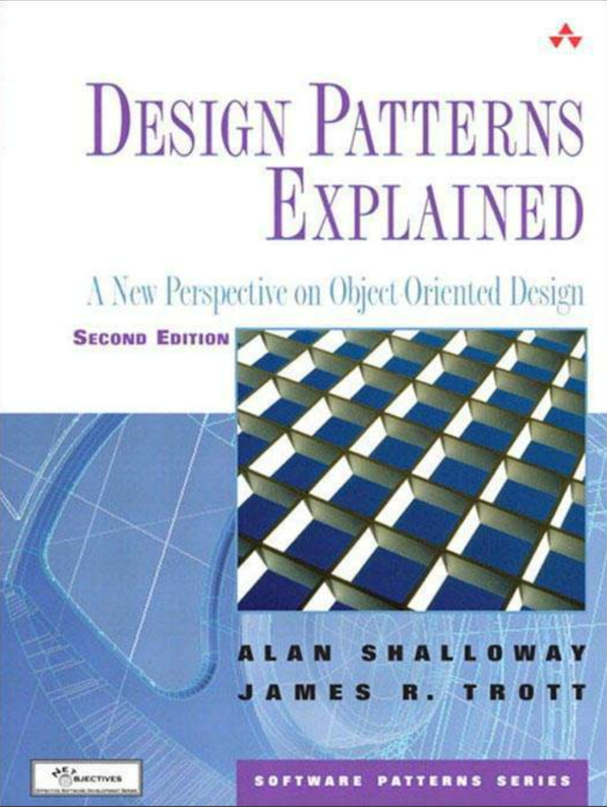
SWE 2410 Design and Cloud Patterns
This course:
Basic OO design: how to organize classes for understandability
Design patterns: improving designs, making systems more maintainable
Cloud patterns: designing for distributed computation
UML: capture designs in simple diagrams
See syllabus link in Canvas
Required text:

Slide 6
Why OO?
What is the goal of object-oriented design/OO programming?
Why do we prefer OO designs?
What is the alternative?
Sample procedural design: suppose next classroom is DH 110
Leave classroom, turn right
Walk to stairway
Take steps down one floor
Go towards north entrance
Look for first classroom door on your left
But not all students will go to the same room!
Notes:
Note: I don’t expect answers for the first two questions!
DH 240: the room next to Rosie; my assumption is that the current classroom is DH 210, so one might revise around that…

Slide 7
Why OO?
Extending to full class:
Find schedules of all students
For each,
determine location of next room
plan route to room
give route to student
review route with student to make sure no questions
Is this how you would solve the problem?
Better:
List of rooms at back of class, directions for each
Campus map, possibly highlighted with target locations
Tell students to snap a picture of the map with their phones...
This makes the student responsible for finding the route!
Notes:
Note: I don’t expect answers for the first two questions!

Slide 8
A theme: remove if
Every object should be responsible for itself
Operations which change the object should be part of the object
Eg: a student object isn’t unregistered from a course by another object, it has an unregister method to do it for itself
If statements based on outside parameters release control
X.f(int x): if x == 1 do a, x == 2 do b: callers of f dictate what to do
Painful to test: have to confirm sequence right no matter how called
instanceof: yet another way to introduce outside control
X.g(class x): if x instanceof Y do a else b: caller again dictates action
There are many other ways if statements make code complex
Removing this complexity is hard, but critical to maintainable code

Slide 9
So OO it is, but which classes?
Could just sit down and write various classes
Problem: difficult to see any structure during maintenance
Observation: two distinct types of classes
Classes specific to a particular implementation – containers, GUI elements, etc.
Classes that reflect objects in a problem: buildings, trees, people
Classes in problems: known as domain classes
These are solution-independent
When requirements change, these classes must change!
They are natural to the problem: they relate to objects your clients know about
Basic principle: start with these classes, add solution classes only as needed

Slide 10
Finding Domain Classes
This leads to a simple way to identify classes: nouns
That is, objects are things, nouns name things, so finding nouns in problem descriptions leads to domain classes
Example: Meal-Wheel
Goal: find a place to eat for lunch
Don’t want to spend a lot of time with the “where would you like to eat” conversation
Have list of restaurants, spin a (virtual) wheel to find one to go to

Slide 11
How to identify classes?
A user interaction with system written in the form
As a [type of user] I want to [do something] in order to [achieve a goal].
Meal Wheel user stories
As a hungry student, I want my phone to randomly select from different restaurants, so I know where to eat.
As a picky student, I want my phone to suggest close restaurants that serve sashimi so I can choose a place to eat within 10 minutes walk.
As a restaurant owner, I want to distribute menus to potential customers so customers can be attracted by my food selections.
As a restaurant owner, I want potential customers to know of dietary restrictions that I support so I can attract customers who do not eat particular foods.

Slide 12
Finding classes:
Noun identification method
Nouns – things: classes, attributes
Verbs – actions: methods
Meal Wheel user stories
As a hungry student, I want my phone to randomly select from different restaurants so I know where to eat.
As a picky student, I want my phone to suggest close restaurants that serve sashimi so I can choose a place to eat within 10 minutes walk.
As a restaurant owner, I want to distribute menus to potential customers so customers can be attracted by my food selections.
As a restaurant owner, I want potential customers to know of dietary restrictions that I support so I can attract customers who do not eat particular foods.
Notes:
Activity: identify nouns, verbs of interest

Slide 13
Finding classes:
Noun identification method
Nouns – things: classes, attributes
Verbs – actions: methods
Meal Wheel user stories
As a hungry student, I want my phone to randomly select from different restaurants so I know where to eat.
As a picky student, I want my phone to suggest close restaurants that serve sashimi so I can choose a place to eat within a 10-minute walk.
As a restaurant owner, I want to distribute menus to potential customers so customers can be attracted by my food selections.
As a restaurant owner, I want potential customers to know of dietary restrictions that I support so I can attract customers who do not eat particular foods.
Challenges:
Where to eat, place: different words for same concept
Sashimi: just an example of a food item
10-minute walk: distance; is this an object?
Need further refinement; need to examine objects and classes in more detail.
Notes:
Note: duplicate nouns are omitted here, though it can be better to identify all nouns on a first pass and go back and eliminate duplicates.
We are also ignoring very non-specific verbs such as want

Slide 14
Review
How design fits into software process
Requirements: what
Design: how – plan for implementation
Core goals of design:
understandability/maintainability
efficiency
testability
Identifying domain classes
Domain/problem-space vs. solution-space classes
Using nouns to identify classes
Next: how patterns fit into design

