Slide 1
3. Object-Oriented Design
(OOD)
SWE 2410 Design and Cloud Patterns
Drs. Hasker, Yoder
Notes:
Acknowledgement: Slides originally by Dr. Hasker

Slide 2
UML Refresher
See https://faculty-web.msoe.edu/hasker/swe2410/samples/uml-sample
Basic notation to know:
  Class, attributes, methods
    No constants, other trivial attributes; types only where critical
    No constructors, setters, getters
  Associations: directed, undirected
    Show just the association if another class is a member
    Directed association: has-a; more on this later
  Multiplicities: *, +, 1, 3..5
  Role names: names for class instance variables
  Generalization, implements
  Stereotypes: <<interface>>, <<abstract>>, etc.

Slide 3
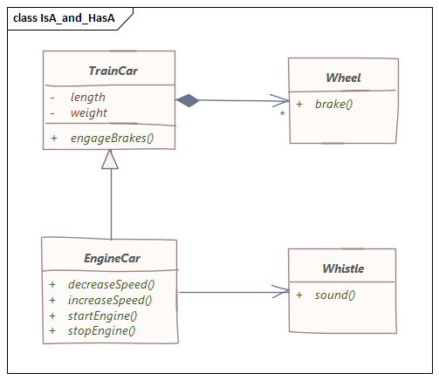
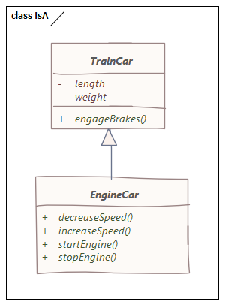
is-a, has-a, needs-a
What does “is-a” mean in a class diagram?
  How is this drawn?
What does “has-a” mean in a class diagram?
  What are the different ways this can be drawn?
  Note: if has-a is in the domain, don’t want to introduce programming
  concepts like declarations!
  Don’t show both an association and attribute for the same concept!
Special case for “has-a”: needs-a
  The train car needs wheels or it’s not really a train car!
  Always use the arrow with this connector!
Use is-a, has-a, needs-a to determine connectors
  Note the direction works in all cases
At the domain level, these are invaluable checks
  Not reasonable: “A box is a train car” – use “BoxCar” instead
Caution: don’t use needs-a everywhere
  Yes, requirements may say the EngineCar must have a whistle,
  but there is no logical reason it has to have a whistle – could put whistles on wheels
Notes:
Other examples of has-a vs needs-a: a binary search tree needs a root node (it isn’t a tree otherwise), a house needs walls and a roof but has a garage.

Slide 4

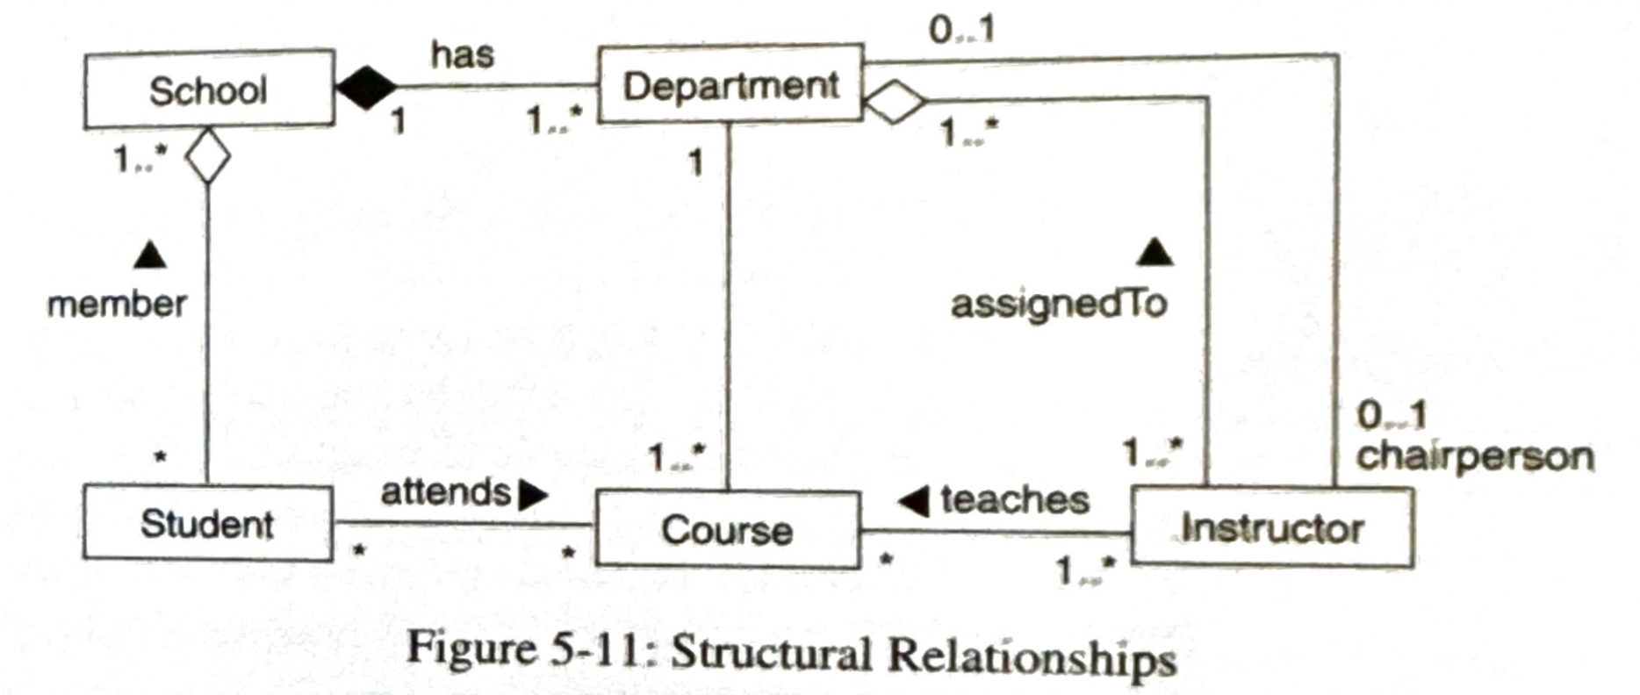
Open vs. closed diamonds
Common issue: composition vs. aggregation
Just has-a – no difference from straight line
Do not use!
needs-a – very useful!

Slide 5
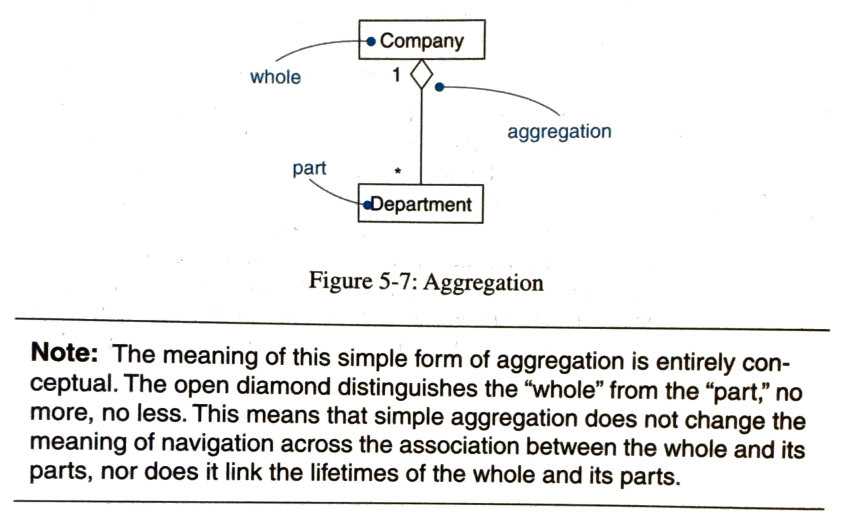
Open vs. closed diamonds
Common issue: composition vs. aggregation
needs-a – very useful!
UML User Guide, p. 68: Open diamond has no impact, no meaning
Notes:
p. 68, top

Slide 6
Minimal Clutter
Where are the types?
Are they needed by the user?

Slide 7

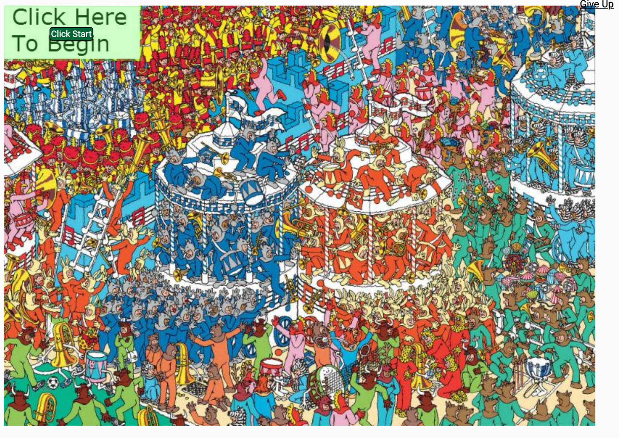
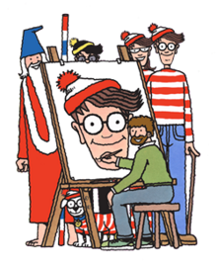
Where’s Waldo?
Why is Waldo so hard to find?
Unnecessary clutter?
Compare to following:
(sporcle.com)
(https://en.wikipedia.org/wiki/Where's_Wally)
Notes:
Waldo is to the left of the light-blue striped carousel in the upper right; the tuba points at him

Slide 8
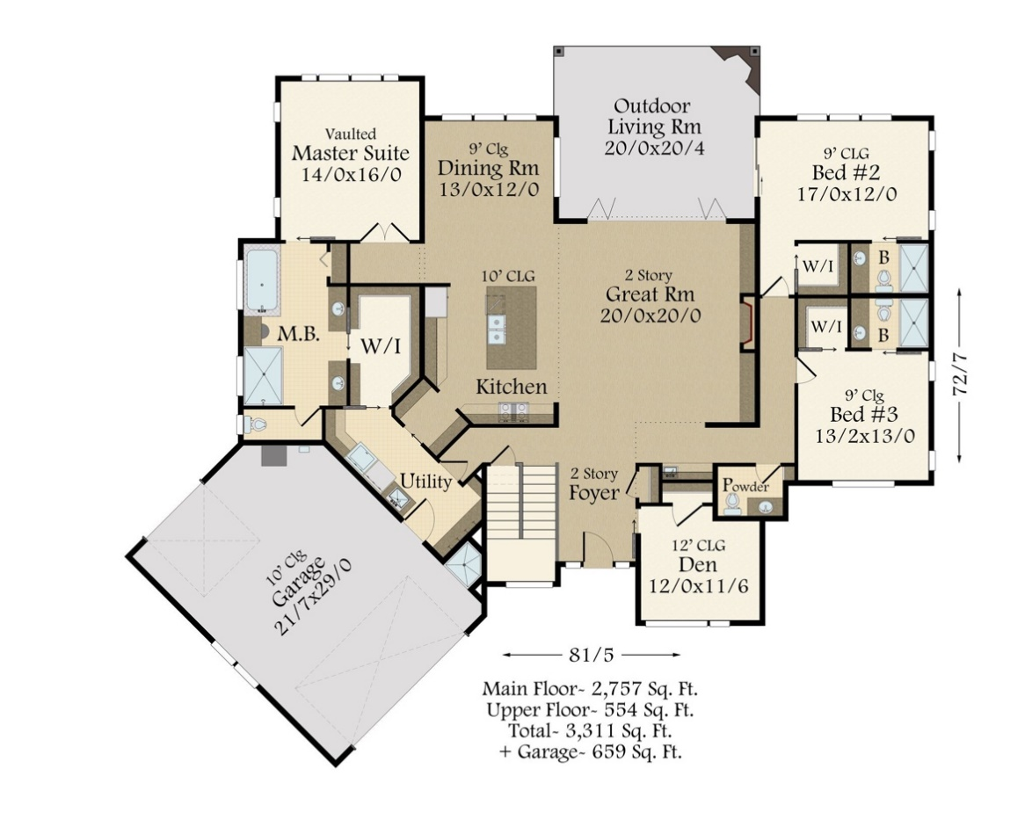
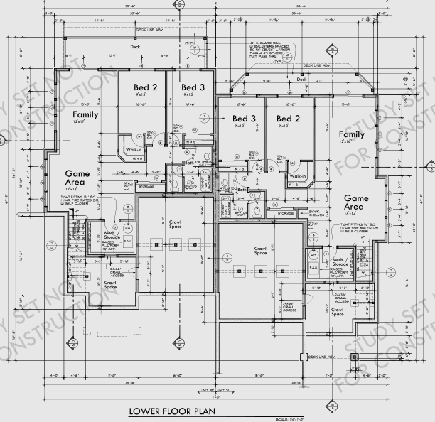
Example closer to software:
or
Which would you show to a client?
Which would the builder use?
Notes:
Image on right has exact measurements throughout the building

Slide 9
Minimal Clutter
Where are the types?
Are they needed by the user?
Types:
  Important to implementation
  Not important to clients – they just add clutter!
  Experienced developers can infer the type from the diagram
May need full detail: contract diagram
  Very useful in large projects
  Makes it easier for one piece of code to interact with another
  Our focus will typically be on clients and user requirements…

Slide 10
Bigger issue: which classes?
Now that we know how to document projects, what do we draw?
Need to identify classes in project
Two types: solution-space, problem-space
  Domain classes: the classes that make up the problem
Starting point: identify nouns
  Logic: these capture the things being computed, objects are things...
  Verbs also useful: actions on objects
Input: user stories
  Nouns can tell us possible classes, but there are often other nouns...
Notes:
Steps in SE 2030: write use cases & scenarios, develop classes from those – some students will know about noun identification

Slide 11
Identifying classes
Some options – things in the system
Student, food order, menu
Diet, walking, 10 minutes
Orders
Database of restaurants
Lookup table of restaurant locations
javafx classes
  Scene, Stage, Pane, MouseEvent
String, Date
Meal Wheel user stories
  As a hungry student, I want my phone to randomly select from different restaurants so I know where to eat.
  As a picky student, I want my phone to suggest close restaurants that serve sashimi so I can choose a place to eat within 10 minutes walk.
  As a restaurant owner, I want to distribute menus to potential customers so customers can be attracted by my food selections.
  As a restaurant owner, I want potential customers to know of dietary restrictions that I support so I can attract customers who do not eat particular foods.
What classes should be in this system?
  Classes abstract things, so we’re really asking what things do we need?
Issues that might help us decide which things need to be classes:
What will be maintainable?
What if we switch to (say) iPhone & iOS/Swift rather than Android/Java?
What if we decide the data should be stored in text files?

Slide 12
Domain classes
Implementations: solution space
  Classes that are in a particular solution
  Possible classes: table of restaurants to GPS coordinates, table of restaurants to menus, table of dietary restrictions to menu items
Problems: domain classes
  Classes that are part of the problem space
  Start with these classes, add solution classes only as needed
Why prefer domain classes?
  Solution independent – less likely to change to support new features
  How would each solution change if we track popularity and wait times?
  Natural: these are the entities that form the problem to solve
Design: adding solution space classes to meet goals
Notes:
Goals: performance, portability, safety, reliability

Slide 13
How to identify domain classes?
Solution 1: just sit there and think them up
Solution 2: mine the stories/scenarios/requirements
  Nouns: classes – things
  Verbs: actions/methods
  Simple values: attributes

Slide 14
Application:
Noun identification method
Nouns – things: classes, attributes
Verbs – actions: methods
Meal Wheel user stories
  As a hungry student, I want my phone to randomly select from different restaurants so I know where to eat.
  As a picky student, I want my phone to suggest close restaurants that serve sashimi so I can choose a place to eat within a 10-minute walk.
  As a restaurant owner, I want to distribute menus to potential customers so customers can be attracted by my food selections.
  As a restaurant owner, I want potential customers to know of dietary restrictions that I support so I can attract customers who do not eat particular foods.
Assumption: every noun will become a class
But do all of these make sense as classes?
For example. is student different than customer?
Is a 10-minute walk a thing?
Notes:
Note: duplicate nouns are omitted here, though it can be better to identify all nouns on a first pass and go back and eliminate duplicates.
We are also ignoring very non-specific verbs such as want

Slide 15
Understanding classes
What is a class in the first place?
One solution: identify responsibilities
  What the class provides to the rest of the system
What are the responsibilities of…
  a house? door? window?
  Bank account? Student record in registration system?
How many responsibilities should a class have?
    Could say “just one,” but what would happen if Student had just 1?
  Responsibilities: clear, limited, but complete!
    At least one, rarely more than two
  No responsibilities to rest of system? Not an object
    Eg: A house design system with garages holding cars, but car has no responsibilities
Single Responsibility Principle (SRP)
A class should have one and only one reason to change
Counter-example: a report class that both collects data and prints it
  2 reasons for change: data collection, format
Exception
  If this leads to many small classes, consider finding more abstract responsibility
Basic rule of principles: they always have exceptions; dig past the catch phrase!
Notes:
What are some other ways to define objects?
Car example: you would add a garage which should have minimum sizes, but no need to model cars that go into that garage

Slide 16
How to violate SRP
“doit” class: does everything
  Generally surrounded by lots of passive objects
  Often has one or two large, impossible-to-reuse methods
System class – little need to document (the Java-specific) main()!
  Often becomes a doit class – all the responsibilities
  High level design diagrams should be language-independent
  Focus on the domain, not solutions
Classes for actions
  “parser”, “artificial intelligence”, “list maintainer” – another doit class
    No clear responsibilities!
  Roll these into domain objects!

Slide 17
A more systematic definition
These issues motivate finding a more complete definition
  Which possible classes identified by nouns make good domain classes?
Starting point: objects are things
  This includes physical things – building, street
  Also some concepts: account, payment transaction, committee meeting
Things exist, can change, provide utility:
Each object has a state
  Captures information, provide it on request, record events
  Student: name, id, classes taken or are taking, GPA
  Sometimes implied by behavior: light bulbs can be turned on & off
Notes:
Objects are things: they abstract physical objects (a city) as well as concepts (an account, a committee meeting)

Slide 18
A more systematic definition
Things exist, can change, provide utility:
Each object has a state
  Captures information, provide it on request, record events
  Student: name, id, classes taken or are taking, GPA
  Sometimes implied by behavior: light bulbs can be turned on & off
Each object has behavior
  Operations that do things; sometimes implied by state
  Student: compute GPA for term, add a class to schedule
  Sometimes implied by state: a roster can be listed
Each object has responsibilities
  What the object provides to the rest of the system
  Student: record classes taken, track status of accounts, track overall status

Slide 19
A more systematic definition
Often confused: responsibilities and behaviors
Responsibility: duty to the rest of the application
  No responsibilities? No class
Behavior: the action
That is: behavior is what an object does, responsibility is what it is expected to take care of
Example: what are the responsibilities a student?
  Attend class, study, read, do assignments?
  These are actions – that is, behaviors!
  Responsibility: learn material
Things exist, can change, provide utility:
Each object has a state
  Captures information, provide it on request, record events
  Student: name, id, classes taken or are taking, GPA
  Sometimes implied by behavior: light bulbs can be turned on & off
Each object has behavior
  Operations that do things; sometimes implied by state
  Student: compute GPA for term, add a class to schedule
  Sometimes implied by state: a roster can be listed
Each object has responsibilities
  What the object provides to the rest of the system
  Student: record classes taken, track status of accounts, track overall status
Notes:
Another example:
Example: what are the responsibilities of the fielder at first base in baseball?
Would you expect the first base player to field left field flies?
What are that player’s behaviors?

Slide 20
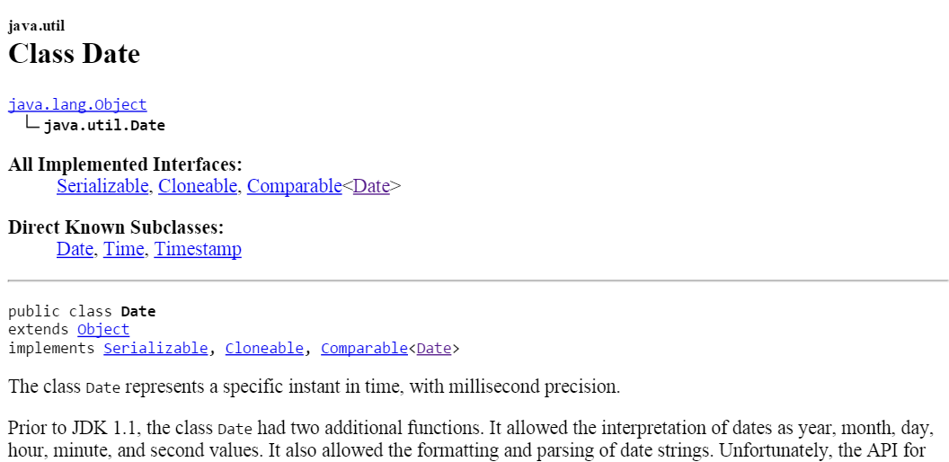
Responsibilities are the key to understanding classes, but…
What is the responsibility of java.util.Date?
  See first line of Java API
Milliseconds from when?
If time is a construct, this represents a concept, not a thing
Date objects have state, behavior, and responsibilities, but…
They are concepts, not ”real” objects
Likewise for the Java class Math…
We need another condition
Notes:
With my Unix mindset, I might count milliseconds since Jan. 1, 1970. You might count milliseconds since (or before) your birth.

Slide 21
What’s a domain object, continued…
An object has identity
  Something you can point at
  A street address: text
  A building: a specific building at a specific location
  Helps distinguish between pieces of information about something (color, name, identification number, temperature) and the things that have that information (people, hurricanes, cars, buildings)
Objects without identity: attributes
  Examples: colors, names, addresses, numbers – all are concepts
  “Red” can appear in multiple places
  Contrast to Student: just one instance of each student in a system
Notes:
See https://en.wikipedia.org/wiki/Identity_(object-oriented_programming) for a discussion of identity.

Slide 22
What characterizes a domain object
An object is something with
  Responsibility
  Identity
  Behavior
  State

Slide 23
What characterizes a domain object
An object is something with
  Responsibility
  Identity
  Behavior
  State
Objects not meeting RIBS: attributes or otherwise non-domain objects
  System, colors: no identity
  Dates: no changeable state: March 3 and March 4 are completely different dates
Classes: a template for new objects
  Allows creating many objects with very similar behavior, responsibilities
  Abstractions of particular objects: a general car, bus, vehicle
Domain classes: abstractions of domain objects

Slide 24
What characterizes a domain object
An object is something with
  Responsibility
  Identity
  Behavior
  State
Violating each:
  Identity: numeric values, text, arrays of things
    A specific collection, such as students in a section, can have identity!
  Behavior: simple values
    operations on numbers return a new number; they aren’t changing the number’s ”state”
  State: “air”, “river water”, 2025, 150 lbs
    These are quantities of things or things with no shape
    Things with no shape: a container of that thing can be an object (a river, a bottle of air)
  Responsibility: out of scope items
    Eg: In a system for raising bridges, no software in the street lights related to the bridge, no responsibilities

Slide 25
Returning to meal wheel:
Meal Wheel user stories
  As a hungry student, I want my phone to randomly select from different restaurants so I know where to eat.
  As a picky student, I want my phone to suggest close restaurants that serve sashimi so I can choose a place to eat within a 10-minute walk.
  As a restaurant owner, I want to distribute menus to potential customers so customers can be attracted by my food selections.
  As a restaurant owner, I want potential customers to know of dietary restrictions that I support so I can attract customers who do not eat particular foods.
Notes:
Note: duplicate nouns are omitted here, though it can be better to identify all nouns on a first pass and go back and eliminate duplicates.
We are also ignoring very non-specific verbs such as want

Slide 26
Nouns & verbs
Nouns:
Student
Phone
Restaurant
Where to eat
Sashimi
Place
10-minute walk
Owner
Menu
Food selection
Customer
Dietary Restriction
Verbs
Select [restaurant]
Eat [at restaurant]
Suggest [close restaurants]
Serve [sashimi]
Choose [a place to eat]
Distribute [menus]
Know [of dietary restrictions]
Support [dietary restrictions]
Attract [customers]
What are the responsibilities of each?
Phone: whole system
Sashimi: something to eat – an example
Walk: a measure of distance
Notes:
Other objects: clear responsibilities – have students pick those out

Slide 27
Nouns & verbs
Nouns:
Student
Phone
Restaurant
Where to eat
Sashimi Menu Item
Place Location
10-minute walk Distance
Owner
Menu
Food selection Menu Item
Customer
Dietary Restriction
Verbs
Select [restaurant]
Eat [at restaurant]
Suggest [close restaurants]
Serve [sashimi]
Choose [a place to eat]
Distribute [menus]
Know [of dietary restrictions]
Support [dietary restrictions]
Attract [customers]
What are the responsibilities of each?
Phone: whole system
Sashimi: something to eat – an example
Walk: a measure of distance
Notes:
Student: redundant with Customer (and Customer is more specific);
Restaurant: capture name, location
Place: ultimately, the location of the restaurant
Owner: sets menu

Slide 28
Nouns & verbs
Nouns:
Student
Phone
Restaurant
Where to eat
Sashimi Menu Item
Place Location
10-minute walk Distance
Owner
Menu
Food selection Menu Item
Customer
Dietary Restriction
Verbs
Select [restaurant]
Eat [at restaurant]
Suggest [close restaurants]
Serve [sashimi]
Choose [a place to eat]
Distribute [menus]
Know [of dietary restrictions]
Support [dietary restrictions]
Attract [customers]
Next: associate actions with objects

Slide 29
Nouns & verbs
Nouns:
Student
Phone
Restaurant
Where to eat
Sashimi Menu Item
Place Location
10-minute walk Distance
Owner
Menu
Food selection Menu Item
Customer
Dietary Restriction
Verbs
Select [restaurant]
Eat [at restaurant]
Suggest [close restaurants]
Serve [sashimi]
Choose [a place to eat]
Distribute [menus]
Know [of dietary restrictions]
Support [dietary restrictions]
Attract [customers]
Next: construct a (domain level) class diagram
No types, no getters/setters,
Minimal attributes
All in the language of the client

Slide 30
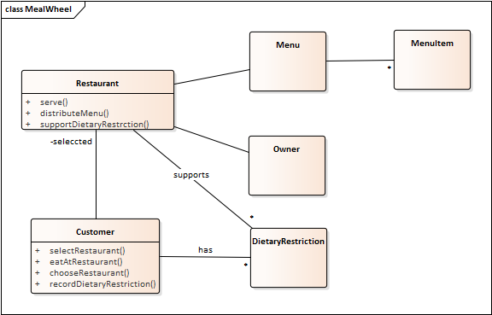
Nouns & verbs
Nouns:
Student
Phone
Restaurant
Where to eat
Sashimi Menu Item
Place Location
10-minute walk Distance
Owner
Menu
Food selection Menu Item
Customer
Dietary Restriction
Verbs
Select [restaurant]
Eat [at restaurant]
Suggest [close restaurants]
Serve [sashimi]
Choose [a place to eat]
Distribute [menus]
Know [of dietary restrictions]
Support [dietary restrictions]
Attract [customers]
Next: construct a (domain level) class diagram
No types, no getters/setters,
Minimal attributes
All in the language of the client

Slide 31
MealWheel example
Nouns:
Student
Phone
Restaurant
Where to eat
Sashimi Menu Item
Place Location
10-minute walk Distance
Owner
Menu
Food selection Menu Item
Customer
Dietary Restriction
Verbs
Select [restaurant]
Eat [at restaurant]
Suggest [close restaurants]
Serve [sashimi]
Choose [a place to eat]
Distribute [menus]
Know [of dietary restrictions]
Support [dietary restrictions]
Attract [customers]
Another example: a “Distance” object in MealWheel makes no sense because it does not have identity – it’s an attribute

Slide 32
An initial design process…
Start with domain classes
  These persist across problem changes
  Capture things clients, users will recognize
  Capture requirements that go with those items
Explore interactions through UML diagrams
Add containers, architectural elements
  Decisions about time/space/complexity tradeoffs
  Databases, network communications, GUI elements
Introduce design patterns, refine
  These generally reduce coupling, increase flexibility
  May REMOVE classes from previous steps
  Be careful about removing domain classes!
Notes:
Might remove a domain class, but document why, especially where it’s responsibilities have moved

Slide 33
Example #1: domain model for…
As a student, I would like to take a quiz so I have an opportunity to learn the material through studying.
As an instructor, I would like to create quizzes with multiple choice and short answer questions so I can check students’ knowledge.
As an instructor, I would like to grade answers to questions so I can find out how much each student knew about the material in the question.
As an instructor, I would like the system to suggest possible scores for questions so I can grade quizzes more quickly.
As a student, I would like to see the total score and the response feedback so I can evaluate how well I studied.
As an instructor, I would like to allow multiple answers to short answer questions so I can avoid checking each manually.

Slide 34
Example #2: domain model for…
As a student with limited vision, I would like to be able to navigate around MSOE without having to be lead by another student or service animal.
As a student with limited vision, I would like to receive directions on my smart watch while following a route so I know when to turn left or right in a building.
As a student, I would like to be able to enter my class schedule into my calendar with room numbers so I know where to be at the right time.
As a student, I would like to have my smart watch plan a route to the next class so I know how to get to that class at the start of the term.
As a student, I would like routes to follow hallways so I am not walking through other classrooms, especially if classes are in session.
Notes:
First story: an “epic” – it’s really a full system, not a piece of one

Slide 35
Sound designs
Start with domain classes (satisfying RIBS)
  These persist across problem changes
  Capture things clients, users will recognize
  Capture requirements that go with those items
Explore interactions through sequence and state diagrams
Add containers, architectural elements
  Decisions about time/space/complexity tradeoffs
  Databases, network communications, GUI elements
Introduce design patterns, refine
  These generally reduce coupling, increase flexibility
  May REMOVE classes from previous steps
  Be careful about removing domain classes!
Notes:
Might remove a domain class, but document why, especially where its responsibilities have moved

Slide 36
Additional issues
Software Design Principles, Ch. 3:
  Favor (object) composition over (class) inheritance
Example:
class StrictStringStack {
private List<String> items = new LinkedList<String>();
public void push(String x) { items.add(x); }
public String pop() { return items.pop(); }
}
Another case where “is-a” and “has-a” works!
  A stack is not a list, but it does have one
  In fact, it needs a list!
Avoid abbreviations unless very common
  Abbreviations mean having to remember yet another thing
  Correct spelling matters!
Follow standards
  Typically capitalize class names, lower case methods/attributes
Plural names – objects are instances
  A group of students: a roster
Poor inheritance
  If A extends B, then anywhere a B can appear, so can an A
  Liskov Substitution Principle – see Ch. 5 of Software Design Principles
  Never violate contracts
Example: deriving Stack from List
Can sort a list
  Eg: put items in alphabetical order
Should we be able to sort a stack?
If class Stack extends List …
Then following is legal:
Stack todo = new Stack(); …
sort(todo);
Notes:
Plural names: Menu, not Menus (even though will have multiple menus in system – that’s what * is for)
“Favor composition over inheritance” is another way to think of LSP

Slide 37
Review
Preference for domain classes over solution-space (implementation-specific) classes
Noun identification method
Doit, passive classes and their dangers
Liskov Substitution Principle
RIBS: responsibility, identity, behavior, state
  A tool for identifying domain objects, classes

Slide 38
Working in teams
Basic rules:
  No, you don’t have to implement everything yourself
  If necessary, you will be graded separately
  Make sure what you submit does run and has (documented!) behavior
  Help your instructor: document what the system does not do
If partner fails to complete something on time
  Don’t panic, they may well get to later; just ensure your part is gradable
  They often do, and late penalties can be applied to just one team member (tell us!)
Key: over-communicate
  Send multiple messages describing progress as time gets short
  Tell your partner about changes in plans
  Respond to messages right away so your partner knows you know what they said!
  Use good commit messages so partners can see the progress in the repository

Slide 39
Sequence Diagrams
Relevant because we will use these to document lab 3
Class diagrams: capture relationships between classes
  Associations, generalizations
  Also: attributes, methods – the declarations
Class diagrams do not capture the actual behavior
  This matters when trying to understand the actual relationships
Solution: sequence diagram
  Objects, messages passed between them, sequence of operations
  Example: Grassba

Slide 40
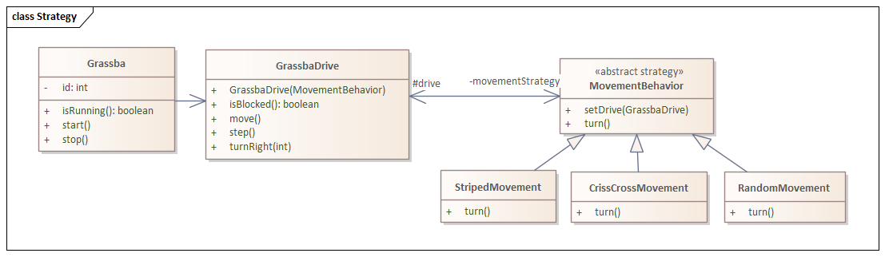
Grassba Problem
Grassba mower: automatically cut yard as directed
Strategy: different ways mower can cover the yard
CrissCrossMovement: strategy in which mower rotates 90 degrees when blocked

Slide 41
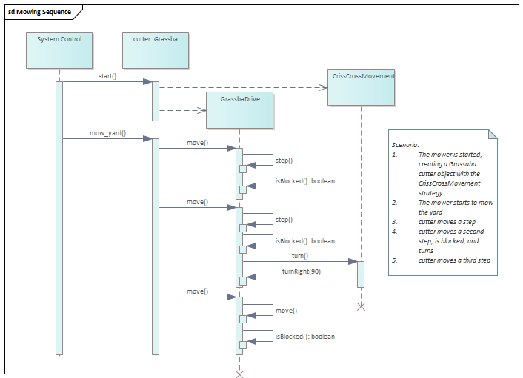
Sequence Diagram
Instances of classes - objects
Captures how system responds to input/request
Visual form of pseudocode
Construct - new
Method call
Method call with argument
Scenario: a note describing what the diagram illustrates.
Not always needed!
Timelines – life of object
Notes:
The scenario note isn’t needed if the problem context contains the steps being illustrated, but it is critical that the viewer knows what the sequence diagram illustrates!

Slide 42
Relationship to Class Diagram
See https://developer.ibm.com/articles/the-sequence-diagram/
for an additional example
Messages: method in target class
  Shows how a method is used!
Level of detail depends on what is needed
Note mow_yard not in original diagram; probably would need this!
Do not always show parameters
Can show returns, but only if adds information

Slide 43
Sequence and the Strategy Pattern
What was the goal of the Strategy Pattern?
What is the general form of the class diagram for the pattern?
Consider the diagram for Grassba:

Slide 44
Adding a sequence diagram for Grassba
This also captures the pattern
Note scenario!
Methods are in which classes?
Both views useful!
Notes:
Sequence explains the scenario; the scenario is the key

Slide 45
Sequence Diagrams: object to object interactions
Capture object-to-object interactions
Across top: instances of classes
Each instance: a timeline (possibly starting and stopping)
Arrow: method calls/”messages”, target will be the class containing the message
Create: new
Return: optional
Don’t try to capture all detail…

