Slide 1
6. Observer Pattern
Design Patterns Explained, Ch. 18
SWE2410 Design and Cloud Patterns
Dr. Rob Hasker (based on slides by Dr. Mark Hornick)

Slide 2
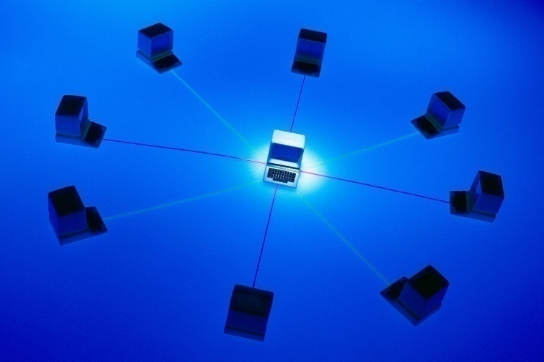
Distributing information to clients
Show Weather Station example
  Note use of threads: essentially a separately running program
  Will discuss threads later
Core idea:
  One-to-many dependency between objects
  One object changes state
  All dependents are notified and updated automatically

Slide 3
Other applications
Consider what happens when move cursor in MSWord
  Enable, disable bold/italic/superscript/underline/etc.
  Update font, size
  Update centering/left justification/right justification
  How would this be implemented?
How to get a message to all students? Email?
  What if only some students want messages from me?
  Is there a better way? Discuss and present!

Slide 4
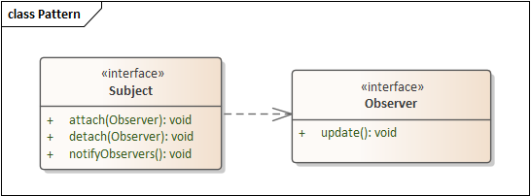
Observer pattern: key components
Subject
  Subject has dependent observers.
Observer(s)
  Observe events
  Event: subject changes state
  Observers: respond to state change
Implementation: interfaces with ways to attach, detach, update
Not: observing someone walking down the street!
Alarm
Notes:
Stress: speaker is an alarm; walking down the street is not an event, it’s a continuing action; this pattern is about observing discrete events

Slide 5
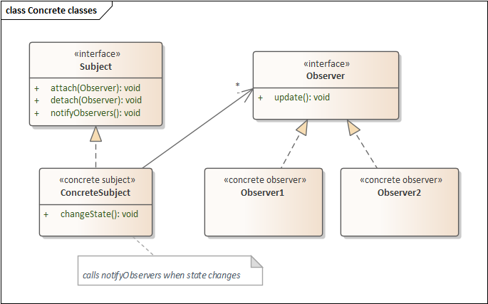
Using the pattern
ConcreteSubject
  implements observer tracking
  Calls notifyObservers on state change/event
ConcreteObserver: implements update
Subject can be abstract
An abstract Observer is rarely useful
Review Weather Station App

Slide 6
Why use Observer Pattern?
Separation of software subsystems
  For instance: separation between GUI & Domain objects
  Also: separation between sensors and systems acting on them
Loosely-coupled classes
  Tightly-coupled: reduced reusability, understandability
Goal: elegant communication between loosely-coupled classes
Note: the Java class library implements this as the deprecated class pair Observer/Observable
  We are not using these

Slide 7
Generic Subject class
interface Subject {
void attach(Observer o);
void detach(Observer o);
void notifyObservers();
}
class ConcreteSubject implements Subject {
public void attach(Observer obs);
public void detach(Observer obs);
public void notifyObservers();
private Collection<Observer> observers;
}
Notes:
Some texts define notify() instead of notifyObservers()
We use notifyObservers because notify is a method in Java’s Object class
Sequence isn’t important, so
any type of collection is fine
Notes:
Subject::attach(Observer* pObserver)
{
m_hObservers.push_back(pObserver);
}
Subject::detach(Observer* pObserver)
{
m_hObservers.remove(pObserver);
}
Subject::notify()
{
Vector<Observer*>::iterator m_ppObserver;
for (m_ppObserver = m_hObservers.begin();m_ppObserver = m_hObservers.end(); ++m_ppObserver)
(*m_ppObserver)->update();
}

Slide 8
Attach, notification sequence
s: ConcreteSubject
o1: Observer1
o2: Observer2
attach()
attach()
changeState
notifyObservers()
update()
getContextSpecificInfo()
update()
getContextSpecificInfo()
Notes:
changeState: general operation

Slide 9
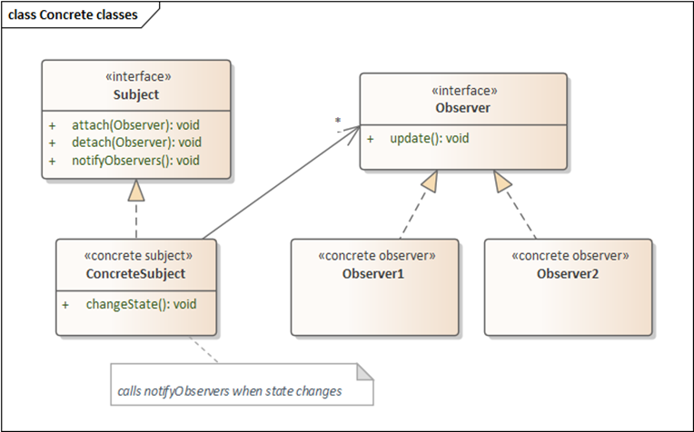
Observer pattern in Java
Why use a LinkedList instead of an ArrayList?
Implementation of subject is straightforward:
  Collection<Observer> observers = new LinkedList<>();
  attach(Observer o): observers.add(o);
  detach(Observer o): observers.remove(o);
  notifyObservers(): for(Observer o : observers) o.update();
Not answered: what argument to update?
  Observers need data!
WeatherStation: pass data generator
  Observers call methods to get data
  Always the best solution?
  What if there are many clients?

Slide 10
Generic Observer
interface Observer {
void update(???);
}
class ConcreteObserver implements Observer {
public ConcreteObserver();
public void update(???);
}
Key question:
What is the appropriate argument for the update() method?

Slide 11
Weather Program example
abstract WeatherSensor implements Subject
{
abstract double currentTemp();
abstract double currentWindSpeed();
Collection<Observer> observers;
public void attach(Observer obs) {…}
public void detach(Observer obs) {…}
public void notifyObservers() {…}
public boolean hasObserver(Observer obs) {…}
}
Allows objects to query if they are currently observing – simplifies some of the code in the example
See sample code
available on website as observer-weatherapp.zip
note Observer, Subject classes
What is passed to update?

Slide 12
Pull vs push for observers
One approach: observers request data they need
  Known as the pull model
  Doesn’t always scale – can lead to bottlenecks
Another approach:
  Send data along with update call, the push model
  Eg: WeatherStationDisplay.update(float temp, float windspeed)
  But consider TemperatureDisplay.update – only uses the first argument
  How extensible is this? What if we have more data?
  Is update(WeatherData theData); a solution?
Engineering decision: which principles do we ignore?
  Such decisions are the fun of engineering!

Slide 13
Benefits
Coupling between Subject and Observers:
  Subject knows it has a list of Observers, but not specific classes
  Each Observer conforms to a simple interface
  Hence, coupling is
    Abstract
    Minimal
Notes:
Cohesion: observers highly cohesive – no code to monitor multiple places; subjects don’t have code checking on observers, so also cohesive

Slide 14
Consequences (negative)
Pattern may not be useful if only some objects need notification
Overuse can mean cascading updates
  Eg: if A’s dependents each have more dependents, and those have even more
  Result: more time calling updates than computing useful results
Neither is really a problem with the pattern itself!

Slide 15
Review
So what is this pattern about?
When to use it?
Where can we use interfaces, abstract classes in this pattern?
  Where must we use them?
  Why should we consider rolling our own in Java?
Draw a UML diagram
What methods might be private/protected?

