Slide 1
7. MVC
Wikipedia Page on MVC
SWE2410 Design & Cloud Patterns
Dr. Rob Hasker (based on slides by Dr. Josiah Yoder)

Slide 2
Mental Models
How does a vacuum cleaner work?
What happens when it’s plugged in and
turned on?
Typical model:
plug in, electricity flows like water
electricity pushes on motor to spin it (like water wheel)
machine creates vacuum that pulls on dirt
In actuality:
phase switch 120 times per second
electromagnets make the motor spin; windings often powered by induction
pressure differential creates wind that blows in objects
Does it matter?
The simplified model is enough to fix most problems!

Slide 3
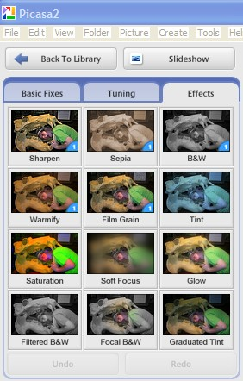
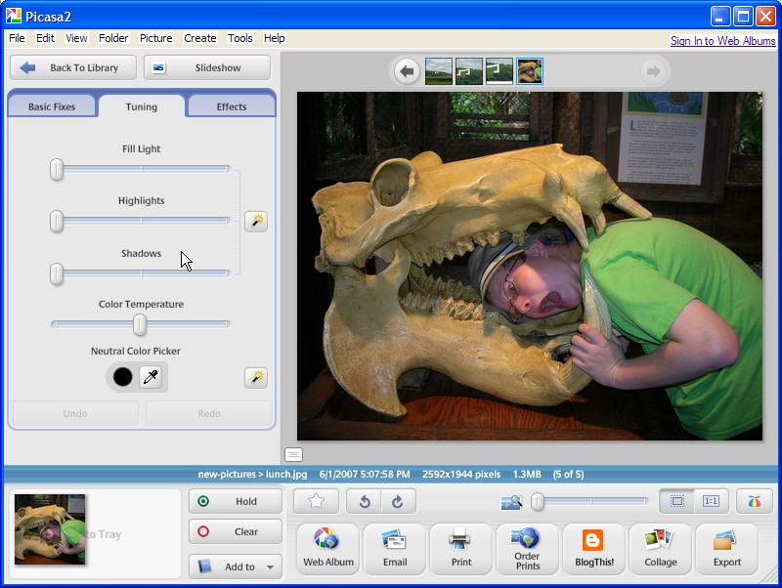
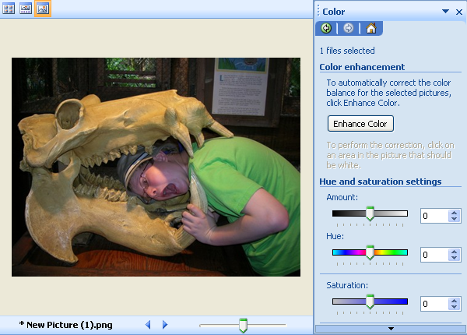
Mental Models in Software
Example: what happens when you scroll up on a spreadsheet?
Example: how to fix color?
Traditional:
Newer:
Goal: reflect user models

Slide 4
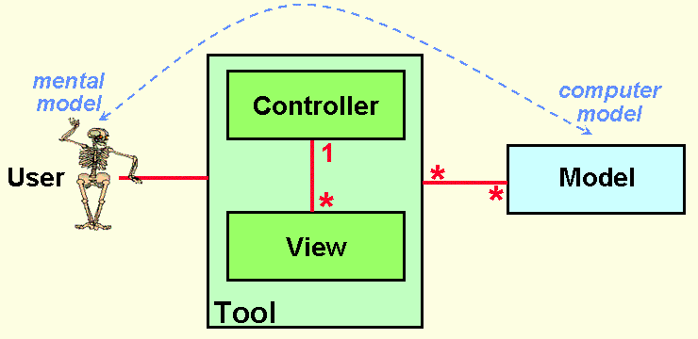
Model-View-Controller
Goal: divide software into elements
Natural subsystem: capture user’s model
Need to present data to user: view
Can even allow multiple views!
User needs to interact with that model: (UI) control
Often also includes policy
That is, business rules/logic
Domain classes!
Notes:
Full agenda:
Return Exam
Questions about lab due tomorrow in class?
Threads: Locking on null object
Threads: invokeLater
Threads: The squares example
Decorator Class Diagram
More on Java IO
Class diagrams
Design Principles
in the patterns we’ve seen so far
Compare with alternatives
Decorator vs. array approach suggested in class
Non-decorator array – decorator can be added on without modifying the original hierarchy
Decorator has “before-after” and possibly other combinatorial control that would be hard-coded in array
[Show “screenshot” of discussion from class? Or just re-type?]
Strategy vs. Decorator class diagrams side-by-side
Structural difference (inheritance optional in Strategy pattern?)
Decorator vs. “Strategy” array
Perhaps next:
Coding Starbuzz coffee (?)
Add real patterns
ArrayList – null-checking
Java I/O: Students do coding examples
http://stackoverflow.com/questions/9358821/should-i-extend-arraylist-to-add-attributes-that-isnt-null

Slide 5
Basic MVC
To support the user’s mental model
http://heim.ifi.uio.no/~trygver/themes/mvc/mvc-index.html
Notes:
Image by a creator/discoverer of MVC

Slide 6
Basic flow of MVC
click, drag, type
display
User
Views
Controller
manipulate
update
Model
Notes:
Architectural pattern popular for user interface design

Slide 7
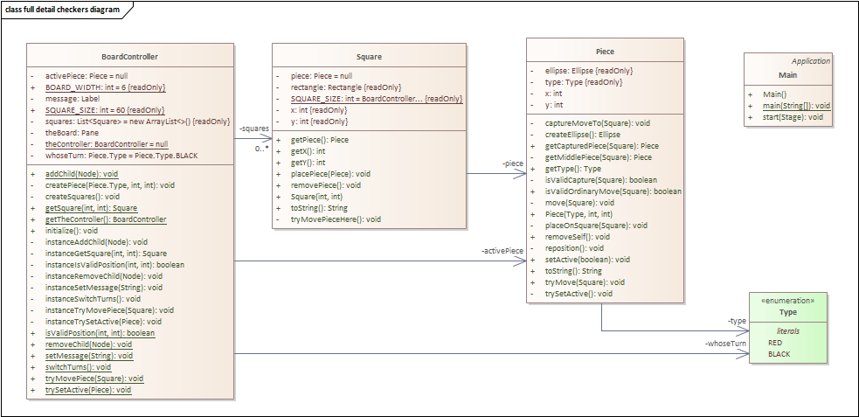
MVC and the Checkers Game
Reverse-engineered code
Too much detail to review!
Notes:
This is the reverse-engineered diagram produced by Enterprise Architect from the original Checkers code we distributed at the start of lab 1 (as of fall, 2025)

Slide 8
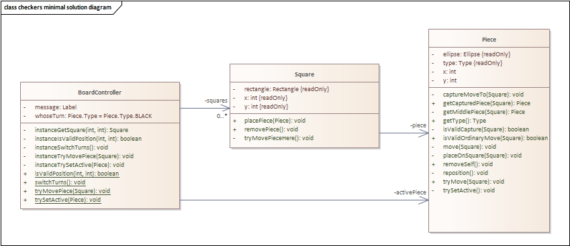
MVC and the Checkers Game
Minimal solution diagram – more readable!
But Piece “looks” messy – why so much logic?
Often: bad diagram = bad design!
Notes:
Removed main, the color type, most of the methods related to drawing pieces

Slide 9
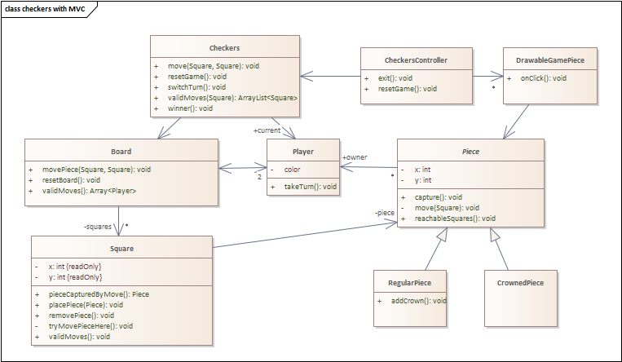
MVC and the Checkers Game
(JavaFX) View
(Game) Controller
display
click, drag, type
Views
Controller
update
manipulate
Model
Model
Notes:
This diagram reflects capturing the domain classes for the problem and separating out the JavaFX code from those classes. This has not been implemented, so there may be more two-way associations, and we may need a different set of methods for the CheckersController and the game controller.

Slide 10
Alternative Flow
The interpretation that’s especially common in web applications
View: HTML, Javascript
Controller: application on server
Model: data in database
But often used for standard apps
User
display
click, drag, type
forward events
update
View
Controller
( just policy)
manipulate
update
Model

Slide 11
MVC in Lab 6
See original code for lab (coconuts)
BeachController: capture keystrokes, display graphical elements
Crab, IslandObject, LaserBeam, Coconut, HittableIslandSubject: model
But not pure: mixes in code to display objects – the view
Fix: use Decorator to define the draw method
Sky: game – a mix of model, game control, view
Could refine this further
Key: game play is captured in Sky

Slide 12
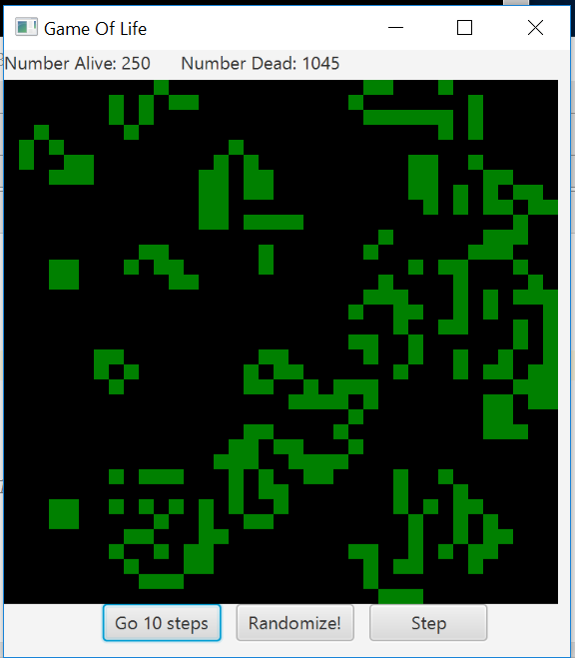
Game of Life
(SE 1021, Winter 2017)

Slide 13
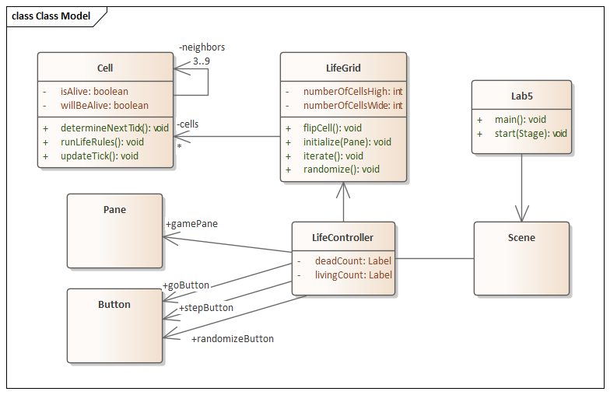
Game of Life
(SE 1021, Winter 2017)

Slide 14
What is MVC? (3)
user clicked, etc.
change . . display
View
update
update
state, . please
Controller
change state
Model
Notes:
Model – The data and “business logic” – how it works
View – What the user sees
Controller – Strategy for handling events / interface between Model and View

Slide 15
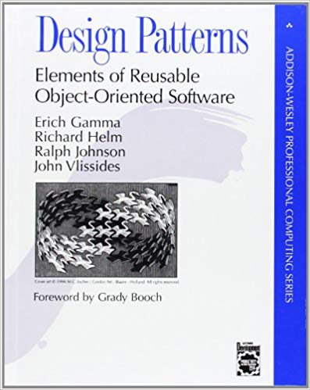
MVC and Design Patterns
From the “Gang of Four”:
“MVC decouples views and models by establishing a subscribe/notify protocol between them [and] lets you attach multiple views to a model”
What design pattern is this?
Notes:
Answer: Observer

Slide 16
MVC and Design Patterns
From the “Gang of Four”:
“Another feature of MVC is that views can be nested.”
What design pattern is this?
Notes:
1 view per form: application is a combination of views
Alternatively: a view for each panel, develop view for the panel that contains those panels

Slide 17
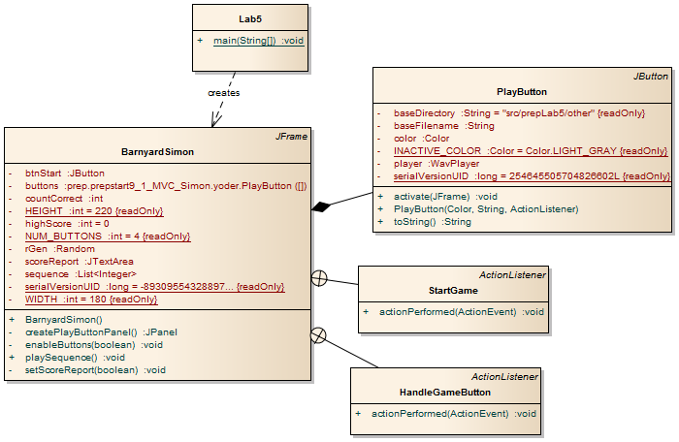
Simon without MVC

Slide 18
UI Implementation with MVC
Suppose a menu entry is active only when a document has been changed
Temptation: activate the menu entry on change, deactivate for new documents
Problem: undo/redo can restore original state as can additional edits
It is VERY difficult to track changes in a UI
More robust solutions: view simply displays model
View examines model for changes, reset activation/inactive on every redisplay
Generally: view sets all UI elements based on state of model
This seems inefficient, but the computer works much faster than people
Simplified view code, easier to ensure view matches model
Simplified testing: history doesn’t matter

Slide 19
MVC
Model: data, user model
Largely: domain classes + containers
View: display the data
May also include handling user actions
Often: app contains multiple views
Controller: business logic, interface to model
May include handling user actions
Advantages:
Distributed logic
Separate messy display code from the domain implementation
Supports automated testing of model, business logic
Challenges:
Not clear what functionality goes where
Confusing to novice programmers
When to use?
When you want maintainable apps!

