Slide 1
8. Command Pattern
see https://www.oodesign.com/command-pattern
SWE2410 Design & Cloud Patterns
Dr. Rob Hasker (based on slides by Dr. Mark Hornick)

Slide 2
What was learned from the exercise?
I’ll go over the sequence diagrams later
Who felt lost?
For those who didn’t feel lost, how did you approach the problem?
This is what you’ll see in your first job/internship!
  You will spend several days feeling completely lost
  You won’t know who does what, where to go for help
  You won’t understand what you’re doing, why you’re doing it, how to do it
  You’ll be convinced you’re unable to contribute
Solution: ask questions
  Read on relevant topics
  Ask questions like “I understand X and Y, but can you help me with Z?”
  These show you have put in effort, give the responder something to work with
Notes:
My assumption: people who didn’t feel lost either already knew about the Command Pattern OR they simply did the steps without asking why

Slide 3
So what’s the context for the exercise?
Significant issue in UI: excise
  actions not contributing to goal
  Financial excise: taxes, insurance
  Bicycle locks, repairing flats, oiling the chain
Software excise: configuration, manuals
Goal: eliminate excise so user more effective

Slide 4
Some types of excise in software
User Interface excise
  Must move/resize window before can do work
  Command-line excise: learning commands
Training wheels
  Must allow dismissing support for beginners
  Example: apps that prompt you with “see our new features” on every use
  Example: EA adding sample classes, packages to initial class diagram
Computer excise
  Requiring users to place every new software package
  Frequent, slow updates for security features that affect few users
Notes:
Power saver notifier: displays message about turning off wireless/Bluetooth/etc at 30% - great idea, just do it; don’t need non-dismissible banner on my nofications page!

Slide 5
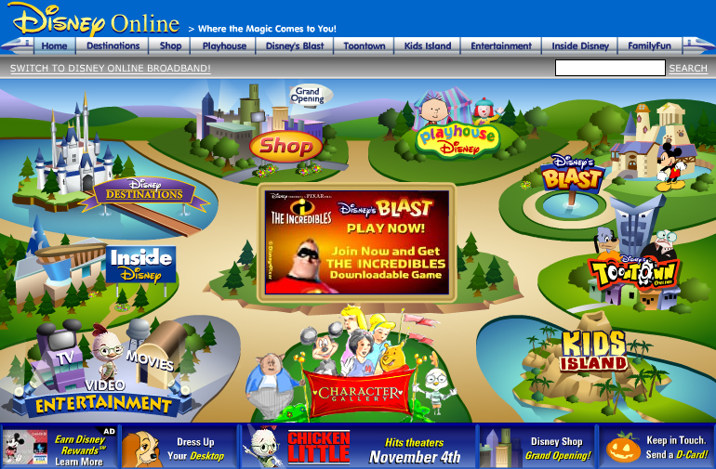
Some types of excise in software
Visual excise
2007 website
Cluttered!
  User must decode
Flash-heavy
Each item had very little content
Confusing!
  Blast vs. ToonTown vs Kids Island?
Where do I go first?
Notes:
Power saver notifier: displays message about turning off wireless/Bluetooth/etc at 30% - great idea, just do it; don’t need non-dismissible banner on my nofications page!

Slide 6
Undo
Removing excise: a key part of improving user interfaces
Another source of excise: “are you sure you want to do that?”
  Annoying at best
  Can be interpreted as asking, “Are you qualified to use this software?”
Solution: Undo
  Every action should be undoable so don’t need to ask before doing them
  This allows the user to learn through exploration
Simple way to support undo: save, restore state
  Each action: save state of system before the action
  Doesn’t scale: every video edit could require saving gigabytes of data…
  Even if have that much memory, undo/redo will be very slow!
Notes:
Not all actions are undoable! Eg: launching ICBMs

Slide 7
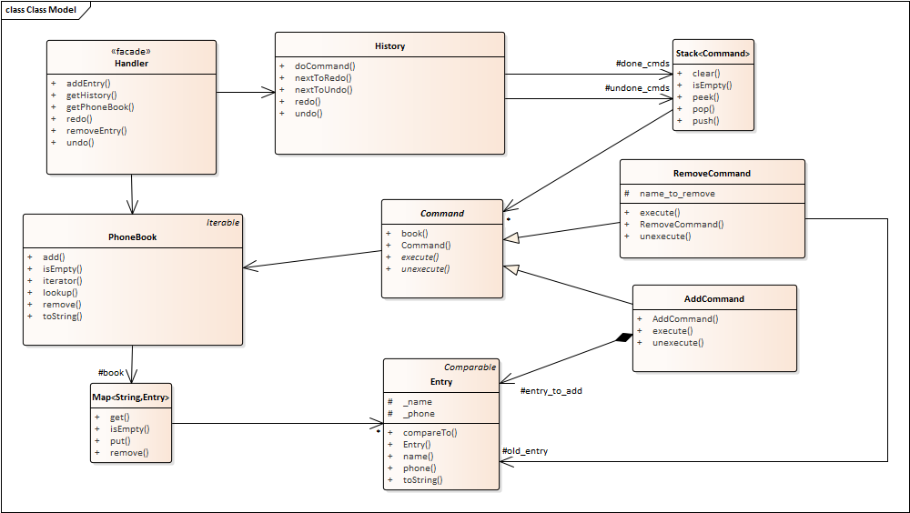
Review: phonebook & commands
What happened when we an entry was added?
What happened when one was removed?
What happened when undoing a remove?

Slide 8
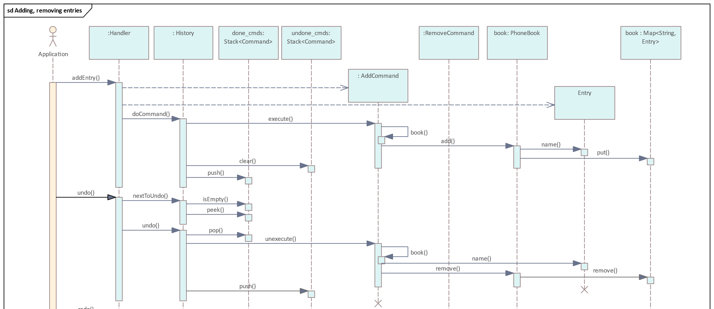
(The initial diagram for the exercise)
AddCommand: used to add entries to phonebook
Undo/redo: unexecute, re-execute command
RemoveCommand: remove entry

Slide 9
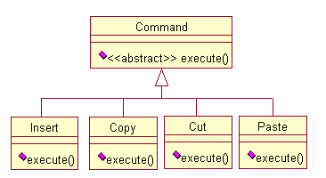
Command Pattern
Basic behind command pattern: store commands as objects
  base class defines
  abstract execute()
  subclasses:
  implement execute()
  undo/redo: add unexecute
Uses
  All menus, buttons, etc. can invoke same action
  Stack commands for undo/redo
  Share common bits of operations

Slide 10
Command pattern applied
javafx-phonebook.zip
Core commands: add and remove
Add: book().add(entry_to_add);
Remove:
  old_entry = book().lookup(name_to_remove); book().remove(name_to_remove);
2 lists: done_cmds, undone_cmds
Notes:
Undo for add: book().remove(entry_to_add.name()); Undo for remove: book().add(old_entry);

Slide 11


Subtle aspect of history
Executing a new command clears the undone_cmds stack – why?
Consider a word processor:
  Oops – wrong fox
  Undo last two words:
  Type ‘red’:
  Should redo give this?
  Or this?
  Must type ‘fox’ as well:
When a new command is executed, cannot return to state assumed by the remaining commands on the undone_cmds stack
  undone_cmds must be cleared whenever a new operation is done
The quick black fox
The quick
The quick red
The quick black red
The quick red black
The quick red fox
Notes:
Yes, there are black foxes
The black fox is from https://en.wikipedia.org/wiki/Silver_fox_(animal) (black foxes are often called silver foxes, though they can look completely black)
The red fox is from https://www.nwf.org/Educational-Resources/Wildlife-Guide/Mammals/Red-Fox
Note after undoing fox and black, the command to add `black’ is at the top of undone_cmds.

Slide 12


More phonebook details
GUI: JavaFX code (not shown)
Implements GUI/policy/data layers
  History part of policy layer, encapsulates undo/redo
  Handler: front end to policy
  Command: policy operations
Domain:
  Phonebook: current contents
  Map provides lookup
Add, Remove: tracks entry so can execute, unexecute
  Note the needs-a relationship!
  Add owns the entry
Policy
Model

Slide 13
More phonebook details
Issues:
What data to store?
Have a few “intelligent” commands, or lots of small ones?
  In JavaFX phonebook, what happens when undo a name change?
Provide way to group commands into a unit?
  Note Edit is delete followed by insert – confusing to users
Need way to save commands without exposing internal details?
Notes:
Undoing a name change (the Edit action): can see this is a remove followed by an add – likely unexpected behavior!

Slide 14
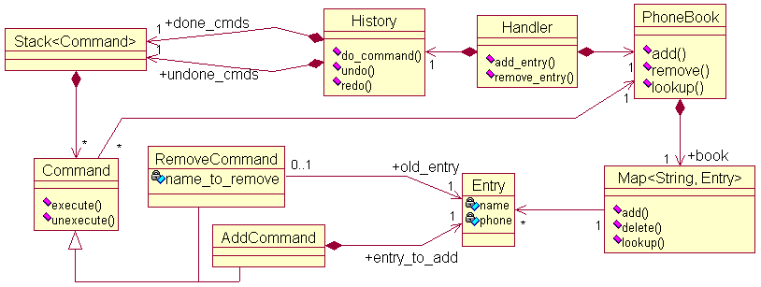
More phonebook details
Other ramifications:
  Macro = sequence of commands
  User might define own commands & assoc w/ menus
  Can log commands to handle system crashes, accountability, etc.
Notes:
Note: rational rose version of the diagram is behind the EA one in case we go to rational rose some day…

Slide 15
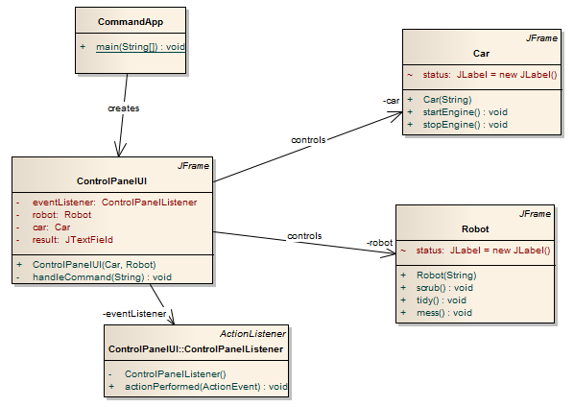
A different application
How to support operations like startEngine, scrub?
Should control panel team implement both?
UI should be independent of actions

Slide 16
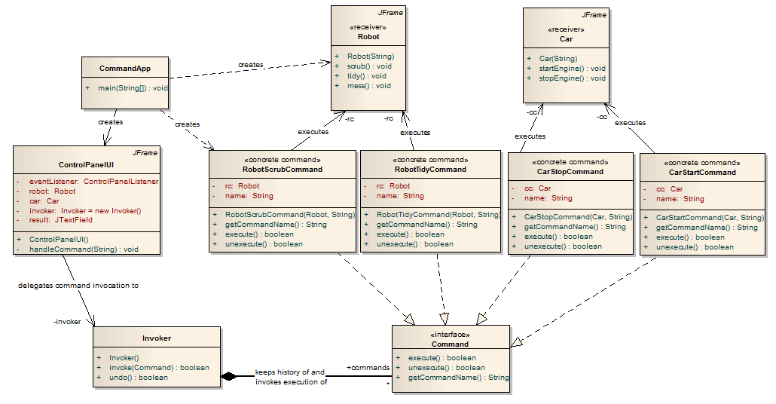
Using command pattern with this

Slide 17
Command Pattern
Move the code in an action into an execute() method in a new class
Derive that class from an abstract Command class
Results:
  Can create collections of commands to be executed
  Supports undo/redo: eliminating unnecessary “do you want to do that” questions – eliminating excise
  Macros: a sequence of commands
Negative consequences? Impact to coupling and cohesion?
Issues: how much data to store in each command? Undo large chunks?
Notes:
Coupling: commands no more coupled with the rest of the system than whatever would have held the actions in the first place; if two commands interact, there may be hidden couplings between their classes
Cohesion: each command has one class to hold it, strong cohesion. Moving some functionality out of original policy class, possibly improving and possibly hurting its cohesion

Slide 18
Review
Common source of user frustration: excise
  some forms: user interface, training wheels, computer, visual
Undo: avoid unnecessary confirmation questions
Supporting undo with save, restore state: doesn’t scale
Robust solution: Command Pattern
  Each user action is an instance of an object
  Execute, unexecute: do/undo operation
  done, todo stacks: tracking what has been done and undone

