Slide 1
9. Threads
SWE2410 Design and Cloud Patterns
Dr. Rob Hasker (based on slides by Dr. Mark Hornick)

Slide 2
What CSC1110 students are told…
Running a program starts with main()
  True
Instructions in main are then executed in sequence
  Also true
Program halts when main() returns or call exit()
  Well…

Slide 3
The ugly truth…
A running program = a collection of “threads”
  Each thread: an independent execution stream
Body of main(): executed on the primary thread
Program termination:
  Primary thread terminates
  AND
  All secondary threads terminate
When discussing threads, we think of a program as a process

Slide 4
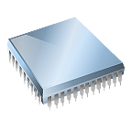
Processes
Defining process:
  a program / application running on your computer
Each contains a (private) collection of run-time resources such as
  a memory space
    not shared with other processes
  an execution priority
    controls how frequently the process is run
  a set of credentials
    authorization to access various resources such as files, services
  one or more threads
    each thread runs in the process and has access to all its memory
    In Java, the JVM works with the OS to manage, execute these threads
Notes:
Well, sometimes processes share memory, but that’s out of scope for this discussion

Slide 5

A process has 1..* threads
Default: main process creates a primary thread
BUT:
A process can create and execute more than one thread
The JVM works with the OS to create processes and threads
  The underlying OS provides the essential multiprocessing support

Slide 6

Managing multiple processes
Older computers: only one process running at a time
  While one process runs, other processes sleep
Operating system cycled between processes
  Scheduler: determine which to run next
  Rapid cycle: change every few milliseconds
  User’s view: all appear to run at same time
  Illustration: process table in Task Manager
Modern machines: multiple CPUs, cores
  Each can run a separate process
  Still have limits, so still need the scheduler

Slide 7

Java application: the JVM creates a Process and a Primary Thread
The primary thread: executes main()
If no additional threads created…
  Program terminates when primary thread terminates
  That is, when there are no more instructions to execute

Slide 8
Standard, single-threaded application
public class App {
public static void main(String[] args) {
App me = new App();
me.method_A();
}
private void method_A() {
// more code here
method_B();
return;
}
private void method_B() {
return;
}
private void method_C() {
// more code here
}
}
JVM creates the primary thread to run program
Primary thread executes main()
Execution proceeds until reach end
Program terminates on returning from main()

Slide 9
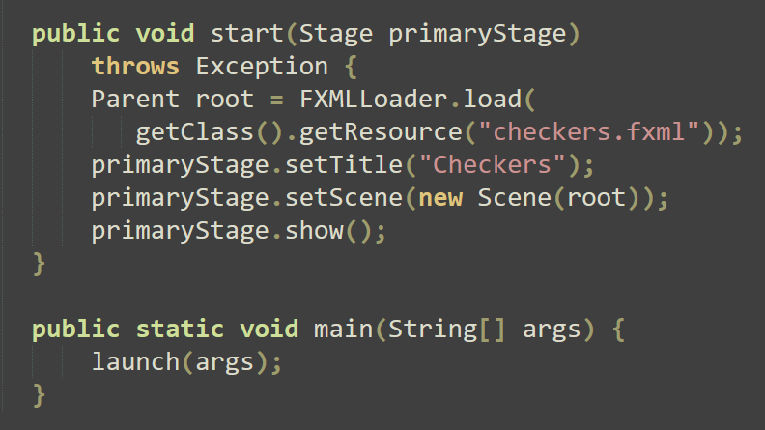
How to create other threads?
Additional threads are created by a Swing or JavaFX application
  GUI framework creates additional threads
  In JavaFX: launch method executes start, and that starts a controller thread
  Any code after launch() would be run in the primary thread

Slide 10
How to create other threads?
Additional threads are created by a Swing or JavaFX application
  GUI framework creates additional threads
  In JavaFX: launch method executes start, and that starts a controller thread
  Any code after launch() would be run in the primary thread
Additional threads are created by various Java utility classes
  For example: Timer, TimeLine
Can also create threads explicitly

Slide 11
Explicitly creating threads
Code:
Thread t = new Thread(r);
t.start();
Argument r (for Thread constructor):
Must implement Runnable
Runnable interface: just has public void run()
The start() method sets up the thread and calls run()
Key: start() can return immediately
No guarantee it waits for the thread to complete
No guarantee it does not wait!

Slide 12
The main class may implement Runnable:
public class App implements Runnable {
public static void main(String[] args) {
App me = new App();
me.method_A();
}
private void method_A() {
// more code here
method_B();
return;
}
private void method_B() {
Thread t = new Thread(this); // App is runnable!
t.start(); // start executing the run() method
return;
}
public void run() {
// more code here
}
}

Slide 13
Both threads execute simultaneously and independently after the secondary thread is started
public class App implements Runnable{
public static void main(String[] args) {
App me = new App()
me.method_A();
}
private void method_A() {
// more code here
method_B();
return
}
private void method_B() {
Thread t = new Thread(this);
t.start();// execute run() on new thread
return;
}
public void run() {
// more code here
}
}

Slide 14

Using a second class which implements Runnable
public class App {
public static void main(String[] args) {
App me = new App();
me.method_A();
}
private void method_A() {
SomethingToDo todo = new SomethingToDo();
Thread todoThread = new Thread(todo);
todoThread.start();
return;
}
}
public class SomethingToDo implements Runnable {
public void run() {
// more code here
}
}

Slide 15
Using a lambda expression
public class App {
public static void main(String[] args) {
App me = new App();
me.method_A();
}
private void method_A() {
// assume declared x, y, z here...
Thread t = new Thread(()-> method_to_run(x, y, z));
t.start();
return;
}
private void method_to_run(int a, int b, String q) {
System.out.print(a + b);
System.out.print(q);
}
}
This method gets executed in place of the run (when t.start() is executed)

Slide 16
Using a Timer – also based on Runnable:
import java.util.Timer;
Timer timer = new Timer();
op = new DoSomething(); // must be Runnable
timer.schedule(op, x); // execute op.run after x milliseconds
The op is an instance of a Runnable class (has run() method)
The schedule method waits delay_time millseconds, then executes op.run()
  op then runs as its own thread
Can also use scheduleAtFixedRate, which executes the task repeatedly
Warning: NOT javax.swing.Timer!

Slide 17
Note: we have no control over order between threads
public class App implements Runnable {
public static void main(String[] args) {
App me = new App();
me.method_A();
}
private void method_A() {
Thread t = new Thread(this);
t.start(); // execute run() on new secondary thread
method_C(); // execute method_C on the primary thread
}
private void method_C() {
// more code here
}
public void run() {
// some other instruction is here
method_C(); // execute method_C on the secondary thread
}
}
No control over which executes method_C first
This is not to annoy programmers!
It is to make sure threads / applications execute as quickly as possible

Slide 18
Question:
What can happen if threads execute the same code at the same time?
See https://faculty-web.msoe.edu/hasker/swe2410/samples/
Execute java count2000.java
  failed attempt at 1000+1000
  As written: 1000 + 1000 is between 900 and 1100…
  Change body of loop to count += 1; - still fails!

Slide 19
Fortunately, Java supports several mechanisms for synchronizing the execution of multiple threads
Keeping code thread-safe
S

Slide 20
The Thread class’s join() method is one way of synchronizing two threads:
Thread t = new Thread(cref);
t.start();
t.join(); // wait for 2nd thread to finish…
method_C(); // …before executing next inst.
The second thread starts executing the instructions in the run() method.
The current thread (the launcher of the second thread) waits until the second thread finishes
This is very course-grained; not very useful in most applications
Illustrate with Count2000.java
Note code runs more slowly (in real clock time…)

Slide 21
Alternative: declare a method as synchronized
- only one thread will run it at a time
public class App {
public static void main(String[] args) {
App me = new App()
me.method_A();
}
private void method_A() {
Thread t = new Thread(() -> codeForAnotherThread());
t.start();
method_C(); // run method_C on the primary thread
}
private synchronized void method_C() {
// More code here
}
public void codeForAnotherThread() {
// some other instructions here
method_C(); // run method_C on the secondary thread
}
}

Slide 22
Entering synchronized method blocks threads
- first thread must exit before another enters
Note: which waiting thread runs first is random!
Thread x
Thread y
Thread z
Which gets to enter the method first is determined arbitrarily by the scheduler
private synchronized void method_C() {
<statement 1>
<statement 2>
<statement 3>
}
When x exits, scheduler picks one of y or z to run (arbitrarily)
If x calls method_C again before the other finishes, it could run again!

Slide 23
Entering synchronized method blocks threads
- first thread must exit before another enters
Thread x
Thread y
Thread z
Which gets to enter the method first is determined arbitrarily by the scheduler
private synchronized void method_C() {
<statement 1>
<statement 2>
<statement 3>
}
Challenge: if too much code is synchronized,
there’s no advantage to multithreading!
Illustrate with Count2000 – synchronize countUp
When x exits, scheduler picks one of y or z to run (arbitrarily)
If x calls method_C again before the other finishes, it could run again!

Slide 24
Synchronized block: controls just a small segment of code
- synchronize on some object
Thread x
Thread y
Thread z
private void method_C() {
<safe statement 1>
<safe statement 2>
synchronized( <sync_object> ) {
<unsafe statement 3>
<unsafe statement 4>
<unsafe statement 5>
}
<safe statement 6>
}
When Thread x leaves the block, the scheduler arbitrarily allows one of the other threads to enter.

Slide 25

The synchronizing object can be any object
Java’s Object class incorporates the concept of something called a monitor
Monitors are used to guard the gates of synchronized blocks
Monitors only become active within a synchronized block

Slide 26
Can use the object itself for synchronization:
Thread x
Thread y
Thread z
private void method_C() {
<safe statement 1>
<safe statement 2>
synchronized( this ) { // gate down
<unsafe statement 3>
<unsafe statement 4>
<unsafe statement 5>
} // gate up
<safe statement 6>
}

Slide 27
Or any generic Object
Thread x
Thread y
Thread z
private static Object guard = new Object();
private void method_C() {
<safe statement 1>
<safe statement 2>
synchronized( guard ) { // gate down
<unsafe statement 3>
<unsafe statement 4>
<unsafe statement 5>
} // gate up
<safe statement 6>
}
See effect of synchronizing in Count2000.java

Slide 28
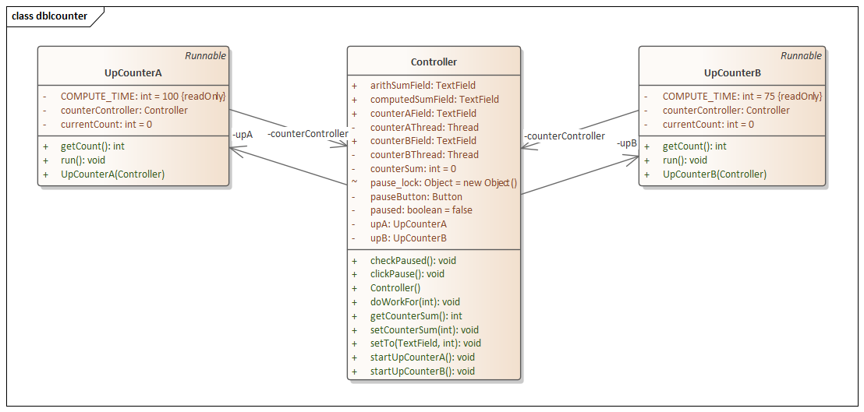
Question:
Can this happen in GUI code?
Fixing dblcounter:
Add synchronized to Controller.incrementSumField
Observe this works.
Comment code with runLater and uncomment out code it replaces
runLater runs the code in the GUI’s thread, which is the only safe way to make form updates.
See https://faculty-web.msoe.edu/hasker/swe2410/samples/
See dblcounter: JavaFX application with unprotected counters – see samples page

Slide 29
Demonstrations
samples/Count2000.java
  2 threads, both results are close to 1000 since no synchronization
  This demonstrates the problem does not depend on GUIs
  make countUp synchronized, show works but runs more slowly
samples/dblcounter.zip
  If not already covered: build, run, pause, observe the sums do not match
  Uncomment the synchronized code in both counters, observe now works
weather_observer
  Could easily revise to use a thread when notifying observers
  Each update() could spawn a thread to do the work
  Observer pattern is especially relevant in multi-threaded applications!

Slide 30
Review
Process: running application
  memory, priority, permissions, threads
Thread: execution stream
  Essentially: a stream of instructions executed by CPU in a process context
Creating threads
  Java Swing or JavaFx, Timer/Timelines, new Thread()
A thread of a problem
  What happens if two threads access the same memory at the same time
  Using synchronized to avoid the problem
  UI’s and threads

