Slide 1
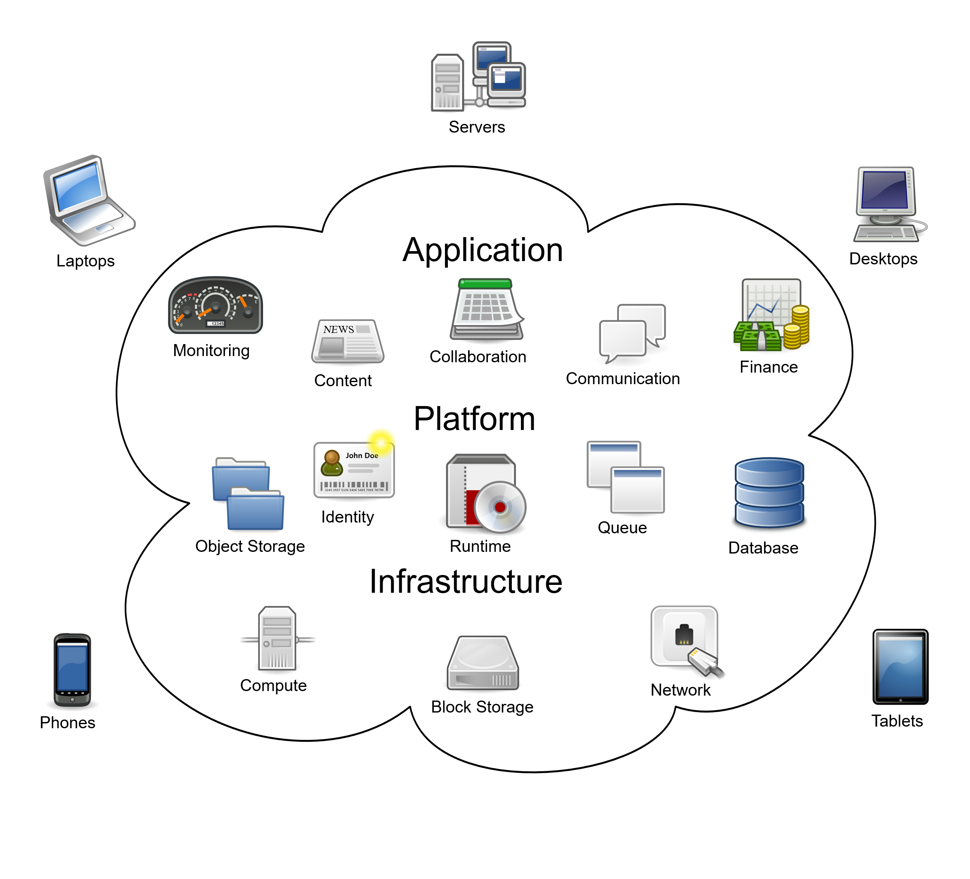
10. Cloud Computing
https://en.wikipedia.org/wiki/Cloud_computing
Note to instructor: use AWS Academy to start AWS Console at start of presentation
SWE2410 Design and Cloud Patterns
Dr. Rob Hasker
Notes:
Image By Sam Johnston - This W3C-unspecified vector image was created with Inkscape ., CC BY-SA 3.0, https://commons.wikimedia.org/w/index.php?curid=6080417 Cloud_computing.svg

Slide 2
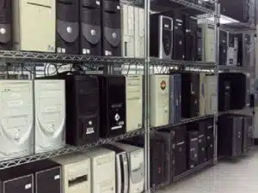
Why do we need “the cloud”?
Why do we need the internet?
  Communication is obvious, but what are other needs?
  Why can’t we do everything on our phones or computers?
  Store data
  Provide additional computing resources
  Compute results that require privileged data
Traditional internet model: provider buys a computer, plugs it into the wall
What problems does that create for the provider?
  Need to ensure it stays connected – what if there’s a local power outage?
  Must maintain operating system, system security – need to hire expensive people
  What if the load is too great for the machines you bought?
Solution: “put it in the cloud”
  that is, run your software on someone else’s machine, let them handle these issues
Notes:
Server image from https://discoposse.com/2018/03/20/23-things-only-90s-sysadmins-will-remember/

Slide 3
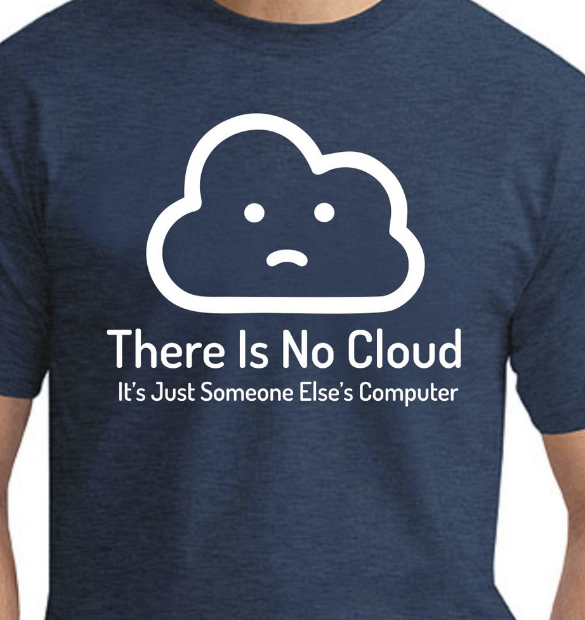
So is “putting it in the cloud” the same as renting computers from others?
No: a service provider also handles
  Power, space, cooling
  Operating system maintenance
  Backups
  Hardware redundancy
  System management
  … and more!
(M. Branscombe/ZDNet)
Saying it’s just someone else’s computer is like saying a road just a paved path…
  Need more: stop lights, markings, signs
Watch out for arguments based on “reduction to the absurd”
But what is the difference between renting computers and cloud computing?
That is, what does “cloud computing” mean?
Notes:
T-shirt image from https://www.geekytees.co.uk/product/there-is-no-cloud/, (GeekyTees) captured 2024-11-02
Another example of reduction to the absurd: a rocket is just a tube on top of a bomb,
Discussion about simplification: https://www.zdnet.com/article/stop-saying-the-cloud-is-just-someone-elses-computer-because-its-not/
(The paved path simplification example is R. Hasker’s)

Slide 4

Definition from NIST:
(National Institute of Standards and Technology)
Cloud Computing: model for convenient, on-demand network access to a shared pool of configurable computing resources
Essential characteristics
  On-demand self-service – no central sysadmins
  Broad network access
  Resource pooling – share resources between orgs
  Rapid elasticity – obtain resources quickly
  Measured service – allow controlling expenditures
Notes:
Definition, characteristics by NIST (National Institute of Standards and Technology): https://csrc.nist.gov/projects/cloud-computing
On-demand self-service: clients can acquire resources, configure them to their needs – don’t have to ask sys admin to do it for you
Image by Adobe Firefly using the prompt “cities in asia with connections between them and a small computer at each”, generated 7-Oct-23

Slide 5
Definition from NIST
Cloud Computing: model for convenient, on-demand network access to a shared pool of configurable computing resources
Key technologies supporting this
  Fast, wide-area networks
  Powerful, inexpensive server computers
  High-performance virtualization
    Virtualization: Emulating a complete OS on the computer
    Isolates application from any other applications
Notes:
Material from NIST https://csrc.nist.gov/projects/cloud-computing

Slide 6
Some key issues for cloud developers
Most resources are “virtual”
  What does this mean?
  Start by understanding “virtual machine”: a computer emulating another computer
Notes:
Discussion of virtual machines: https://azure.microsoft.com/en-us/resources/cloud-computing-dictionary/what-is-a-virtual-machine

Slide 7
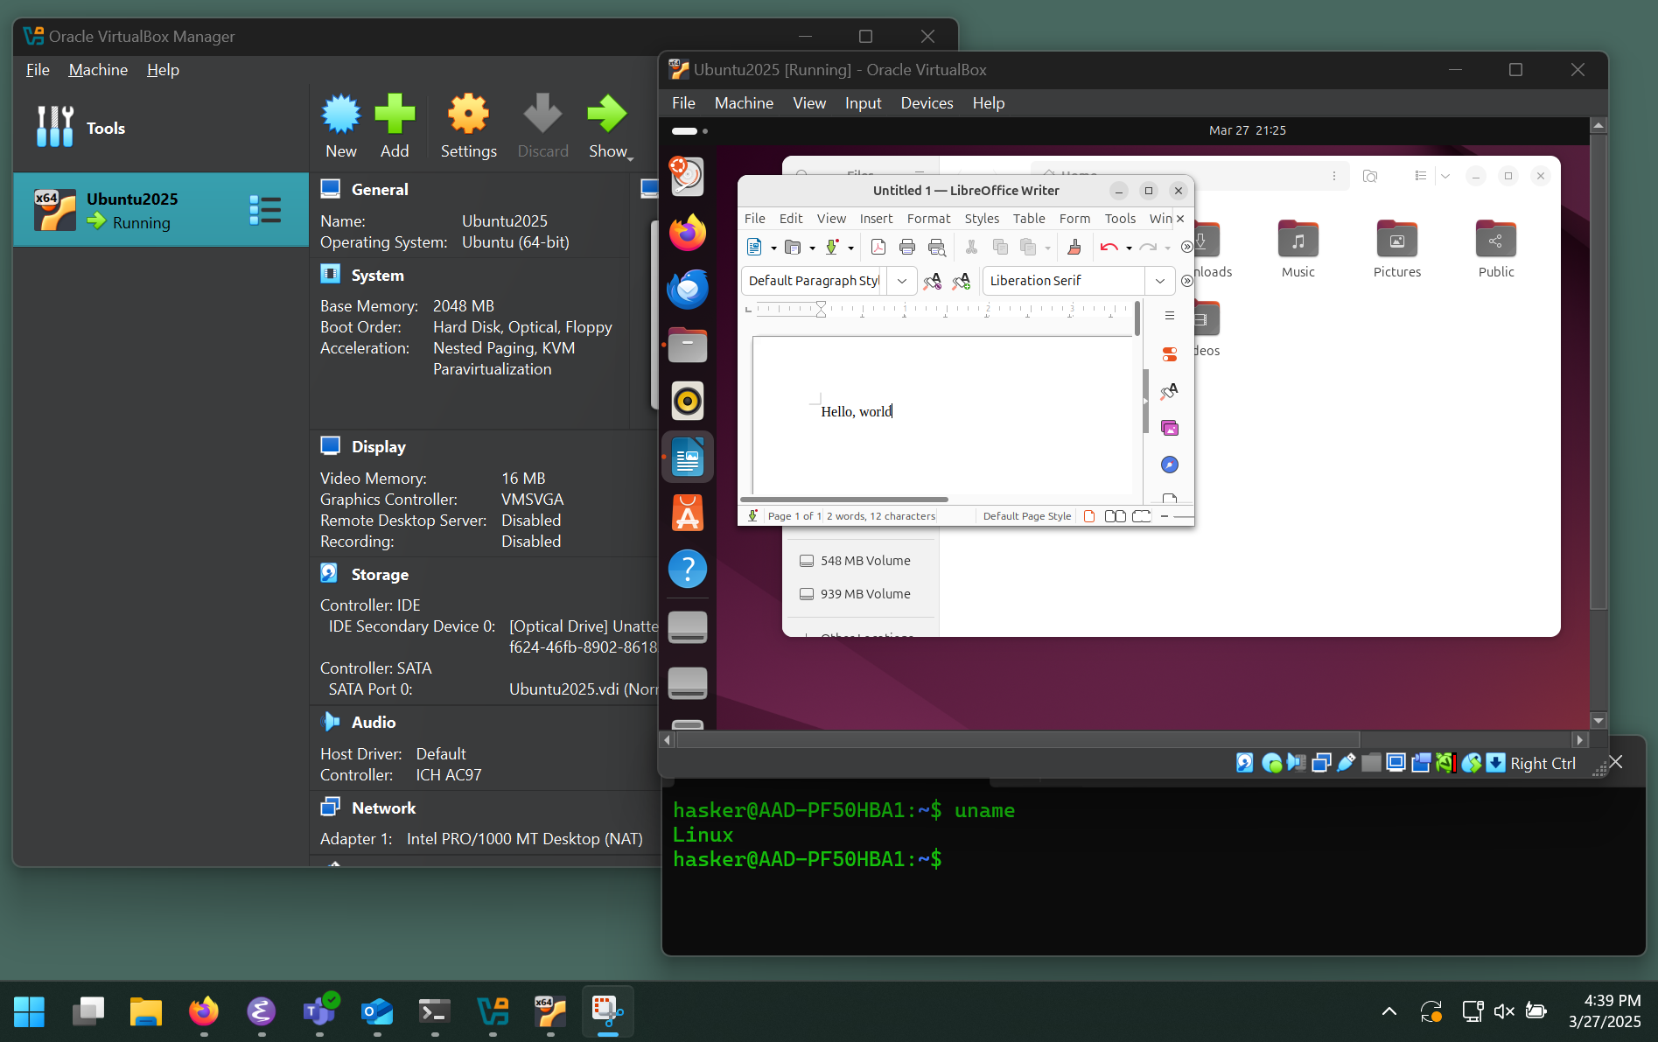
VirtualBox – manages virtual machines
The Ubuntu desktop
running Linux (within VirtualBox)
Virtual Machines
in a laptop
A VM in VirtualBox
with its resources
Allocated resources
Uses:
Cross-platform development
Use tools not available in native OS
Can set up VM for specific scenario
Ensure new software doesn’t break computer
Another VM: Windows Subsystem for Linux (WSL)
Windows11 laptop

Slide 8
Some key issues for cloud developers
Most resources are “virtual”
  Virtual machine: a computer emulating another computer or computers
Must allow computers to go offline at any moment
  Individual computers are reliable
  But consider how many students need their laptop replaced in a year…
Message transmission is not predictable
  If send message A then B from Tokyo to Helsinki, one or both may not arrive, and if they do arrive B might arrive before A
  Just as challenging: a message may arrive multiple times
Notes:
Discussion of virtual machines: https://azure.microsoft.com/en-us/resources/cloud-computing-dictionary/what-is-a-virtual-machine

Slide 9
Computing in the cloud
Simple model: single machine runs web server or other software
  Hard to scale, client heavily involved in managing host
Improvement: create a container – a snapshot of the running system
  Capture OS, resources like databases, run each container as a virtual machine
  Scaling: spin up new server, load container, update IP addresses, run
  This is the model for tools like Docker
  Client needs to ensure container is secure, starting a server can take minutes
Better still (often): Functions as a Service (FaaS)
  Programmers write small pieces of code – functions – and that code is executed directly on the server’s OS
  The functions have no OS-dependent features
  Scaling: run same code on more machines
  Often known as serverless computing since all server management done by host
Notes:
See https://en.wikipedia.org/wiki/Function_as_a_service

Slide 10
APIs
With FaaS, programmer thinks more in terms of modules
Each module provides an Application Programmer Interface (API)
Simplest example of APIs: libraries that other developers can use
  For instance, JavaFX
  Could write your own code to draw buttons, change drawing when clicked, read keystrokes and mouse clicks, manually create a GUI
This was the practice in the 1980s: everyone wrote their own GUI system
  It did give you lots of control!
  Problems: no consistency, no polish, lots of work recreating what others did
  JavaFX gives a more consistent interface, allows developers to focus on requirements
See: https://blog.hubspot.com/website/application-programming-interface-api

Slide 11
APIs
Cloud-based APIs: API for code running on a separate server
Wins
  Distributes computational load
  Provides real information hiding
    Clients not in same memory space, so they cannot access internals
    Eg: pricing information – may want to keep the details very private
    Secret communications: the best way to ensure messages do not leak is to not store them where they can be accessed in uncontrolled ways
  New model for libraries: users pay per use
    Don’t have to predict up front how much it’ll be worth
  If done right, easier to debug issues
  … and many more!

Slide 12
APIs
Common types of APIs
  Data sharing: retrieving data from a third party
  Integrating apps: eg, using GMail with BlueSky
  Embedding content: embedding a YouTube video in an application
  Internal sub-systems: one team uses an API to execute code written by another
How to make sure only specific systems can access the API?
  API key – a unique identifier authenticating API calls
Endpoint: location where API interacts with client
Notes:
... though signals on a telephone line would be pretty slow
Term definitions from https://blog.hubspot.com/website/what-is-rest-api

Slide 13
Communicating with an API
Could be done in any well-defined way
  e.g. transmitting data over a bus, signals on a telephone line
Common method: using the Hyper-Text Transfer Protocol (HTTP)
Primary HTTP requests:
  GET: retrieve a resource; eg, a web page
  POST: create a new resource; eg, create an account or transaction
  PUT: edit/update an existing resource
  DELETE: delete a resource
Further refinement: REST API – stateless, scalable communication
  Not discussed here; see https://blog.hubspot.com/website/what-is-rest-api
Notes:
... though signals on a telephone line would be pretty slow

Slide 14
REST APIs
Representational State Transfer: guidelines to ensure communication is simple, scalable
Rules:
  client sends request, server responds
    server never sends a request to the client
  uniform interface: one way to transfer data
  stateless: every request and response provides all information needed
  layered: every layer uses the same protocol
see https://blog.hubspot.com/website/what-is-rest-api

Slide 15
Basic structure of a cloud-based app
Build a phone app: FindMyMSOElaptop
  Configure WiFi system to record laptop IDs when they attempt connection
  Keep database logging these connections
Client: log in with MSOE id
  Given login, return last known connection location
Endpoint
API provider
API Key
username,
pass, SSO Key
Single
Signon
WiFi
Network
POST
Finder
App
authentication token
ack
On phone
location
authentication token
location
Locator
API
DB
GET
Endpoint
API provider
Notes:
Finder App sends the authentication token (which includes the user id) to the locater api, it queries the datavbase, and then it returns the location which is displayed in the Finder App

Slide 16
How to transmit data to API?
Raw text: no structure, quickly becomes ad-hoc
Binary
  Difficult to debug, especially since cannot generate/read by hand
  Sensitive to system differences in how ints, floats, etc. stored on machine
XML: robust, powerful, but often expensive to process
JSON – Javascript Object Notation
  Human-readable
  Ubiquitous because JavaScript is commonly used in web apps
  Almost every programming language has a library to read, write JSON
  Flexible
  Self-documenting

Slide 17
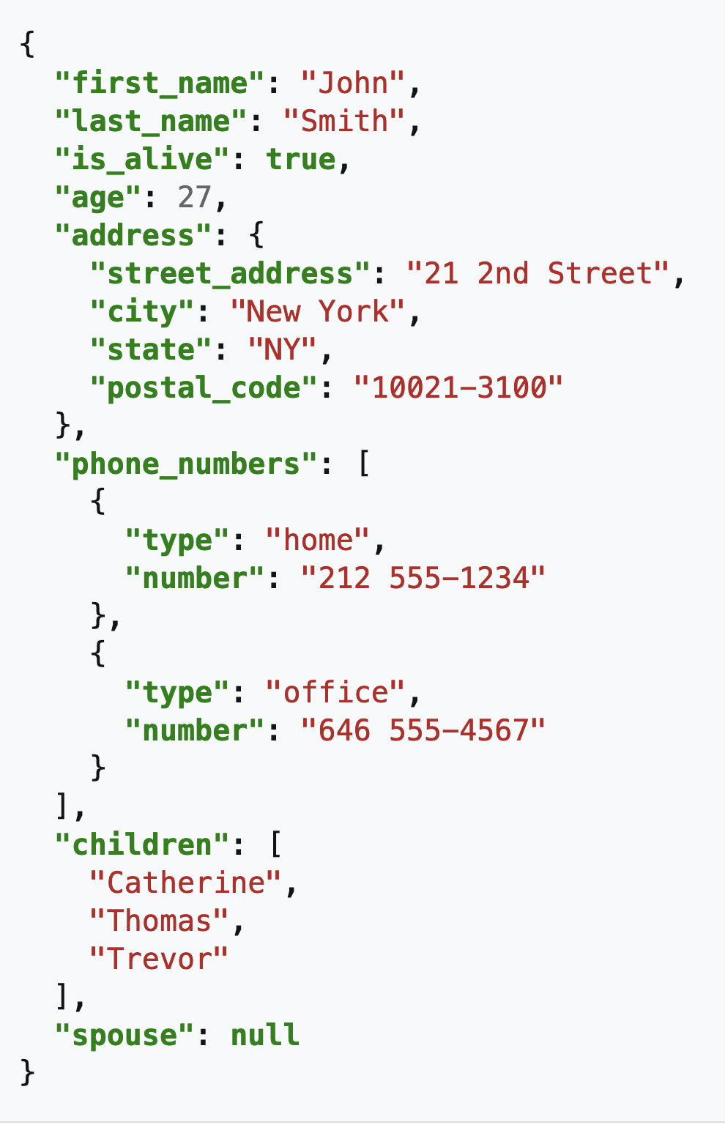
JSON Sample
All data represented by ASCII
  Pictures can be included as binary
  Preference is to use ASCII for all else
Human-readable
  Named fields, simple data types
  Easy to confirm values
  Easy to create new data values
Not efficient
  Repeated field names
  Binary values take less space: 3.14159 takes 8 bytes as a string, 4 bytes as a float
Basic Datatypes:
Number
String
Boolean
null
Array/sequence: square brackets [ ]
Object: name: value pairs in braces { }
Notes:
The name/value pair provides an attribute; no representation for methods...

Slide 18
Cloud Computing with FaaS
The pieces:
  Platform: the hardware running a service
  Server: the software providing a service
  Client: system requesting the service
  API: communication protocol between client and server
  Endpoint: address used by client to connect to server
Open question: how to structure the servers?
  A simple model: AWS Lambda
  When a client accesses a lambda, data is passed in, the result is computed, and that result is returned
  AWS is just one implementation of FaaS; other providers have similar methods

Slide 19


AWS Lambda: Core Model
Web events
Email
Files on S3
Mobile requests
etc.
Application
Code
(Python, Java, JS, C++, etc.)
  JSON
  JSON
Key application limits:
Max run time: 15 minutes
Memory: up to 10 GB
File storage: up to 10 GB
Invocation payload: 6 MB
Threads: 1024
Notes:
S3: Amazon “Simple Storage Service”
Sequence:
External entity sends data to URL in JSON format
AWS Lambda starts application code, forwards data
Code returns data in JSON format
Response returned to client
(Stylized lambda: Amazon logo)

Slide 20
AWS Academy
AWS Academy: how we will experiment with AWS services
  AWS is a pay-as-you-go service – requires a credit card
  AWS Academy: provides free access to services for students
  Has limits to usage – be careful to not consume the class budget!
Yes, you can sign up for your own account
  The free tiers will allow exploration!
  However, they may not have access to Lambda
  You MUST use the class account for labs
Yes, the interface is designed for experts, not beginners...
If you want to take AWS courses through the academy, feel free
  You cannot use the courses to get certified, but they have useful content
  Our primary usage: access to AWS Console

Slide 21
AWS Console: A First Lambda
Open AWS Console
Type “Lambda” in the search AWS Services Search
  Note: Amazon has many services, search is the best way to access them
Click on Create a function button
Set name to hello_cloud, runtime to Python, role to LabRole, click Create function button in lower right
Visit Code Source, note it has a return statement returning a message; Deploy
Click Configuration, Function URL, Create function URL
Set Auth type to NONE, click Save (in lower right corner)
  Function URL goes public
Click on the Function URL link, this sends you to the browser to see response
Modify message, click on Deploy, redeploy, visit the browser page, refresh
Notes:
The refreshed page should contain the new version of the message

Slide 22

Lambda with parameters
Will use JSON to send/return data
Visit https://docs.aws.amazon.com/lambda/latest/dg/getting-started.html
Switch to Python tab
Copy Python code to compute area to lambda_function.py
Click Deploy
Click on Test tab, Create new test event, set the event’s name
Set Event JSON to
  {"length": 3, "width": 4}
Click Test, look for “Executing function: succeeded” box
Open Details by clicking on the ▸, first line is result
Another useful application for testing: PostMan
  This allows sending/receiving JSON directly – will use in later lab
Notes:
Code:
iimport json
import logging
Unformatted code copied from cloud (in case it goes away)
logger = logging.getLogger()
logger.setLevel(logging.INFO)
def lambda_handler(event, context):
# Get the length and width parameters from the event object. The
# runtime converts the event object to a Python dictionary
length = event['length']
width = event['width']
area = calculate_area(length, width)
print(f"The area is {area}")
logger.info(f"CloudWatch logs group: {context.log_group_name}")
# return the calculated area as a JSON string
data = {"area": area}
return json.dumps(data)
def calculate_area(length, width):
return length*width

Slide 23
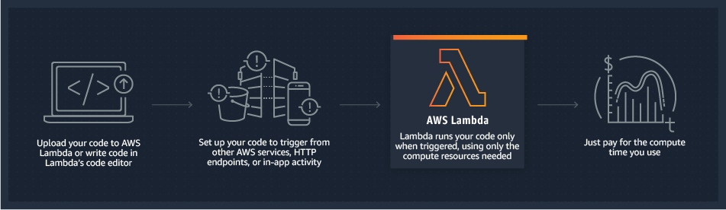
AWS Lambda: Deployment
(Image from https://lumigo.io/learn/aws-lambda-architecture/)

Slide 24
FaaS with Lambdas
“On demand” – only charged when code runs
Common applications: batch, stream processing, mobile apps, IoT
  IoT: Internet of Things: devices connected through network
Often used to provide APIs used by other apps
  Eg: proprietary stock predictor
  Controlled, relatively secured access to a service
Providers:
  First to come online (in 2014): AWS Lambda
  Very similar: Azure Functions, Google Cloud Functions, DigitalOcean Functions, etc.
  Open source solutions: IBM OpenWhisk, Oracle Cloud Fn
  Will cover just AWS Lambda
    Not the same as lambda functions in languages like Java, though has similarities
Notes:
IoT: Internet of Things – typically fridges, stoves, lights, trash, garage door: sensors and actuators connected through local network

Slide 25
Lambda
Code
  JSON
  JSON
Wins:
  “Serverless” – let Amazon do the maintenance
  Pay just for CPU time used, not paying for unused capacity
  Scales easily
  Cohesion, coupling?
Issues:
  15-minute processing cap – cannot use for (say) training AI models
  If lambda code makes a blocking call (such as to another lambda), will pay for the time it waits
    Should use Step Functions instead – discussed later
  Cold starts/latency: see next slide

Slide 26
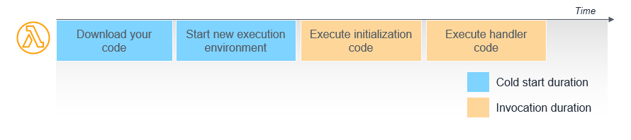
Lambda: cold starts & latency
Cold Start: time to set up a lambda
  AWS does keep a lambda in memory for a time after execution
  Until that timeout passes, there is no startup delay
Latency: time taken to compute results, including cold start time
  Variability in latency: frustrating for users
Partial Solution: provisional concurrency
  pay for guarantee that N versions will be warmed up at all times
  but this eats into the cost model: paying for execution only...
Notes:
Image from https://aws.amazon.com/blogs/compute/operating-lambda-performance-optimization-part-1/

Slide 27
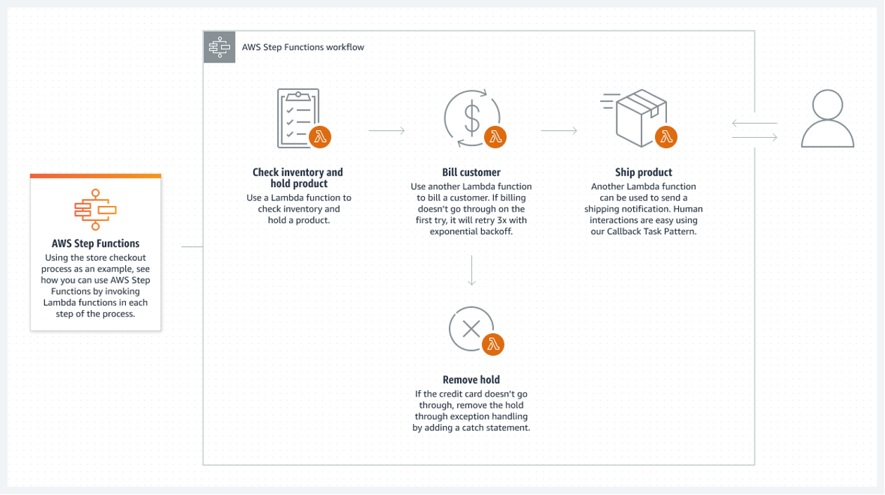
AWS Step Functions
Solves the problem of paying for lambdas to wait
Orchestrated microservices / managed workflows
System tracks workflow steps / application state
Ideal for capturing business logic

Slide 28
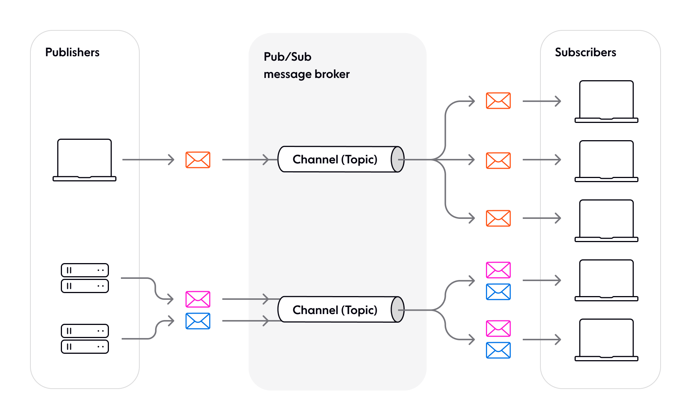
Additional Patterns
See https://ably.com/topic/pub-sub
There is a long list of cloud patterns; c.f. Microsoft
One that relates well to this course: Publisher/Subscriber
  Generally known as Pub/Sub
When not busy, message sent to subscriber
Each publisher sends
messages to a specific channel
Broker tracks subscribers, queues messages
Key: all subscribers get each message
Notes:
Image from the Ably site

Slide 29
Pub/Sub
What design pattern does this remind you of?
How is it similar?
How is it different
Notes:
Similar to Observer
Difference: this adds message queue to allow subscribers and publishers to operate at different speeds
The fact that there are multiple publishers is not a difference; that would just be using the Observer with multiple subjects

Slide 30
Recall: key issues for cloud developers
Most resources are virtual
  Virtual machine: a computer emulating another computer or computers
Must allow computers to go offline at any moment
  Allow for some machines to break because with enough of them, some will
Message transmission is not predictable
  Messages may arrive out of order, not at all, or many times
How does Pub/Sub address these?
Notes:
Discussion of virtual machines: https://azure.microsoft.com/en-us/resources/cloud-computing-dictionary/what-is-a-virtual-machine

Slide 31
How Pub/Sub addresses these issues
Most resources are virtual
Publishers, Subscribers are simple functions
True for any FaaS model!
Allow for computers to go offline
Loose coupling between publisher, subscriber
Message transmission not predictable
Queues!

Slide 32
Pub/Sub
Benefits:
Loose coupling between publisher, subscribers
Publisher not waiting on subscribers – asynchronous
Scales easily
Allows publishers and subscribers to be written in different languages

Slide 33
Pub/Sub
When not to use:
No need for scaling: otherwise, combine publishers and subscribers into 1 app
Have few components: otherwise, simply use a message queue
Streaming services: Pub/Sub introduces delays in message broker
If need synchronous communication (where clients send requests and expect a response in a well-defined time)
Notes:
https://ably.com/topic/pub-sub#when-should-you-use-the-pub-sub-pattern

Slide 34
Review
Cloud Computing: model for convenient, on-demand network access to a shared pool of configurable computing resources
Key cloud computing terms: VM, GET, POST, API Endpoint, JSON
Key issues for developers: virtual resources, design must allow for computer failures, message transmission is not predictable
FaaS/Lamba: serverless computing
  Load code which reads from JSON, returns JSON
  Pay for actual execution
  Need strategy for cold starts
Step Functions: similar to Lambda, but manager tracks state of system and sequences steps
Pub/Sub: Observer pattern with message queue
  Asynchronous, each queue can be processed by multiple clients (subscribers)
Next: Competing Consumers
Notes:
Most resources are virtual
Virtual machine: a computer emulating another computer or computers
Must allow computers to go offline at any moment
Allow for some machines to break because with enough of them, some will
Message transmission is not predictable
Messages may arrive out of order, not at all, or many times

Slide 35



Lab: Cloud Services
Lab this week: compute simple operations on large numbers
Five parts:
  Listener: POST problem to solve
  SQS: Queue items
  Process: compute results
  Database: store results
    Alternative: S3, but database better suited here
  List: list all results
Full application would return results
  We aren’t doing that to limit work
Listener
SQS
Process
DynamoDB
List
POST
GET
Notes:
SQS: Simple Queue Service

Slide 36
SQS: Simple Queueing Service
Listener
SQS
Process
DynamoDB
List
POST
You will set this up using AWS (it’s an AWS service)
Basically, take a number from the request, store it on the queue
Queue items are simple strings
For example, putting on x:
GET
  queueManager.sendMessage(String.valueof(x));

Slide 37
DynamoDB: Database
Listener
SQS
Process
DynamoDB
List
POST
We will cover databases in a later course
For this course, will just store, retrieve simple data
  Really, like writing to a file
We will not use query languages or other tools
Will get an item from the queue, compute a result, store it
Values are stored as hash maps:
  HashMap<String, AttributeValue> values = ...;
  Hash text and attribute value are both String objects
  values.put(“Num”, “42”); values.put(“IsPerfect”, “False”);
Store:
  database.putItem(TABLE_NAME, values);
GET

Slide 38
Getting data from database
ScanRequest scanRequest = new ScanRequest()
.withTableName(PrimeTestingHandler.TABLE_NAME);
ScanResult result = client.scan(scanRequest);
for (Map<String, AttributeValue> returned_item : result.getItems()) {
try {
if (returned_item != null) {
Set<String> keys = returned_item.keySet();
for (String key : keys) {
logger.info(String.format("%s: %s\n",
key, returned_item.get(key).toString()));
}
} else {
logger.error("No items found in the table "+PrimeTestingHandler.TABLE_NAME+"\n");
}
} catch (AmazonServiceException e) {
logger.error(e.getErrorMessage());
}
Connect
to DB
Retrieve all entries
For each entry…
Will simply read all entries
This logs results
Your version will return a table formatted into a string
Process all keys
Report no keys; do this in loop so clients cannot empty table just after finding table not empty
Handle fatal errors; in practice would do more than simply log
Notes:
Checking for empty items: this eliminates the case where the table gets filled, we check that the table is not empty, then another job deletes all entries just before this job tries to actually list the entries

Slide 39
Lab: Cloud Services
Key to getting lab to work: logs
Log every entry point, inputs
Log actions taken
Include version number
Lab this week: compute simple operations on large numbers
Five parts:
  Listener: POST problem to solve
  SQS: Queue items
  Process: compute results
  Database: store results
    Alternative: S3, but database better suited here
  List: list all results
Full application would return results
  We aren’t doing that to limit work
Listener
SQS
Process
DynamoDB
List
POST
How to make this scalable?
GET
Notes:
SQS: Simple Queue Service

Slide 40

Competing Consumer Pattern
Material adapted from https://medium.com/event-driven-utopia/competing-consumers-pattern-explained-b338d54eff2b
  Author: Dunith Danushka
Allows multiple consumers to “compete” for messages on the same channel
  Concurrent processing of messages
  Asynchronous
  Tasks distributed between consumers.
Goal: a scalable, reliable, resilient message processing system

Slide 41
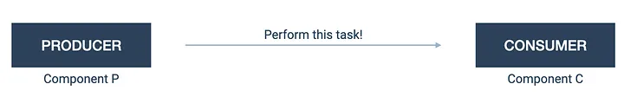
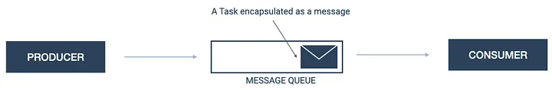
Competing Consumer Pattern
Goal:
Problem: implies synchronous communication
  Blocks all clients, tasks often take longer than HTTP allows
Solution:
Notes:
Having synchronous communication is frowned upon
P can’t be blocked until C completes
5 minute task exceeds http request window

Slide 42
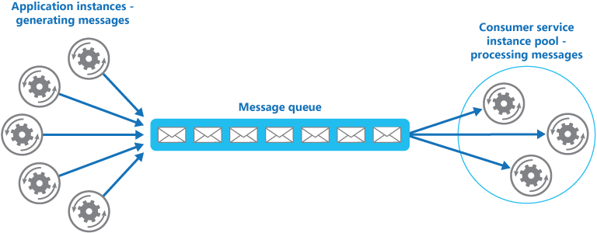
More complete solution:
Key element: only one consumer gets each message
This is different from Pub/Sub, where each message goes to all subscribers
Notes:
We have multiple instance of C competing for messages on the same queue
They will concurrently process more messages to drain the queue faster
Any of the consumers could potentially process any message

Slide 43
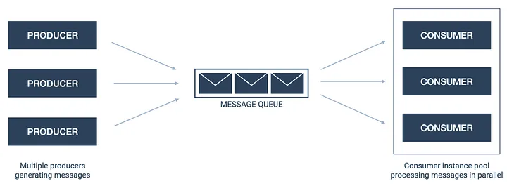
More complete diagram:
Notes:
We have multiple instance of C competing for messages on the same queue
They will concurrently process more messages to drain the queue faster
Any of the consumers could potentially process any message

Slide 44
Benefits
Scalability
  Easy to auto-scale number of (serverless) consumers based on length of queue
  Provides cost savings over non-FaaS solutions
Reliability
  Automatic buffering of messages if all consumers busy
  Messages not dropped
Resiliency
  If consumer fails, message returned to queue immediately

Slide 45
When to use
Need asynchronous tasks
  If producer needs result before continuing, just use synchronous communication
Tasks are independent (so can run in parallel)
  If consumer B depends on consumer A, use Step Functions or other pattern
Need scalability
Need resilience: robustness if consumer fails

Slide 46
Lab: Cloud Services
Solution: apply Competing Consumers
SQS: queue of jobs to do
Process: handling each item in queue
AWS Educator Limit: 2 processing tasks
Lab this week: compute simple operations on large numbers
Five parts:
  Listener: POST problem to solve
  SQS: Queue items
  Process: compute results
  Database: store results
    Alternative: S3, but database better suited here
  List: list all results
Full application would return results
  We aren’t doing that to limit work
Listener
SQS
Process
DynamoDB
List
POST
Goal: scalable
GET
Notes:
SQS: Simple Queue Service

Slide 47
Tracking values through the system
Client 1 posts a request for the GPF (greatest prime factor) of 51
Client 2 posts a request for 53
Listener adds 51 to queue
Listener adds 53 to queue
Process takes 51, computes its GPF as 17, adds 51/17 to database
Process takes 53, computes the GPF 53, adds 53/53 to database
Client invokes List
List returns the table “lpf(51):17, lpf(53):53”
Listener
SQS
Process
DynamoDB
List
POST
GET

