Slide 1
see https://www.oodesign.com/composite-pattern
SWE2410 Design and Cloud Patterns
Dr. Rob Hasker (based on slides by Dr. Mark Hornick)
13. Composite Pattern
Notes:
1

Slide 2
Composite Pattern context
Graphics drawing
Render graphic primitives (e.g. lines, rectangles, ellipses,…)
Also subdrawings: groups of primitives translated, rotated, or scaled as a unit
User-Interface Menus
A menu: multiple menu items.
Each menu item can in turn be a menu (sub-menu).
Generally, any application implementing a hierarchical structure
A object can contain many sub-objects
Each sub-object can in turn contain an object.
Q: Do any JavaFX classes implement a similar hierarchy???
Notes:
2

Slide 3

The Composite Pattern is applied in situations involving object hierarchies
The problem
A collection of objects forms a hierarchy
Each object may be
An individual (primitive, leaf, or part) object
A composition of other objects (composite)
We want to treat all objects uniformly
No special treatment (if, instanceof) for composite objects (sub-drawings or sub-menus)
Solution
Compose objects into recursive tree structures via the Composite Pattern
Notes:
3

Slide 4
Composite Pattern: compose objects into tree structures to represent part-whole hierarchies
aComposite
aPart
aPart
aComposite
aPart
Goal: be able to treat composites in the same way as parts
aPart
aPart
aPart

Slide 5
Example
Goal: construct computer
Classic CS solution: divide and conquer
Treat it as a hierarchy of components
Composite units are collections of parts + composites
computer
part
composite
keyboard
monitor
System Unit
Fan
HDD
Cabinet
part
Chassis
CPU
Memory
GPU
Motherboard
Notes:
5

Slide 6
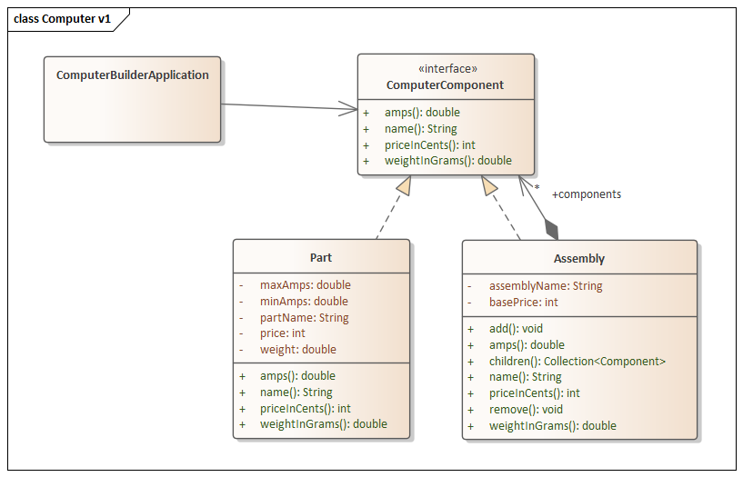
Composite Pattern class diagram
ClientApp uses the ComputerComponent Interface to compute assembly price, weight, etc.
ComputerComponent defines an interface (or abstract class) for all objects: both Leaf and Composite
There may be variations in the names of the add(), remove(), and children() methods
A Part has no children
Assembly: collection of computer components – components with children.

Slide 7
Component: interface to parts and assemblies
interface ComputerComponent {
String name();
int priceInCents();
double weightInGrams();
double amps();
}
public class Part implements ComputerComponent {
private String partName;
private int price;
private double weight;
private double minAmps, maxAmps;
Part(String name, int price, double weight,
double minAmps, double maxAmps)
{ … set items …}
public String name() { return partName; }
public int priceInCents() { return price; }
public double weightInGrams() { return weight;}
public double amps() {
return (minAmps + maxAmps) / 2.0;
}
}
Clearly could be an abstract class as well..

Slide 8
public class Assembly implements ComputerComponent {
private String assemblyName;
private int basePrice;
private Collection<Component> components;
Assembly(String name, double basePrice) {
components = new ArrayList<Component>();
}
String name() { return assemblyName; }
// essential Composite behaviors:
public void add(Component c) {
components.add(c);
}
public void remove(Component c){
components.remove(c);
}
public List<Component> getChildren() { return components; }
// continued next slide

Slide 9
...public class Assembly implements ComputerComponent {
// ...continued from previous slide
// context-specific behavior
public int price() {
double compositePrice = basePrice;
for(ComputerComponent c: components) {
compositePrice += c.price();
}
return compositePrice;
}
… see code in demo folder (especially main)
Issue: differences between part and composite: part has no
add, remove, getChildren methods – not really the same!

Slide 10
public class Part implements ComputerComponent { // Part is a “Leaf”
private String name;
private double price;
Part(String name, double price) {
this.name = name;
this.price = price;
}
// Composite-related behaviors
public void add(Component c) {
// what should we do here??
// do nothing? Throw exception? Return a true/false?
}
public void remove(Component c){
// same as above; what should we do here?? }
public Collection<Component> getChildComponents() { // alternatives:
// Throw an exception?
// Return a null?
// return Collections.EMPTY_LIST; }
}

Slide 11
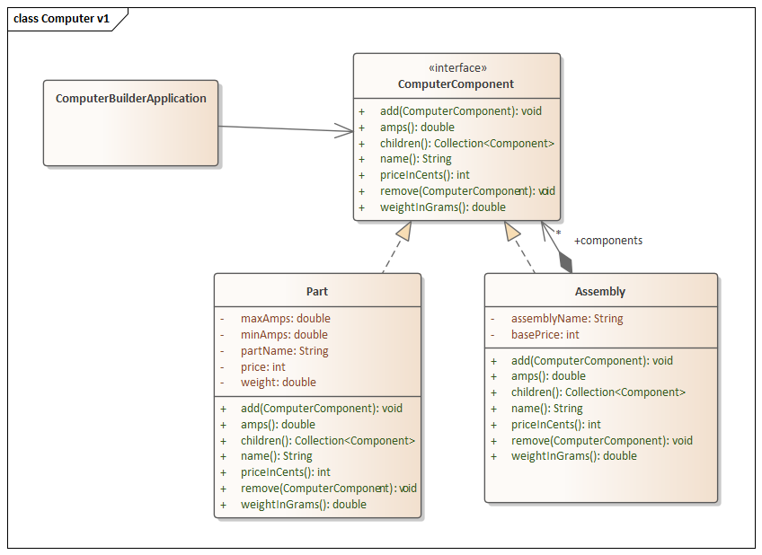
ALTERNATIVE: “Transparent” composite
A part/leaf can have no children; methods like add(), remove() don’t make sense for this class, but are still inherited from Component .

Slide 12
Liskov Substitution Principle
if S is a subtype of T, then objects of type T may be replaced with objects of type S (i.e. an object of type T may be substituted with any object of a subtype S) without altering any of the desirable properties of the program (correctness, task performed, etc.).
Positive example:
class LinkedList<String> extends Collection<String>
Negative: class Stack<String> extends Vector<String>
Allows calling indexOf(), sort() on stacks
Notes:
quote from Wikipedia

Slide 13
Alt approach: include composite behavior in components
interface ComputerComponent { // behaviors for Part and Composite
void add(Component c);
void remove(Component c);
List<Component> getChildren();
public abstract double price(); // Part-specific
... <other Part behaviors>
}
Q: Should/can Component be defined as an Interface rather than an Abstract Class?

Slide 14
public class Assembly implements ComputerComponent {
private String name;
private double basePrice;
private List<Component> components;
Assembly(String name, double basePrice) {
components = new ArrayList<Component>();
}
// essential Composite behaviors:
public void add(Component c) {
components.add(c);
}
public void remove(Component c){
components.remove(c);
}
public List<Component> getChildren() { return components; }
// continued next slide

Slide 15
...public class Composite implements Component {
// ...continued from previous slide
// context-specific behavior
public double price() {
double compositePrice = price;
for(Component c: components) {
CompositePrice += c.getPrice();
}
return compositePrice;
}

Slide 16
public class Part implements ComputerComponent { // Part is a “Leaf”
private String name;
private double price;
Part(String name, double price) {
this.name = name;
this.price = price;
}
// Composite-related behaviors
public void add(Component c) {
// what should we do here??
// do nothing? Throw exception? Return a true/false?
}
public void remove(Component c){
// same as above; what should we do here?? }
public Collection<Component> getChildComponents() { // alternatives:
// Throw an exception?
// Return a null?
// return Collections.EMPTY_LIST; }
}

Slide 17
Consequences
Defines class hierarchy
Leafs(Parts), Composites
Composite may replace Leaf/Part in any client operation
Simplifies client
No special treatment for Composites vs Parts – every object can simply be treated as a Component
Clients don’t know (don’t care) whether they are dealing with Leaf/Part or Composite.
The specific type of object is transparent
Easy to add new Component types
Just add new derived class
No client changes needed
Notes:
17

Slide 18
Consequences
Concern:
Two, very different responsibilities in one class
A Component defines both Part and Composite behavior
Also, a Part cannot logically support certain behaviors (add, remove, getChildren)
…or can we just look at a Part as a Composite with no children???
At any rate, type safety is compromised
Composite Pattern represents a classic tradeoff
Trading transparency for type safety
Notes:
18
This violates LSP

