Slide 1
Teaching Basic Class Diagram Notation With UMLGrader
Robert W. Hasker
Yan Shi
ASEE, 2014
Milwaukee School of Engineering
University of Wisconsin – Platteville

Slide 2
The traditional way to teach UML
Large, open-ended problems
Students expected to apply learned notation
Often: assigned to groups
Challenges:
Student may miss opportunities to apply key notation
Lengthy turnaround times for grading

Slide 3
The traditional way to teach UML
Large, open-ended problems
Students expected to apply learned notation
Often: assigned to groups
Challenges:
Student may miss opportunities to apply key notation
Lengthy turnaround times for grading
How well is this working?

Slide 4
Exam problem, junior-level SE course
Snow removal drivers have routes, assigned trucks
Each route has one driver
Two types of trucks: dump trucks and snow plows
A route = sequence of street segments
A street: name + sequence of segments
Segment: defined by the crossing streets at each end

Slide 5
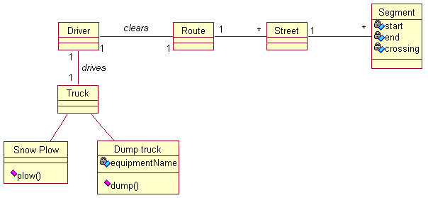
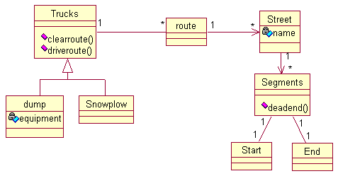
Sample solutions

Slide 6
Sample solutions
X

Slide 7
Sample solutions
X
X

Slide 8
Sample solutions
Score | Count | +/- Class
4 | 1
3.5 | 1
3 | 5
2.5 | 4
2 | 6 | 3
1.5 | 13 | 7
1 | 7 | 4
X
X

Slide 9
Sample solutions
Score | Count | +/- Class
4 | 1
3.5 | 1
3 | 5
2.5 | 4
2 | 6 | 3
1.5 | 13 | 7
1 | 7 | 4
X
X
Prereqs:
Intro to SE
CS1/CS2
Half: OOA&D

Slide 10
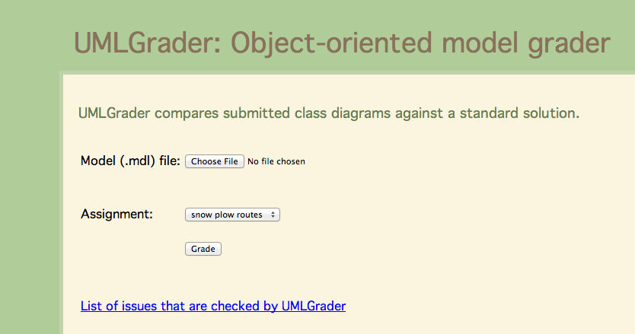
Solution: tool to compare solutions
At http://member.acm.org/~hasker

Slide 11
Example

Slide 12
Example
Errors for
class names

Slide 13
Example
Association errors
Errors for
class names

Slide 14
Example
Association errors
Errors for
class names
Attribute errors

Slide 16
Lab exercise
Students given problem statement, asked to draw
34 of 37 students able to match with no errors
Help: explained roles vs. association names, specifying role names, specifying multiplicities

Slide 17
Matching rules
Match names,
ignoring spaces
Can specify alts
Missing attribute
Attributes, operations: match substrings

Slide 18
Matching rules
Exact match on class names allows catching errors with plurals
When specified, multiplicities must match
Match associations by role name, then multiplicities

Slide 19
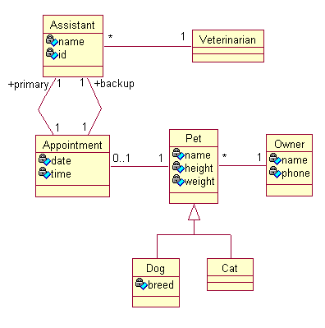
Exam 2, upper level class
Problem:

Slide 20
Exam 2, upper level class
Problem: Results:
Score | Exam 1 | Exam 2
4 | 1 | 3
3.5 | 1 | 17
3 | 5 | 10
2.5 | 4 | 5
2 | 6 | 2
1.5 | 13 | 0
1 | 7 | 0
Ave: | 1.92 | 3.19
σ | 0.78 | 0.50

Slide 21
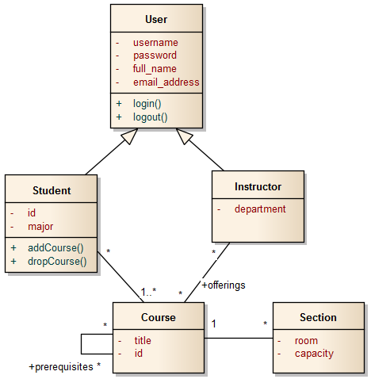
Evaluation: Intro to Software Eng.
Sophomore-level
Introduces UML about half-way through semester
After introduction: quiz using course registration system
Average score out of 10 points: 6.46

Slide 22
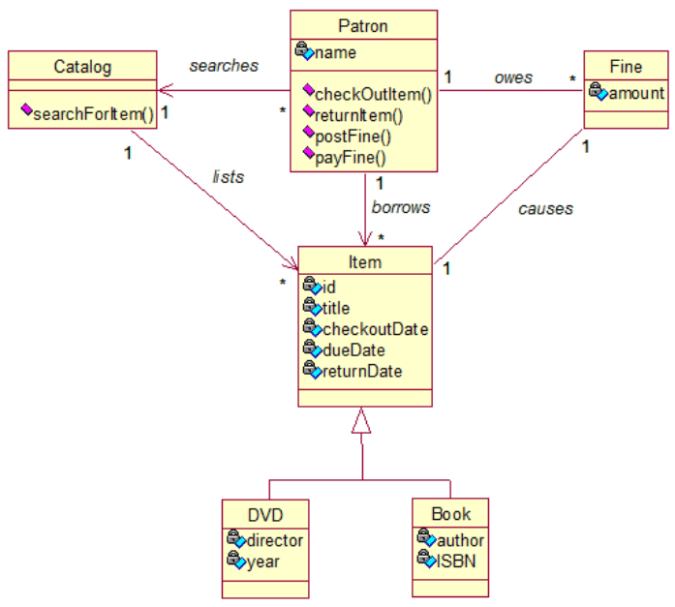
Intro to SE exercise
Diagram:

Slide 23
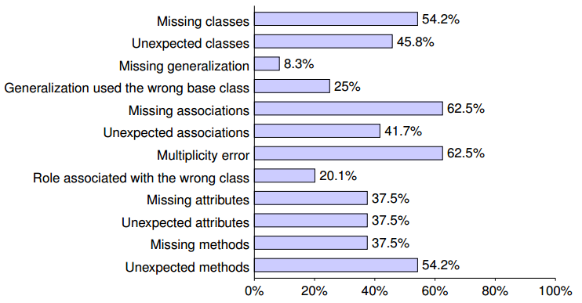
Intro to SE exercise
Diagram:
- Errors Encountered

Slide 24
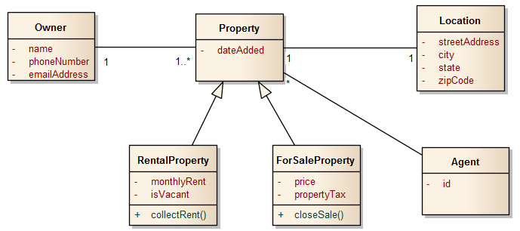
Intro to SE: Exam question
Real estate problem:
 | Count | Mean | σ
Quiz | 25 | 6.46 | 1.88
Exam | 25 | 8.30 | 1.20
Student’s t-test: Significant improvement
w/ t value 5.68, p < .001 (23 dof)

Slide 25
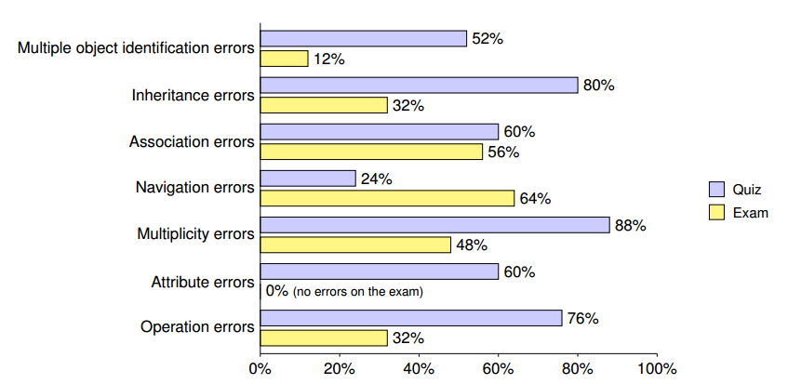
Intro to SE: Exam errors by type

Slide 26
Intro to SE: Exam question
Real estate problem:

Slide 27
What can we conclude?
Proposal: using exercises to teach UML notation:
Students given description for constrained problem
UMLGrader compares solution against model solution
Students iterate until no errors
Evaluation methodology has limits
Clear issue: what would happen with no lab at all?
But experience suggests this is not working!
Recall first evaluation done in a course with multiple prereqs!
Evidence for experimentation
Radical suggestion: teaching UML notation through worksheet-like exercises

Slide 28
UMLGrader status
Available via http://member.acm.org/~hasker
Supports Rational Rose, IBM Rhapsody
Instructor can control which checks are applied
Contact me to set up an exercise
Available by September:
Support for Enterprise Architect
Similar comparisons for state diagrams
In the works
Interface for other instructors to upload, modify assignments
Adding checks on named associations, navigability, containment, types
Checking sequence diagrams

Slide 29
Thanks
Thanks to the ASEE SE reviewers for a number of very helpful suggestions for improvements.

