Slide 1
2. Strategy, Adapter Patterns
Strategy: Ch. 9
Adapter: Ch. 7
SWE 2410 Design and Cloud Patterns
Dr. Rob Hasker
Notes:
Ch. 9 of Design Patterns Explained (Strategy); Singleton: Ch. 21, but not material on double-locked
OLD:
Ch. 22 of Java Design Patterns
Reference to “Program to interfaces rather than implementations” in Software Design Principles

Slide 2
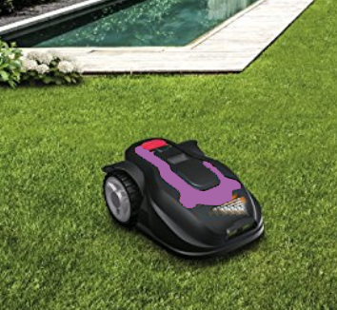
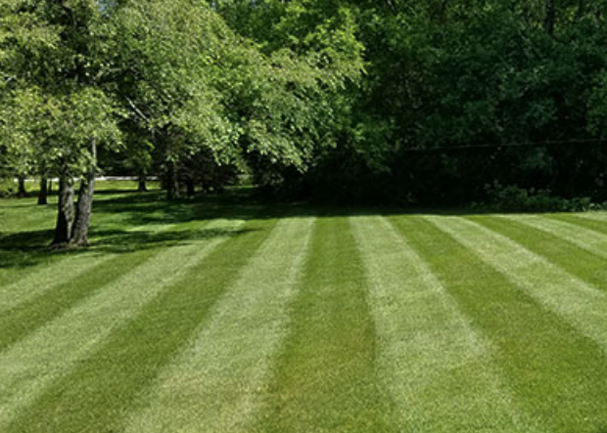
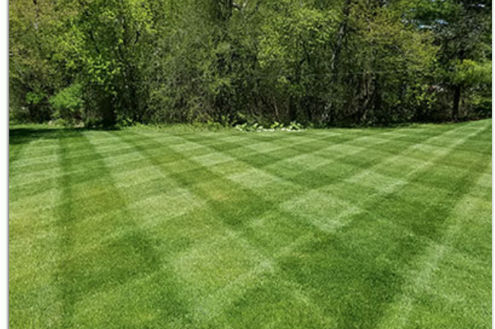
Grassba
Goal: automatically mow your lawn
Issue: need to support different patterns
Classic solution: if statement
Notes:
Maybe you don’t care, but lots of people do!

Slide 3
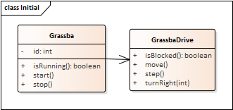
public class GrassbaDrive {
public void move() {
step();
if ( blocked() ) {
if ( style == STRIP )
turnRight(180);
else if ( style == CROSS )
turnRight(90);
else
turnRight(random(180));
}
}
public void turnright() {...}
…
}
But what about more interesting patterns?
What if need to store pattern-specific information?
What if there are large numbers of patterns?
Notes:
Other patterns to suggest: stars, pictures of people, a picture of grassba mowing a lawn

Slide 4
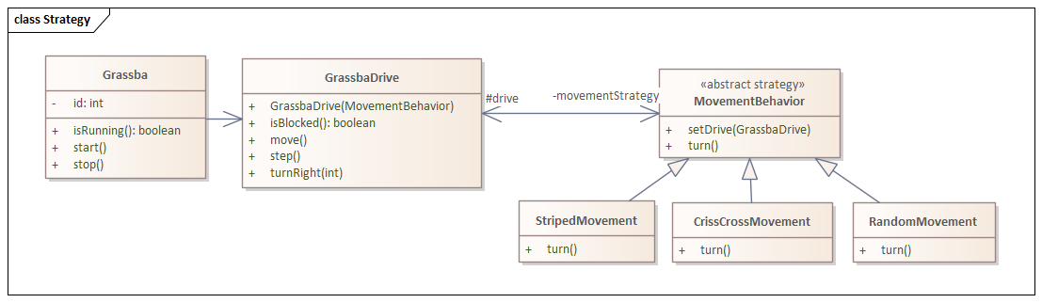
Solution: write a class
public class GrassbaDrive {
private MovementBehavior movementStrategy;
public GrassbaDrive(MovementBehavior s) {
movementStrategy = s;
movementStrategy.setDrive(this);
}
public void move() {
step();
is ( isBlocked() )
movementStrategy.turn();
}
public void turnRight() { … } …
}
public class StripedMovement extends MovementBehavior {
…
public void turn() {
drive.turnRight(180);
}
}
Strategy Pattern: Ch. 14 of Design Patterns Explained
Notes:
Note # indicates an attribute is protected – this is particularly important for the drive

Slide 5
public class CrissCrossMovement extends MovementBehavior {
…
public void turn() {
drive.turnRight(90);
}
}
public class RandomMovement extends MovementBehavior {
…
public void turn() {
drive.turnright(random(180));
}
}

Slide 6
Using the strategies:
GrassbaDrive stripedDrive = new GrassbaDrive(new StripedMovement());
GrasbaDrive randDrive = new GrassbaDrive(new RandomMovement());
// recall the GrassbaDrive constructor:
public GrassbaDrive(MovementBehavior s) {
movementStrategy = s;
movementStrategy.setDrive(this);
}
Why do we need this line?
But what problems does it create?
Notes:
Need the reference back to the container because the movement will depend on sensors, actuators on the Grassba
But needing a reference to the container SIGNIFICANTLY reduces reusability.

Slide 7
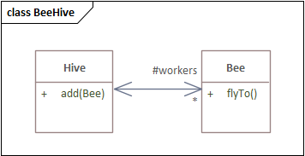
Containers and elements
Class Hive {
protected List<Bee> workers;
public void add(Bee b) { workers.add(b); }
…
}
class Bee {
protected Hive myHive;
public Bee(Hive h) { myHive = h; }
…
}
Sensible?
  Sure: bees live in hives
  But consider:
  Bee drone = new Bee(null);
  Drone (male) bees wander
  Effectively need new class for bees that are not in a hive
General issue:
  If element has reference to container, can only use with that container
  This makes reusing the class much harder
  An example of tight coupling
Principle: Avoid having elements refer to their containers
Notes:
Programmers are used to using null for something like a non-existent hive, but it means we are not reflecting the domain!
If the distinction is truly important, create drone-specific classes, but then need worker class; maybe the rule “all bees have hives” is getting in the way of development!

Slide 8
Using the strategies:
GrassbaDrive stripedDrive = new GrassbaDrive(new StripedMovement());
GrasbaDrive randDrive = new GrassbaDrive(new RandomMovement());
// recall the GrassbaDrive constructor:
public GrassbaDrive(MovementBehavior s) {
movementStrategy = s;
movementStrategy.setDrive(this);
}
In this case, strategy must be tightly coupled with GrassbaDrive, so rule violation is ok
Notes:
Need the reference back to the container because the movement will depend on sensors, actuators on the Grassba

Slide 9
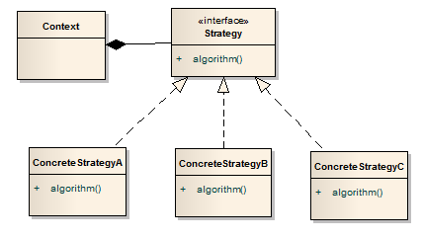
General form
Is there a preference for interfaces over abstract classes?
Elements:
Context: class that encapsulates, uses specific behavior
Strategy: interface that defines the behavior
ConcreteStrategy: implements a specific behavior

Slide 10
When to use the Strategy pattern?
Strategy pattern: a behavioral pattern
  Captures run-time behavior
  Indicator: application requires similar objects whose behavior varies
  But is there another way to capture the different behavior?

Slide 11
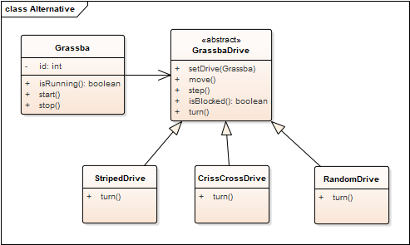
Alternative to Strategy pattern
Have an abstract base class with alternatives
But what happens if add gas engine/electric motor option?

Slide 12
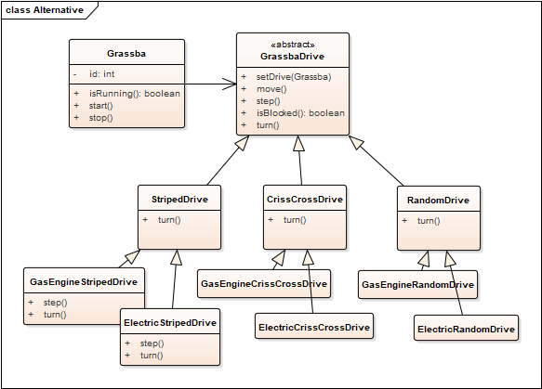
Alternative to Strategy pattern
Have an abstract base class with alternatives
But what happens if add gas engine/electric motor option?
In general: significant code duplication, too many overrides
What is this like with Strategy?
Inheritance simpler in some cases,
strategy pattern better in others.

Slide 13
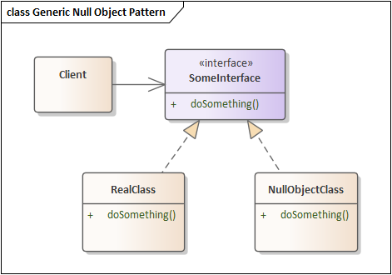
Null Object pattern, reconsidered
How are the Strategy, Null Object patterns similar?
How are they different?
Notes:
A significant part of the course: identify problems and solve those problems using (design) patterns

Slide 14
Exercise
Find cases in which the strategy pattern is used in the Java API
  Especially: JavaFX
Create an example where the strategy pattern is useful in Java FX application code
Notes:
javafx.scene.chart
java checkedinputstream, checkoutputstream

Slide 15

Review
Strategy pattern
  Problem?
  Solution?
  Advantages?
  Consequences?
Principle at work:
  Program to an interface, not an implementation
    Software Design Principles, Ch. 3
    For example, write methods/classes that take Collection<E>, not (say) ArrayList<>
  What does this mean in general?
  Does the Strategy Pattern have more to it than programming to an interface?
  When did you program to an interface in CS 2852 (Data Structures)?

Slide 16
UML details for Null Object Pattern
Recall UML notation:
  0..1: StereoController has 0 or 1 Equalizers
  Equalizer: has multiple Level objects
  StereoController has reference to a Volume object
Implied multiplicity: 1
Drop role name if obvious
Not documenting constructors; little additional information
Don’t list attribute if have association
Minimal clutter!
Notes:
A significant part of the course: identify problems and solve those problems using (design) patterns

Slide 17
Pattern #3
Scenario:
  System built around a class by Vendor1
    Purchased when build application
  Vendor1 goes out of business, and you need an update
  Will replace by Vendor2’s library
Existing
Application
Vendor1 Classes
Vendor1 interface

Slide 18
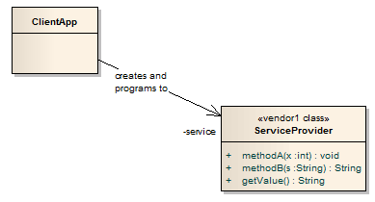
Original Configuration
Vendor2: similar class, but new interface
Change all the calls to methodA, etc?
Assumption: ClientApp is heavily dependent on ServiceProvider
many calls to various ServiceProvider methods.
Commonly, ServiceProvider implements numerous methods (more than shown here)
Notes:
Issue: it’s often not just the method names, but rules on the order they were applied

Slide 19
Solution: Adapter (Wrapper) Pattern
Adapter
  Implements the interface your classes expect
  Uses the vendor interface to service your requests.
Existing
Application
Vendor2 Classes
Adapter
Textbook Ch. 7

Slide 20
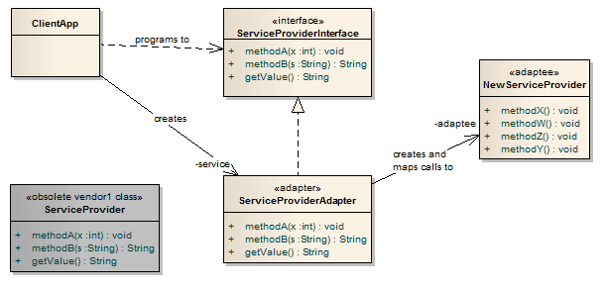
Applying Adapter
4. An adapter class is written
which maps calls from the
original methods to the
new methods
2. An interface declaring
the same methods as
the original
ServiceProvider
is created.
Client MUST use this interface!
1. The original ServiceProvider class is obsolete and discarded
3. A replacement class for the original
ServiceProvider is found that provides
similar functionality but with a
Different set of methods – the adaptee

Slide 21
The Adapter Pattern features
Note client calls original method
That method delegates to the new service provider
Typically: the implementation of methodA will be short
  simply call one or two methods in NewServiceProvider
However, may have a complex interface
  may need to construct additional information
  Example: making a 3-D character move on a screen
Result from adaptee: must translate back to the results expected by the client
Only changes to the clients:
  Declare variables using the interface type
  Create instance(s) of the adapter instead of the original vendor

Slide 22
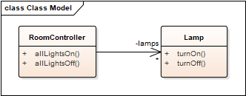
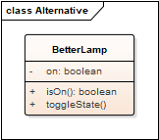
Example: lighting a room
Delivered system:
What to do if replace Lamp by BetterLamp?
Notes:
Solution (may have compilation errors!):
public class LampInterface { void turnOn(); void turnOff(); }
public class LampAdapter extends LampInteface {
private BetterLamp lamp = new BetterLamp();
public void turnOn() { if ( ! lamp.isOn() ) lamp.toggleState(); }
public void turnOff() { if ( lamp.isOn() ) lamp.toggleState(); }
}

Slide 23
When to use Adapter
Legacy code which interfaces to a class library that has changed
  Changes might include versions, vendors, new requirements
New application
  Interfaces with known third-party library
  That library not yet defined
  Isolate the problem!
  Define an interface, write the adapter later

Slide 24
Adapter: a structural design pattern
Captures relationships between classes
Reduces the dependencies between classes
  Traditional solution: rewrite existing code to meet new need
  What if we need the original code for another system?
  Clone the code?
When copy/paste is your design strategy, you’ve lost
  Don’t repeat yourself (DRY), again!

Slide 25
Adapter as a design pattern
What is an alternative name?
  Wrapper
When to apply?
  That is, what problem is being solved?
Describe the application to a neighbor (in generic terms)
  Draw a class diagram!
What are the advantages?
What are the shortcomings?
  Not: more classes – we’ve only introduced a couple; lost in the noise
    All patterns introduce new classes; only significant if create large numbers
  Overhead for delegation calls
  It’s less obvious what an adapter method call does
Notes:
The “more classes” is always true and uninteresting unless it is a LOT more classes or very high performance requirements

Slide 26
What we’ve accomplished
The Adapter pattern has solved a big issue: how to disassociate two pieces of code that are likely to change
Our goal: isolate components that change
Question: should we always use an interface class?
  Why might we want an abstract class instead?
Notes:
abstract classes: allow non-final fields, concrete methods

Slide 27
Application
Working in teams of two, apply the adapter pattern to a queue:
  Download se2811/samples/SimpleLinkedList.java
  Download se2811/samples/SimpleQueue.java
  Use IntelliJ to build, run both
  Download se2811/samples/GenericQueue.java
  Create LinkedQueue.java with the same test main as SimpleQueue.java but using SimpleLinkedList instead of ArrayList.
  If instructed, upload LinkedQueue.java to Canvas.

Slide 28
Review
Design patterns
Null Object Pattern, revisited
Adapter: adapt existing software to new classes
  Provide flexibility if don’t have details for a critical class early in the project

Slide 29
Design Patterns
Generally: solving maintenance problems
  Course goal: make maintenance easier
  Why?
Each pattern:
  Problem statement: what problem is being solved
    How maintenance improved
  Name: allows communication
  Solution: class design
  Advantages – what is improved in the design
  Shortcomings – negatives of using the pattern
Reusing approaches, not specific code or algorithms
Notes:
Why? Successful systems get used, used systems result in requests for changes.

Slide 30
Patterns of patterns
What patterns have we looked at?
  Null Object, Adapter, Strategy, Singleton
  Will cover many more
  Is there a way to organize them?
Singleton: based on how objects are created
Strategy: how objects behave at run time
Adapter: the structure of objects/classes
Null Object: doesn’t quite fit in any of the 3 primary categories
  Probably closest to behavioral
Will look at more examples in each category
Common feature: all reduce coupling between classes, increase cohesion within classes
Notes:
Will discuss cohesion, coupling further

