Slide 1
2. Strategy Pattern
Ch. 9
SWE 2410 Design and Cloud Patterns
Dr. Rob Hasker
Notes:
Ch. 9 of Design Patterns Explained (Strategy)

Slide 2
git review
Tool used for almost all labs in this course
Assumption: used git with IntelliJ in your first course
Basic model (as used by us):
“Primary” copy of git repository on GitHub
Your machine: a local copy that you edit
We copy from GitHub for grading
GitHub
Your machine
Notes:
But first, a git review

Slide 3
git
clone
commit
GitHub
Your machine
pull
push
Clone: make initial copy of repository on local machine
Pull: Pull changes from host (GitHub), update local
Commit: Copy changes from files to local git database
Push: Push changes to host
If there are changes on the host when pull, git merges them in
  If cannot do automatically, get a merge conflict
Basic steps: clone repo, make changes, commit the changes, push
  Recommendation: push frequently – it’s a backup mechanism!
  When in groups, pull frequently as well to avoid conflicts!
Notes:
IntelliJ:

Slide 4
git
clone
commit
GitHub
Your machine
pull
push
IntelliJ: New > Project from Version Control
IntelliJ: Git > Update Project…
Clone: make initial copy of repository on local machine
Pull: Pull changes from host (GitHub), update local
Commit: Copy changes from files to local git database
Push: Push changes to host
If there are changes on the host when pull, git merges them in
  If cannot do automatically, get a merge conflict
Basic steps: clone repo, make changes, commit the changes, push
  Recommendation: push frequently – it’s a backup mechanism!
  When in groups, pull frequently as well to avoid conflicts!
IntelliJ: Git > Commit…
IntelliJ: Git > Push…
Notes:
IntelliJ:

Slide 5
git keys
clone
commit
GitHub
Your machine
pull
push
Commit, push often!
  It backs up your work in case your machine fails
  It gives others a chance to merge their work with yours
  You will not forget to push later
Pull often!
  Frequent merges are easier
Solution to many problems: check out new location
  Solve most difficult merge conflicts by copying changes to that location
  Build from new location to make sure your final commit is actually working
Recommendation: type git status in IntelliJ Git terminal
Note: don’t use branches in this class!
Save them for large, multi-person, multi-sprint projects
Notes:
IntelliJ:

Slide 6
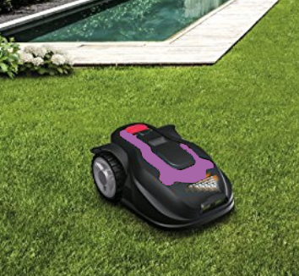
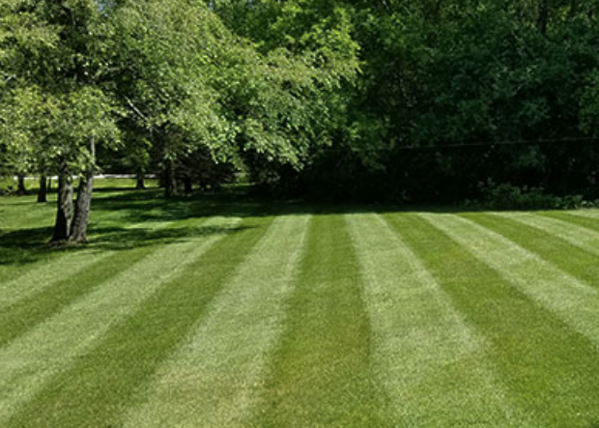

Grassba
Goal: automatically mow your lawn
Issue: need to support different patterns
Classic solution: if statement
Notes:
Maybe you don’t care, but lots of people do!

Slide 7
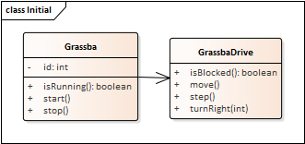
public class GrassbaDrive {
public void move() {
step();
if ( blocked() ) {
if ( style == STRIP )
turnRight(180);
else if ( style == CROSS )
turnRight(90);
else
turnRight(random(180));
}
}
public void turnright() {...}
…
}
But what about more interesting patterns?
What if need to store pattern-specific information?
What if there are large numbers of patterns?
Notes:
Other patterns to suggest: stars, pictures of people, a picture of grassba mowing a lawn

Slide 8
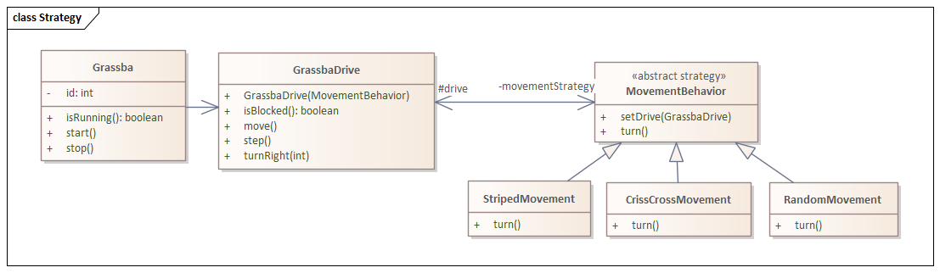
Solution: write a class
public class GrassbaDrive {
private MovementBehavior movementStrategy;
public GrassbaDrive(MovementBehavior s) {
movementStrategy = s;
movementStrategy.setDrive(this);
}
public void move() {
step();
is ( isBlocked() )
movementStrategy.turn();
}
public void turnRight() { … } …
}
public class StripedMovement extends MovementBehavior {
…
public void turn() {
drive.turnRight(180);
}
}
Notes:
Note # indicates an attribute is protected – this is particularly important for the drive

Slide 9
public class CrissCrossMovement extends MovementBehavior {
…
public void turn() {
drive.turnRight(90);
}
}
public class RandomMovement extends MovementBehavior {
…
public void turn() {
drive.turnright(random(180));
}
}

Slide 10
Using the strategies:
GrassbaDrive stripedDrive = new GrassbaDrive(new StripedMovement());
GrasbaDrive randDrive = new GrassbaDrive(new RandomMovement());
// recall the GrassbaDrive constructor:
public GrassbaDrive(MovementBehavior s) {
movementStrategy = s;
movementStrategy.setDrive(this);
}
Notes:
Need the reference back to the container because the movement will depend on sensors, actuators on the Grassba
But needing a reference to the container SIGNIFICANTLY reduces reusability.

Slide 11
Using the strategies:
GrassbaDrive stripedDrive = new GrassbaDrive(new StripedMovement());
GrasbaDrive randDrive = new GrassbaDrive(new RandomMovement());
// recall the GrassbaDrive constructor:
public GrassbaDrive(MovementBehavior s) {
movementStrategy = s;
movementStrategy.setDrive(this);
}
Why do we need this line?
We’ll need to look at it more closely...
Notes:
Need the reference back to the container because the movement will depend on sensors, actuators on the Grassba
But needing a reference to the container SIGNIFICANTLY reduces reusability.

Slide 12
Is this approach useful elsewhere?
How did classes help for lawn mowing?
Starting point: had a complex routine capturing multiple solutions to a problem
Improvement: move each solution to its own class
Issue: how would I explain using this to other developers?
  Needs a name
  Needs diagrams to help describe the change
But why do it?
  Need to know when approach applies, what are the consequences

Slide 13
Design Patterns
Goal: identify common design solutions
  Not algorithms, but structure
A pattern for pattern
  Name
  Problem?
  Solution?
  Advantages?
  Consequences?
Strategy Pattern
  Problem: if statement with many independent branches
  Solution: move each branch to its own class
  Advantage: replace if statement – simpler model, easier to test
  Consequence?

Slide 14
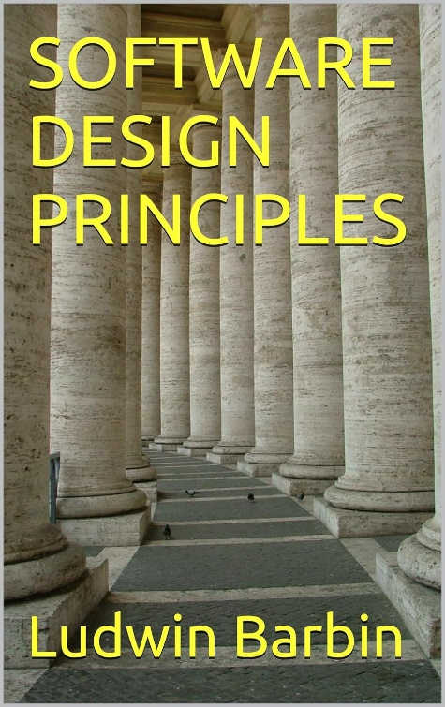
Review
Not required!
But could be useful…
Strategy pattern
  Problem?
  Solution?
  Advantages?
  Consequences?
Principle at work:
  Program to an interface, not an implementation
    Software Design Principles, Ch. 3
    For example, write methods/classes that take Collection<E>, not (say) ArrayList<>
  What does this mean in general?
  Does the Strategy Pattern have more to it than programming to an interface?
  When did you program to an interface in CS 2852 (Data Structures)?

Slide 15
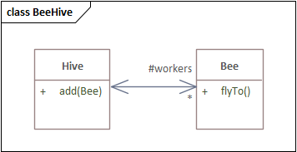
Containers and elements
Class Hive {
protected List<Bee> workers;
public void add(Bee b) { workers.add(b); }
…
}
class Bee {
protected Hive myHive;
public Bee(Hive h) { myHive = h; }
…
}
Sensible?
  Sure: bees live in hives
  But consider:
  Bee drone = new Bee(null);
  Drone (male) bees wander
  Effectively need new class for bees that are not in a hive
General issue:
  If element has reference to container, can only use with that container
  This makes reusing the class much harder
  An example of tight coupling
Principle: Avoid having elements refer to their containers
Notes:
Programmers are used to using null for something like a non-existent hive, but it means we are not reflecting the domain!
If the distinction is truly important, create drone-specific classes, but then need worker class; maybe the rule “all bees have hives” is getting in the way of development!

Slide 16
Using the strategies:
GrassbaDrive stripedDrive = new GrassbaDrive(new StripedMovement());
GrasbaDrive randDrive = new GrassbaDrive(new RandomMovement());
// recall the GrassbaDrive constructor:
public GrassbaDrive(MovementBehavior s) {
movementStrategy = s;
movementStrategy.setDrive(this);
}
In this case, strategy must be tightly coupled with GrassbaDrive, so rule violation is ok
Notes:
Need the reference back to the container because the movement will depend on sensors, actuators on the Grassba

Slide 17
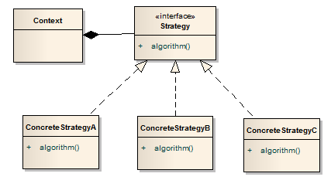
General form
Is there a preference for interfaces over abstract classes?
Elements:
Context: class that encapsulates, uses specific behavior
Strategy: interface that defines the behavior
ConcreteStrategy: implements a specific behavior

Slide 18
When to use the Strategy pattern?
Strategy pattern: a behavioral pattern
  Captures run-time behavior
  Indicator: application requires similar objects whose behavior varies
  But is there another way to capture the different behavior?

Slide 19
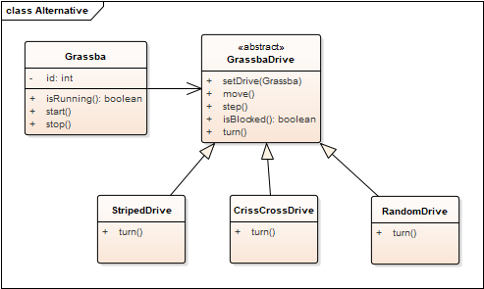
Alternative to Strategy pattern
Have an abstract base class with alternatives
But what happens if add gas engine/electric motor option?

Slide 20
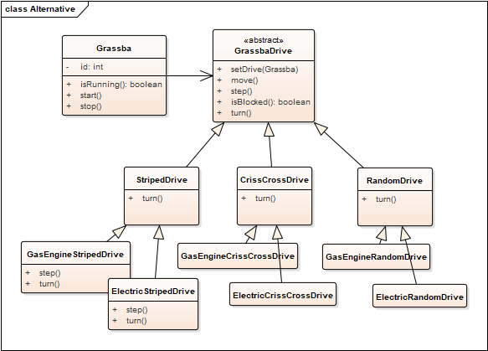
Alternative to Strategy pattern
Have an abstract base class with alternatives
But what happens if add gas engine/electric motor option?
In general: significant code duplication, too many overrides
What is this like with Strategy?
Inheritance simpler in some cases,
strategy pattern better in others.

Slide 21
Design Patterns
Observations from the Strategy Pattern:
Patterns generally improve structure
But they can also introduce structural problems
We need a way to talk about structure – advantages and disadvantages
Next: more on identifying classes, problems with various class structures
Generally: solving maintenance problems
  Course goal: make maintenance easier
  Why?
Each pattern:
  Problem statement: what problem is being solved
    How maintenance improved
  Name: allows communication
  Solution: class design
  Advantages – what is improved in the design
  Shortcomings – negatives of using the pattern
Reusing approaches, not specific code or algorithms
Notes:
Why? Successful systems get used, used systems result in requests for changes.

