Slide 1
5. Decorator
Reading: Design Patterns Explained, Ch. 17
SWE2410 Design and Cloud Patterns
Dr. Rob Hasker (based on slides by Dr. Mark Hornick)

Slide 2
Pattern Review
What elements do we need?
What problem do patterns solve?
How do they fit in the design process?
Why are patterns typically part of design, not problem analysis?
  That is, domain engineering = problem analysis/requirements
  Design: detailed system structure, algorithms, patterns
Notes:
Elements: name, application, diagram/directions on applying, benefits, consequences

Slide 3
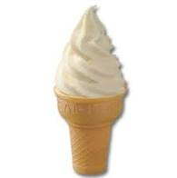



The Decorator Pattern
Notes:
Note: in 2024, this pattern was the basis for a lab adding ingredients to a product. Students may not have heard the term “decorator” in that lab context, but it clearly did use the pattern.

Slide 4
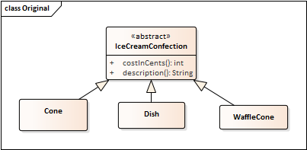
Example: Ice Cream Store
// CONSIDER:
public class Money {
private static float BIG_VALUE = 1e8F;
public static void main(String[] args) {
float num = BIG_VALUE;
for(int i = 0; i < 1000; ++i)
num += 1.0;
System.out.println(BIG_VALUE + " + 1000: " + num);
num = 0.0F;
for(int i = 0; i < 1000; ++i)
num += 1.0;
num += BIG_VALUE;
System.out.println("1000 + " + BIG_VALUE + ": " + num);
}
}
// output:
1.0E8 + 1000: 1.0E8
1000 + 1.0E8: 1.00001E8
Confection: “a dish or delicacy made with sweet ingredients”
IceCreamConfection: either an interface or abstract
Show methods once!
Description: maybe an attribute, maybe computed
Why might costInCents return an int?
Doubles would only help a bit…
Notes:
Don’t need to show methods in subclasses – LSP says they are there automatically, so they just add clutter!
First: sample code showing danger of using floats for dollar amounts; not robust

Slide 5
Implementing the core classes
public abstract class IceCreamConfection {
public abstract String description();
public abstract int costInCents();
}
public class Cone extends IceCreamConfection {
public String description() {
return “Cone”;
}
public int costInCents() {
return 124;
}
}
Notes:
This covers the basic item, but what to do if extend it?

Slide 6
Extending functionality
Store sells many topics: fudge, M&Ms, peanuts
Each topping: additional cost
  If they are free, could lead to abuses…
Issue: how to account for these additions to products?
Notes:
College students will park a meal on an ice cream cone…

Slide 7
Decorator Pattern: Goals
More general goal: attach additional functionality to an existing class at runtime
Another goal: avoid extra subclassing
  That is, don’t create a subclass for each type of product
  Issue: Too many subclasses
  Issue: The classes might be in other hierarchies
Additional goal: avoid modifying existing classes
  … especially critical when no access to source or the base class is used elsewhere

Slide 8
Alternative 1: Create a new class for each combination.
Ice Cream | Toppings
Cone | M&M
Dish | Fudge
WaffleCone | Peanuts
 | Caramel
What can go wrong?
Results in class explosion!
What happens when a new topping is added?
What happens when the cost of a topping (e.g. fudge) changes?
Maintenance nightmare!
Notes:
We would then add subclasses for dishes, waffle cones as well

Slide 9
Alternative 2: Add flags for the toppings
abstract class IceCreamConfection {
…
public int toppingCost() {
int toppingCost = 0;
if (hasFudge())
toppingCost += FUDGE_COST;
if (hasCaramel())
toppingCost += CARAMEL_COST;
…
return toppingCost;
}
}
public class Cone extends IceCreamConfection {
…
public int costInCents() {
return 124 + super.toppingCost();
}
}
IceCream
-description: String
-hasFudge: boolean
-hasMnM: boolean
-------
+getDescription()
+cost()
+hasFudge()
+hasCaramel()
------
Notes:
Challenge: doesn’t work well with more complex behavior.
Many design patterns are about removing if statements.

Slide 10
So, what’s the (general) problem?
Adapt to new behavior
Leave existing code unchanged
Support future changes in requirements
Solution: Decorator Pattern
Introduce abstract class for the new behavior
Allow that class to access the original object

Slide 11
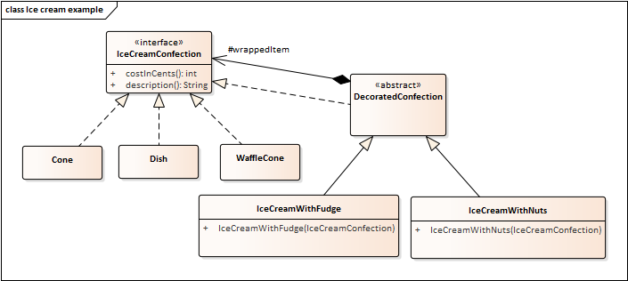
DecoratedConfection: abstract since need common wrappedItem for all decorations
Decoration: gives a new item that has all of the same properties, interface as the original
  An IceCreamWithFudge also defines costInCents(), description()

Slide 12
abstract class DecoratedConfection implements IceCreamConfection {
protected IceCreamConfection wrappedItem;
public DecoratedConfection(IceCreamConfection icc) { wrappedItem = icc; }
public double costInCents() { return wrappedItem.costInCents() + 25; } // 25 cent toppings
}
public class IceCreamWithFudge extends DecoratedConfection {
public IceCreamWithFudge(IceCreamConfection icc) { super(icc); }
public String description() { return wrappedItem.description() + “ with fudge”; }
}
Notes:
The full example is at https://faculty-web.msoe.edu/hasker/se2811/samples/ice_cream/

Slide 13
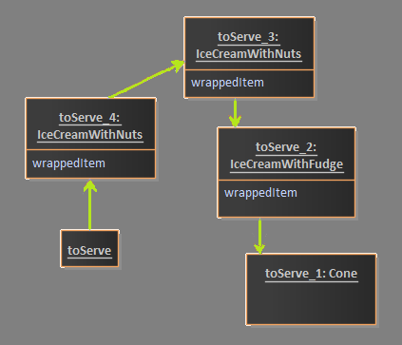
Using the Decorator Pattern
Start by creating an IceCreamConfection object:
  IceCreamConfection toServe = new Cone();
Decorate it with the Fudge topping.
  Create a IceCreamWithFudge object and wrap it around the item to serve:
  toServe = new IceCreamWithFudge(toServe);
Decorate it with the Nuts topping.
  Create a IceCreamWithNuts object and wrap it around the item to serve:
  toServe = new IceCreamWithNuts(toServe);
Extra nuts:
  toServe = new IceCreamWithNuts(toServe);
  So get two IceCreamWithNuts decorators!
Calculate cost with all toppings:
  Int total = toServe.costInCents();
Memory Map
See next page for sequence
Notes:
Draw picture of this!

Slide 14
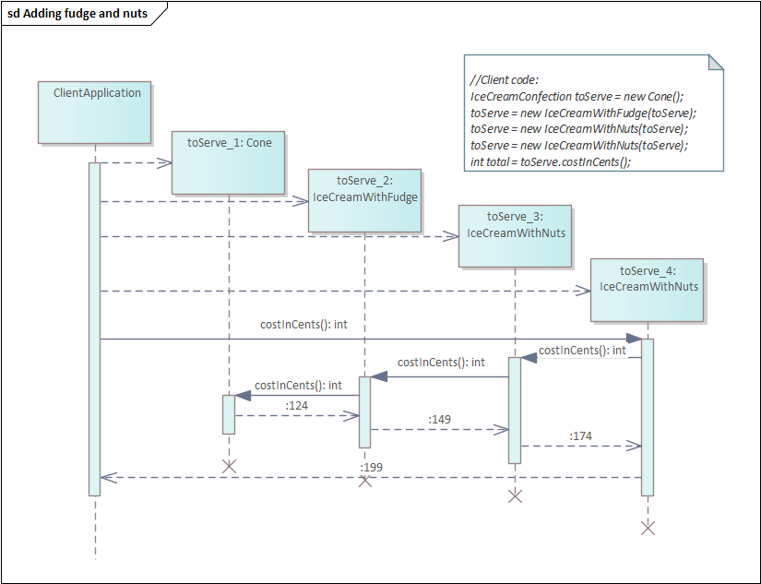
Memory Map
Question: how to support a two-scoop cone?
Notes:
Draw picture of this!

Slide 15
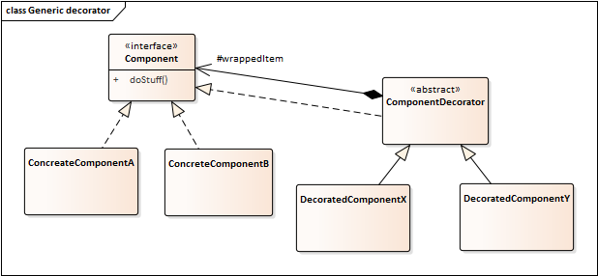
Warning:
Base class, Component, must be an interface
Otherwise, any values in Component will have multiple versions: one in the ConcreteComponent A or B instance, another in every decorator instance
Loss of identity: which instance is the “real” one with the actual attribute?
If need common attributes between ConcreteComponent A & B, add an abstract class!
Notes:
Note: *really* want the base class (Component) to be an interface, otherwise you will have two copies of any Component attributes.

Slide 16
What’s going on here?
Open-closed principle:
  Classes should be open for extension, but closed to modification
Can extend at will
  No final classes!?
  Supports new applications of existing code
Don’t alter the existing code!
  It may be used elsewhere!
  At the least it means new unit tests

Slide 17

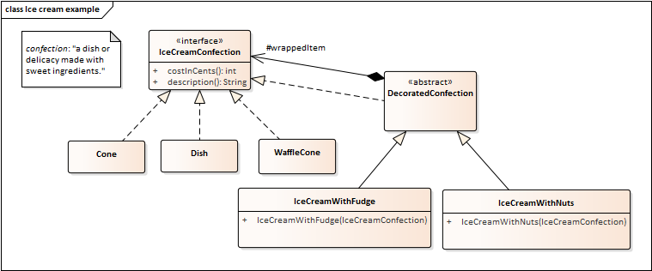
Evaluation
What’s good about the decorator?
What’s bad?
Impact on coupling?
Impact on cohesion?
Notes:
Good: can provide new functionality/responsibilities on old classes; Bad: it’s not clear! You do get some extra classes, but it’s far fewer extra classes than the combinatorial explosion from handling all combinations…. Coupling: no change to coupling between confections and rest of system; cohesion of new classes very strong (all functionality for the new operations in one place); cohesion of existing classes unchanged (which is good).

Slide 18
Summary
Decorators: same super-type as objects being decorated
One or more decorators can be used to wrap an object
Can pass decorated object anywhere original can be passed
Decorated: adds behavior before or after delegating to the decorated object
Can decorate objects at run time
  … with multiple decorators
Supports open-closed principle: open to extension, closed to modification

Slide 19
java.io: many classes for I/O
OutputStream, FileOutputStream, PipedOutputStream, DataOutputStream, ObjectOutputStream, PrintStream, PrintWriter, …
Associations between these not clear from Java API documentation

Slide 20
But note: simply applying Decorator

Slide 21
Decorator pattern applied to input streams:
Create custom stream decorators by extending FilterOutputStream and FilterInputStream

Slide 22
Demonstration

