Slide 1
6. Observer Pattern
Design Patterns Explained, Ch. 18
SWE2410 Design and Cloud Patterns
Dr. Rob Hasker (based on slides by Dr. Mark Hornick)

Slide 2
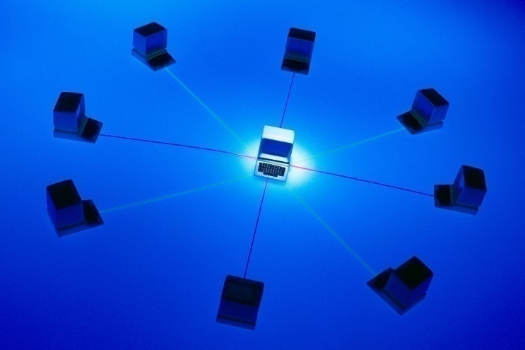
Distributing information to clients
Show Weather Station example
  Note use of threads: essentially a separately running program
  Will discuss threads later
Core idea:
  One-to-many dependency between objects
  One object changes state
  All dependents are notified and updated automatically

Slide 3
Other applications
Consider what happens when move cursor in MSWord
  Enable, disable bold/italic/superscript/underline/etc.
  Update font, size
  Update centering/left justification/right justification
  How would this be implemented?
How to get a message to all students? Email?
  What if only some students want messages from me?
  Is there a better way? Discuss and present!

Slide 4
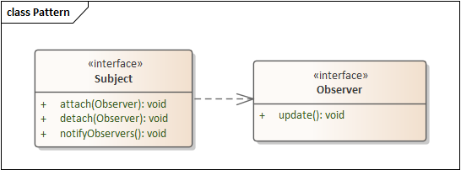
Observer pattern: key components
Subject
  Subject has dependent observers.
Observer(s)
  Observe events
  Event: subject changes state
  Observers: respond to state change
Implementation: interfaces with ways to attach, detach, update
Not: observing someone walking down the street!
Alarm
Notes:
Stress: speaker is an alarm; walking down the street is not an event, it’s a continuing action; this pattern is about observing discrete events

Slide 5
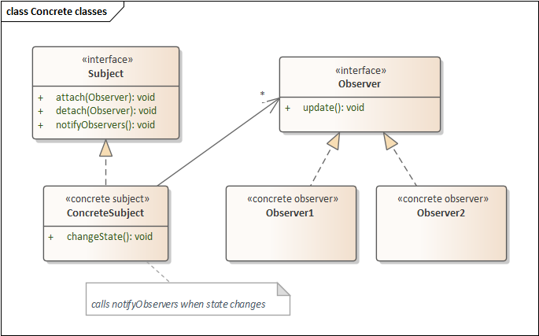
Using the pattern
ConcreteSubject
  implements observer tracking
  Calls notifyObservers on state change/event
ConcreteObserver: implements update
Subject can be abstract
An abstract Observer is rarely useful
Review Weather Station App

Slide 6
Why use Observer Pattern?
Separation of software subsystems
  For instance: separation between GUI & Domain objects
  Also: separation between sensors and systems acting on them
Loosely-coupled classes
  Tightly-coupled: reduced reusability, understandability
Goal: elegant communication between loosely-coupled classes
Note: the Java class library implements this as the deprecated class pair Observer/Observable
  We are not using these

Slide 7
Generic Subject class
interface Subject {
void attach(Observer o);
void detach(Observer o);
void notifyObservers();
}
class ConcreteSubject implements Subject {
public void attach(Observer obs);
public void detach(Observer obs);
public void notifyObservers();
private Collection<Observer> observers;
}
Notes:
Some texts define notify() instead of notifyObservers()
We use notifyObservers because notify is a method in Java’s Object class
Sequence isn’t important, so
any type of collection is fine
Notes:
Subject::attach(Observer* pObserver)
{
m_hObservers.push_back(pObserver);
}
Subject::detach(Observer* pObserver)
{
m_hObservers.remove(pObserver);
}
Subject::notify()
{
Vector<Observer*>::iterator m_ppObserver;
for (m_ppObserver = m_hObservers.begin();m_ppObserver = m_hObservers.end(); ++m_ppObserver)
(*m_ppObserver)->update();
}

Slide 8
Attach, notification sequence
s: ConcreteSubject
o1: Observer1
o2: Observer2
attach()
attach()
changeState
notifyObservers()
update()
getContextSpecificInfo()
update()
getContextSpecificInfo()
Notes:
changeState: general operation

Slide 9
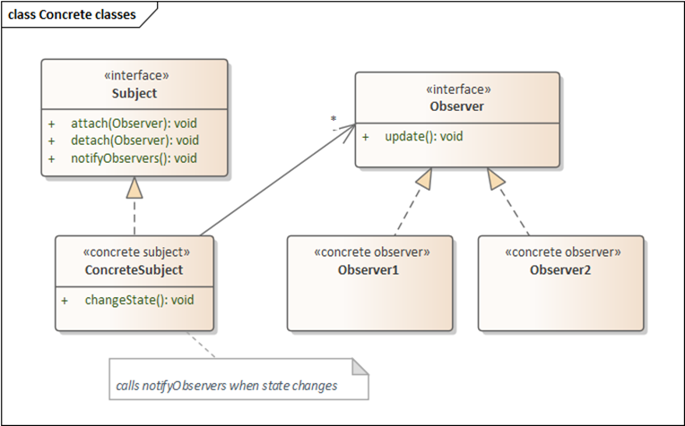
Generic Observer
interface Observer {
void update(???);
}
class ConcreteObserver implements Observer {
public ConcreteObserver();
public void update(???);
}
Key question:
What is the appropriate argument for the update() method?

Slide 10
Weather Program example
abstract WeatherSensor implements Subject
{
abstract double currentTemp();
abstract double currentWindSpeed();
Collection<Observer> observers;
public void attach(Observer obs) {…}
public void detach(Observer obs) {…}
public void notifyObservers() {…}
public boolean hasObserver(Observer obs) {…}
}
Allows objects to query if they are currently observing – simplifies some of the code in the example
See sample code
available on website as observer-weatherapp.zip
note Observer, Subject classes
What is passed to update?

Slide 11
Implementation Questions
Generically, what should be the arguments of the update method?
  Note what is used in the weather example; why sufficient?
  Could we send the subject as the argument?
  General alternatives: pull vs. push
  What would be the danger of pushing simple data to observers?
Can an observer store the subject? What’s the impact?
When would it be good to declare the subject as an interface?
Notes:
Danger of pushing simple data: can lead to stamp cohesion
Pull vs push: pull can lead to communication bottlenecks, especially in multi-threaded applications
Storing the subject adds a dependency, but at least the subject does not need details about observers
ConcreteSubject could be

Slide 12
Benefits
Coupling between Subject and Observers:
  Subject knows it has a list of Observers, but not specific classes
  Each Observer conforms to a simple interface
  Hence, coupling is
    Abstract
    Minimal
Notes:
Cohesion: observers highly cohesive – no code to monitor multiple places; subjects don’t have code checking on observers, so also cohesive

Slide 13
Consequences (negative)
Pattern may not be useful if only some objects need notification
Overuse can mean cascading updates
  Eg: if A’s dependents each have more dependents, and those have even more
  Result: more time calling updates than computing useful results
Neither is really a problem with the pattern itself!

Slide 14
Observer pattern in Java
Observer, Observable
  Deprecated since version 9
  Issue: pushed Object, making it hard to do any type checking
    Had to write code like if ( observer instanceof WeatherSensor ) …
Implementation is simple enough; Java’s pattern is not very useful
  Collection<Observer> observers = new LinkedList<>();
  attach(Observer o): observers.add(o);
  detach(Observer o): observers.remove(o);
  notifyObservers(): for(Observer o : observers) o.update();
Why use a LinkedList instead of an ArrayList?

Slide 15
Review
So what is this pattern about?
When to use it?
Where can we use interfaces, abstract classes in this pattern?
  Where must we use them?
  Why should we consider rolling our own in Java?
Draw a UML diagram
What methods might be private/protected?

