Slide 1
7. MVC
Wikipedia Page on MVC
SWE2410 Design & Cloud Patterns
Dr. Rob Hasker (based on slides by Dr. Josiah Yoder)

Slide 2
Mental Models
How does a vacuum cleaner work?
  What happens when it’s plugged in and
  turned on?
Typical model:
  plug in, electricity flows like water
  electricity pushes on motor to spin it (like water wheel)
  machine creates vacuum that pulls on dirt
In actuality:
  phase switch 120 times per second
  electromagnets make the motor spin; windings often powered by induction
  pressure differential creates wind that blows in objects
Does it matter?
  The simplified model is enough to fix most problems!

Slide 3
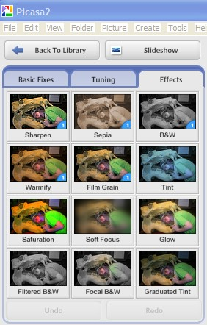
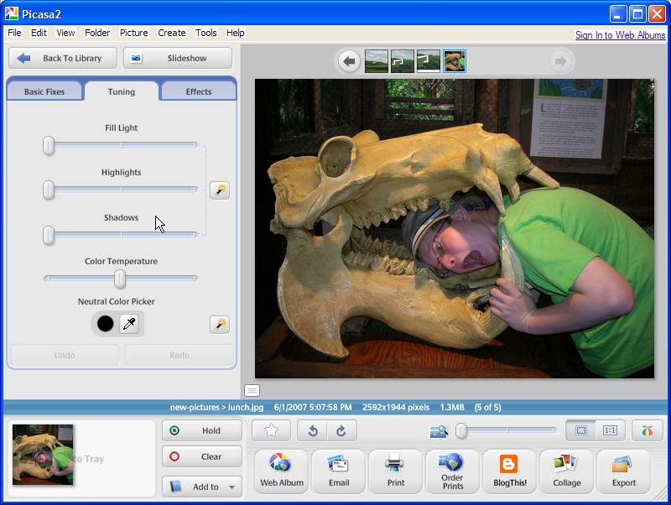
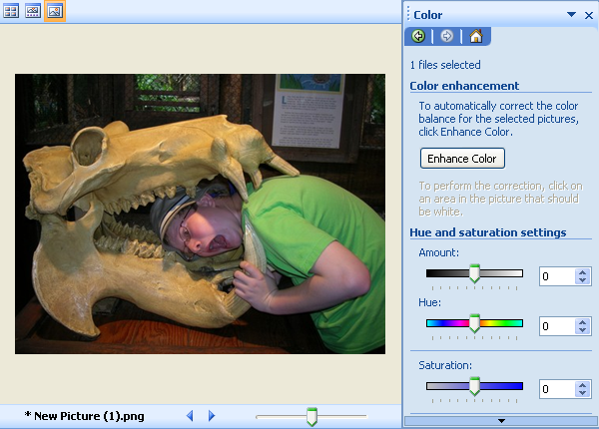
Mental Models in Software
Example: what happens when you scroll up on a spreadsheet?
Example: how to fix color?
  Traditional:
Newer:
Goal: reflect user models

Slide 4
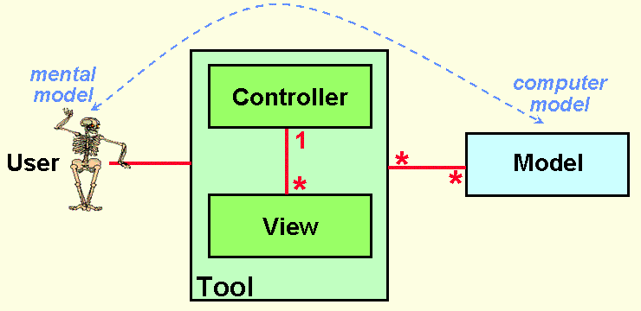
Model-View-Controller
Goal: divide software into elements
Natural subsystem: capture user’s model
Need to present data to user: view
  Can even allow multiple views!
User needs to interact with that model: (UI) control
  Often also includes policy
  That is, business rules/logic
Domain classes!
Notes:
Full agenda:
Return Exam
Questions about lab due tomorrow in class?
Threads: Locking on null object
Threads: invokeLater
Threads: The squares example
Decorator Class Diagram
More on Java IO
Class diagrams
Design Principles
in the patterns we’ve seen so far
Compare with alternatives
Decorator vs. array approach suggested in class
Non-decorator array – decorator can be added on without modifying the original hierarchy
Decorator has “before-after” and possibly other combinatorial control that would be hard-coded in array
[Show “screenshot” of discussion from class? Or just re-type?]
Strategy vs. Decorator class diagrams side-by-side
Structural difference (inheritance optional in Strategy pattern?)
Decorator vs. “Strategy” array
Perhaps next:
Coding Starbuzz coffee (?)
Add real patterns
ArrayList – null-checking
Java I/O: Students do coding examples
http://stackoverflow.com/questions/9358821/should-i-extend-arraylist-to-add-attributes-that-isnt-null

Slide 5
Basic MVC
To support the user’s mental model
http://heim.ifi.uio.no/~trygver/themes/mvc/mvc-index.html
Notes:
Image by a creator/discoverer of MVC

Slide 6
Basic flow of MVC
click, drag, type
display
User
Views
Controller
manipulate
update
Model
Notes:
Architectural pattern popular for user interface design

Slide 7
MVC in Lab 6
See original code for lab (coconuts)
BeachController: capture keystrokes, display graphical elements
Crab, IslandObject, LaserBeam, Coconut, HittableIslandSubject: model
  But not pure: mixes in code to display objects – the view
  Fix: use Decorator to define the draw method
Sky: game – a mix of model, game control, view
  Could refine this further
  Key: game play is captured in Sky

Slide 8
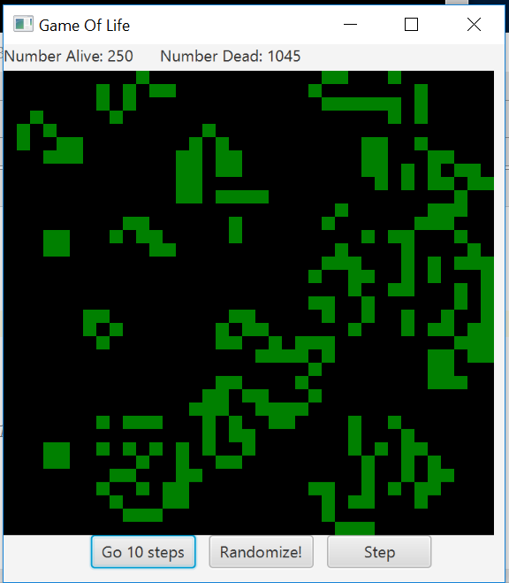
Game of Life
(SE 1021, Winter 2017)

Slide 9
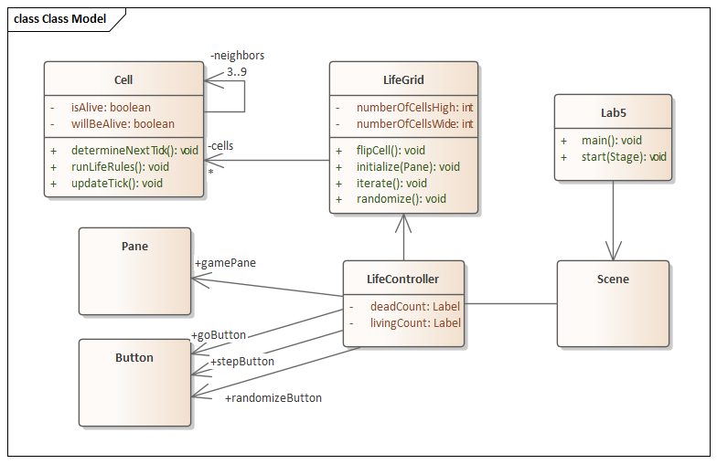
Game of Life
(SE 1021, Winter 2017)

Slide 10
Alternative Flow
The interpretation that’s especially common in web applications
View: HTML, Javascript
Controller: application on server
Model: data in database
But often used for standard apps
User
display
click, drag, type
forward events
update
View
Controller
( just policy)
manipulate
update
Model

Slide 11
What is MVC? (3)
user clicked, etc.
change . . display
View
update
update
state, . please
Controller
change state
Model
Notes:
Model – The data and “business logic” – how it works
View – What the user sees
Controller – Strategy for handling events / interface between Model and View

Slide 12
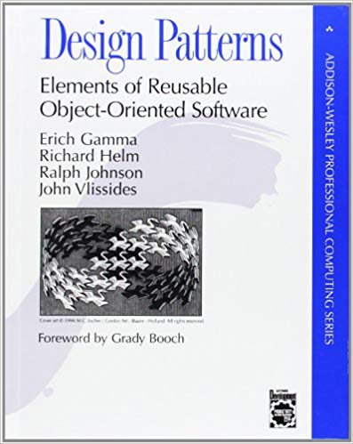
MVC and Design Patterns
From the “Gang of Four”:
“MVC decouples views and models by establishing a subscribe/notify protocol between them [and] lets you attach multiple views to a model”
What design pattern is this?
Notes:
Answer: Observer

Slide 13
MVC and Design Patterns
From the “Gang of Four”:
“Another feature of MVC is that views can be nested.”
What design pattern is this?
Notes:
1 view per form: application is a combination of views
Alternatively: a view for each panel, develop view for the panel that contains those panels

Slide 14
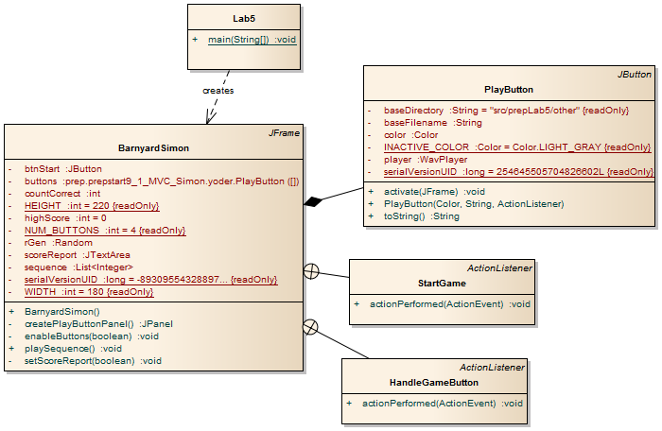
Simon without MVC

Slide 15
UI Implementation with MVC
Suppose a menu entry is active only when a document has been changed
  Temptation: activate the menu entry on change, deactivate for new documents
  Problem: undo/redo can restore original state as can additional edits
  It is VERY difficult to track changes in a UI
More robust solutions: view simply displays model
  View examines model for changes, reset activation/inactive on every redisplay
  Generally: view sets all UI elements based on state of model
This seems inefficient, but the computer works much faster than people
  Simplified view code, easier to ensure view matches model
  Simplified testing: history doesn’t matter

Slide 16
MVC
Model: data, user model
  Largely: domain classes + containers
View: display the data
  May also include handling user actions
  Often: app contains multiple views
Controller: business logic, interface to model
  May include handling user actions
Advantages:
  Distributed logic
    Separate messy display code from the domain implementation
  Supports automated testing of model, business logic
Challenges:
  Not clear what functionality goes where
  Confusing to novice programmers
When to use?
  When you want maintainable apps!

