Slide 1
12. Adapter, Façade Pattern
Design Patterns Explained, Ch. 7
Design Patterns Explained, Ch. 6
SWE2410 Design and Cloud Patterns
Dr. Rob Hasker (based on slides by Dr. Mark Hornick)

Slide 2
Adapter Patter
Scenario:
  System built around a class by Vendor1
    Purchased when build application
  Vendor1 goes out of business, and you need an update
  Will replace by Vendor2’s library
Existing
Application
Vendor1 Classes
Vendor1 interface

Slide 3
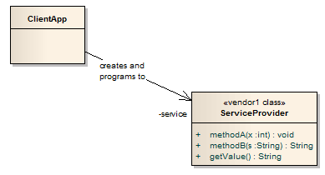
Original Configuration
Vendor2: similar class, but new interface
Change all the calls to methodA, etc?
Assumption: ClientApp heavily dependent on ServiceProvider
many calls to various ServiceProvider methods.
Usually, ServiceProvider implements numerous additional methods
Notes:
Issue: it’s often not just the method names, but rules on the order they were applied

Slide 4
Solution: Adapter (Wrapper) Pattern
Adapter
  Implements the interface your classes expect
  Uses the vendor 2 interface to service requests
Existing
Application
Vendor2 Classes
Adapter
Textbook Ch. 7

Slide 5
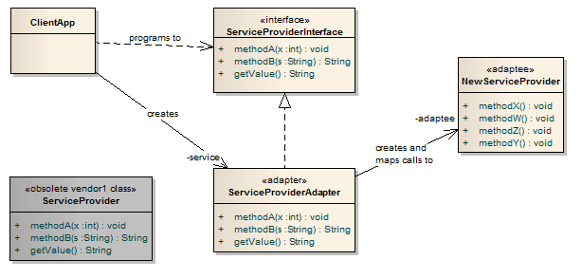
Applying Adapter
1. Create an interface for the original ServiceProvider
Client MUST use this interface!
3.Find a replacement for ServiceProvider (same functionality, different methods) – the adaptee
2. The original ServiceProvider class discarded
4. Write an adapter class which maps calls from the original methods to new methods

Slide 6
The Adapter Pattern features
Note client calls original method
That method delegates to the new service provider
Typically: methodA will be short
  simply call one or two methods in NewServiceProvider
However, may have a complex interface
  may need to construct additional information
  Example: making a 3-D character move on a screen
adaptee: must translate back to the results expected by the client
Only changes to the clients:
  Declare variables using the interface
  Create instance(s) of the adapter instead of original vendor

Slide 7
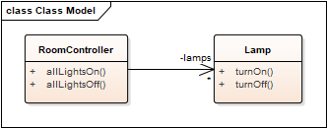
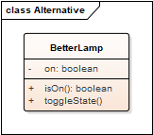
Example: lighting a room
Delivered system:
What to do if replace Lamp by BetterLamp?

Slide 8
Example: lighting a room
Old system:
Replacement for lamp:
// Solution (may have compilation errors!):
public class LampInterface {
void turnOn();
void turnOff();
}
public class LampAdapter
extends LampInterface {
private BetterLamp lamp = new BetterLamp();
public void turnOn() {
if ( ! lamp.isOn() ) lamp.toggleState();
}
public void turnOff() {
if ( lamp.isOn() ) lamp.toggleState();
}
}

Slide 9
When to use Adapter
Legacy code which interfaces to a class library that has changed
  Changes might include versions, vendors, new requirements
New application
  Interfaces with known third-party library
  That library not yet defined
  Isolate the problem!
  Define an interface, write the adapter later

Slide 10
Adapter: a structural design pattern
Captures relationships between classes
Alternative name: Wrapper
When to apply: interface code to a different API
  Program to interfaces, not implementations
  Could we use an abstract class instead of an interface?
Advantage:
  Reduces dependencies between classes – low coupling
Shortcomings?
  Overhead for delegation calls
  It’s less obvious what an adapter method call does
Typically want to remove adapter over time
  (unless anticipate further changes)
Notes:
Yes, could use abstract class, but that would be in a case where you need to keep using the alternative implementations – probably just doing OO at that point

Slide 11
Optional Application (in-class activity)
Working in teams of two, apply the adapter pattern to a queue:
  Download se2811/samples/SimpleLinkedList.java
  Download se2811/samples/SimpleQueue.java
  Use IntelliJ to build, run both
  Download se2811/samples/GenericQueue.java
  Create LinkedQueue.java with the same test main as SimpleQueue.java but using SimpleLinkedList instead of ArrayList.
  If instructed, upload LinkedQueue.java to Canvas.

Slide 12
Recall: Adapter (Wrapper) Pattern
Goal: replace by Vendor 2
Adapter
  Implements the interface your classes expect
  Uses the old vendor interface to pass requests to the new vendor
Existing
Application
Vendor 1 Classes
Existing
Application
Vendor 2 Classes
Adapter

Slide 13

Consider watching a movie at home...
Use multiple interfaces (remotes) to
Turn on Receiver/amplifier
Turn on TV/Monitor
Turn on DVD player
Set the Receiver input to DVD
Put the Monitor in HDMI input mode
Set the Receiver volume to medium
Set Receiver to DTS Surround
Start the DVD player.
Interacting with the following classes:
Receiver/Amplifier
TV/Monitor
DVD

Slide 14
To decrease the complexity…
Oops – this is impossible to read
It’s difficult to read sentences while listening!
New class: TheaterFacade
  The façade treats the various components as a sub system and calls on them to implement a watchMovie method.
  To watch a movie, we just call one method, watchMovie and it communicates with the Monitor, DVD, and Receiver for the rest of the system
  The façade still leaves the subsystem accessible to be used directly
    subsystem classes are still available to provide additional control if needed

Slide 15
To decrease the complexity…
New class: TheaterFacade
  Façade: treats components as a subsystem
    Calls them implement watchMovie
  watchMovie calls
    Monitor
    DVD
    Receiver
  Subsystems are still directly accessible
    Allows for finer control when needed

Slide 16

The general problem
Complex system
  Multiple subsystems
  Each with its own interface
  Each with many methods
Difficult for clients (blue) to deal with
  Hide complexity if not needed
Origin of name:
Façade: the front of a building
  For instance, a theater or church façade
Notes:
16
Picture: from a cathedral in France, image copyright Robert W. Hasker, 2025; permission granted to include in slide deck for discussions of the Facade Pattern, but no other uses without permission of the author.

Slide 17
Façade Solution
Solution
  Centralize subsystem interface
  Simplify/reduce number of centralized methods
  Presents unified “face” to clients
Facade
Notes:
17

Slide 18
Removing the burden from beginning Java developers with a Façade (WinPlotter)

Slide 19
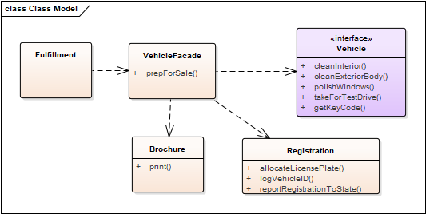
Example: Vehicle sales prep

Slide 20
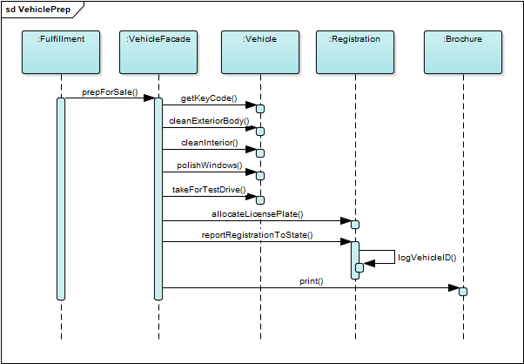
Example: Vehicle sales prep
What cohesion does VehicleFacade exhibit?
Is this a problem?
Notes:
answer: procedural

Slide 21
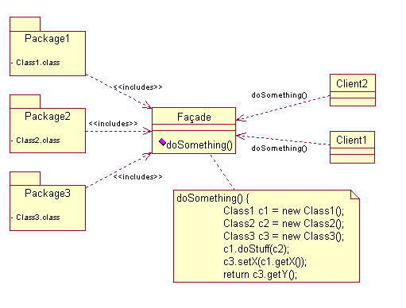
Generic Pattern

Slide 22
Façade Consequences
Shields clients from complex subsystems
  That is, reduces coupling
  Internal classes can change more easily
  Introduces “layering” – each outer layer simplified/cleaner
Refinement:
  Make the façade class abstract
  Can then provide alternative implements of façade
Notes:
22

Slide 23
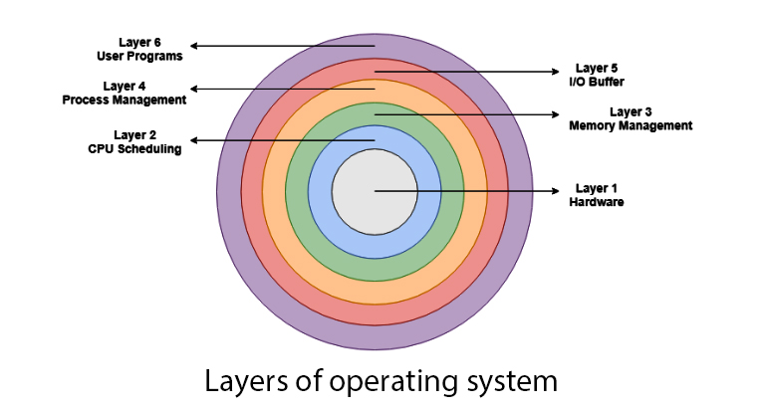
Façade Applications
Interface to existing library
  Unify or “clean up” complex interface
Design layered system
  Various service levels
  Façade abstracts interface of each level
Notes:
23
OS Layer image from

Slide 24
Three patterns...
Façade
  Provide “clean” interface
  Underlying operations still available
Adapter
  Conform interface to a specific client
  Adapt new set of classes to old
  Stabilize interface to library under development
Proxy – possibly later
  Interface to remote client or controlled access to a resource
  Underlying operations not available
Notes:
24

Slide 25
Review
Façade: clean interface to complex subsystems
Decorator (previous notes): adding properties to objects without using inheritance
Both: composition over extension
  Referencing an object that does the work instead of simply inheriting a new class
  This reflects a basic fact of OO: deeply nested hierarchies are confusing
  Avoid A extends B extends C extends D ... extends G

