Slide 1
12. Façade Pattern
Design Patterns Explained, Ch. 6
SWE2410 Design and Cloud Patterns
Dr. Rob Hasker (based on slides by Dr. Mark Hornick)

Slide 2
Recall: Adapter (Wrapper) Pattern
Goal: replace by Vendor 2
Adapter
  Implements the interface your classes expect
  Uses the old vendor interface to pass requests to the new vendor
Existing
Application
Vendor 1 Classes
Existing
Application
Vendor 2 Classes
Adapter

Slide 3
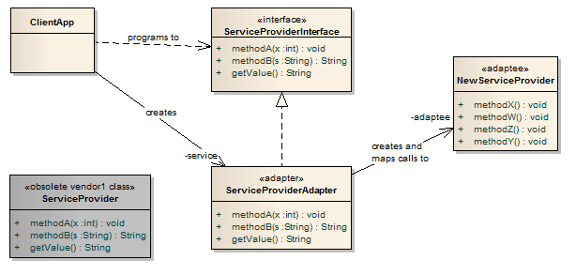
Applying Adapter
4. An adapter class maps calls
from the original methods to
new methods
2. An interface for the original
ServiceProvider is created.
Client MUST use this interface!
1. The original ServiceProvider class is obsolete and discarded
3. A replacement class for the original
ServiceProvider is found that provides
similar functionality but with a
Different set of methods – the adaptee

Slide 4

But suppose you want to watch a Movie...
Use multiple interfaces (remotes) to
Turn on Receiver/amplifier
Turn on TV/Monitor
Turn on DVD player
Set the Receiver input to DVD
Put the Monitor in HDMI input mode
Set the Receiver volume to medium
Set Receiver to DTS Surround
Start the DVD player.
Interacting with the following classes:
Receiver/Amplifier
TV/Monitor
DVD

Slide 5
To decrease the complexity…
New class: TheaterFacade
  The façade treats the various components as a sub system and calls on them to implement a watchMovie method.
  To watch a movie, we just call one method, watchMovie and it communicates with the Monitor, DVD, and Receiver for the rest of the system
  The façade still leaves the subsystem accessible to be used directly
    subsystem classes are still available to provide additional control if needed

Slide 6
The Problem
Complex system
  Multiple subsystems
  Each with its own interface
  Each with many methods
Difficult for clients (blue) to deal with
No need to expose the complexity to clients if they aren’t using it…
Façade: the front of a building
Think especially of a buliding façade on a theater lot…
Notes:
6

Slide 7
Façade Solution
Solution
  Centralize subsystem interface
  Simplify/reduce number of centralized methods
  Façade presents new unified “face” to clients
Facade
Notes:
7

Slide 8
Removing the burden from beginning Java developers with a Façade (WinPlotter)

Slide 9
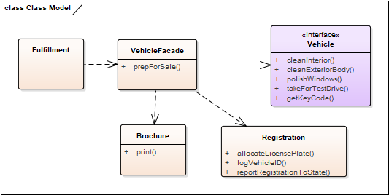
Example: Vehicle sales prep

Slide 10
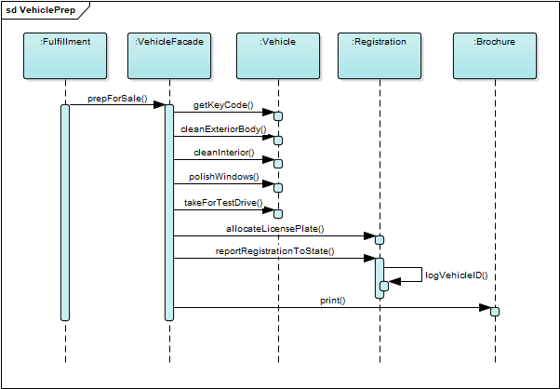
Example: Vehicle sales prep
What cohesion does VehicleFacade exhibit?
Is this a problem?
Notes:
answer: procedural

Slide 11
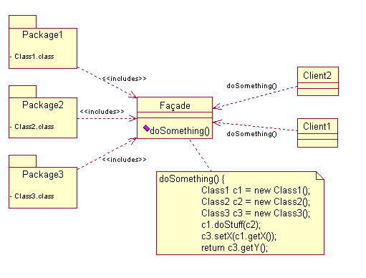
Generic Pattern

Slide 12
Façade Consequences
Shields clients from subsystem components
  Make subsystem easier to use
Reduces coupling from client to subsystem classes
  Allow internal classes to change freely
  Permit “layering” of system function
  Level of client-subsystem coupling
    Make Facade an abstract class
      Different concrete subclasses for different implementations of the subsystem
    Configure the façade object with different subsystem objects
Notes:
12

Slide 13
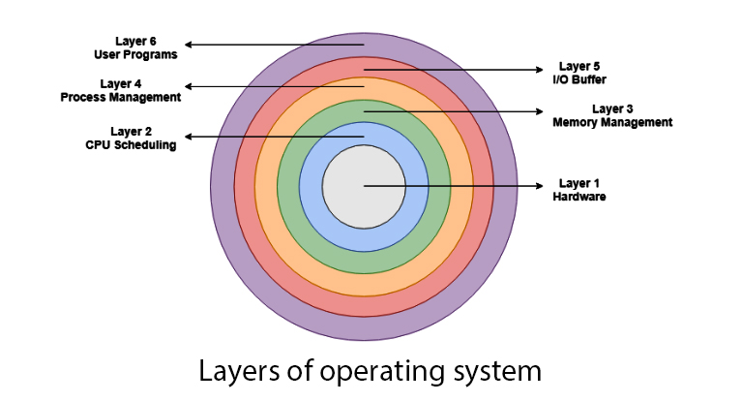
Façade Applications
Interface to existing library
  Unify or “clean up” complex interface
Design layered system
  Various service levels
  Façade abstracts interface of each level
Provide abstract interfaces
  To alternative implementations
Notes:
13
OS Layer image from

Slide 14
Three patterns...
Façade
  Provide “clean” interface
  Underlying operations still available
Adapter
  Conform interface to a specific client
  Adapt new set of classes to old
  Stabilize interface to library under development
Proxy - later
  Interface to remote client or controlled access to a resource
  Underlying operations not available
Notes:
14

Slide 15
Review
Façade: clean interface to complex subsystems
Decorator (previous notes): adding properties to objects without using inheritance
Composition Over Extension principle

