Slide 1
14. Factory Pattern
SWE2410 Design and Cloud Patterns
Dr. Rob Hasker (based on slides by Dr. Mark Hornick)

Slide 2
Issue: multiple types of clocks
See time example in sample code folder
  Class Time: hours + minutes, where hours can grow forever
  Class Clock: hours + minutes as captured on 24-hour clock
  Review test code for each
AbstractTime: abstracts the two clocks
  makeTime(int hours, int minutes, String type)

Slide 3
Issue: multiple types of clocks
See time example in sample code folder
  Class Time: hours + minutes, where hours can grow forever
  Class Clock: hours + minutes as captured on 24-hour clock
  Review test code for each
AbstractTime: abstracts the two clocks
  makeTime(int hours, int minutes, String type) {
  if (type.equalsIgnoreCase("time"))
  return new Time(hours, minutes);
  else
  return new Clock(hours, minutes);
  }
makeTime: an example of a static factory method
Introduces dependency (coupling) on subclass!
Notes:
Discuss dangers of depending on subclasses in general

Slide 4
Static factory methods
Also: Clock.fromString, Time.fromString
  Generally: method to parse objects from inputs
General form:
public class X {
…
public static X makeX(someType someData) {
…
return new X(…); // or new Y(…) where Y extends X
}
}
Very useful for parsing inputs, especially structured data
Pair with toString methods for output
Notes:
I use this to pro

Slide 5
Ducks a-swimming
Problem: modeling ducks in a pond
  Each type of duck: particular swimming pattern
    Eg: straight lines vs. circular
  Each type of duck also has a particular quack
    Mallard, canvasback, black-bellied whistler
Solution?
  Strategy: abstract move, abstract quack

Slide 6
Applying the strategy pattern…
// create some behaviors
SwimBehavior csb = new CircularSwimming();
QuackBehavior sqb = new StandardQuacking();
SwimBehavior rsb = new RandomFloating();
// daffy has circular swimming, std quacking
Waterfowl daffy = new Duck(“daffy”, csb, sqb);
// donald has random floating, std quacking
Waterfowl donald = new Duck(“donald”, rsb, sqb);
daffy.swim();
donald.quack();

Slide 7
How this looks in the application…
SwimBehavior circ_swimmer = new CircularSwimming();
SwimBehavior rand_floater = new RandomFloating();
QuackBehavior std_quacker = new StandardQuacking();
QuackBehavior silent = new NoQuacking();
List<Duck> ducks = new LinkedList<>();
String swim_type = in.next();
String quack_type = in.next();
String name = in.next();
while ( !swim_type.equals(“done”) ) {
SwimBehavior swim_style =
swim_type.equals(“circular”) ? circ_swimmer : rand_floater;
QuackBehavior quack_style =
quack_type.equals(“standard”) ? std_quacker : silent;
ducks.add(new Duck(name, swim_style, quack_style);
swim_type = in.next(); quack_type = in.next(); name = in.next();
}

Slide 8
How this looks in the application…
SwimBehavior circ_swimmer = new CircularSwimming();
SwimBehavior rand_floater = new RandomFloating();
QuackBehavior std_quacker = new StandardQuacking();
QuackBehavior silent = new NoQuacking();
List<Duck> ducks = new LinkedList<>();
String swim_type = in.next();
String quack_type = in.next();
String name = in.next();
while ( !swim_type.equals(“done”) ) {
SwimBehavior swim_style =
swim_type.equals(“circular”) ? circ_swimmer : rand_floater;
QuackBehavior quack_style =
quack_type.equals(“standard”) ? std_quacker : silent;
ducks.add(new Duck(name, swim_style, quack_style));
}

Slide 9
How this looks in the application…
SwimBehavior circ_swimmer = new CircularSwimming();
SwimBehavior rand_floater = new RandomFloating();
QuackBehavior std_quacker = new StandardQuacking();
QuackBehavior silent = new NoQuacking();
List<Duck> ducks = new LinkedList<>();
String swim_type = in.next();
String quack_type = in.next();
String name = in.next();
while ( !swim_type.equals(“done”) ) {
SwimBehavior swim_style =
swim_type.equals(“circular”) ? circ_swimmer : rand_floater;
QuackBehavior quack_style =
quack_type.equals(“standard”) ? std_quacker : silent;
ducks.add(new Duck(name, swim_style, quack_style));
}
But what happens when
we have more behaviors?

Slide 10
How this looks in the application…
SwimBehavior circ_swimmer = new CircularSwimming();
SwimBehavior rand_floater = new RandomFloating();
QuackBehavior std_quacker = new StandardQuacking();
QuackBehavior silent = new NoQuacking();
List<Duck> ducks = new LinkedList<>();
String swim_type = in.next();
String quack_type = in.next();
String name = in.next();
while ( !swim_type.equals(“done”) ) {
SwimBehavior swim_style =
swim_type.equals(“circular”) ? circ_swimmer : rand_floater;
QuackBehavior quack_style =
quack_type.equals(“standard”) ? std_quacker : silent;
ducks.add(new Duck(name, swim_style, quack_style));
}
But what happens when
we have more behaviors?
Operation?
Class?

Slide 11
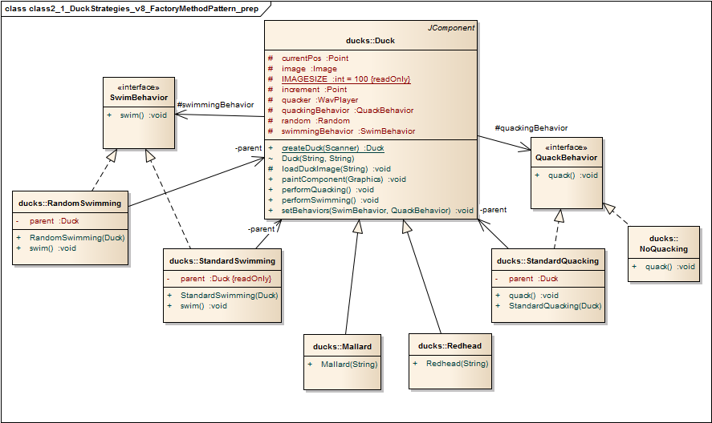
Duck class, Simple Factory Idiom
method solution

Slide 12
Duck class, Simple Factory Idiom
static method solution
public static Duck createDuck(Scanner in) {
String swim_type = in.next(), quack_type = in.next(), name = in.next();
SwimBehavior swim_style =
swim_type.equals(“circular”) ? circ_swimmer : rand_floater;
QuackBehavior quack_style =
quack_type.equals(“standard”) ? std_quacker : silent;
return new Duck(name, swim_style, quack_style);
}

Slide 13
Duck class, Simple Factory Idiom
Alternative:
create a class
DuckFactory
method solution
public class DuckFactory {
public Duck
grow(String swim_type,
String quack_type) {
…
}
}

Slide 14
Duck class, Simple Factory Idiom
Alternative:
create a class
DuckFactory
method solution
public class DuckFactory {
public Duck
grow(String swim_type,
String quack_type) {
…
}
}
Yes, just pushed problem into another object
But, have one place to maintain duck creation
Alternative: static methods – but can’t subclass

Slide 15
Issue: Direct instantiation problem
The issue/problem/context:
  A client needs to create one of several (or many) types of (similar) objects
  Creation of objects may need to be happen within various differing locations within the app (distributed creation)
  Client doesn’t want to know specifically what kind of object to create
    Client may need to incorporate intelligence such as “thread awareness” in order to create the objects on the correct thread
    Object creation may need to be a multi-step procedure
    Hard to maintain – may require a lot of different “new’s”
    And generally, we want to program to interfaces or abstract classes

Slide 16
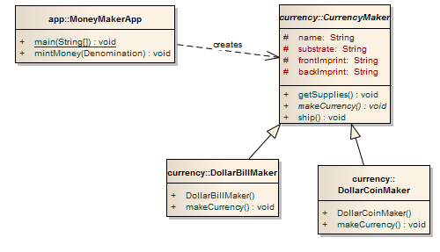
Scenario: Client directly creates class instances

Slide 17
Factory Pattern
Solution
  Define an interface for object creation methods in an abstract Factory class that can be used by the Client whenever concrete objects (aka Products) need to be created
    The interface consists of methods known as Factory Methods
  Let some concrete subclass decide specifics
    By providing an implementation of the Factory Methods
    This delegates the decision of what/how to create to the concrete subclasses

Slide 18
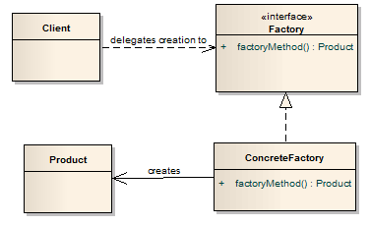
Factory Pattern
    The interface consists of Factory Methods
  Creation is not done via constructor methods because constructor methods cannot be overridden

Slide 19
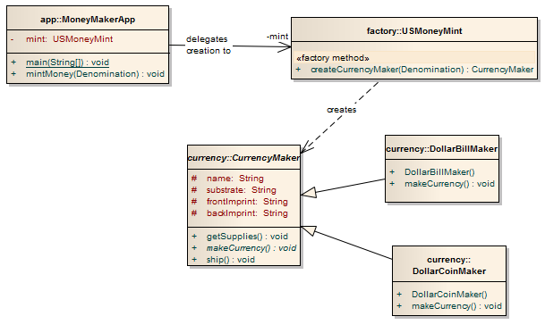
Factory pattern
    The concrete factory (USMoneyMint) implements a single Factory Method (createCurrencyMaker), which instantiates concrete Products (DollarBillMaker or DollarCoinMaker)

Slide 20
Factory pattern
    The concrete factory (USMoneyMint) implements a single Factory Method (createCurrencyMaker), which instantiates concrete Products (DollarBillMaker or DollarCoinMaker)
    But the client still has to create the Factory (USMoneyMint) that creates the CurrencyMakers
    There are two Products being built here by the USMoneyMint Factory – DollarCoinMaker and DollarBillMaker

Slide 21
Factory pattern
Why not move the if statement to the constructor?
    The concrete factory (USMoneyMint) implements a single Factory Method (createCurrencyMaker), which instantiates concrete Products (DollarBillMaker or DollarCoinMaker)
    But the client still has to create the Factory (USMoneyMint) that creates the CurrencyMakers
    There are two Products being built here by the USMoneyMint Factory – DollarCoinMaker and DollarBillMaker

Slide 22
Factory pattern
Why not move the if statement to the constructor?
Constructor doesn’t “return” an object!
It just initializes the current object
    The concrete factory (USMoneyMint) implements a single Factory Method (createCurrencyMaker), which instantiates concrete Products (DollarBillMaker or DollarCoinMaker)
    But the client still has to create the Factory (USMoneyMint) that creates the CurrencyMakers
    There are two Products being built here by the USMoneyMint Factory – DollarCoinMaker and DollarBillMaker

Slide 23
Abstract Factory Pattern
The next level of extension of the Factory concept
The products created by are sufficiently different to warrant separate Factories
  Whose “factory methods” are similar
Students will not be responsible for the Abstract Factory Pattern unless it’s covered during the week 10 presentations

Slide 24
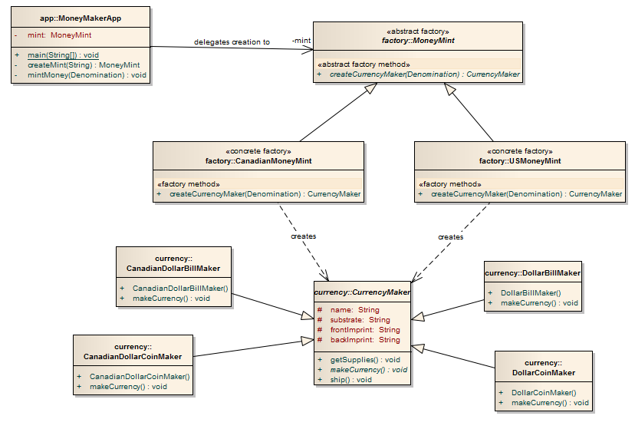
Abstract Factory
    The abstract factory (MoneyMint) defines the Factory Method implemented by the concrete factories, which is used by the client to create CurrencyMakers
    But the client still has to create the concrete Factories (USMoneyMint), but can refer to them abstractly (via MoneyMint references)
The products created by are sufficiently different to warrant separate Factories (USMoneyMint and CanadianMoneyMint), each of which “knows” which products to make

Slide 25
Review
Goal: decouple object creation from client code
Simple solution: static factory method – not extensible
  But is a good model for parsing inputs into objects
Factory class: supports multiple generation methods
Abstract Factory Class: multiple product lines

