Slide 1
Software Tools and Process
SWE 2710

Slide 2
Icebreaker
Presenter
Stand (and stay standing until the end)
Say
Name (first and last)
Major
A fun fact about yourself
Everyone else
If you have the fun fact in common, stand
First person to stand becomes the presenter
Everyone else sits down

Slide 3
Essential Info
Instructor: Dr. Rob Hasker
email: hasker@msoe.edu
Office: DH 413
Preferred communication: Teams
Hours: see https://faculty-web.msoe.edu/hasker/
“msoe hasker” will get you to this page

Slide 4
Grading
Lab assignment submission details will be posted on Canvas
Quizzes (~1 per week)
Final exam is cumulative

Slide 5
Grading policy
The grading formula applies only to those students who have successfully met the objectives of this course
No work will be accepted late
Unless extenuating circumstances exist
You are encouraged to discuss quizzes and programming assignments with your fellow students
However, individual assignments are representations of your own work ONLY
Each person is responsible for writing ALL of your code (no copy/pasting unless it is supplied by the professor)
Unless otherwise specified (code generation)

Slide 6
Questions??

Slide 7

What do we mean by “software tools”?
What tools have you used to develop software?
How did they help?
What makes for a good tool?

Slide 8

What do we mean by “software process”?
What process did you use in the first year?
How might it have been better?
How large are most projects?
Windows 11: 50 million lines of code
Key to process: identifying phases
What phases are natural?
Standard Phases:
Requirements: what project needs
Design: structure; how it works
Implementation: writing the code
Testing: verifying it works
Maintenance: fixing errors, adding features

Slide 9
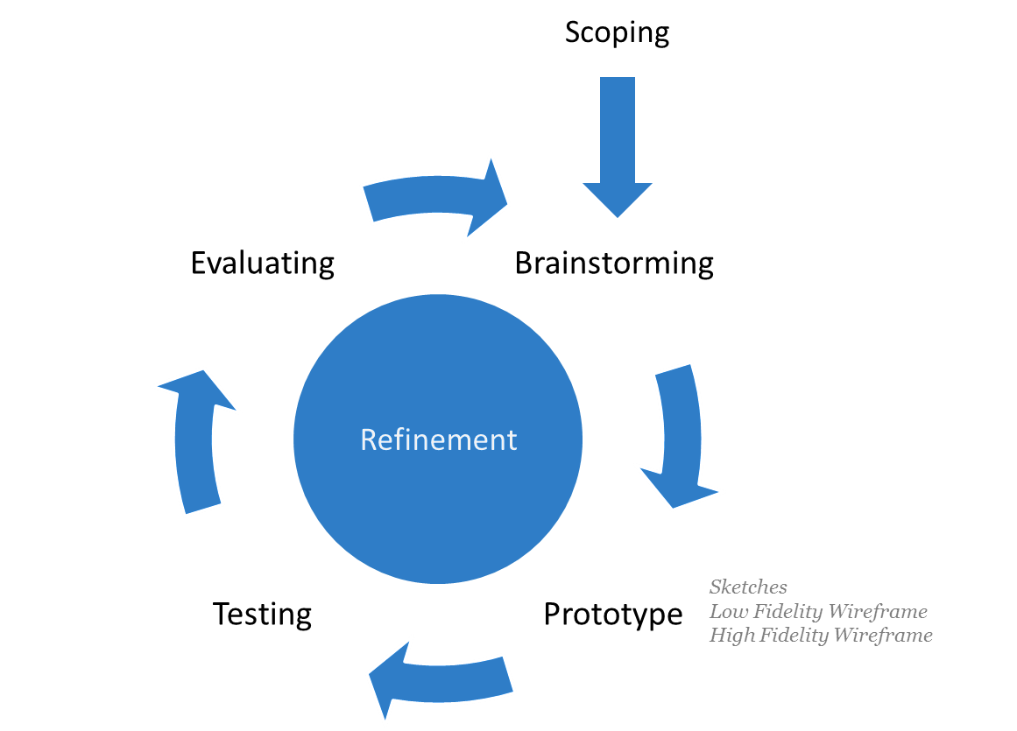
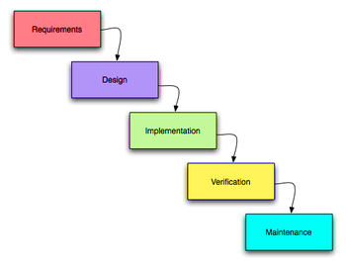
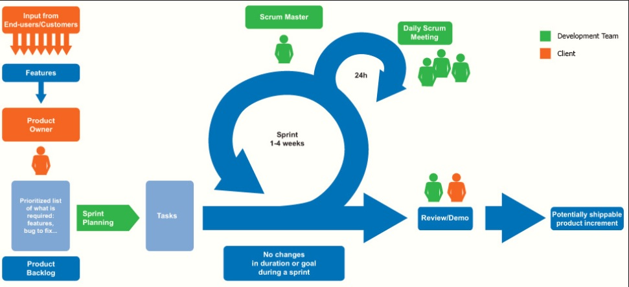
Common software processes
Key issues with waterfall process
No clear path for fixes
Customer does not see product until after verification – high risk
Prototyping
Scrum
Waterfall – simple sequence of standard phases

Slide 10
Starting point: knowing the requirements
A requirement: a specific capability provided by a system
Including how it is presented to users
Sometimes: what it does not do – example: fail on bad input
The system is not complete until all requirements satisfied
Key issue: testability
How do we know if the project is done if we cannot check each requirement?
Examples: calculations, report formats, response times
Counter-examples: “easy to use”, “fast”, “efficient”, “pleasing to the eye”
Why might a system not be done just because all requirements satisfied?
Example: capture requirements for a ride-share app such as Uber or Lyft
Notes:
Why is simply satisfying all requirements not enough? Maybe we don’t have all of them!

Slide 11
Review
What this course is about
Introducing tools used to develop systems meeting the need
Using process to organize a team to meet the need
Software processes
Waterfall: basic phases, in sequence; inadequate for real projects
Prototyping: flexible, but not very structured
Scrum: robust for small teams, can be scaled
Requirements
Key to understanding the need
Next: use cases and user stories
Getting at requirements

