Slide 1
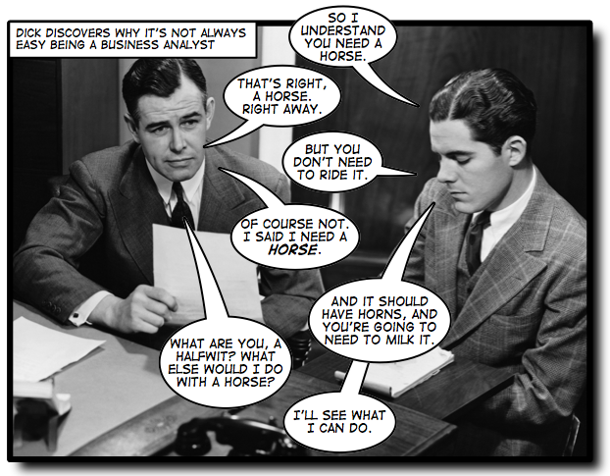
Use Cases and User Stories
an engineer
Notes:
Yes, customers are sometimes not speaking the same language as us...

Slide 2
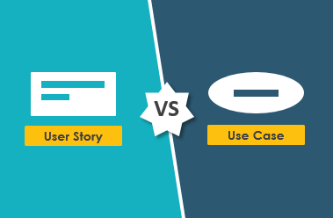
Terminology
User Story
Short description (formulaic sentence)
Text only
Use Case
Description of a set of interactions
Text or UML representation
Both: common ways to capture requirements
Issue: simple lists of requirements hard to process, keep organized
But distinct types!
“A user story is to a use case as a gazelle is to a gazebo”
– Alistair Cockburn
Notes:
... well, the “gazelle/gazebo” comparison is a bit overstated...

Slide 3
User Stories: user actions, focus
User story format:
“As a <specific type of user>, I want to <action> so that <reason>”
Examples:
As a student, I want to view open courses so I can create next semester’s schedule.
As an instructor, I want to view the students registered for the course sections so that I can take attendance.
As the registrar, I want to create courses and course sections for the next semester so that students can search for courses to add to their schedules.
Notes:
User story format discussion: https://www.atlassian.com/agile/project-management/user-stories

Slide 4
Use cases
What actually happens when someone uses the system
... to (try to) achieve a goal
Captures how system should work in detail
Comparison:
User stories: a single interaction
Use cases: multiple interactions, multiple flows
Use Cases were introduced by Ivar Jacobson in the 1980’s

Slide 5
Elements of a use case
Actors: people who interact with the use case
Typically, people
Can be another system if outside project scope
Goal: what is achieved by executing the use case
Examples: register a student in courses, purchase a car, make a move in a game
Scenarios:
Sequences of steps involved in achieving the goal
Typically: each step is a user input followed by a system response
Starting a car
Driver puts car into Park
Car indicates Park on shifter
Driver puts foot on brake
Brake lights show brakes engaged
Driver inserts key, turns to start
Check engine lamp lights for 2 seconds
Starter engages, turns engine
Engine starts
Starter disengages

Slide 6
More on scenarios
Starting a car with inadequate battery charge
Driver puts car into Park
Car indicates Park on shifter
Driver puts foot on brake
Brake lights show brakes engaged
Driver inserts key, turns to start
Check engine lamp lights for 2 seconds
Starter engages, but too little power to turn engine
Starting a car
Driver puts car into Park
Car indicates Park on shifter
Driver puts foot on brake
Brake lights show brakes engaged
Driver inserts key, turns to start
Check engine lamp lights for 2 seconds
Starter engages, turns engine
Engine starts
Starter disengages
This case: sunny day scenario
Everything works!
Aka normal flow
Goal always obtained
Often have multiple ones
Can also have rainy day scenarios
“Error” cases – goal not achieved

Slide 7
Different types of actors
Examples from Canvas:
As a student, you can
View the courses you are enrolled in
Submit your assignments
Retrieve your grades
As an instructor, I can
View the courses I am teaching
View the students in each course
Create assignments
Grade assignments
The registrar can
Create courses
Assign me to a course as the Faculty
Assign you to a course as a Student
Each of these is a Goal, and each distinct Goal is the end result of a separate Use Case

Slide 8

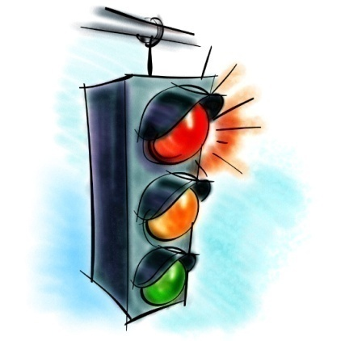
Use Cases have clear boundaries
Every Use Case must have a definite Starting and Stopping point
Every Use Case is started off by an external initiator (an Actor)
Every Scenario must have a condition that indicates that is complete
goal achieved or not
Often, one use case must be satisfied before another can proceed
This is called a precondition
Give a use case that might need to be completed before starting a car

Slide 9
Use Cases have clear boundaries
Postconditions: result of completing a use case
The system may have changed state
Data may have changed
Files may have been created or destroyed
Other output may have been generated

Slide 10
Meeting Goals of User Stories and their associated Use Cases
To verify that a Goal has been achieved, we usually talk about Acceptance Criteria
These take the form of:
Evidence of tests passing
Approval of observed functionality

Slide 11
Expectations for software reliability are increasing
A good solution goes beyond the obvious things a customer tells you
-Makes sure your system works even in unusual or unexpected circumstances
Plan for things to go wrong!
”Thinking and writing about failure handling saves the design team a lot of money over the course of the project.” from Use cases, ten years later – Alistair Cockburn

Slide 12
Alternate Scenarios of a Use Case describe atypical or exceptional situations (“Rainy day scenarios”)
Alternate Scenarios can have
Different steps from those of the Main Path
Additional steps added to the Main Path
recovery steps to get back on the Main Path
All Scenarios in a Use Case target a common Goal, although in some Alternate Scenarios the Use Case may terminate abnormally (without achieving the intended Goal)

Slide 13


Writing Use Cases is usually an iterative process
In reviewing Use Cases, you nearly always uncover requirements that the Customer expects
…but didn’t think about on their own
…sometimes you need to think beyond what the Customer asks for in order to determine the complete Requirements (more User Stories may need to be written)

Slide 14
Template for use cases
Use Case Title or User Story
Brief Description including Goal
Identification of Actor(s)
Pre-conditions
Scenarios
Basic/Normal Flow
Alternate Flows
Post-conditions
Additional Notes

Slide 15
Exercise: ATM
The customer steps up to the ATM and swipes her card
User Story Requirement #x: As a Customer, I would like to login to my Checking Account at an ATM so that I can withdraw money.
Identify preconditions
Individually write down the steps in the Main Path required to achieve the Goal
Think sequence diagram!
Each step should be described as an action/response
i.e. an action initiated by an Actor and the subsequent response by the system
Each step should be numbered
Identify postconditions

Slide 16
Use case modeling
Use cases were developed originally to support requirements elicitation
Now incorporated into UML
Each use case represents a discrete task that involves external interaction with a system
Actors in a use case may be people or other systems
Represented diagramatically to provide an overview of the use case and in a more detailed textual form

Slide 17
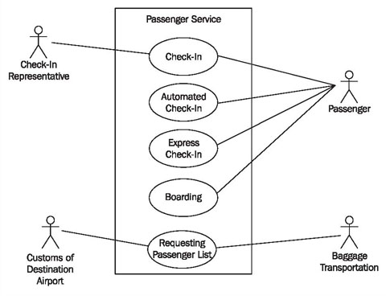
Use Case Diagram
Visual description
Simplified
Easier to view
Building blocks:
Actors
Use cases
Boundaries (optional)
Relationships
Associations
Include
Extend
Generalizations
Only one we will look at for now

Slide 18
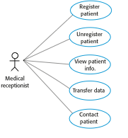
Use cases involving the role ‘Medical Receptionist’

Slide 19
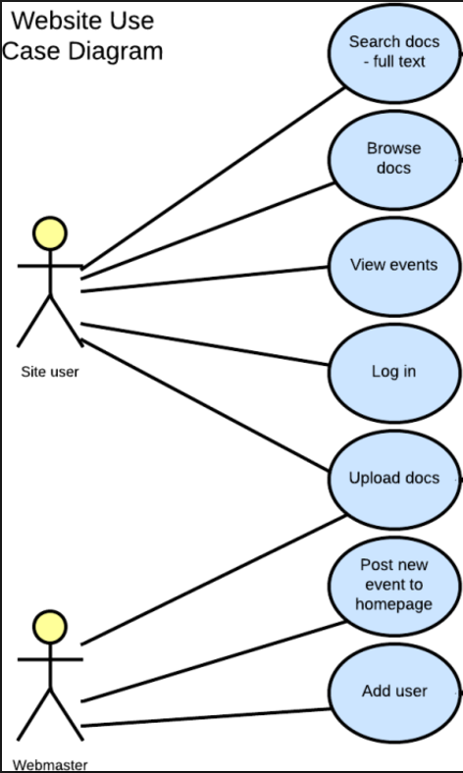

Slide 20
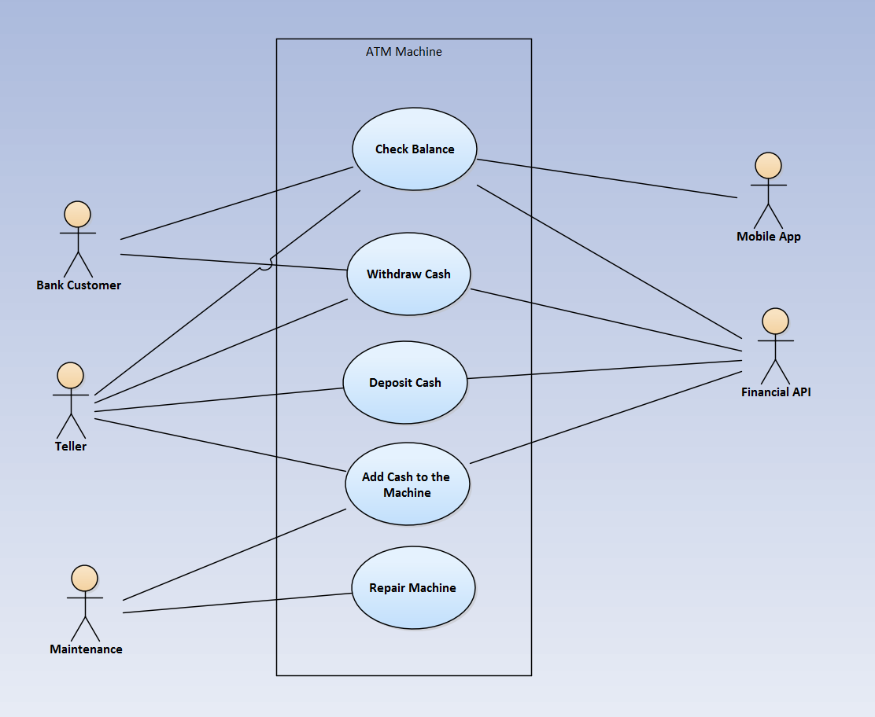
A more complex diagram

Slide 21
Review
User stories: short description of interaction
“As a <specific type of user>, I want to <action> so that <reason>”
Use cases:
actors, goals, scenarios
sunny day, rainy day scenarios
Use case diagram: actors + use cases + associations

