Slide 1
Requirements and User Stories
Notes:
Critical: make sure students read this chapter before doing the notes

Slide 2
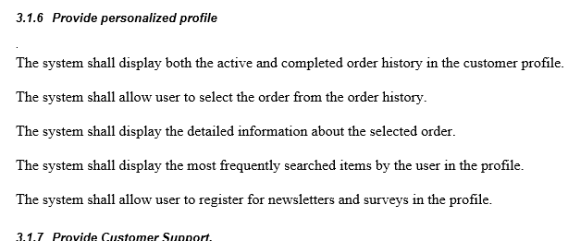
What is a Requirement?
Describe how the software should act.
Great detail on how the software should work.
Requirements docs contains executive summary, scope, assumptions, estimates and actors (team roles).
Purpose is to guide how the software team will build something.
Often specified as text use cases
  Other formats exist
Formal requirements are put into a Software Requirements Specification (SRS) document

Slide 3
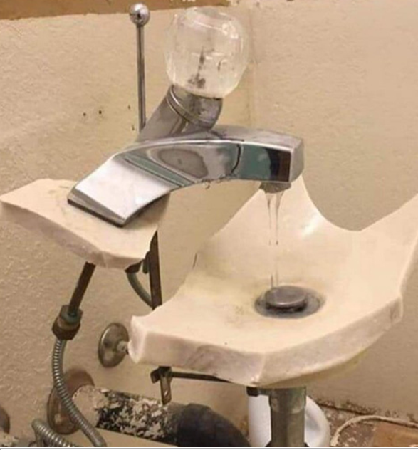
Customer
I want to wash my hands
Software engineer:

Slide 4
Nonfunctional requirements
Definitions:
  A property of the system, not a specific operation
  Cross/cutting concerns/needs which apply to many project elements
Not: bad
Examples?
  Safety, security, performance, robustness
  Learnability, natural language support
Traditional concern: hard to test
  In practice: need testable version

Slide 5
More on user stories
Short description of functionality told from user’s perspective.
Focus on why and how user interacts with the software
  As an online customer, I want to be able to view the items in my virtual cart so I can confirm I am buying what I need.
Open question: what exactly is an appropriate user story
  This will be a key tool for gathering, documenting requirements
  We need to know how to capture that

Slide 6
Starting point: when are we done?
How do I know if a user story is completely implemented?
  Story just captures basic operation, little detail
Solution: acceptance criteria
  List of conditions
  When story implementation accepted by client
Consider
  As an online customer, I want to be able to view the items in my virtual cart so I can confirm I am buying what I need.
Acceptance criteria:
  Given that the online customer has added two items to their virtual cart, when they click on the cart icon they will be redirected to a page that lists all of the items in alphabetical order along with images, descriptions, and prices, and in which the descriptions are clickable links to go to the product’s page.
Often need more than one!
  Such as error cases, alternative sequences, additional detail

Slide 7
Comparing user stories to requirements
Requirements | User Story
Contract mentality – waterfall model | Agile methodology: respond to need
Heavy documentation | Light weight
Detailed requirements are often wrong and incomplete | Initiate conversation
Details emerge over time as we work | Developed improved understanding over time
Requirements become outdated by the time the app is coded | Room to add new feature or address a fix
Minimizing new features – more stable design | New features can trigger redesign

Slide 8
Anatomy of a complete user story
Title: | Any short and meaningful title | Any short and meaningful title
Narrative
Start with summary in one of these standard forms: As a <Role>, I want to <Action> so that <Benefits> A <Role> can <Action> so that <Benefit> <Role><Action> so that <Benefit> If necessary, can include links to images, screenshots or external documents. Example: As a frequent shopper, I want to see the value of my reward points so I know what items I can add to my shopping cart.
Acceptance Criteria
List specific criteria that must be met for deliverable to be accepted. Example: Confirmation message points have been successfully added Verify points are aggregated from purchase

Slide 9
Writing good stories
I
Make stories as independent from each other as much as possible
N
Not overly detailed. Details emerge in negotiation.
V
Deliverable perceived as valuable to users or customers
E
T
S
Domain, technical knowledge allow the teams to provide estimate
Small or appropriately sized so the team can finish one Story in a few days, several in one Sprint
Validation criteria and techniques are specified clearly so it is testable
Short cycle of development
A Scrum project is a sequence of sprints

Slide 10
For example
User Stories | Independent | Negotiable | Valuable | Estimatable | Small | Testable | TOT
Allow a job user to post a resume | 1 | 2 | 1 | 3 | 2 | 1 | 10
Information on the resume can be exported to a PDF | 4 | 4 | 5 | 4 | 5 | 5 | 27
Job user can submit up to 5 work experiences | 2 | 4 | 1 | 1 | 2 | 3 | 13
Potential employer can search by technical skills | 5 | 5 | 5 | 5 | 5 | 5 | 30
Job user can tie different cover letters to specific resumes | 1 | 3 | 5 | 5 | 3 | 4 | 21

Slide 11
A matter of scale
Stories can be very detailed:
  As a student, I want to see the total number of credits for the courses which I have added to my schedule so I can limit my workload.
Stories can be very broad – epics.
  As a student, I want to take courses that allow me to complete major requirements so I can graduate in four years.
Why can’t we just write epics?
Why not have lots of detailed stories?
Notes:
Why not all one or the other:

Slide 12
Themes vs Epic vs Story vs Task
All could be used to describe parts of a project
Need consistent terminology
Theme | Epic | Story | Task
Collection of Stories by category | A BIG story | Individual feature | Elements of a story
Epic can also be a theme by itself | Too big to deliver in a single sprint | Deliverable within a single sprint | Specific and measurable
 | Needs to be broken into smaller stories | Product Backlog Item (PBI) | Achievable - timeboxed
Weeks | Months | Days | Hours

Slide 13
Knowledge Acquisition Stories
Prototype/spike/experiment/proof of concept
Example: evaluate alternative designs
  Key: repeatable results
Why shouldn’t these be allowed?
  Be suspicious of anything not delivering value
Why should they be allowed?
  Important principle: fail fast
How does the cost to unwind factor in?

Slide 14
Gathering stories
Who should do it?
  Should product owner be the sole team rep?
Basic method: ask user
  Why might this not be effective?
User-story-writing workshop
  What? Who? Why? How long? Goal?
  Steps:
    User role analysis: give names, personas to roles
    Brainstorm: bottom-up, top-down, story map
Story Mapping: epics, themes, stories – p. 97
  Often more focused on prioritization.

Slide 15
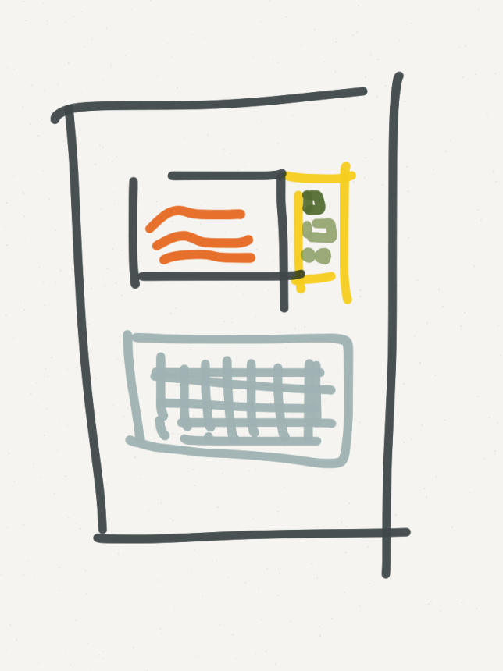
How would we “test” stories?
Best practices: integrate testing throughout product cycle
  So how to test a story?
Thoughts???
  How have you tested your code previously?
  Is there more that you should do?

Slide 16
Stories vs. Requirements
Are stories just another form of requirements?
  Can document reqs in acceptance criteria
  Why wouldn’t reqs work as sprint tasks?
Why might we still need a traditional requirements document?
  Safety critical systems: must trace requirements through project.
  Would stories be the most effective way to organize such requirements?

Slide 17
Review
More on requirements, stories
Nonfunctional requirements: crosscutting concerns
Stories: capture elements
Acceptance criteria: tests for accepting story implementation
  How we know a story is done
Knowledge acquisition: stories to learn/test new ideas
  Useful, but be cautious of overusing
Next: capturing stories/scenarios as sequence diagrams

