Slide 1
Design and UML
Sequence Diagrams
“There are two ways of constructing a software design. One way is to make it so simple that there are obviously no deficiencies. And the other way is to make it so complicated that there are no obvious deficiencies.”
– Tony Hoare

Slide 2
Creating a design
How did you design your software in other projects?
What is the limitation of those approaches as software gets bigger/more complex?
Basic issue: if going to write an object-oriented system, need classes!
Key observations:
  Instances of classes are things
  Things mentioned in user stories & acceptance criteria are important to the project
  Use stories, acceptance criteria to identify nouns
  This gives an initial set of classes, then refine to get final system
Assumption: must have full set of user stories
Or at least all of the key ones
Can design as you go...

Slide 3

Textual Analysis of Use Case scenarios is used to create high-level designs
Precondition: User Stories should be complete, so that all capabilities of the system are described
Textual Analysis is a quick and easy way to make a “first guess” at the classes that will comprise the system

Slide 4

Textual Analysis: looking for the nouns and verbs
-in your Use Cases/User Stories
Nouns in the Use Cases are candidates for the classes you need to write
  Grammar 101: nouns are things
Verbs in the Use Cases are usually the methods that the classes implement
  Verbs are actions

Slide 5
Examples
As a student I would like to see my grades in Canvas in order to know how I am doing in a class.
  Student, Grade, Class
  AC: how grade computed: Submission, Assignment, Score
As a bank customer I would like to deposit checks using my phone in order to avoid going to the bank
  Customer, Check, Phone, Bank
Note the acceptance criteria usually has to be considered as well!
.

Slide 6
Approach: Read through each Use Case, picking out the nouns appearing in the scenario descriptions
You’re actually discovering objects, which are instances of classes that abstract the problem domain entities
As a student I would like to see my grades in Canvas in order to know how I am
doing in a class.
As a bank customer I would like to deposit checks using my phone in order to
avoid going to the bank.

Slide 7
After identifying nouns, eliminate redundancies
“list of names”
“name collection”
“array of names”
“Welcome message”
“Welcome dialog”
“Welcome screen”
“Names”
“Welcome Screen”
Note: Do not identify individual Buttons,
Checkboxes, Menus, etc as individual nouns;
these would all be part of a parent screen.

Slide 8
Some Nouns can be excluded
The following nouns are not candidates for classes:
“user retrieves cash from ATM”
  If cash is just a number, not a good class
  But if thinking about the dispenser software, maybe...
“user inserts envelope into ATM”
  envelope: just a container for cash; no software requirements
  Another way to consider it: no responsibilities

Slide 9
Write the objects and methods for the following User Stories...
As a Facebook user, I would like to be able to read my messages when I get a notification so I can respond appropriately.
As a Facebook user, I would like to respond to messages in the same window as I read the message so I can respond appropriately.
As a Facebook user, I would like to see when someone else has read my sent messages so I can know whether I should keep monitoring them.

Slide 10
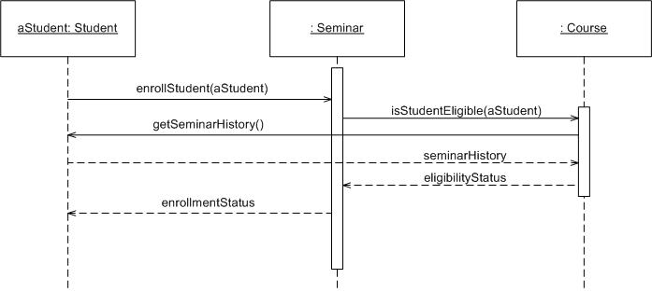
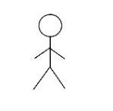
UML Sequence Diagrams
aStudent : Student
Alternatively, actors can be
shown using an image
Sequence diagram: captures the sequence of messages between objects
Across the top: instances of objects
Dashed line: timeline for the object
Arrows: messages sent to objects
  Messages ordered from top to bottom
  Boxes on timelines: a call to a method
  Dashed arrows: value returned – these are optional

Slide 11
Sequence diagrams: high-level interactions
  A diagram: one interaction for a specific circumstance
    e.g. startup, shutdown, processing a single button click,…
    for us: method calls
      Can have other ways, but out of scope for this course
    Generally the interaction shown is interesting or important for some reason
  Key: a diagram captures sequence of events around a scenario
: ATM
checking : Account
savings : Account
main
status = withdraw(100)
status = deposit(100)

Slide 12
Sequence diagrams: high-level interactions
public class ATM {
private static Account checking = new Account();
private static Account savings = new Account();
private ATM() { }
public static void main(String[] args) {
boolean status = checking.withdraw(100);
status = savings.deposit(100);
}
}
Note: form of name in box is variable_name : class
These are instances at runtime
Use : X if the instance is obvious
: ATM
checking : Account
savings : Account
main
status = withdraw(100)
status = deposit(100)

Slide 13
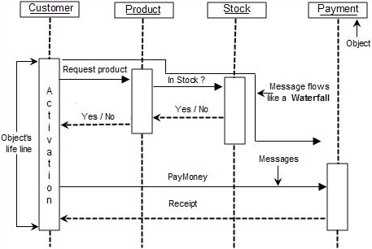
Example
Can you improve on this?

Slide 14
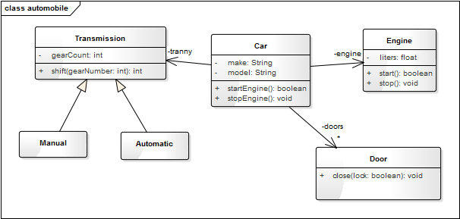
Example
Create a sequence diagram for starting a car
Sequence diagram for opening a door?
Is closing a door different?
Are all of these diagrams useful?
  Avoid drawing diagrams that are obvious!
  If diagram (or documentation) seems obvious, dig deeper for something that does add information

Slide 15
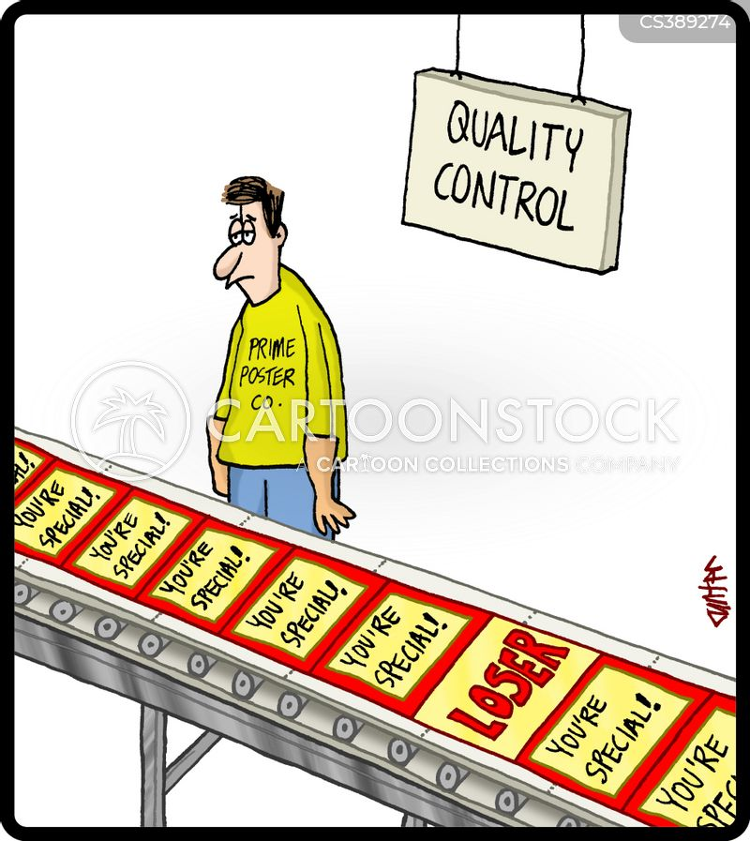
Enterprise Architect
Why might it be a bad idea to draw all diagrams by hand?
  Hard to read
  Low effort: suggests team did not really care
  Painful to maintain
    Try global search-and-replace on a drawing
Word, drawing tools
  Author spends a lot of time getting the details to fit the standard
  Again, it suggests the team does not care about quality
Enterprise Architect (EA)
  Reasonably compliant
  But yes, painful to learn…
Without quality, might as well go home…
Note: EA is required, but can use trial version if necessary
Notes:
Image obtained from cartoonstock, https://www.cartoonstock.com/cartoon?searchID=CS389274
“Necessary” meaning you need to use a computer other than the one you rented through the school

Slide 16
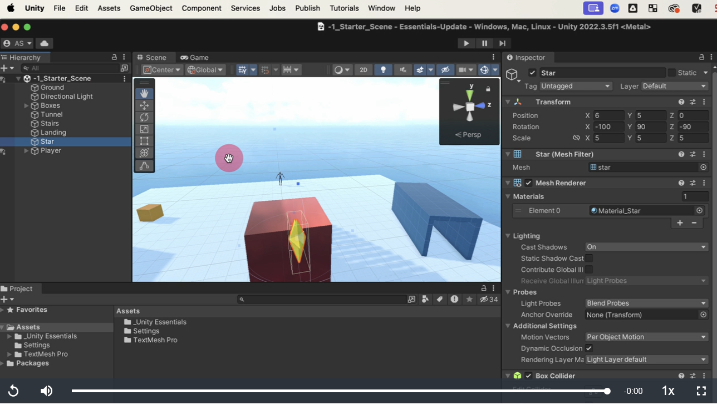
Living with the beast…
Why is EA hard?
  It’s big because it addresses lots of software design issues, very flexible
  But it’s not the only large system! Consider Unity…
Notes:
Image from Unity tutorial at https://learn.unity.com/pathway/unity-essentials/unit/editor-essentials/tutorial/explore-the-editor-interface-1-1?version=6.3

Slide 17
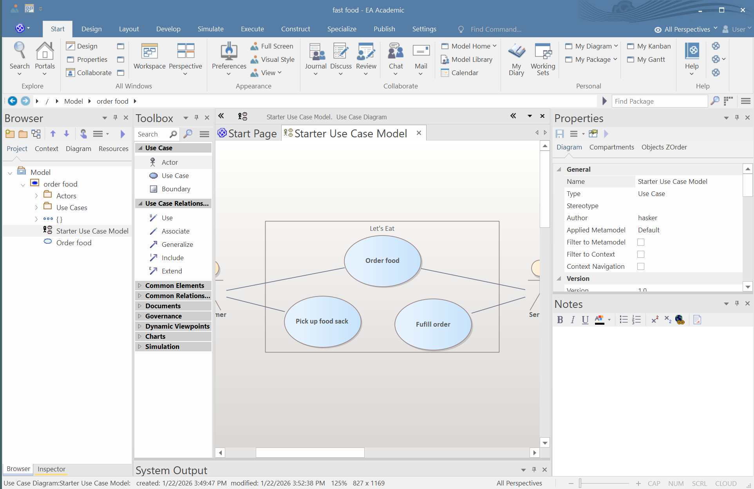
Living with the beast…
Keep notes on the parts of the menu you use
Why is EA hard?
  It’s big because it addresses lots of software design issues, very flexible
  But it’s not the only large system! Consider Unity…
Core elements of EA
  Model: diagrams
  Properties: element
  details
  Toolbox
Diagram editor
With a little practice, drawing diagrams with EA is faster
Getting used to this will help with other tools…

Slide 18
Example
Create a sequence diagram for...
  Opening Facebook on a phone
  Checking messages
  Replying to a message
  Closing the app

Slide 19

Design patterns
A design pattern is a way of reusing abstract knowledge about a problem and its solution
  A pattern is a recurring solution to a standard problem, in a context
Pattern descriptions usually make use of object-oriented characteristics
  inheritance, polymorphism, encapsulation
What commonly-used patterns can you think of?
  Not necessarily software…

Slide 20
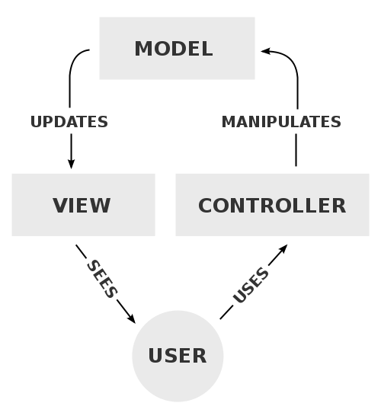
Model, View, Controller
Note: each is a group of classes;
the actual classes are problem-specific.
Model: data and the operations on the data
View: displays the model
Controller: translates user actions into actions on the model
M
Model
View
Controller
V
User
C

Slide 21
Further refinement of MVC
View Objects
  Model the system boundary
  User Interface elements (entire screens, but not individual UI elements)
Controller Objects
  Manager, typically capturing “business rules”/policy
  Code that runs when click button, select menu item, etc.
  JavaFX controller class for small projects, move code out for larger classes
Model Objects
  Persistent data – often saved and then restored at startup
  Domain objects identified during noun analysis
The precise/permanent classification of objects is not always
possible upon first review – iteration is often necessary!

Slide 22
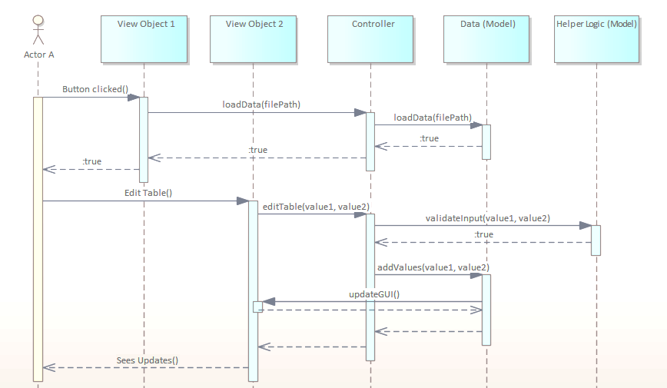
Constraints on relationships
Actors: only interact with View objects
View objects: typically call methods on controllers, actors
Model objects: typically just call controller operations
Controllers: interact with view, model; not actors
Single controller for most systems

Slide 23
Demo!
Let’s create a sequence diagram in EA for a simple ATM scenario…
Notes:
  Precondition: have EA class model for domain
  Create a simple sequence model, remove all elements from the model
  Drag classes from Model browser onto sequence diagram
  When add method call, select from dropdown after creating arrow

Slide 24
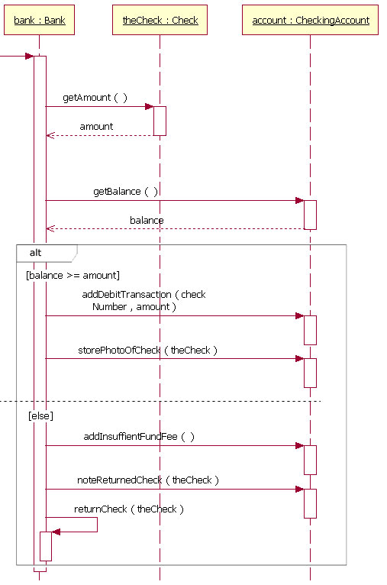
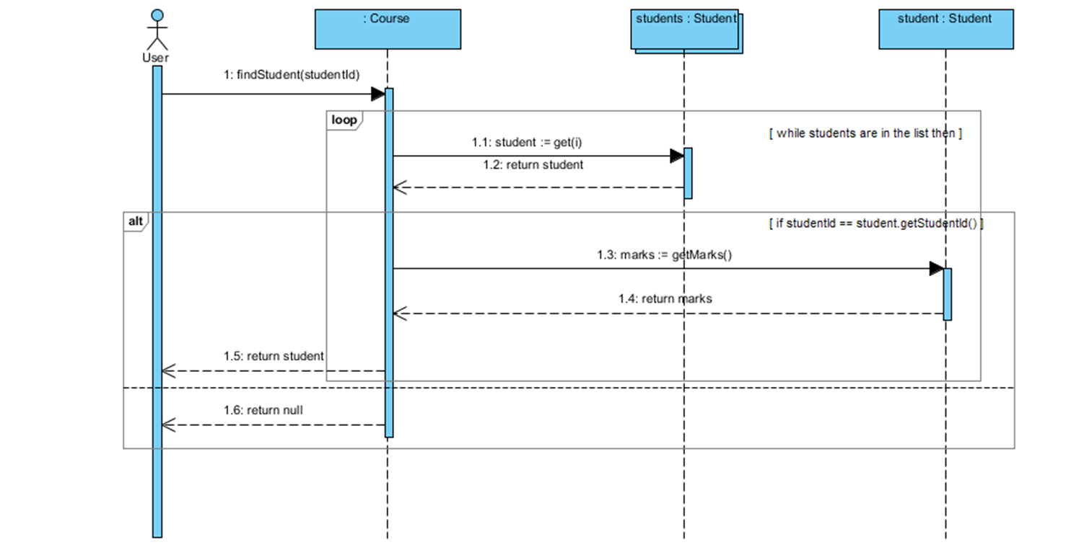
Additional notation
Conditional logic: [else], [balance >= amount]
Iteration
Conditionals, iteration are useful at times, but not absolutely required
For example, a single pass through a loop usually captures the methods you need
If need iteration or conditionals, the assignment will specify it explicitly

Slide 25

Similarly, you can illustrate iteration

Slide 26
Review

