Slide 1
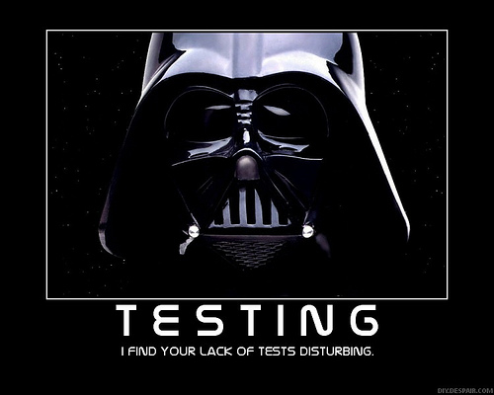
Introduction to Testing

Slide 2
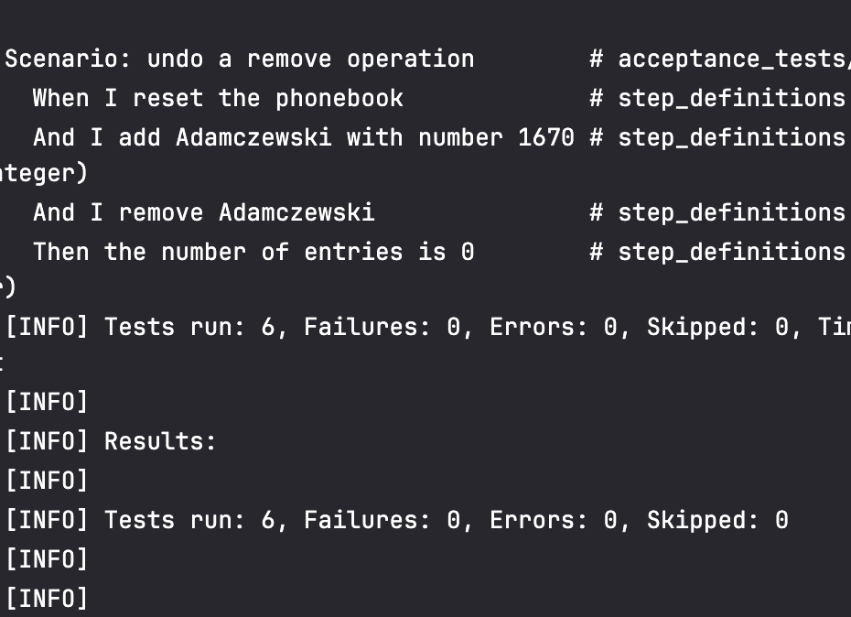
Testing
What is the goal?
Typically: show program works as intended
Find the errors before the users do!
What can a test show?
Not: the code has no errors
Only: this particular test produces the correct result
What about nonfunctional requirements?
Eg: System can process 1000 transactions per minute
Test: randomly generate several thousand transactions, measure time to process
Tests show the presence of errors, not an absence
Sometimes successful tests are ones which find errors!
But is this enough? What else could go wrong?
Validation and verification: checking have the right requirements and that the requirements implemented

Slide 3
V&V
Validation
Verification
Evaluating the product to see if meets the requirements
Specified by the customer
Was the right software built?
Does it match what the customer wants?
Specification
Evaluating the product to see if it meets the design
Specified by the architect
Was the software built “right”?
Does it match the design?
Both must be performed!

Slide 4
Test-Driven Development (TDD)
Why worry about testing before we write any code?
If can’t write tests, do we understand the requirements?
Gives a goal to be satisfied: simple checks if code starting to work!
Write tests first!
Leads to writing methods that are easy to test
Helps focus developers on writing cohesive, single-purpose methods/classes
Encourages simple interfaces – low coupling

Slide 5
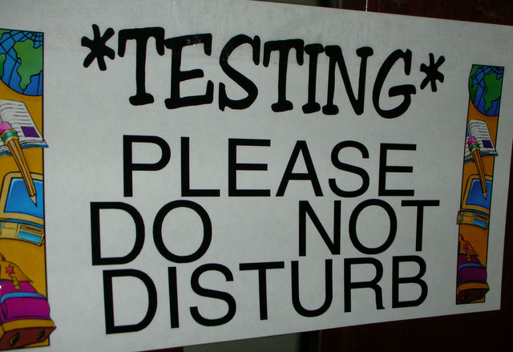
Testing Scope
Unit testing
Test individual components in isolation
Units: Classes, methods, etc
Usually done by the developer
Integration testing
Test groups of components which interact
Key element: testing interfaces
Acceptance testing
Test full system
Checks from the client’s point of view

Slide 6
Testing methods
Just run the code
Difficult to reproduce results
Depends on people taking time to do the tests
Written test plans
Reproduceable, but painful to run
Unless someone paid to do it, probably will just run the tests once...
Separate test programs
Flexible, but a lot of setup
Better: combination of unit tests, other methods

Slide 7
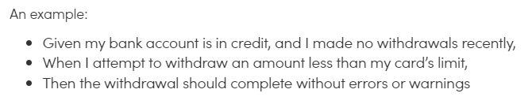
Acceptance Criteria - First Pass
Given
Given some context
When
When some action is carried out
Then
Then a particular set of observable consequences should happen

Slide 8
Testing Activity
In pairs
Identify one testable acceptance criteria for the Tool Monitoring App
Write one test for your acceptance criteria
Given
When
Then
If you are stumped, try using ChatGPT or Gemini!
These will be presented

Slide 9
Acceptance Testing Objectives
Three major objectives of acceptance testing:
Confirm that the system meets the agreed upon criteria
Identify and resolve discrepancies
If there are any
Determine the readiness of the system for cut-over to live operations

Slide 10
Full Acceptance Tests
All acceptance tests should be established BEFORE a design is implemented
Why?
Test cases must be written
Why is documentation important?
How many???
Let’s look at some detailed test cases
DH Room Reservation App
What other test cases could we write?

Slide 11
Criteria to consider
Functional Correctness and Completeness
Accuracy
Data Integrity
Data Conversion
Backup and Recovery
Competitive Edge
Usability
Performance
Start-up Time
Stress
Reliability and Availability
Maintainability and Serviceability
Robustness
Timeliness
Confidentiality and Availability
Compliance
Installability and Upgradability
Scalability
Documentation

Slide 12
Acceptance Test Execution
Acceptance testing: developed by (or at least with) customer
Two subgroups
Basic/fundamental
Complex/nuanced
If the basic tests pass, then move onto the complex tests
Test status must be documented
Defects should be documented for future repair
Behavior-driven development (BDD)
Automate turning acceptance criteria into executable tests
Acceptance test: all AC pass
Win: executable requirements documentation!
Win: end users/others can write your tests for you!

Slide 13
Review
Goal of testing: find errors
NOT: show no errors
Verification and validation
Test-Driven Development (TDD)
Write tests before code
Types: unit, integration, system, acceptance
Acceptance criteria: acceptance testing for a story
Behavior-driven development: write AC before code
Using given/when/then to capture acceptance criteria

Slide 14
Quotable quotes
Wisdom of Andy Lester (experienced, published engineer)
Never underestimate the power of one little test.
There is no such thing as a dumb test.
Your tests can often find problems where you're not expecting them.
Test that everything you say happens actually does happen.
If it's worth documenting, it's worth testing.
Moses Jones, software developer
If you don't unit test then you aren't a software engineer, you are a typist who understands a programming language.
“If it ain’t tested, it’s broke.”
- Pete Schumacher, avionics test engineer

