Slide 1
WearOS

Slide 2
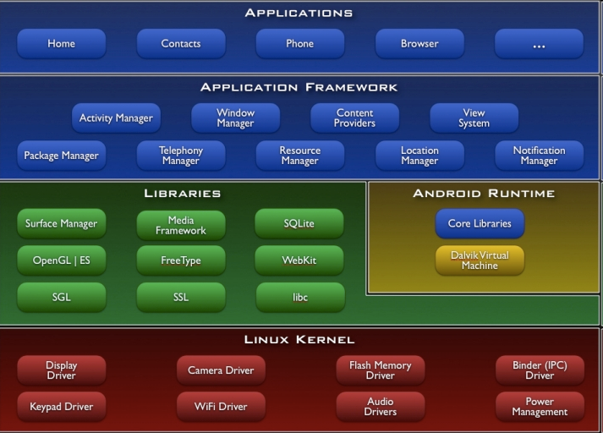
What is Android?
Android is a complete software stack for mobile phones, cars, tvs and more!
3.5 billion Android active users!

Slide 3
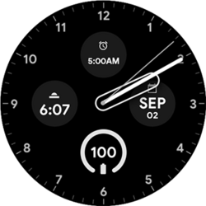
WearOS
Closed-source Android distribution for smart watches
~20% market share
Competitors
  Garmin ~8% market share
  Apple ~28% market share
  Others

Slide 4
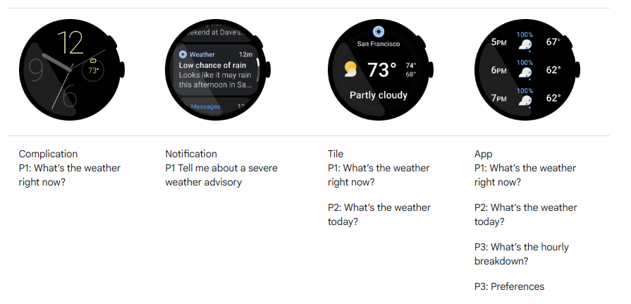
WearOS Principles
Focus on user and how they will use the app
Any feature displayed in addition to the time
Shown in the tiles carousel with a quick swipe

Slide 5
App
Focused view that handles tasks too complex for a complication, tile, or notification
Options
  View-based
    VERY similar to JavaFX
  Compose-based
    Declarative UI toolkit
    Less code

Slide 6
Health Services
Intermediary between sensors and your apps
  No need to connect to sensors directly
  You don’t need to develop your own algorithms!
Manages battery optimally
Concepts
  Data types (single point in time-BPM, interval data-DISTANCE)
  Events (goal states)
  Exercise Types
Data can be emulated with Simulated Sensor Data
  https://developer.android.com/health-and-fitness/guides/health-services/simulated-data

Slide 7
Tasks
Build your first Hello World Application on WearOS
  https://developer.android.com/training/wearables/get-started/creating
Run the app on an emulator
Update the GUI message to include your name
Note: The quiz this week will ask you to upload a screenshot of your working Hello World App running in the emulator

