Slide 1
UML Class diagrams
SWE 2710 Tools and Practices
Notes:
Acknowledgement: Slides originally by Dr. Hasker

Slide 2
UML Refresher
See https://faculty-web.msoe.edu/hasker/resources/uml
Basic notation to know:
Class, attributes, methods
No constants, other trivial attributes; types only where critical
No constructors, setters, getters
Associations: directed, undirected
Show just the association if another class is a member
Directed association: has-a; more on this later
Multiplicities: *, +, 1, 3..5
Role names: names for class instance variables
Generalization, implements
Stereotypes: <<interface>>, <<abstract>>, etc.

Slide 3
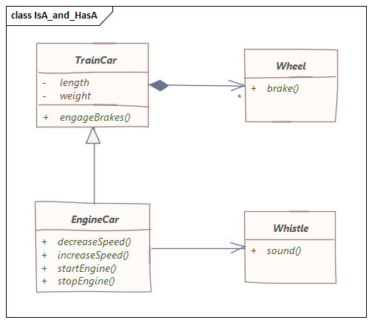
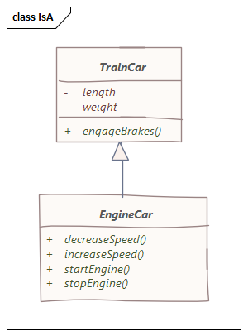
is-a, has-a, needs-a
What does “is-a” mean in a class diagram?
How is this drawn?
What does “has-a” mean in a class diagram?
What are the different ways this can be drawn?
Note: if has-a is in the domain, don’t want to introduce programming
concepts like declarations!
Don’t show both an association and attribute for the same concept!
Special case for “has-a”: needs-a
The train car needs wheels or it’s not really a train car!
Always use the arrow with this connector!
Use is-a, has-a, needs-a to determine connectors
Note the direction works in all cases
At the domain level, these are invaluable checks
Not reasonable: “A box is a train car” – use “BoxCar” instead
Caution: don’t use needs-a everywhere
Yes, requirements may say the EngineCar must have a whistle,
but there is no logical reason it has to have a whistle – could put whistles on wheels
Notes:
Other examples of has-a vs needs-a: a binary search tree needs a root node (it isn’t a tree otherwise), a house needs walls and a roof but has a garage.

Slide 4
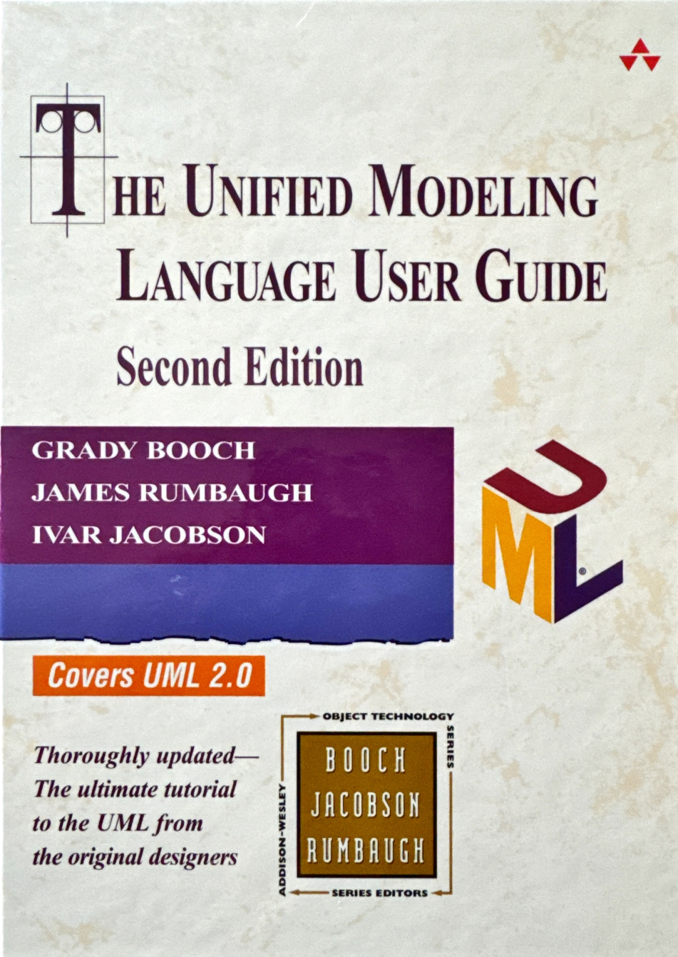
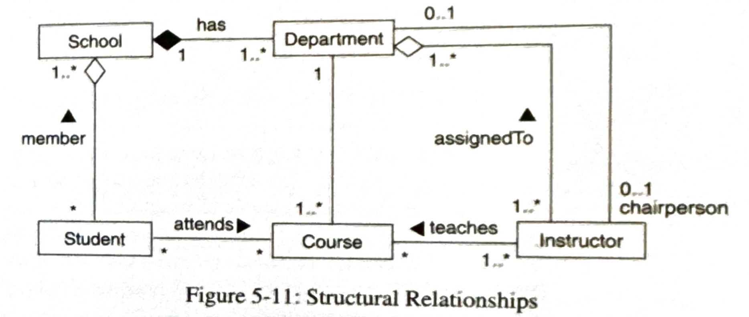
Open vs. closed diamonds
Common issue: composition vs. aggregation
Just has-a – no difference from straight line
Do not use!
needs-a – very useful!

Slide 5
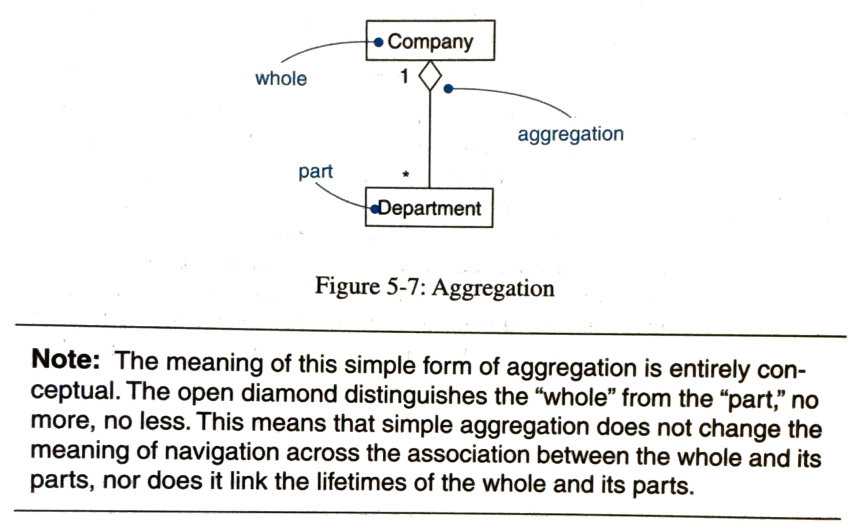
Open vs. closed diamonds
Common issue: composition vs. aggregation
needs-a – very useful!
UML User Guide, p. 68: Open diamond has no impact, no meaning
Notes:
p. 68, top

Slide 6
Minimal Clutter
Where are the types?
Are they needed by the user?

Slide 7

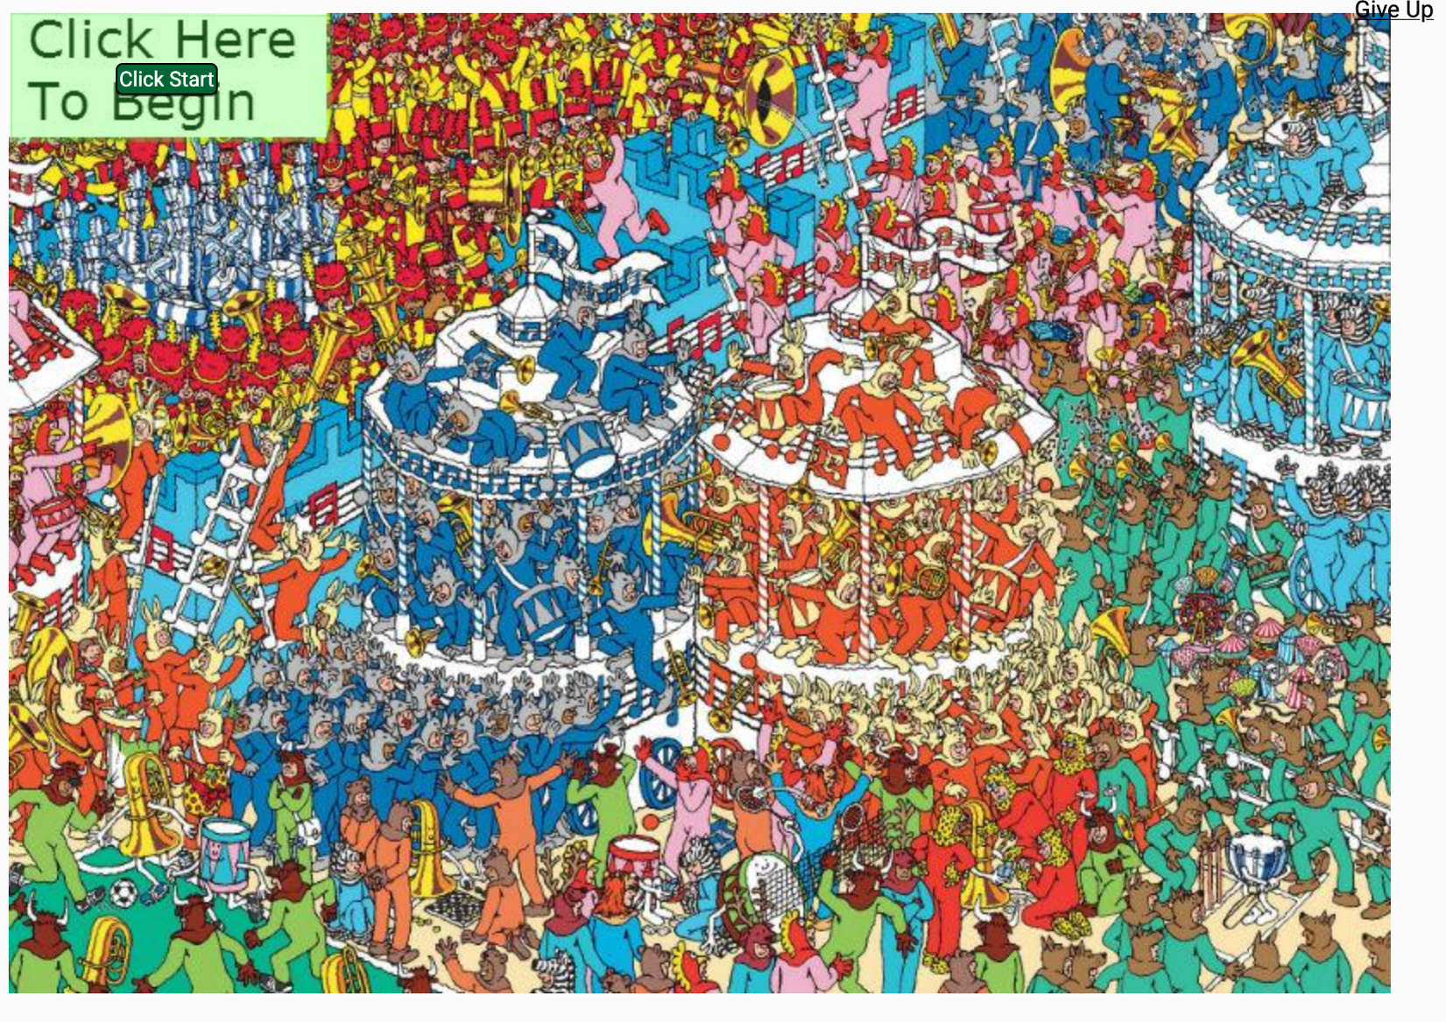
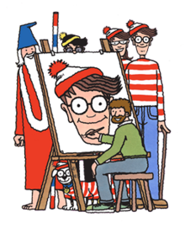
Where’s Waldo?
Why is Waldo so hard to find?
Unnecessary clutter?
Compare to following:
(sporcle.com)
(https://en.wikipedia.org/wiki/Where's_Wally)
Notes:
Waldo is to the left of the light-blue striped carousel in the upper right; the tuba points at him

Slide 8
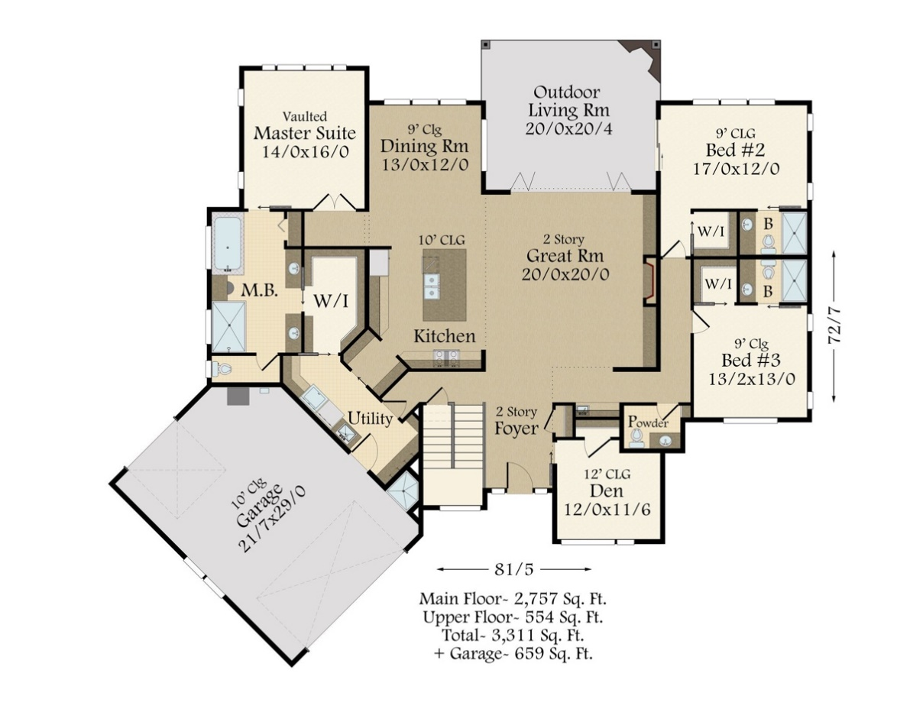
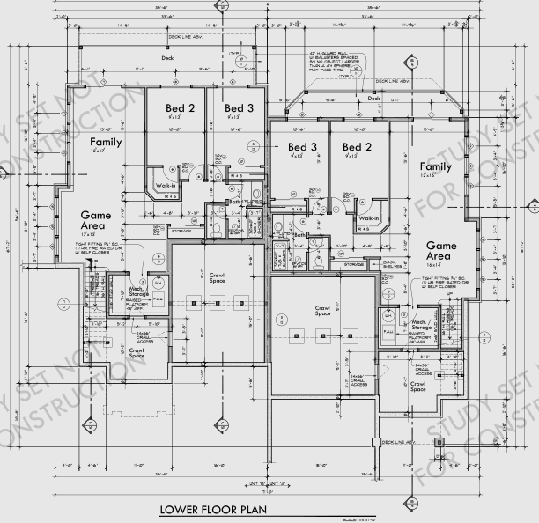
Example closer to software:
or
Which would you show to a client?
Which would the builder use?
Notes:
Image on right has exact measurements throughout the building

Slide 9
Minimal Clutter
Where are the types?
Are they needed by the user?
Types:
Important to implementation
Not important to clients – they just add clutter!
Experienced developers can infer the type from the diagram
May need full detail: contract diagram
Very useful in large projects
Makes it easier for one piece of code to interact with another
Our focus will typically be on clients and user requirements…

Slide 10
Domain classes
Implementations: solution space
Classes that are in a particular solution
Possible classes: table of restaurants to GPS coordinates, table of restaurants to menus, table of dietary restrictions to menu items
Problems: domain classes
Classes that are part of the problem space
Start with these classes, add solution classes only as needed
Why prefer domain classes?
Solution independent – less likely to change to support new features
How would each solution change if we track popularity and wait times?
Natural: these are the entities that form the problem to solve
Design: adding solution space classes to meet goals
Notes:
Goals: performance, portability, safety, reliability

