Slide 1
Scrum
SWE 2710

Slide 2
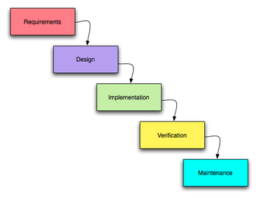
Classical software development
Known as waterfall model:
Water gently flowing down hill towards a goal…
But what happens if discover a problem?
Is this really more like Niagara Falls?
Not agile – doesn’t respond to change well
So why was this ever used?
Requirements: talking to customer
Design: How to implement requirements
Implementation: coding
Verification: testing
Maintenance: fixing
Justification:
Simple
Covers all necessary products

Slide 3
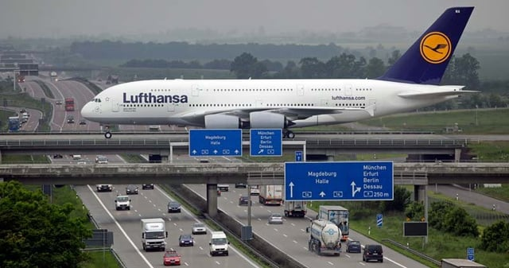
The case for plan-driven development
Consider the A380
          5000+ ft² floor space, up to 853 passengers, $4e8 a plane
          Thousands of engineers
          Some planning may be helpful!

Slide 4
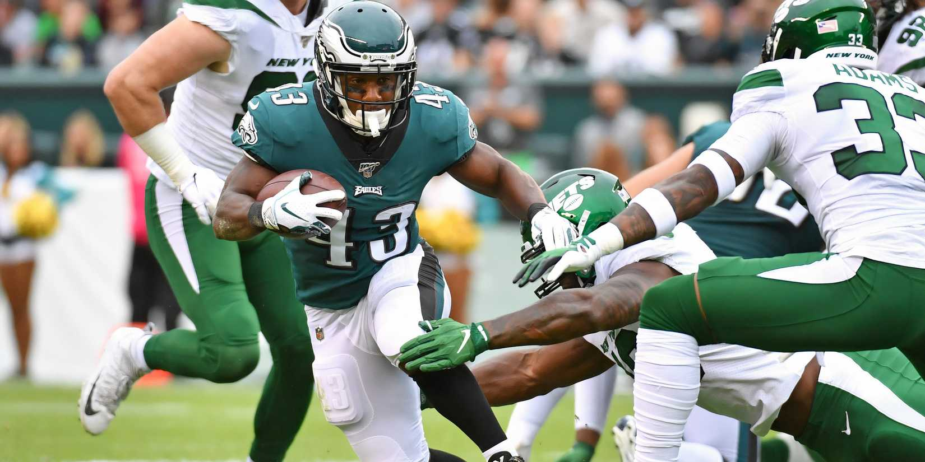
The case for agile
The problem with planning: estimation
  Estimation is hard!
  Get better with experience, but it’s still hard
  Customers rarely know what they want up front
Agile
  Develop the plan as you go
  Be more responsive
  But how can this work?
Many agile methods
  Kanban (motivated by manufacturing)
  Extreme programming – because who wouldn’t want to be an extreme programmer
  The method we study in 2710: Scrum
Notes:
Picture from https://www.givemesport.com/most-agile-nfl-players-all-time/ (captured Feb, 2026)

Slide 5
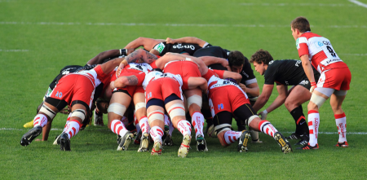
Why the name “scrum”?
Origin of term: rugby football
  Scrum: restarts game after interruption
  Players struggle to gain possession of ball tossed between teams
Folks working together to solve shared problem; no leaders
  Key difference: no opposing team!

Slide 6
Scrum has been used by:
Microsoft
Yahoo
Google
Electronic Arts
Lockheed Martin
Philips
Siemens
Nokia
IBM
Capital One
BBC
Intuit
Nielsen Media
First American Real Estate
BMC Software
Ipswitch
John Deere
Lexis Nexis
Sabre
Salesforce.com
Time Warner
Turner Broadcasting
Oce
Notes:
6

Slide 7
Scrum has been used for:
Video game development
FDA-approved, life-critical systems
Satellite-control software
Websites
Handheld software
Mobile phones
Network switching applications
ISV applications
Some of the largest applications in use
Commercial software
In-house development
Contract development
Fixed-price projects
Financial applications
ISO 9001-certified applications
Embedded systems
24x7 systems with 99.999% uptime requirements
the Joint Strike Fighter
Notes:
7

Slide 8
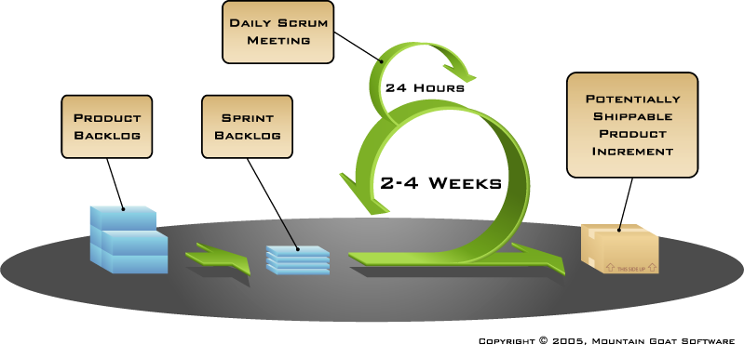
Scrum Basics: project = Σ_{i=1..n} sprint_{i}
If you find videos useful:
  http://www.youtube.com/watch?v=D8vT7G0WATM

Slide 9
History of Scrum
1995:
  analysis of common software development processes → not suitable for empirical, unpredictable and non-repeatable processes
  Design of a new method: Scrum by Jeff Sutherland & Ken Schwaber
  Enhancement of Scrum by Mike Beedle & combination of Scrum with Extreme Programming
1996:
  introduction of Scrum at OOPSLA conference
2001:
  publication “Agile Software Development with Scrum” by
  Ken Schwaber & Mike Beedle
Successful appliance of Scrum in over 50 companies
Founders are members in the Agile Alliance
83% of companies use Scrum or a variant today!
Notes:
Successful = increase in productivity, satisfied/ happy team

Slide 10
Scrum – a lightweight, agile process
Key goals:
  Iterative, incremental process
  Team-based approach
  developing systems/ products with rapidly changing requirements
  Controls the chaos of conflicting interest and needs
  Improve communication and maximize cooperation
  Protecting the team form disruptions and impediments
  A way to maximize productivity
Developed in the 1990s, became the default process by about 2010

Slide 11


Sequential vs. overlapping development
Requirements
Design
Code
Test
Rather than doing all of one
thing at a time...
...Scrum teams do a little of
everything all the time
Notes:
11

Slide 12
Scrum framework
Roles
Product owner
ScrumMaster
Developers
Ceremonies
Sprint planning
Sprint review
Sprint retrospective
Daily scrum meeting
Artifacts
Product backlog
Sprint backlog
Burndown charts
Notes:
12

Slide 13

Product owner
Define the features of the product
Decide on release date and content
Be responsible for the profitability of the product (ROI)
Prioritize features according to market value
Adjust features and priority every iteration, as needed
Accept or reject work results
Notes:
13

Slide 14

The ScrumMaster
Represents management to the project
Responsible for enacting Scrum values and practices
Removes impediments
Ensure that the team is fully functional and productive
Enable close cooperation across all roles and functions
Shield the team from external interferences
Notes:
14

Slide 15





Developers
Typically 5-9 people
  May include ScrumMaster as developer
Cross-functional:
  Programmers, testers, user experience designers, etc.
Members should be full-time
  May be exceptions (e.g., database administrator)
Teams are self-organizing
  Ideally, no titles
Membership should change only between sprints
Notes:
15

Slide 16
Scrum framework
Roles
Product owner
ScrumMaster
Developers
Ceremonies
Sprint planning
Sprint review
Sprint retrospective
Daily scrum meeting
Activities done each sprint
Artifacts
Product backlog
Sprint backlog
Burndown charts
Notes:
16

Slide 17
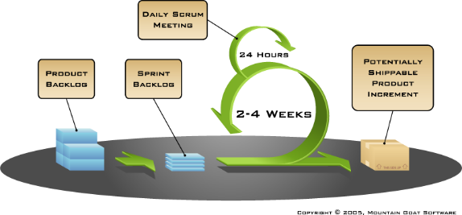
Sprint Planning Meeting
Activities spread throughout sprint
  Identify items to put on the product backlog
    Product Backlog Items: PBIs
  Refine those items: ensure the stories are sprintable
  Estimate their size
Start of sprint
  Product owner: identify highest priority items
  Team: Finalize any details
  Identify sprint goal: where are we headed?
Sprint starts
  With work to be done
  Note: tasks NOT assigned – the sprint backlog belongs to the team
  You may know who will do certain PBIs at start, but
  Anyone can pick up an item that is not started...

Slide 18


Team capacity
Sprint planning meeting
Sprint prioritization
Product backlog
Sprint
goal
Analyze and evaluate product backlog
Select sprint goal
Business conditions
Sprint planning
Decide how to achieve sprint goal (design)
Create sprint backlog (tasks) from product
backlog items (user stories / features)
Estimate sprint backlog in hours
Current product
Sprint
backlog
Technology
Notes:
18

Slide 19
Lets try it
The product owner wants you to create a sandwich for her restaurant
The product backlog contains the following items (ranked):
  Find recipe
  Purchase ingredients
  Combine ingredients
  Test for quality (eat)
  Refine recipe to maximize profitability
  Refine recipe to maximize enjoyability
  Solve world hunger
Put these items on post-it notes for your team on a whiteboard
Lets do the “before lunch” part of the meeting together…
  Creating/updating Product Backlog
  Determining the Sprint Goal
  Participants: Product Owner, Scrum Master, Scrum Team

Slide 20

Sprint planning- 2nd part
Team selects items from the product backlog
they can commit to completing
Sprint backlog is finalized
  Tasks are identified and each is estimated
    Each team member develops and estimate and they are compared
    all at once during the meeting to determine the group estimate
  Collaboratively, not done alone by the ScrumMaster
High-level design is considered
Code the middle tier (8)
Code the user interface (4)
Write test fixtures (4)
Code the foo class (6)
Update performance tests (4)
As a vacation planner,
I want to see photos of
the hotels.
Notes:
20

Slide 21
Lets try it
Do the “after lunch” part in your team
  Creating/updating Sprint Backlog
  Participants: Scrum Master, Scrum Team
Create the sprint backlog using post-it notes!
  Don’t forget to include effort estimates and team assignments
    Each team member should have a task
    Everyone volunteers for tasks (no forced assignments)

Slide 22
The daily scrum
Parameters
  Daily
  15-minutes
  Stand-up
  Focused on development tasks
  Only include folks involved in development
Not for problem solving
  Solve problems in small groups after the meeting
Helps avoid other unnecessary meetings
Notes:
22

Slide 23

Everyone answers 3 questions
1
What did you do yesterday?
2
What will you do today?
3
Is anything in your way?
These are not status for the ScrumMaster
They are commitments in front of peers
Notes:
23

Slide 24
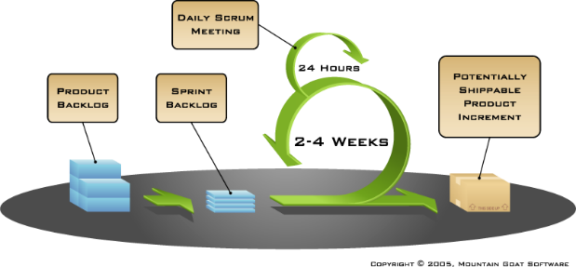
The sprint review
Team presents what it accomplished during the sprint
Typically takes the form of a demo of new features or underlying architecture
Informal
  2-hour prep time rule
  No slides
Whole team participates
Invite the world
We will do these during class
Notes:
24

Slide 25
Sprint retrospective
Periodically take a look at what is and is not working
Typically, ~15 minutes
Done after every sprint
Whole team participates
  ScrumMaster
  Product owner
  Developers
  Typically, NOT other clients, managers
Notes:
25

Slide 26

Sprint Retrospective
Start / Stop / Continue
Whole team gathers and discusses what they’d like to:
Start doing
Stop doing
This is just one
of many ways
to do a sprint
retrospective.
Continue doing
Notes:
26

Slide 27
Scrum framework
Roles
Product owner
ScrumMaster
Developers
Ceremonies
Sprint planning
Sprint review
Sprint retrospective
Daily scrum meeting
Artifacts
Product backlog
Sprint backlog
Burndown charts
Documenting the process
Notes:
27

Slide 28

Product backlog
The requirements
  Typically, user stories
  Also: defects, design improvements
A list of all desired work on the project
Each must have value
Prioritized by the product owner
Reprioritized at the start of each sprint
Product backlog = Σ PBI
Notes:
28

Slide 29
A sample product backlog
(for a hotel reservation system)
Backlog item
Estimate
Allow a guest to make a reservation
3
As a guest, I want to cancel a reservation.
5
As a guest, I want to change the dates of a reservation.
3
As a hotel employee, I can run RevPR reports (revenue-per-room)
8
Improve exception handling
8
...
30
...
50
Notes:
29

Slide 30
The sprint goal
A short statement of focus of sprint for work
Life Sciences
Support features necessary
for population genetics studies.
Database Application
Make the application run on SQL Server in
addition to Oracle.
Financial services
Support more technical indicators than company
ABC with real-time, streaming data.
Notes:
30

Slide 31
Managing the sprint backlog
Individuals pick PBIs (with discussion w/ team)
  not assigned by external agents
Estimated work remaining updated daily
Only team members can add, delete or change the sprint backlog (not the product owner)
If work is unclear, define a sprint backlog item with increased time
  Break it down later
PBI = collection of tasks
  Each task: max 4-10 hours
Notes:
31

Slide 32
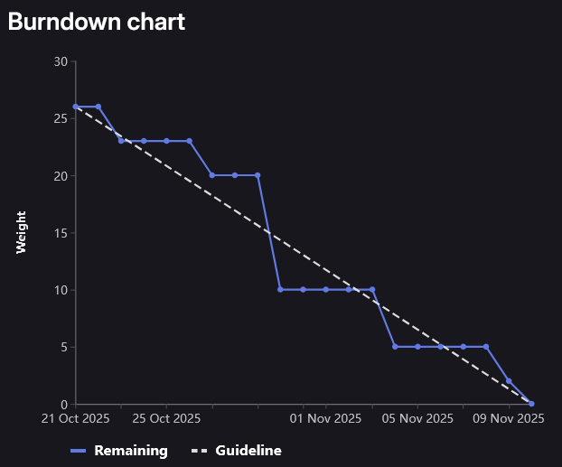
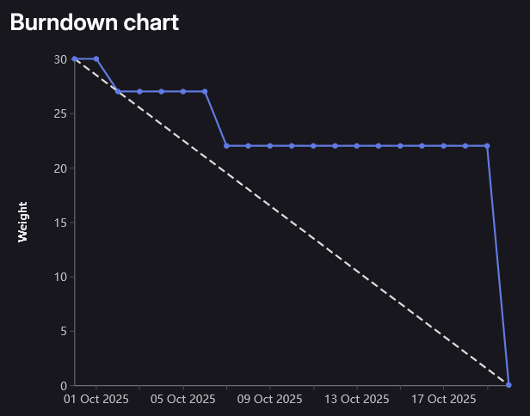
Sprint Burndowns
Progress over sprint
Here: long period with no PBIs completed
Challenging for PO: too much suspense
Better: smooth progress
Prefer to not see: line going up!
Not a substitute for reviews, discussion

Slide 33
Scrum Scalability
Typical individual team is 7 ± 2 people
  Scalability comes from teams of teams
Factors in scaling
  Type of application
  Team size
  Team dispersion
  Project duration
Scrum has been used on multiple 500+ person projects
Notes:
33

Slide 34
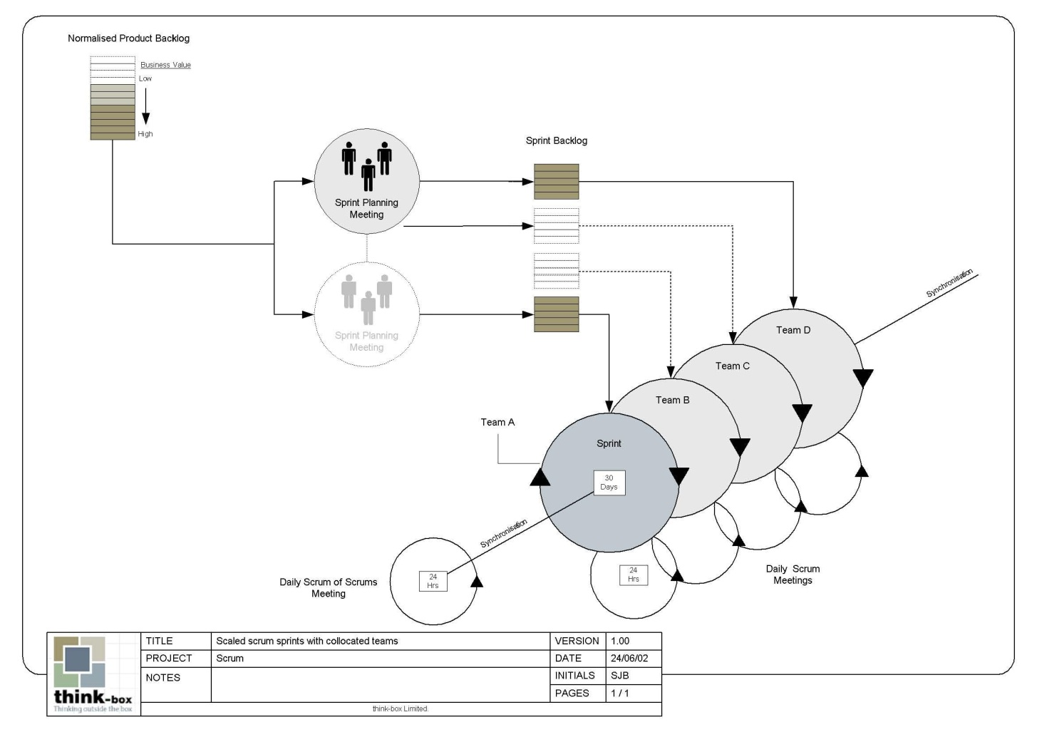
Scaling Scrum

Slide 35
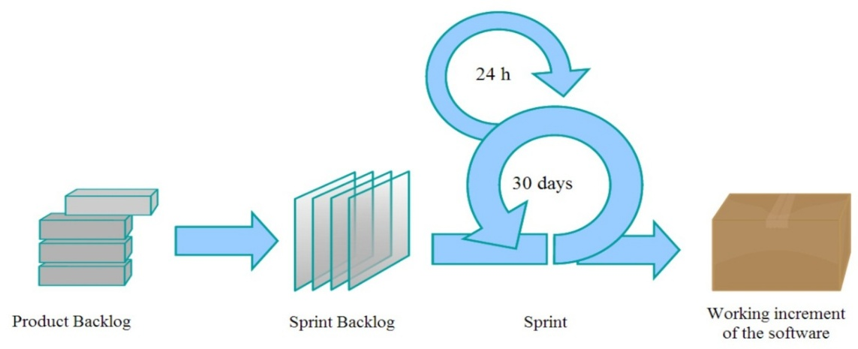
Scrum Overview
Roles
  Product owner
  ScrumMaster
  Developers
Ceremonies
  Sprint
  Sprint Planning
  Daily Scrum Meeting
  Review
  Retrospective
Artifacts
  Product backlog/PBI
  Sprint Backlog
  Burndown charts
Review/retrospective

Slide 36

Scrum Overview
Manage ceremonies; remove impediments
What will be developed, and in what order
Roles
  Product owner
  ScrumMaster
  Developers
Ceremonies
  Sprint
  Sprint Planning
  Daily Scrum Meeting
  Review
  Retrospective
Artifacts
  Product backlog/PBI
  Sprint Backlog
  Burndown charts
Review/retrospective
5-9 people: determine how to deliver what
product owner requests

