Slide 1
The Product Backlog
SWE 2710

Slide 2
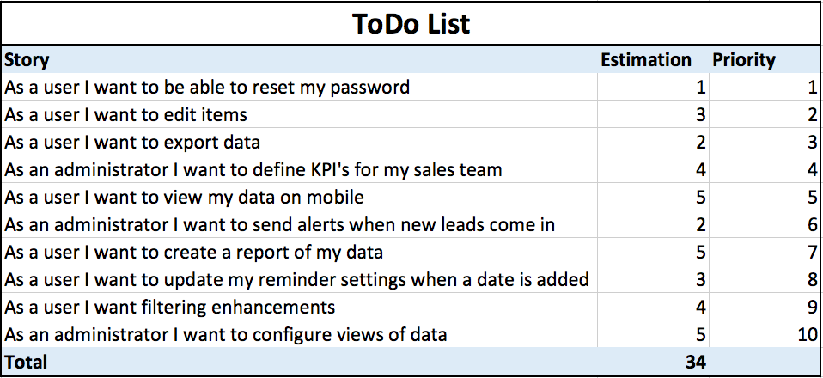
Product Backlogs
Prioritized list of PBIs
New features: user stories
  Other items follow user story format if possible
Will mature
  as team learns about the product, client
Product Backlog Item (PBI)
  Description
  Priority Order
  Acceptance Criteria
  Effort Estimate
  Tasks
What is missing in these stories?
Why might that be ok?
Notes:
It may be ok because these might just be the first line; the second line might be detail added in the PBI (in GitLab)

Slide 3

Product Backlog
PBI types (extended list)
  Feature (User Story)
  Change
  Defect
  Internal (Technical) improvement
  Knowledge acquisition
Give an example of each!
  Base it on projects from other courses
  C++: Hunt the Wumpus?
  SWE 2410: Crabs on the Beach?
  CSC 1120?
How do changes differ from defects?
How do they all differ?
What is common to all?
Notes:
4: Have each table come up with an example, post to Teams

Slide 4
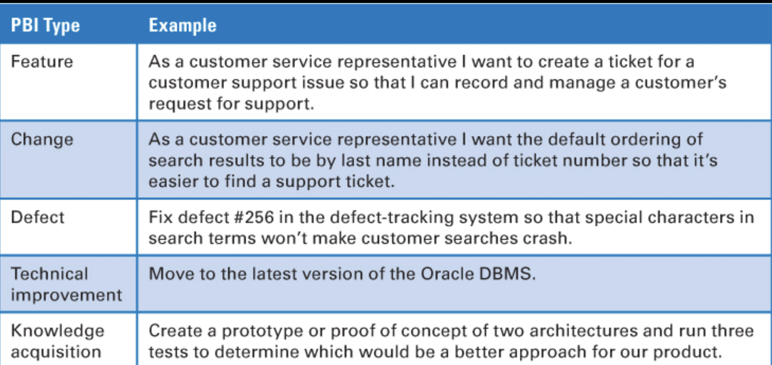
Product Backlog
Examples from textbook
Thoughts?

Slide 5
Good PB characteristics
Evaluating the whole backlog
  Goals for grooming sessions?
  Good for project start
Detailed appropriately
  Full detail for high priority items, do not over-specify low priority items
  Do not waste time on PBIs that will change significantly before sprinting!
Emergent
  Do not lock it down – with rare exceptions, priorities/ideas change with time
Estimated
Prioritized – approximately!

Slide 6
Grooming the PB
Who makes the decisions?
Who is involved?
When is it done?
Notes:
Grooming: both PO and developers

Slide 7
Definition of Ready
When is the backlog ready for action?
Ensure top priority PBI’s are good enough to take action on
  That is, sprint-ready
Criteria:
  Business value articulated
  Details understood
  No blocking dependencies
  Top PBIs are sprintable
    Especially, estimated, acceptance criteria refined
Without AC, cannot know when PBI is finished!

Slide 8
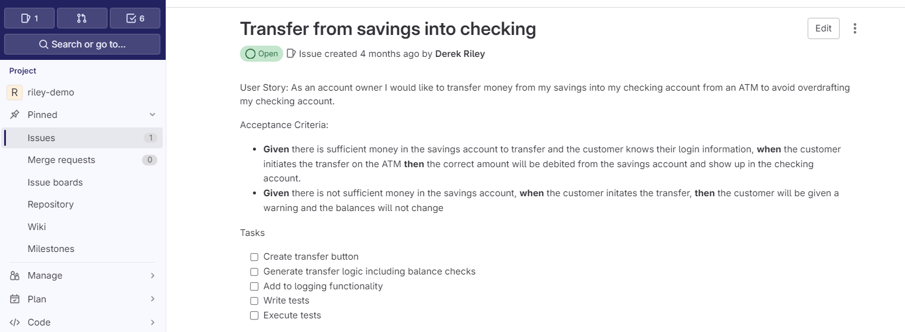
PBI in GitLab
Complete if in sprint

Slide 9
Product Backlog Organization
Do Sooner
Fine-grained
Solution based
Sprint ready
Rank | Story | Size
1 | A | 1
2 | B | 32
3 | C | 5
4 | D | 8
5 | E | 13
6 | F | 7
7 | G | 40
Postpone decisions until the latest responsible time
Project might be ended before we get to them!
Coarse-grained
Originating Requirements based
Do Later

Slide 10
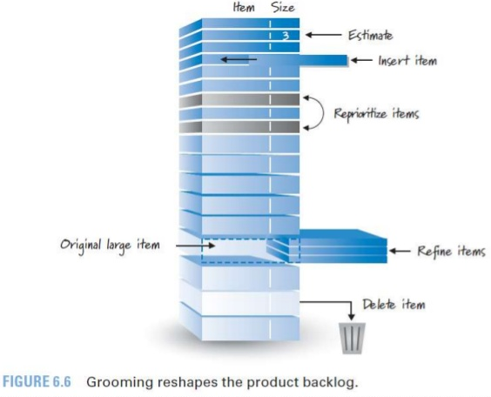
Product Backlog Grooming (Refinement)
Create and refine PBIs
Estimate PBIs
Prioritize PBIs
Collaborative done by:
PO ← Decision Maker
Dev team
Internal and external Stakeholders
SMEs, Architects

Slide 11
What happens in Grooming?
Updates to user stories
Updates to acceptance criteria
If needed, add diagrams (process flows, UI designs, etc.)
Sample data
Test cases
DEFINITION OF READY

Slide 12
Definition of Ready
Ensure top PBI’s are good enough to take action on (to be worked on in a sprint)
  Business value articulated
  Details understood
  No blocking dependencies
  Small enough
  Acceptance criteria defined
Question:
  How to ensure they are small?
  Don’t we need estimates?
Story INVEST Worthy

Slide 13
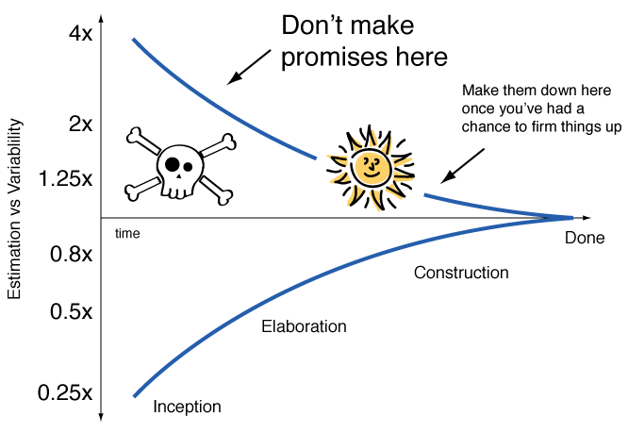
Estimation and Uncertainty
The primary purpose of software estimation is not to predict a project’s outcome; it is to determine whether a project’s targets are realistic enough to allow the project to be controlled to meet them.
- Steve McConnel, Software Estimation
Why estimate?
  Naive: to predict outcomes
  Very hard!
Key: can we complete?
  Is it realistic?
How many PBIs in a sprint?
  Need estimates to know

Slide 14

Common estimation metrics
Ideal days: assume everyone present, how many?
  Straightforward, but requires significant experience
  Difficult to maintain if team is growing in size...
  Key: becomes a firm commitment too easily!
T-Shirt sizes: XS, S, M, L, XL
  Useful, simple, but how do XS and S compare?
Story “points” – typically from a modified Fibonacci sequence
  1, 3, 5, 8, 13, 20, ...
  Straightforward to see relationships between sizes
  NOT precise – keeps from thinking of the numbers as commitments
Notes:
Image from https://www.istockphoto.com/photo/red-casino-dice-gm1132091114-299978666?searchscope=image%2Cfilm

Slide 15
Common Interpretations of Story Points
0: already done or too trivial to mention (eg, fixing a spelling error)
½: tiny; eg, adding a try/catch block
1,2 - small defect, simple story
3, 5 – good, manageable sizes; PBIs that will take about a week to complete
8 – a large story; strongly consider splitting it into two stories
  Any knowledge acquisition that is this large: scope it smaller and learn as you go!
13 - very large feature
20 and up: epics
infinity - obviously too big to even guess at
? – do not understand the story; need more discussion
pi – time for a break
Caution!
These are starting points!
The team will develop its own interpretation
What does it mean if team A gets N points done in a sprint and team B gets 2N done?
But
  Do not get too fine-grained
  Do keep relative sizes approximately consistent
Story points

Slide 16
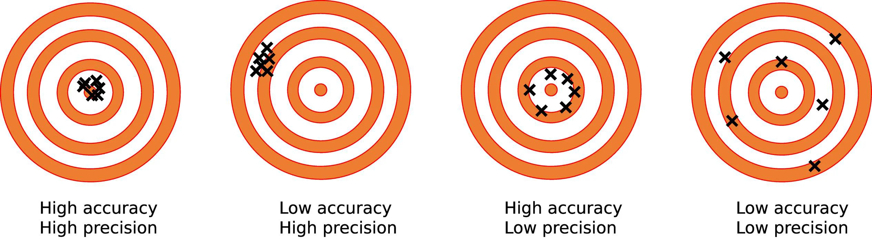
Estimation Concepts
Accuracy: consistently close to target – minimal error
Precision: estimates close to each other - repeatable
What is meant by these concepts?
  Estimate as a team
  Estimates are not commitments
  Focus on accuracy, not precision
  Use relative versus absolute sizes
How should we estimate tasks?
  Should we estimate them?
  Hours: simple, but internal
  Update the hour estimates as you go – team can use to redirect effort
  Sum of hours should fit the story points
  If task so big the story cannot complete, move on to another story!
PBIs: story points
Tasks: hours
Estimates owned by team
Notes:
Material about accuracy, precision (and graphics) from https://88guru.com/library/chemistry/accuracy-and-precision-difference
(captured Feb. 11, 2026)

Slide 17
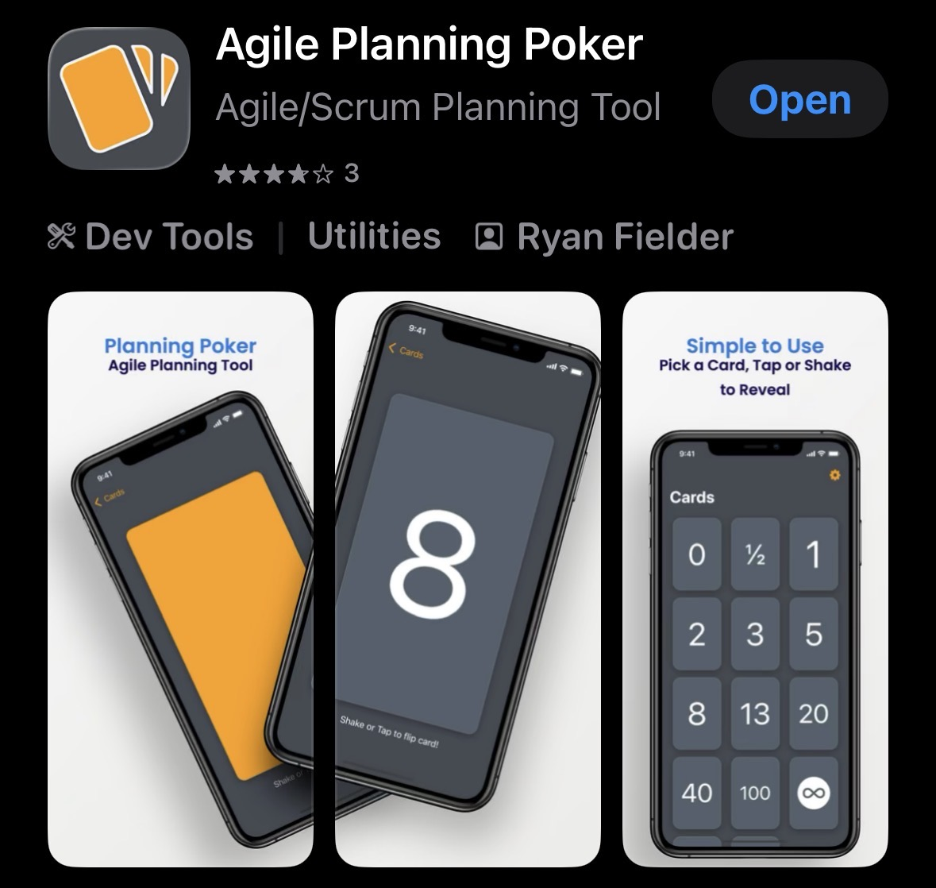
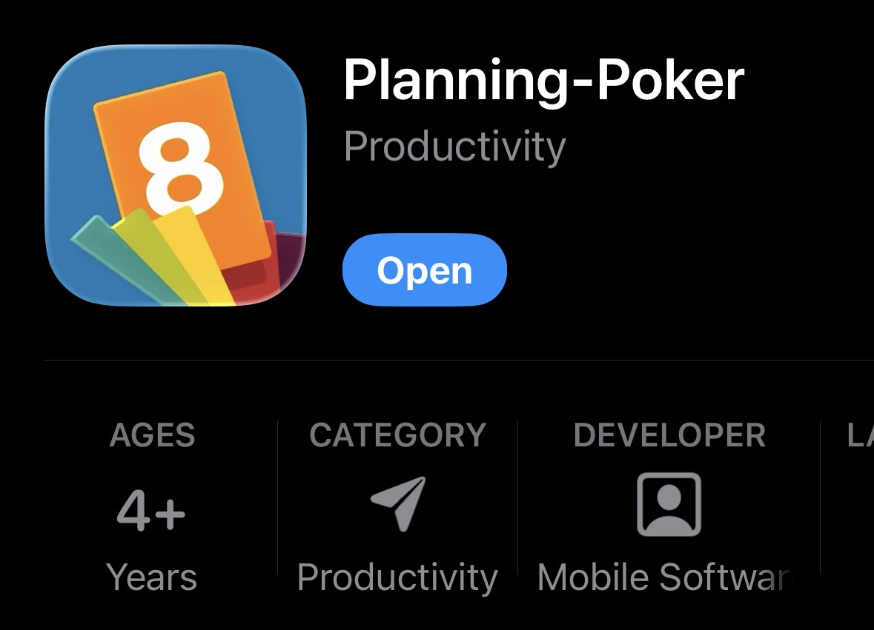

Playing Planning Poker
A method for estimating points
  All involved
In your team:
  Choose a PBI to estimate
  Discuss the item
  Each estimator privately chooses a virtual card
  Show all cards at once
  Check for consensus; discuss and repeat if none
Planningpoker.com
Search for apps

Slide 18
Review
Backlog: collection of PBIs
  Ordered by priority
  Each feature captured in a story format
  Also: fixing flaws, poor designs, knowledge acquisition
Issue: KAs can dominate project
  Always more to learn!
  Better: make it part of a story that has to be done
  Eg: learn a web development language by creating a form you will need
  KAs as tasks, not PBIs
Estimating: use relative sizing, not time commitments
  1, 3, 5, 8, 13, 20
Planning poker: getting the team to determine sizes

Slide 19
Notes on GitLab
Robust tool – used for large projects at MSOE, used heavily in industry
Not specific to Scrum, so has general activities
Warning: repository may be deleted after end of semester
  Copy anything you want to keep to your own repository (but keep private)
Sprints represented as milestones
  A milestone has multiple PBIs, each PBI has tasks
  “Subtask” sometimes used to mean “task within a PBI”
Material entered in MarkDown format
  Easy to create in text editors, readable to humans, robust
  See https://docs.gitlab.com/user/markdown/ for syntax

