Slide 1
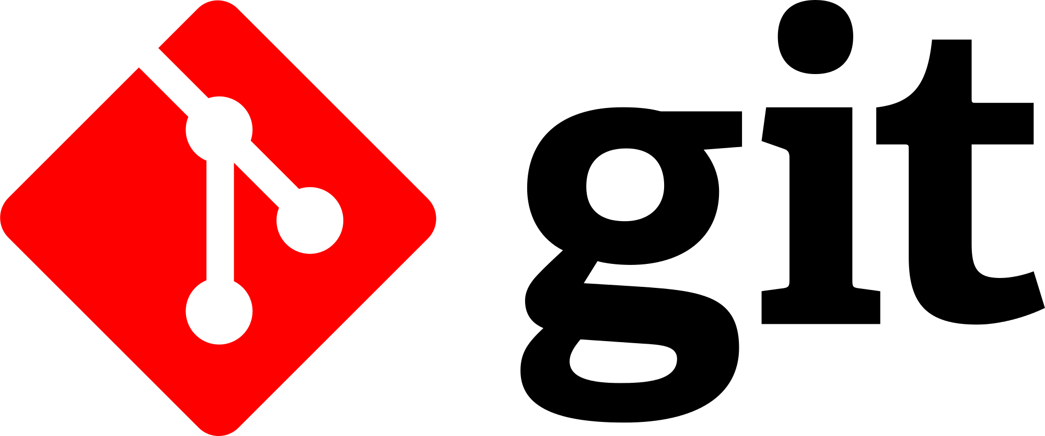
Version Control with Git

Slide 2
Version control
Are there any single-person projects?
  Exception: small games, simple utilities
  But: if it’s maintained, there will be changes; it won’t be the same “you”
  More likely: multiple people working at same time
So how can we share files? Name several ways.
  USB drive
  Shared location on network
  Google drive
  What can go wrong with each?
Key issue: need way to preserve consistency across multiple developers
Also: support multiple releases, multiple customers
Notes:
Issues to consider:
What happens if don’t have access to master USB?
What if network isn’t available, say on a long plane flight?
What if two people editing the same file at the same time on a shared network location/web server?
Suppose I make a batch of changes and someone else makes a batch of changes, how do we keep it consistent?

Slide 3
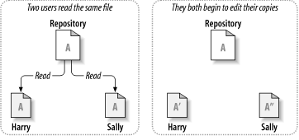
Sharing files can lead to big problems…
Adds some method
Modifies another method

Slide 4

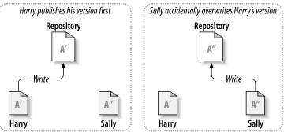
Sharing files can lead to big problems…
Harry’s changes are lost!
Harry gets mad at Sally
Sally gets mad at Harry for unjustly accusing her
We get a movie about it
We could fix this with file systems that keep previous versions
Why isn’t this a real fix?
Notes:
Reasons why simply tracking versions won’t work
Painful to fix
How many versions do we keep?
How to keep multiple files consistent?

Slide 5
The Issue: Effective management of software artifacts, especially code
Some acronyms:
SCM – Source Code Management
SCCM – Source Code Configuration Management
RCS – Revision Control System
VCS – Version Control System
VC – Version Control
DVCS - Distributed Version Control Systems
Notes:
Does anyone use these outside manuals or similar documents?

Slide 6
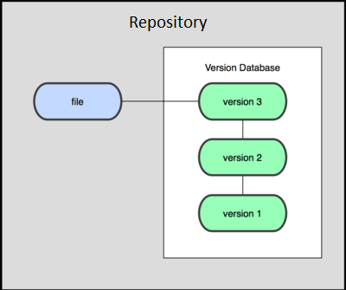
Revision/Version History might help
…but USB/SD, private network drives do not maintain revision history
Cloud drives (e.g. Google Drive, Dropbox, iCould/Time Machine) maintain a (limited) history of the various revisions of a file
  Google Drive: keeps last 100 revisions or last 30 days
    Supported in “Classic” mode only – going away?
IF you detect a collision, you can manually merge the differences and resynchronize your work
  Might be workable for two people – what about 5 or 10?

Slide 7
Any other disadvantages to
Google Drive/Dropbox/Box
Security?
Support (bug fixes and new features)?
Ownership of stored information?
Cost?
Ease of Use?
Acceptance?

Slide 8
History
SCCS, 1972 (IBM)
RCS, 1982 (Unix)
  SourceSafe 1995 (Microsoft)
CVS, 1986 (multi-platform)
SVNs (“Subversion”), 2000 (multi-platform)
Git, Mercurial, 2005 (multi-platform)
Common features:
  All changes tracked, referenced by IDs
  Can revert changes
Single file system
Remote server
Notes:
SCCS: Source Code Control System
RCS: Revision Control System
CVS: Concurrent Versions System
SVN: Subversion

Slide 9
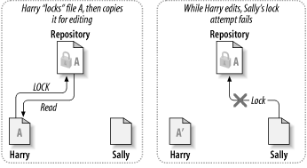

Early model: lock files during change
Sally waits until Harry releases lock
Sally then locks
Points of failure:
  Sally has to poll to see when unlocked
  Harry forgets and goes on vacation
Experience: this created more problems than it solved
Still sometimes used for binaries (word processing, spreadsheets, Enterprise Architect)
Ultimately: team must organize who is doing what!
Notes:
Image: http://svnbook.red-bean.com/

Slide 10
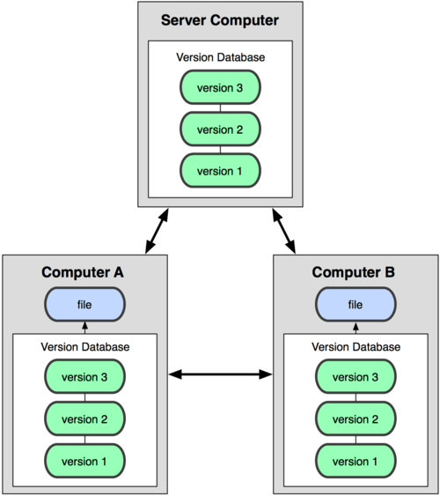
Distributed Version Control
Main repository on server
  Each user has a clone of this repository
  Can perform actions locally, even if offline
User syncs with main repository when convenient
  Can sync individuals as well
Used by Git, Mercurial
Notes:
Image: http://git-scm.com/book/

Slide 11
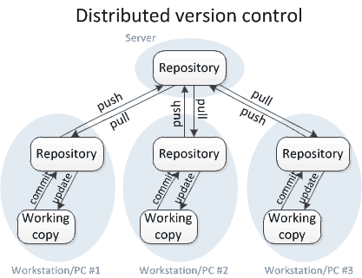
Git Operations
clone
  Copy the entire repository
status
  staged, unstaged, or untracked files
add
  Stages a new file in the local repo
commit
  Lock your changes into the local repo
push
  Sync your files to shared repo
pull
  Get updated files from the shared repo

Slide 12
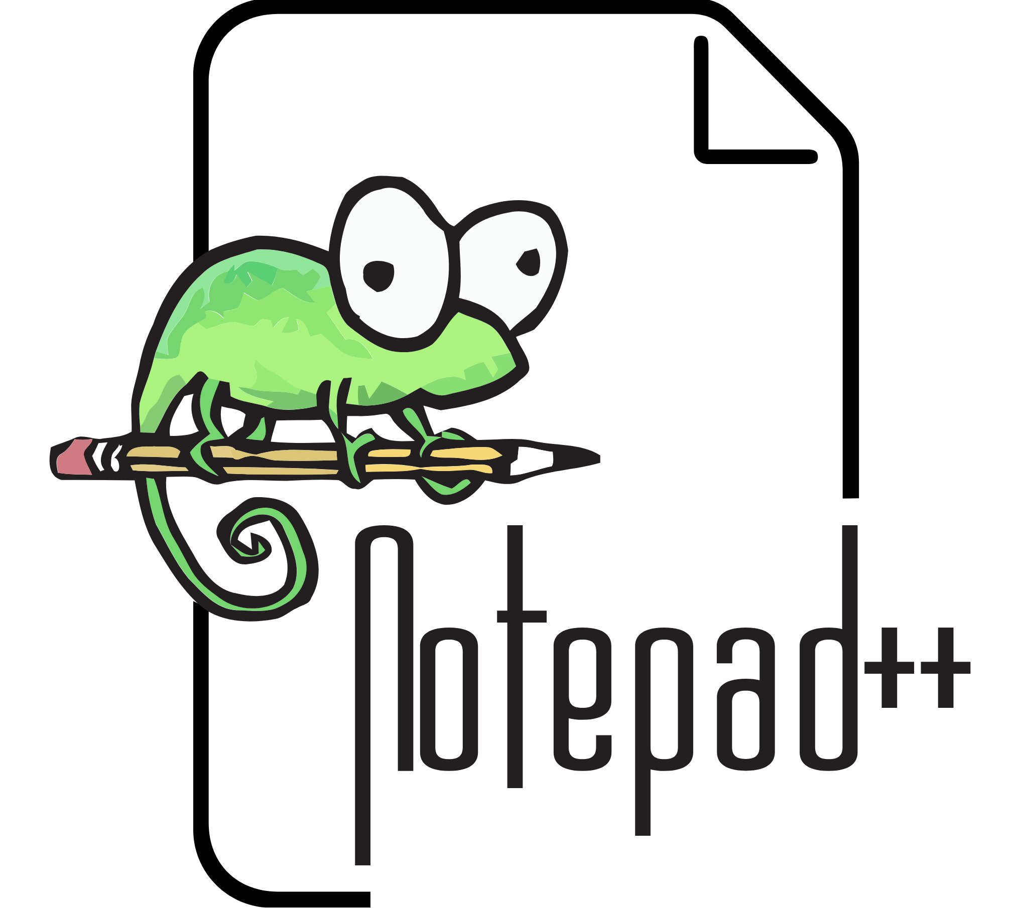
Installing/configuring Git
This means do not convert between Unix, Windows file formats
Do not let revision control
systems modify your files
You must have Git installed on your computer
  https://git-scm.com/download/win
  Default options are good with one change: check-in/check-out as is
Default editor: Notepad++
  Link: https://notepad-plus-plus.org/
  Simple, fast to start, language sensitive
  Associate Java, other files with this
    Great for quick views, simple edits

Slide 13
HTTPS vs SSH
Plain text communication over the network: simple, but insecure
  Messages easily intercepted, anyone can pretend to be “you”
Two approaches:
  SSH: “Secure Shell” – Safe, remote logins
  HTTPS: secure web operations
HTTPS: easy, but requires fresh login for every operation
  Result of using HTTPS: people forget to commit changes, might as well do no work
  HTTPS method: used by people who do not understand the internets
Using SSH: set up public/private key pair
  Used to encrypt, decrypt every command sent to server
  More reliable, long term solution
  If interested, read to learn more: Why SSH, How it works
Setting up SSH key for Gitlab: https://docs.gitlab.com/user/ssh/

Slide 14
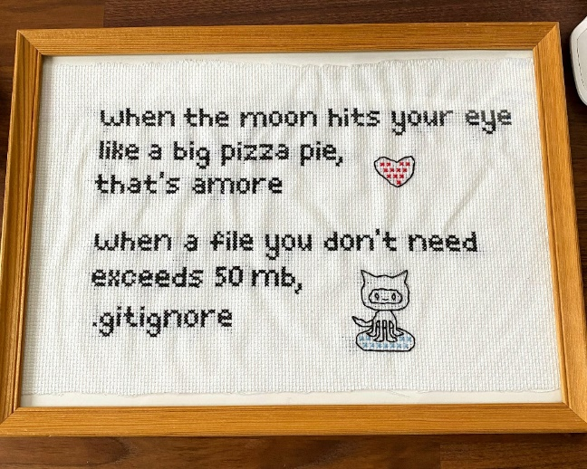
Git Ignore
*.class
*.jar
*.war
*.ear
A .gitignore file in the root directory: specifies files to skip
Baselines: .class, .jar, other build results
  Typically: build directories
IntelliJ: user specific files
  workspace.xml
  misc.xml
See Canvas for the starting .gitignore
  Must change name
  Make sure you are showing extensions!
  Bash command: mv gitignore.txt .gitignore x
  Add before executing git add

Slide 15
Steps to git started
One Person:
  Clone repo: git clone
    Open Git Bash shell in directory you want the project in
    git clone git@gitlab.com:yelirkered/swe2711f23demo.git
  Create a new JavaFX project in Intellij
    Open IntelliJ
    New->Project ->…
    Make sure the location is the root of the git repo you just cloned (it is OK that the directory is not empty)
    Follow Dr. Taylor’s FX instructions otherwise
    https://taylorial.com/tools/java/
  Add .gitignore (at project root)
  Do:
    $ git add .
    $ git commit –m ‘first commit’
    $ git push
Team
  Clone, build, run the project
Set up your SSH Key: https://docs.gitlab.com/user/ssh/
Run Git Bash as administrator
Generate key:
  $ ssh-keygen
  Do not need passphrase for this class
  Would usually add one for more security

Slide 16
Surviving Git
Pull, push often
  DO NOT hold changes until everything is perfect
  DO make sure your code builds; push small bits at a time
  Pull whenever your start work
Use good commit messages
  Teammates need to understand the changes
  Go beyond “worked on XXX” – characterize the changes
Note deleting a local file then pushing removes it for all
  Though the file still available in the history
Do not push sensitive information!
  passwords, ssh keys, API keys, credit card numbers, PINs
  It is difficult to remove information once added

Slide 17
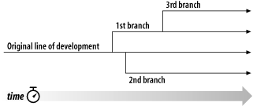
Branching
Typical model of using git: branches
Different developers can work on different branches
merge request: merge branches
Recommendation:
  main: deployable product
  dev: main development branch
  each PBI: off dev
  all branches: lower case names with hyphens between words

Slide 18
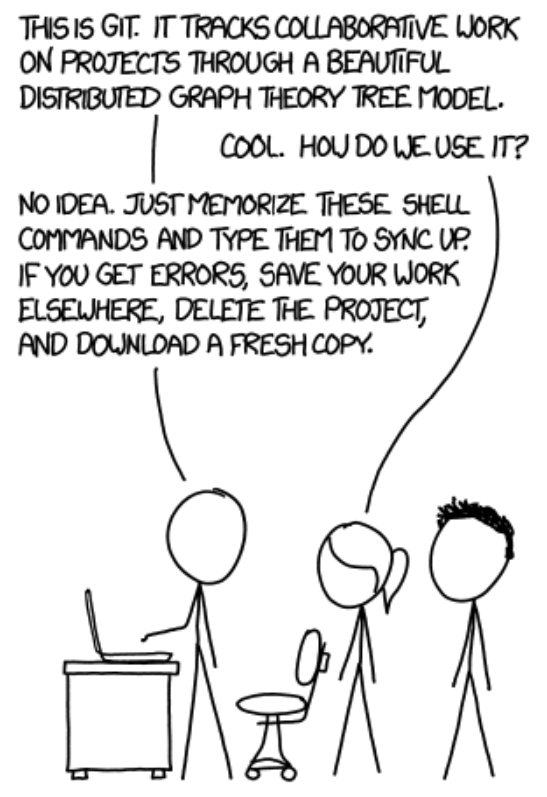
Fixing problems
Credit: XKCD

Slide 19
Other resources
https://www.youtube.com/watch?v=DR7MLaAKcUk
https://www.udacity.com/course/how-to-use-git-and-github--ud775
https://www.youtube.com/watch?v=0fKg7e37bQE

Slide 20
