Slide 1
More Version Control

Slide 2
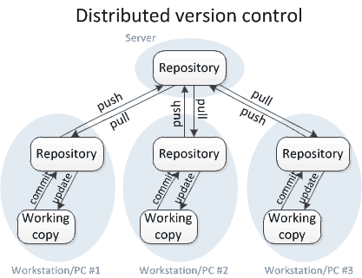
Version Control with git - Recall

Slide 3

Without Branching - Scenario
All team member push to main
Susan is updating the backend
Will take weeks
Stable when complete
Intermediate changes have unpredictable consequences elsewhere
John is making changes to the frontend
Sees side effects caused by Susan’s pushes
Thinks his code caused the changes

Slide 4

Without Branching - Scenario
Tempting solution
Don’t push to the remote repo until all changes are complete
Changes only exist locally during development
One hard drive error away from losing weeks of work!
If there are 10+ developers with different tasks on the same codebase?
Complex interactions between modules can multiply issues

Slide 5
Without Branching – Worse Scenario
Someone pushes code with errors
Code breaks
Who broke it?
Everyone’s workflow halts and the search begins
It happens
All code functions locally
ex: A function header is changed

Slide 6
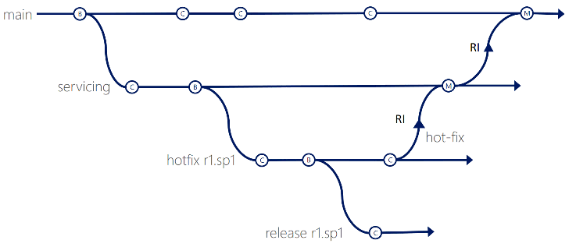
Branching
New commits are only added to the current branch
Can implement experimental code without affecting others
When the life of the branch is over
Merge it into the primary codebase
Branching is crucial on large teams

Slide 7
So far, you have used only a single branch (main) for synchronizing code
Synchronizing frequently-changing code requires merging
Merge conflicts result when the same code is simultaneously modified by >1 developer
EXAMPLES???
git push results in errors if someone else worked on the same code and modified/pushed it before you did.
Merge conflicts can often be resolved automatically if the code modifications are sufficiently separated
git pull automatically merges modifications when possible
Merge conflicts sometimes need manual resolution
git pull fails to resolve the conflict, and you must manually edit the file(s) containing the conflict indicators (<<<, >>>)
git commit stores your manually-merged file(s)
git push uploads the file(s) to the remote branch

Slide 8
The main branch should only be used for maintaining production-ready code
Code modified or created during a Sprint should be maintained on separate branches
A second standard branch – often named “dev” is typically used to maintain code that is being actively worked on
At the beginning of a phase of development, the dev branch is identical to main
During development, the dev branch maintains the evolving code
After a feature has been tested, the dev branch contains the completed code.
The dev branch is then merged into the main branch, and the process repeats
Version 1
Version 2
Version 3
main
branch
merge
merge
dev
We can reduce the amount of synchronization we need to do, as well as the number of merge conflicts, by using branches.

Slide 9
There are two ways to create dev branch
Create a local dev branch and then push that branch to the remote
Create a remote dev branch (using the GitLab web interface), and then pull that branch locally
$ git branch dev $ << Note:the command executes silently>>
$ git fetch && git checkout dev From gitlab.com:se2030/MyRepository
* [new branch] dev -> origin/dev
Branch dev set up to track remote branch dev from origin.
Switched to a new branch dev'

Slide 10
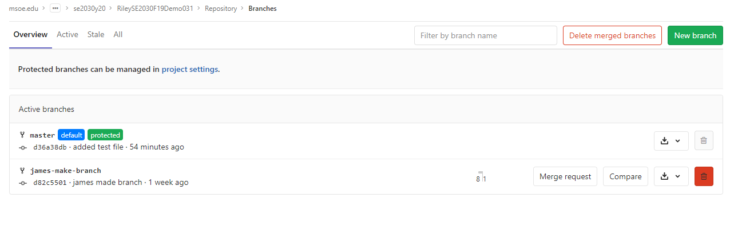
Branching
You can create a branch through the GUI
Pull the branch using
Checkout
NOTE: If you currently have nothing to commit, and you switch branches, the code in your working directory will be replaced with the code that is in the branch you’re switching to.

Slide 11
Wait!
Won’t we still run into the same kind of merge conflicts if we all develop on the dev branch?

Slide 12
Yes! So teams usually use additional feature and defect branches to isolate their work
Additional branches – often named for the story or defect, are typically used to maintain code that is being actively worked on
Usually, only one person works at fixing a defect
Often, different story features are worked on in parallel by only a few people on a team
When a story or defect is complete (and tested), its branch is merged into the dev branch.
When all stories and defects have been merged into dev, dev is merged into main
Version 1
Version 2
main
branch
merge
dev
branch
branch
merge
defectfix
merge
featureA

Slide 13
Switching branches during work
$ git status
On branch defectfix
Your branch is up-to-date with 'origin/defectfix'.
Changes not staged for commit:
(use "git add <file>..." to update what will be committed)
(use "git checkout -- <file>..." to discard changes in working directory)
modified: MyFile.java
no changes added to commit (use "git add" and/or "git commit -a")
Suppose you are working on a defectfix branch and want to switch to a dev branch with git checkout dev. You have uncommitted code on the defectfix branch, so git status reports:
You don’t want to commit MyFile.java, because you are still working on it. If you git checkout dev at this point, you won’t get dev’s version of MyFile.java, because your working copy is still uncommitted.
The solution is to stash your work first before switching branches:
$ git stash
Saved working directory and index state WIP on defectfix : 0b5a394
HEAD is now at 0b5a394 on defectfix branch
The git stash command saves your work to a temporary cache where it can later be recovered, and reverts the defectfix branch back to the last commit so that you can safely switch branches.

Slide 14
Switching back and recovering your Work In Progress (WIP)
Suppose you had switched to a dev branch and now want to return to the defectfix branch to resume you work on MyFile.java. You use git checkout defectfix to switch, and that recovers the last-committed version of MyFile.java, without the changes you had been working on – those changes had been stashed away. You can use git stash list to view your stashes:
$ git stash list
stash@{0}: WIP on defectfix: 0b5a394
To recover MyFile.java use git stash pop and the working copy will be restored:
$ git stash pop
On branch defectfix
Your branch is up-to-date with defectfix '.
Changes not staged for commit:
(use "git add <file>..." to update what will be committed)
(use "git checkout -- <file>..." to discard changes in working directory)
modified: MyFile.java
no changes added to commit (use "git add" and/or "git commit -a")
Dropped refs/stash@{0} (dbcbe46ab23ca6f02df661bc81ac5006ffa4c60c)
Note that git stash pop clears the stash cache

Slide 15
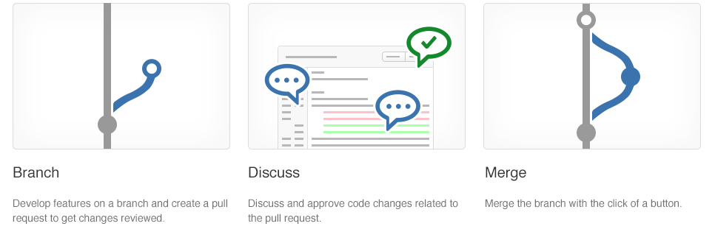

Slide 16
Merging back into a branch
Suppose you have finished fixing a defect on the defectfix branch
You have fully tested it and verified the fix
You have pushed your local work to the remote with a git push, and since you’re the only one working on the defectfix branch, you didn’t get any merge conflicts.
You want to merge your defect fix into the dev branch so that it later gets merged into main.
You want (need) to have your teammates review your fix and approve it before the merge can take place. You initiate a Pull Request to begin the merge process.
Version 1
main
branch
dev
branch
merge
defectfix
Pull Request here!

Slide 17
Executing a Pull Request
Select Create Pull Request. Enter a title and add all team members as reviewers. Leave the Close branch box checked.
Note that the differences between the two branches are shown in on the Overview tab.
Your teammates will get a message from GitLab indicating that they have code to review.
They will review the differences, and either approve or decline the request.
Once all have reviewed the request, you can click on the Merge button, and the defectfix branch will be merged into dev.
The defectfix branch, since it is no longer needed, will be automatically deleted from the remote (since you selected Close branch above).

Slide 18
Best Practices for Branching
Create a Feature branch off of main or dev as appropriate
main should always be kept in a ‘production-ready’ state.
Make your changes.
Commit — saves a version of your code locally
Push — sends your branch/commits to Git
Create a Pull Request when you are ready for a review
Notes:
Pull Request —> Merge Request

Slide 19
Very Large projects
feature
Consider “Git-Flow”
Features get pushed to a Develop branch, which the tests are ran against and deployed to a testing server for QA
before being pushed to main, and later deployed to Production
dev
main
Notes:
https://about.gitlab.com/2014/09/29/gitlab-flow/

Slide 20
Hotfixes
Production release contains a defect
Create a hotfix branch from main
Fix the defect
merge fix into:
Next production release
Develop

Slide 21
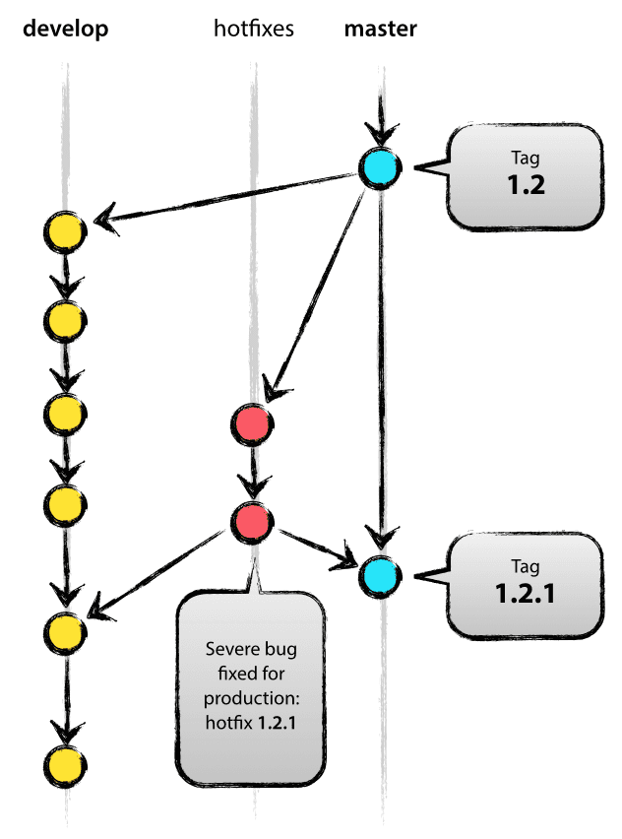

Slide 22
Release Branch
Branch off develop when approaching a release
No features added
Extensive testing and defect fixes
Merge all changes back to develop
When confidently stable
Merge into main as a release

Slide 23
Versioning
Tag the current state of the code
Can easily work with a previous version if needed
Use versioning on main

Slide 24
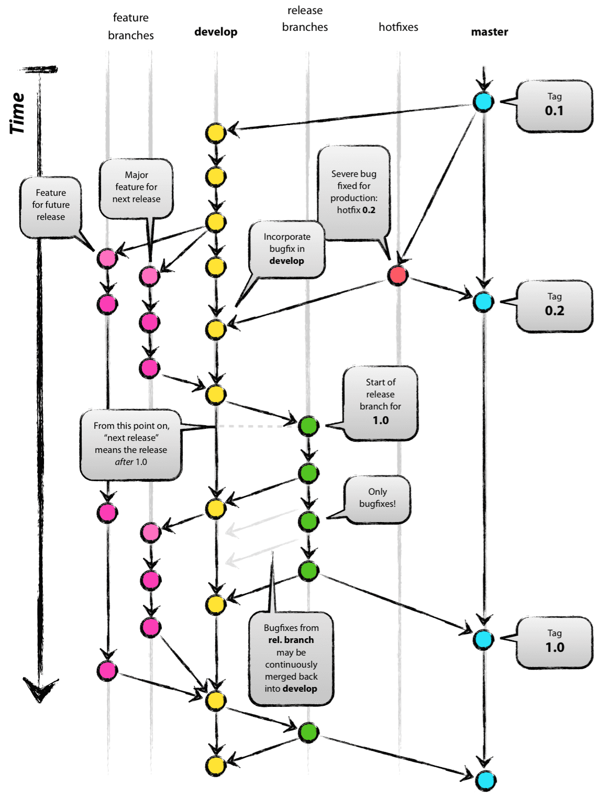

Slide 25
Perspective
Windows development uses Git!
There are approximately 8500 commits per day
1760 builds per day!
https://arstechnica.com/information-technology/2017/05/90-of-windows-devs-now-using-git-creating-1760-windows-builds-per-day/

Slide 26
Git practicing!
https://learngitbranching.js.org/?locale=en_US

