Slide 1
Build Tools
SWE 2710
Notes:
https://www.reddit.com/r/ProgrammerHumor/comments/8xa9k1/it_works_on_my_machine_%E3%83%84/#lightbox

Slide 2
Goal this week
Work to complete sprint 1 goal
Grading for lab 6:
Sufficient time entered?
Estimates updated?
Completed merge requests to dev, reviewed by team (with evidence)
Appropriate branching, commit messages
Lab 7 next week: will demonstrate progress to all
Demonstrations for all teams can take a lot of time
Demonstrate just the portion meeting your sprint goal

Slide 3
Automated build tools
What challenges have you encountered getting your code to build and run on someone else’s computer?
Don’t fall into the trap of “it works on my machine”
It has to work for your client
You are not alone
What makes it difficult?
Project structures, especially local paths
Library dependencies, version mismatches
Almost an infinite number...
Solution: automated build tools/scripts
GUI-based, manual builds are not a scalable solution
Common fixes:
Make sure IDE versions match
Do a clean, a complete rebuild
Why?
Check build windows for warnings, errors
But this might not always work…
IDEs: convenient, but too fragile for official builds

Slide 4
History
These problems apply to command-line builds as well: g++ *.cpp
Make: 1976, Stuart Feldman
Simple, robust, easy to write by hand
But need additional scripting tools for true, cross-platform builds
Apache Ant: 2000
Designed for Java applications, supports any language
Apache Maven: 2002
Relies more on conventions, dictates directory structure
Gradle: 2012
Smaller configuration files, heavily based on plugins
Notes:
https://www.baeldung.com/ant-maven-gradle and elsewhere

Slide 5
Why?
Conclusions:
Building applications is challenging
Automation is necessary
More to learn, but critical for any project
Automate annoying work
Building code is drudgery as the projects get bigger
IntelliJ is not an adequate build environment
Build steps must be done every time, in sequence
Manage dependencies
Dependencies are complicated and messy
Security exploits leverage messy dependencies
Automate steps: avoid mistakes
Parallelizes tasks: improved performance
Necessary to support continuous integration (CI)
build on every commit - next slide
Different developers have different setups
May not track all tools consistently
Configuration documented in multiple places
Optimized for developer, not project
Notes:
Problems with IntelliJ
Relies on whatever tools have been installed by developers
Has to track the other tools – often lags changes
Configuration captured in many places, cannot really check in to repository
Optimized for developer, not project

Slide 6
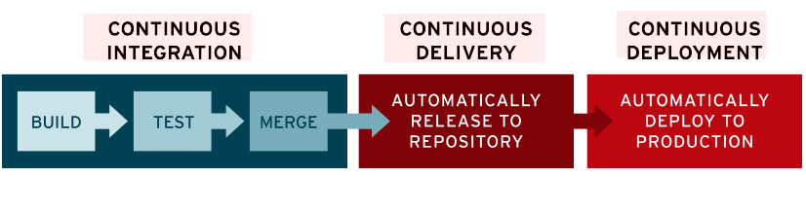
Continuous Integration
When new code is checked in, it is automatically built and tested
Build includes tests – no point in considering a build done without checking
Typically: on remote server
Independent of developer machine/setup
Deployment can be done as well: continuous delivery
We will set up CI later this semester
CD: can refer to either

Slide 7
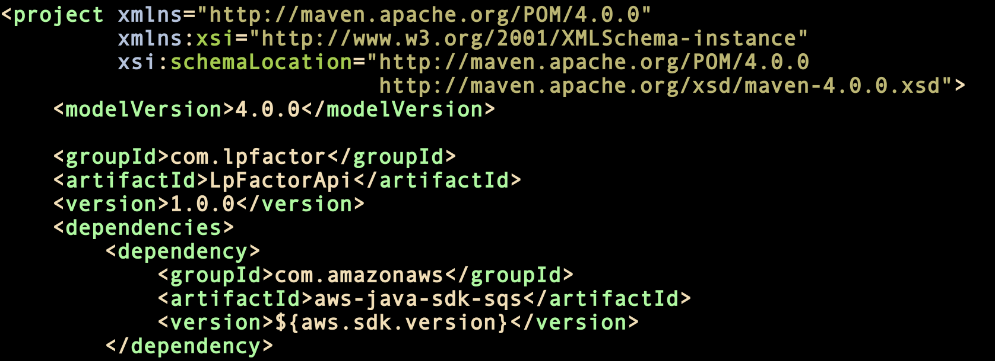
Maven
POM file: XML format
source directory
dependencies
plugins
goals
etc.
Project management tool
Based on POM
Project Object Model
Designed for Java-based projects
Functionality
Build
Create JARs
Contains project info
Dependency integration
remote
libraries
pull depend-encies
local repo
pom.xml
build
Sources
executable

Slide 8
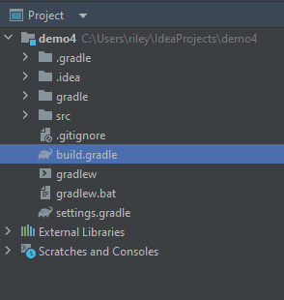

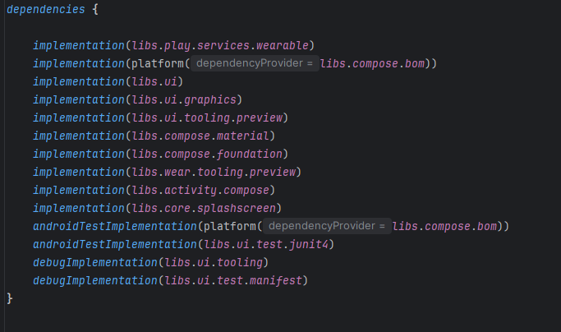
Gradle
Groovy-based declarative build tool
Groovy: Java-based language with dynamic programming features
Java-focused
Consists of “projects”
Each project consists of one or more “tasks”
build.gradle: contains the scripts
Defines tasks, dependencies
Run:
Gradle compiles java files into .class files
Converts .class files into DEX code
Everything is packaged into an .apk file

Slide 9
Gradle build variants
Variants of builds are useful for many reasons
Typical types
Release
Debug
Language
Free/paid
Etc.
More: https://developer.android.com/build/gradle-build-overview#kts
Applies to other build environments!
All support this as well

Slide 10

Fixing “it works on my machine”
¯\_(ツ)_/¯
Unofficial assignment:
Set up command-line build
... especially if you have a working IDE build
Can use GenAI to help debug your build
copy in build file, ask why error occurs
Identify a command-line build tool for your project
... or tools
Look for Gradle, Maven, Ant files
Often: open a shell prompt in your IDE to access the build command
Command-line build tool wins
Avoids differences in user-specific setups
Eg: slight differences in libraries, run commands
Ensures repeatability – don’t waste time on a simple mistake
Provides a “ground truth” for builds
Supports CI/CD, different build targets
Allows complex techniques such as parallelization
Common tools: make, Ant, Maven, Gradle
Notes:
t-shirt image from https://www.geekytees.co.uk/product/it-works-on-my-machine/
You can find this T on almost any site

Slide 11


