Slide 1
Defect Tracking

Slide 2
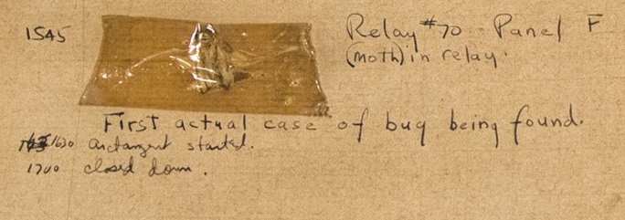
Bugs
What is a bug?
  Original software “bug”: a moth flew into a relay in the Mark II computer
  This shorted out a connection, causing the system to fail
  1946 – this entry is in the log book
Why call it a defect?
  Implication of a bug: it accidently crept into the code
    Is this ever the case?
  Defect is a better term

Slide 3
Defect Tracking
Requirement: track all discovered defects
  Must validate, correct
  Must avoid reoccurrence
  Key issue: clients not impressed by repeated failures
Necessary:
  Don’t lose reported defects
  Ensure defect is fixed
  Ensure coders don’t work on non-defects
    Features masquerading as defects
    Wasting time fixing something that isn’t broken
    Wasting time fixing the wrong part of the project

Slide 4
Defect Information
What would you guess is the most frequent description instructors get?
  “It doesn’t work”
  Why not useful?
What do organizations need?
Where found
  product, release, version, hardware, os, drivers, general area
Who found it: customer, internal?
When found
Description of the Defect
  How to reproduce, associated data
  Links to related defects, features
Triage
  severity, likelihood → priority
Audit Trail
  all changes to the defect data, by whom, when
State: discovered, investigated, fixed...
Owner: who will fix it
  Possibly a group

Slide 5
Priority Matrix
1 is high, 5 is low
Submitter identifies severity, likelihood
  Yes, might update later as get more information
  E.g.: may have workaround, lower impact, etc.
Assign priority as shown to left
  Again, refine as needed
  Matrix cannot account for everything!
 |  | Likelihood
 | Priority | Low | Medium | High
Severity | Crash, bad data | 2 | 1 | 1
 | Work around | 5 | 3 | 2
 | Cosmetic | 5 | 4 | 3
Details will differ – sometimes cosmetic is high priority!
Key: different defects have different priority

Slide 6

Typical
Defect Workflow
WIP
Valid
Fixed
New
Closed
Key: multiple steps
Expensive to track!
Disputed
issue
QA
customer

Slide 7
Management Controls
Management must:
  overview all active defect records
  ensure priorities are good
  ensure no defect gets stuck in a particular state
  ensure appropriate defects receiving attention
System Support
  Most systems can be configured to
    send e-mail and/or re-assign to manager when certain conditional action thresholds are reached
      E.g., priority 1 defect with state unchanged for 24 hrs.
    Post daily reports of overdue defects

Slide 8
Metrics
100
80
60
total
defects
40
departures
Arrivals:
  defects per day entering into Valid
Departures:
  defects per day going from Fixed to Closed
Total:
  sum of defects in states Valid, WIP, and Fixed.
Another purpose for defect tracking is to enable gathering of good, clean defect arrival/departure data.
Gives insight into productivity of
  developers fixing defects
  QA finding defects
Clean data is essential
  e.g., if no way to validate defects
    lots of arrivals may be due to bad code or to bad defect triage
    may expend a lot of effort on coding initiatives and numbers will go the wrong way!
  Must quickly get defects out of New and Fixed
net
20
0
1
3
5
7
9
11
13
15
17
19
21
23
25
-20
days

Slide 9
Defect Attribution
Goal: understand root causes
Attribute to:
  where in the source code
    can identify modules whose re-design will add most bang-for-the-buck
  which developer introduced it
    organizationally tricky but very useful
  during what phase
    requirements, design, implementation, etc
Simple method: ask “why?” five times

Slide 10
Customer Issue Tracking (IT)
Customers have many issues:
  how to use software
  installation issues
  perceived problems
  problems that have already been resolved in a previous patch
  known issues
  ship me a manual, please
  …
Some of these issues will result in new defect awareness, some may not
Requirements of issue tracking systems will include:
  customer relationship management tie-in
  searchable knowledge bases
  customer tracking of issue progress
  …

Slide 11
Shipping Known Defects
Zero defects: not feasible in non-trivial software
  at least, not without (expensive) correctness proofs
  how many defects are acceptable?
  how many are you shipping?
Defect seeding
  inject defects, see how many are found, use the ratio
  challenging to do – how to ensure it gives good information
Must measure customer satisfaction
  How many did they find vs. known defects when shipped
  Does this correlate with customer feedback?
    Did we get the priorities right? Should we spend more on V&V?

Slide 12
Testing/Coding Effort Changes
Can only compare across releases if have a consistent testing effort
  same number of testers, same productivity, same time, same general size of the release
If increase size of testing team relative to coding team,
  ratio of known to unknown defects decreases
Assume ratio is 50%
  ship with 50 known, actually shipping 100 defects
Add testers, raising ratio to 75%
  ship with 75 known, actually shipping 100 defects
    good to know. If increasing testing effort without increasing coding efforts, will be hard-pressed to meet the old thresholds
Add coders, lowering ratio to 25%
  ship with 25 known, actually shipping 100 defects
Add coders and testers
  ratios stay the same
  but will reach the thresholds faster for the same sized effort

Slide 13
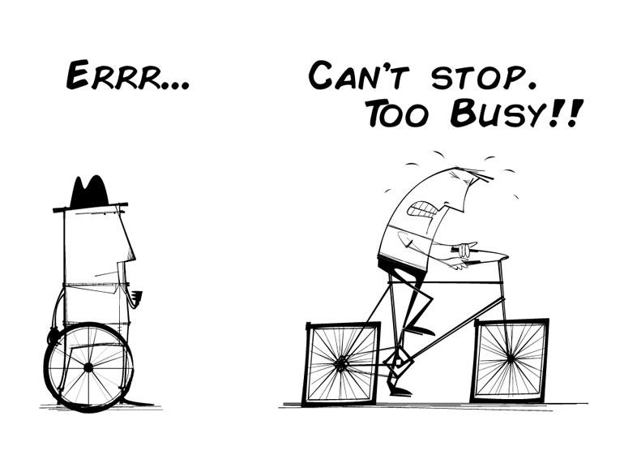
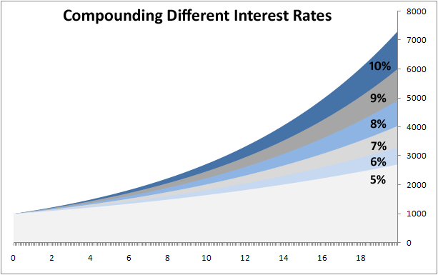
Technical Debt
Issue: sometimes we cut corners on projects
  Is this always bad?
Technical debt: a way to understand this
What is debt (in a financial sense)?
  Principal, interest, payments, compounding
Is all debt bad?
  What if we want to buy a home?
  What if we are building a factory?
  When is debt a problem?
In software:
  Additional effort required to “fix” poor designs
  Refactoring time
  Kicking the can down the road…

Slide 14
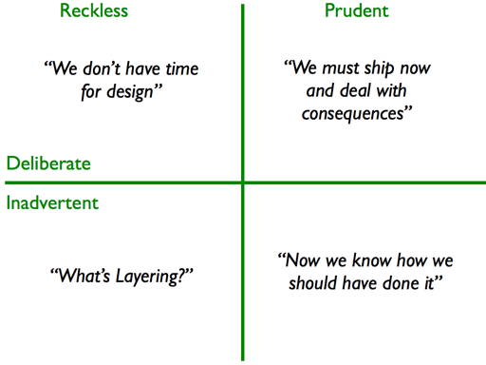
Kinds of Technical Debt
  Unfit (bad) design
  Defects
  Insufficient test coverage
  Excessive manual testing
  Poor integration and release management
  Lack of platform experience
  Other kinds?

Slide 15
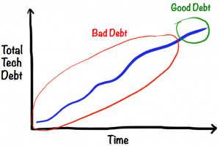
Technical Debt Age
  Is old or new debt “better” to carry?
    Why?
  “A fresh mess is easier to clean”

Slide 16
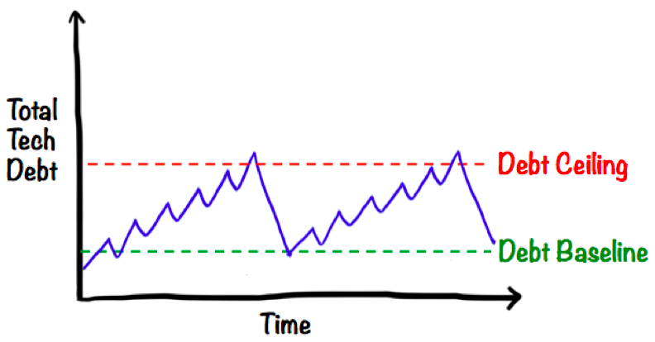
Dealing with Technical Debt
Identify as you go
  Add PBIs to address
  Recognize intentional debt can be good, but do not let it fester
  Commonly: cap amount of acceptable tech debt
Issue: how can a non-technical PO prioritize fixing tech debt?
  Solution: incorporate into a story that can be prioritized
Examples
  system test showing response time too slow
  list of features that changes would enable
  increased customer satisfaction
Is naïve technical debt really tech debt?
  If it isn’t intentional, then maybe it’s just a design defect

Slide 17
Review
Defect/issue tracking
  Essentially: PBIs
  Added elements: who reported, showing customer problem fixed
  Ensuring problem does not repeat – must add a test!
  Metrics around defects
Technical debt
  Sometimes, a good choice: must release tomorrow, can fix later
  Must have a plan to manage
  Must track
  Attempt to recast “fixing technical debt” as customer-facing PBI issue

