Slide 1
Sprint Review & Retrospective

Slide 2
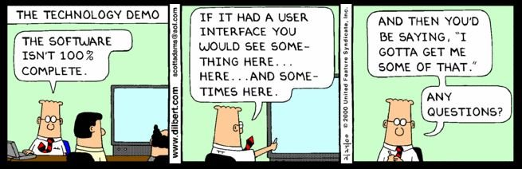
What is Sprint Review?
Scrum Ceremony at end of sprint
Before retrospective (typically)
Main goal: demonstrate system meets sprint goal
What progress have we made?
Keys for legitimacy
Out of dev branch
(main branch: what is deployed)
Remote hosts – avoid local host
Other purposes:
Get feedback, set future priorities
Visibility, discussion, correction
Also: show value of continuing!
Sprint Review
Visibility
Discussion
Course Correction
Feedback

Slide 3
Review Participants
Who | Role
Scrum team | Run presentation Collect feedback Answer questions Explain the increment!
Internal stakeholders | Provide feedback, suggest changes
Other internal teams | Provide area-specific feedback (e.g., sales, legal, other development) sync work
External stakeholders | Provide feedback, suggest changes (who exactly? why?)

Slide 4


Review Preparation
Sprint review prework
Identify participants (specific people)
Set the schedule (when, duration)
Confirm sprint work is done (DONE)
What is the definition of DONE?
Who decides?
When is the decision made?
Granularity of the decision? (per PBI?)

Slide 5
Agenda for Sprint Review
What was done?
In industry, PO describes the sprint goal
Summarize new features
Demonstration
Development team shows what they have built and how it works.
Out of appropriate branch
On remote host if possible
Review Sprint Statistics, check Definition of done for PBI.
SM shares sprint statistics - burndown and velocity chart
PO shows the prioritized list of stories for next sprint
PO provides final decision on whether implementations are acceptable for release
Impediments
Discuss risks identified in the Sprint, organization level impediments. Proposals for solutions.
This week:
Items to discuss at our reviews: in green
Key: prepare, practice your demo
Check again morning of review!
Show us sprint goal, story point burndown on milestone page
Discuss any external impediments
Core goal: show your product owner what you want feedback on
No slides, no PBIs, no vaporware
Don’t tell us, show us
Market conditions
PO gives an update on any relevant changes to the roadmap
Release plan and forecast
PO presents current plan and forecast delivery dates.
Whole group collaborate to discuss potential changes to the release plan, which may include:
Ideas for new features
Reprioritize the product backlog
Review release plan
Feedback and closing

Slide 6
Retrospective
What is the retrospective?
Why do we do it?
What can go wrong?
Issues:
Not doing one
Superficial, not addressing real issues
Just wastes time
Poor execution: facilitation, blame/complain
Too ambitious (or miss ongoing improvements)
Lack of follow-through
Notes:
What: meeting about what might be improved to make team more effective
Why: can’t do projects perfectly, but should improve with experience
What can go wrong: blame game/pointing fingers at individuals
note: Retrospective should not replace ongoing improvement activity during the sprints.

Slide 7
Retrospective Participants
Who | Role
Scrum team | Reflect on the sprint experience from a process point of view
ScrumMaster | Lead process discussion, help team focus on fidelity to its own chosen process
Product owner | Help address issues with requirements, PBI grooming issues, interaction with team
Other stakeholders | Only if invited by the team; not invited if negative effect on team safety/openness

Slide 8
Retrospective Structure
How much time?
Location?
Facilitator?
Scrum Master
Other team member
Outsider (other Scrum Master?)
There is not only one way to facilitate a good retrospective
Notes:
About 1.5 hours for a 2-week sprint, more for longer ones.
Meet in team area or elsewhere? Access to data vs environment more conducive to open discussion.

Slide 9

Overview
Focus
Exercises (or prep)
Objective data
Subjective data
Insight backlog
Retrospective
Improvement actions
Insight backlog
Improved team spirit
Set atmosphere
Share context (common perspective from individual ones)
Identify insights
Determine actions
Close the activity
Notes:
Focus: general improvement, or is there something specific we need to work on?
Exercises: create/mine sprint timeline, brainstorm/group insights (determine ahead or select dynamically)
Atmosphere: ground rules for safe/open discussion, active participation
Context: Share perspectives to seek common team understanding of what happened, from objective data; agree on event timeline, emotions seismograph
[more on following slides]

Slide 10

Technique: Start/Stop/Continue
Each team member says what they would like to:
Start doing
Stop doing
Continue doing

Slide 11
Technique: Dot voting
Issue: can’t fix everything at once
Organize insight backlog
Cards on wall
Select insights from new backlog
“Dot voting”
Consider timeframe for changes
Decide on actions
Specific task items
General changes
B
D
E
F
A
C
Notes:
Specific: improve infrastructure software, tools
General: behavioral, attitudinal

Slide 12





Technique: Boating
Hazards- Where we
could crash
Life Preserver- What
can save us
Anchors- What holds
us back
Propellers- What moves
us forward

Slide 13
Techniques
There are a lot of them
Variety is the spice of life!
http://retrospectivewiki.org/index.php?title=Retrospective_Plans

Slide 14
Follow Through
Sprint tasks
Include tasks to implement chosen actions
Not a separate “improvement” effort!
Integrate into the next sprint’s work
Notes:
Specific: improve infrastructure software, tools
General: behavioral, attitudinal

Slide 15

Interaction Costs Greater in Large Projects
When the # of people on a project is 7, the number of possible interactions is 21. At 1,000 people, the possible interpersonal interactions increases to 499,500.
# of Possible Personal Interactions:
n(n-1)
2
How does hierarchy reduce this problem?

Slide 16
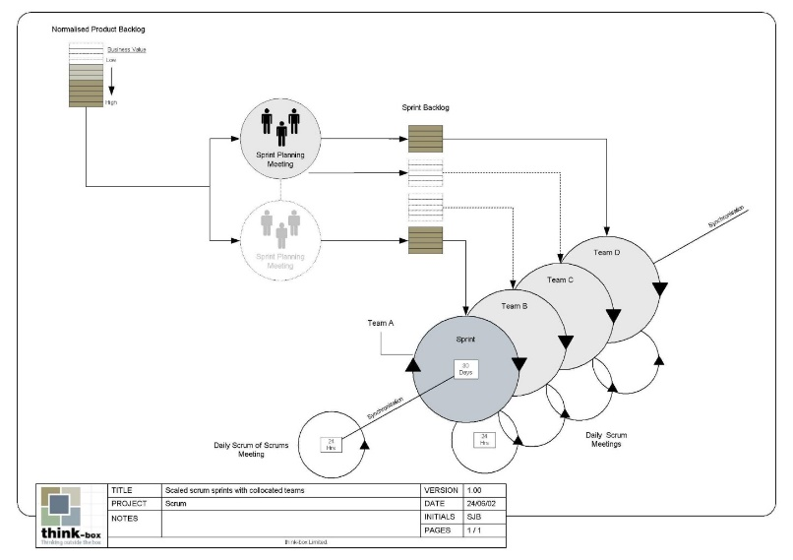
Scalability
Typical individual team is 7 ± 2 people
Scalability comes from teams of teams
Factors in scaling
Type of application
Team size
Team dispersion
Project duration
Scrum has been used on multiple 500+ person projects

Slide 17
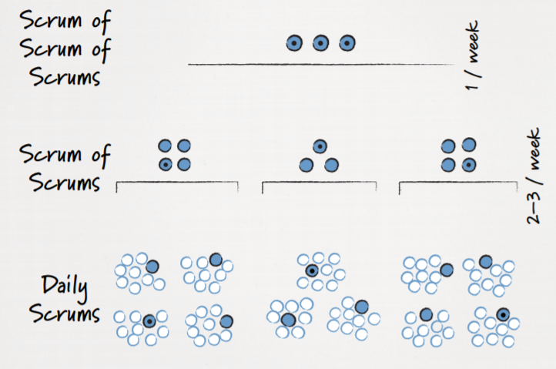

Slide 18
Scaling issues/solutions
Dependencies
These can be resolved using traditional methods
Team silo-ing
Share team members between teams between sprints
Integration
Having a dedicated integration team can facilitate smoother combinations of results
Scrum of Scrums communication

Slide 19




 | Nautical Meaning | Our Meaning
 | “I require medical assistance.” | “We need the product owner.”
 | “We require assistance.” | ”We need the architect.”
 | “We require a tug.” | ”We require a pizza.”
 | “We require dragging anchor.” | “We are on a break.”

Slide 20

Distributed Scrum
Working in a distributed Scrum environment can be challenging
What if the team is distributed?
What if the Scrum Master is distributed?
What if the Product Owner is distributed?
Strategies
Communication!

Slide 21

Physically distributed teams
Acknowledge cultural differences
Time to work
Approaches to authority
Holidays/vacations
Strengthen team subculture
Buy in to a shared mission/vision
Encourage early “wins”
Create a sense of team ownership
Respect meeting time
Establish clear expectations
Hand holding for teams that don’t conform
The SM role is to make Scrum happen, not make hiring/firing decisions
Make sure the team knows this!!!

Slide 22
Meeting Hints
Include time for small talk
Make sure it is known who is speaking
Share pain as appropriate
More, shorter calls tend to be perceived as being more productive overall

Slide 23
