Slide 1

JUNIT

Slide 2
Review- Testing
Testing motivation: show that a program does what it is intended
Catch errors before users do...
Basic strategy: run program, check for incorrect outputs and errors
Sometimes people focus on exception errors, but
Those are easy for user to see; real hazard is getting the wrong output!
Note must test both functional and non-functional requirements
Issue: we can only reveal the presence of errors, NOT their absence
Testing is part of a more general verification and validation process

Slide 3

Testing Phases
Unit testing
Test individual components in isolation
Units: Classes, methods, etc
Usually done by the developer
Module testing
Test a group of components that interact with each other
Logically related
Interfaces between the components must also be tested
Integration testing: test groups of subsystems
System testing: end-to-end
Compare actual outputs to expected outputs

Slide 4
What is Unit Testing?
Special-purpose test code exercising a unit
In object-oriented programming, a unit is a class
Goal: test one method or closely related methods at a time
Complex methods: multiple test cases
Some methods come in pairs: setters and getters would likely be tested together
Overall goal
Every line of code tested at least once
Every logical case tested
If have complex conditions, the different combinations are tested
Will discuss in further detail in Software Verification course
Common issue: exercising “boundary conditions”
“bad” arguments
Values close to limits (1, 0, -1, N, N-1, N+1)
Empty values such as nulls, empty lists
Test framework we will examine: JUnit

Slide 5
Simple unit testing
// Code to test:
int max(int a, int b) { if (a > b) { return a; } else { return b; } }
// test code (in class MyClass):
void testMax() { int x = max(3, 7); if (x != 7) { System.out.println("max(3, 7) gives " + x); } x = max(3, -7); if (x != 3) { System.out.println("max(3, -7) gives " + x); } }
public static void main(String[] args) { new MyClass().testMax(); }
Why do people do this?
What are the challenges?

Slide 6
Improved model: using JUnit
public class Counter { int count = 0; public int increment() { return count += 1; } public int decrement() { return count -= 1; } public int getCount() {
return count;
} }
public class CounterTest { Counter counter1; // declare a Counter here
@BeforeEach void setUp() { counter1 = new Counter(); // counter initialized }
@Test public void testIncrement() { assertTrue(counter1.increment() == 1); assertTrue(counter1.increment() == 2); }
@Test public void testDecrement() { assertTrue(counter1.decrement() == -1); } }
Note: @BeforeEach
Also have @AfterEach
Wins for this method?
Don’t have to look at output
Tests are shorter
Scales to larger code

Slide 7
Terminology, strategy
test suite
test runner
another unit test
test case (for one method)
Unit test: each focused on a single class
Could have multiple ones per class for complex classes
Common: each test case focuses on one method
Complex methods: multiple test cases
Some methods come in pairs: setters and getters would likely be tested together
Test suite: multiple unit tests
Test fixture: software support for running tests
Goal: clear scope to every test case
Test a feature of the class
Complex features: multiple test cases
Integration testing: limited support in JUnit
Can simply create a unit test, but harder to reset state
another test case
another unit test
another test case
another test case
another test case
unit test (for one class)
test case (for one method)
another test case
test fixture

Slide 8
Stubs
Starting point: write method that “does nothing”
If the method has a return value, “nothing” means return correct value
Eg, return true if method returns a boolean, 0 for integers, etc.
This allows the code to compile and run even if they ”do the wrong thing”
known as “stubs”
Can then write the unit tests
The tests must fail!
“Test the tests”
The IDE will generate the test method stubs automatically!
EA will do this too...
Next step, implement some stubs, get their tests to pass
Iterate until full class implemented, tested

Slide 9
Test suites
“If it ain’t tested, it’s broke”
We have to test
But do we have to write executable unit tests?
Customer does not care if units work, they want functioning systems
It’s extra programming
They have to be maintained
Wins:
Solid building blocks make more solid buildings
If you can’t write tests, do you know what the code is supposed to do?
Experiments show writing unit tests decrease debug time
If someone modifies a unit, can determine quickly if it breaks existing code
Much easier to maintain code with tests

Slide 10
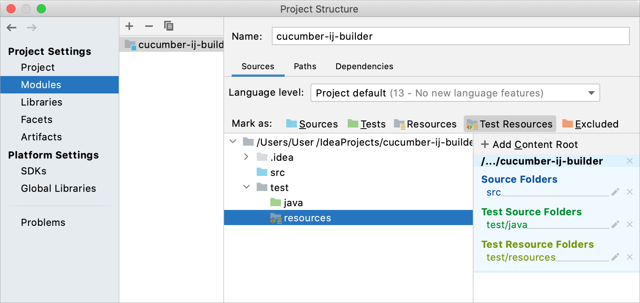
JUnit in IntelliJ
Create a directory to hold your tests
Add new “test” directory
Project Structure, Modules, Sources, mark “test” as Test source root
Create a test resources directory
Mark it appropriately
To create a test,
Move your cursor to the class declaration
public class MyClass {
Alt-Enter
Create Test (select correct destination directory)
Select JUnit5
Choose “setup/@BeforeEach
This will stub out the test case

Slide 11
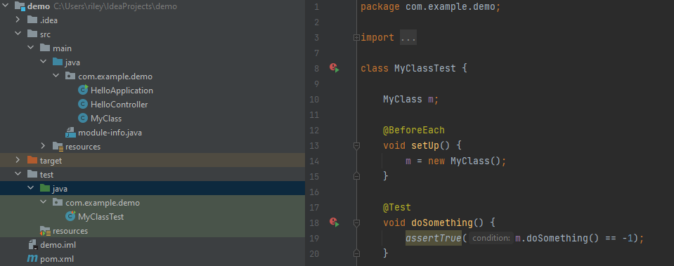
Running Tests in IntelliJ
Your tests should all be in the “test” directory
Resources (files) should be in the test resources directory
You may need to add dependencies
Alt-Enter on imports
All Asserts will need to be imported
Right click on the Unit test class
Run
Test runner will show results

Slide 12
Assert methods
An assert method is a JUnit method that performs a test, and throws an AssertionError if the test fails
JUnit catches these Errors and shows you the result
static void assertTrue(boolean test) static void assertTrue(boolean test, String message)
Throws an AssertionError if the test fails
The optional message is included in the Error
static void assertFalse(boolean test) static void assertFalse(boolean test, String message)
Throws an AssertionError if the test fails

Slide 13
More assert methods
assertEquals(expected, actual) assertEquals(expected, actual, String message)
expected and actual must be both objects or the same primitive type
For objects, uses your equals method, if you have defined it properly, as described on the previous slide
assertSame(Object expected, Object actual) assertSame(Object expected, Object actual , String message)
Asserts that two arguments refer to the same object
assertNotSame(Object expected, Object actual) assertNotSame(Object expected, Object actual , String message)
Asserts that two objects do not refer to the same object
What about assertEquals(1.0, Math.sin(Math.pi/4.0))?
Do not use assertEquals with floats other than 0.0

Slide 14
Reviewing example
public class Counter { int count = 0; public int increment() { return count += 1; } public int decrement() { return count -= 1; } public int getCount() {
return count;
} }
public class CounterTest { Counter counter1; // declare a Counter here
@BeforeEach void setUp() { counter1 = new Counter(); // counter initialized }
@Test public void testIncrement() { assertTrue(counter1.increment() == 1); assertTrue(counter1.increment() == 2); }
@Test public void testDecrement() { assertTrue(counter1.decrement() == -1); } }

Slide 15
Review: .equals
You can compare primitives with ==
x.equals(y) allows the comparison of objects
This method works great for Strings and a few other Java classes
For objects of classes that you create, you have to define equals
assertEquals(expected, actual) uses == or equals
Depending on the type
To define equals for your own objects, define exactly this method: public boolean equals(Object obj) { ... }
The argument must be of type Object, which isn’t what you want, so you must cast it to the correct type (say, Person):
public boolean equals(Object something) { Person p = (Person)something; return p != null && this.name == p.name; // test whatever you like here }

Slide 16
Assert methods
assertNull(Object object) assertNull(Object object , String message)
Asserts that the object is null (undefined)
assertNotNull(Object object) assertNotNull(Object object , String message)
Asserts that the object is null
fail(String message)
Causes the test to fail and throw an AssertionFailedError
Useful during development

Slide 17
Keys to effective unit tests: FIRST
Fast execution
Avoid file I/O, complex setups
Independent
Can run each tests on its own
If there are dependencies, maintenance nightmare
Simply make no assumptions about setup
Repeatable: behave correctly on each run
No random behavior
Don’t depend on files, dates
@RepeatTest: run test multiple times if necessary; generally avoid
Self-validating: no monitoring by user
Thorough: happy, failing paths; valid, invalid inputs
Name tests by effect, state
Pattern: Should_ExpectedBehavior_When_StateUnderTest
Method name not in test name – avoid having to rename tests just to track name changes
Readable
Notes:
https://www.code4it.dev/cleancodetips/f-i-r-s-t-unit-tests/

Slide 18
Mutation testing
How do you know your tests are working?
Test coverage
Percentage of lines of code covered
Limitations?
Alternative: Mutation Testing
Mutation tools exist that change a code base in syntactically accurate ways (still compile) but are semantically incorrect
i.e. Switch > to <, Add +1 to an arithmetic operation, etc.
Notes:
This page of notes developed by Dr. Riley, Dr. Hornick

Slide 19
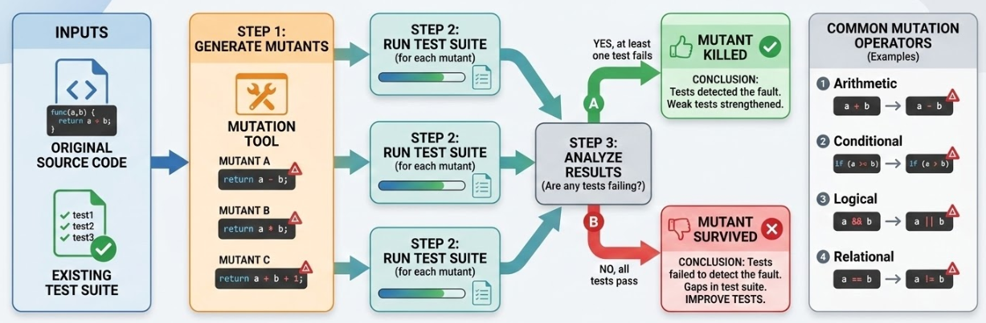
Mutation Testing
What does it mean if mutants survive?
Can use tools to systematically generate mutants
However, can do a manual version: manually generate mutants, see if survive
If many mutants survive, need to increase testing
Notes:
This page of notes developed by Dr. Riley, Dr. Hornick

Slide 20
Review
Unit Testing
Whenever you want your code to work
Reduces debugging, improves maintainability
Test Suite = collection of Unit Tests
Unit Test = collection of Test Cases
Test Fixture: framework to run tests
Test Runner: executes each test
Junit5: @Test, @BeforeEach, @AfterEach
Assertions
FIRST: Fast, Independent, Repeatable, Self-validating, Thorough
Mutation testing: testing the tests

