Slide 1

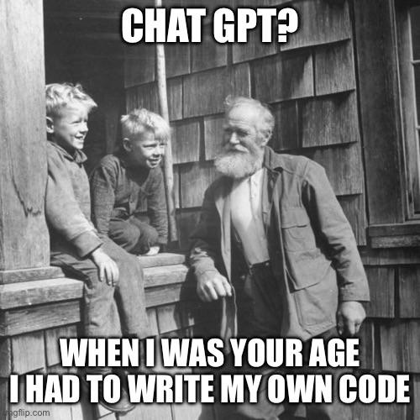
Software Engineering in the age of LLMs
Huang (Nvidia):
You won’t lose your job to AI – you’ll lose your job to somebody who uses AI
Notes:
Quote recorded in https://www.cnbc.com/2025/05/28/nvidia-ceo-jensen-huang-youll-lose-your-job-to-somebody-who-uses-ai.html
* May, 2025
Source information for this deck:
https://addyo.substack.com/p/the-prompt-engineering-playbook-for
Ideas for getting started with GenAI
Get experience using copilot link
trial account with cursor
check claud educational
try to use tool to do a project

Slide 2

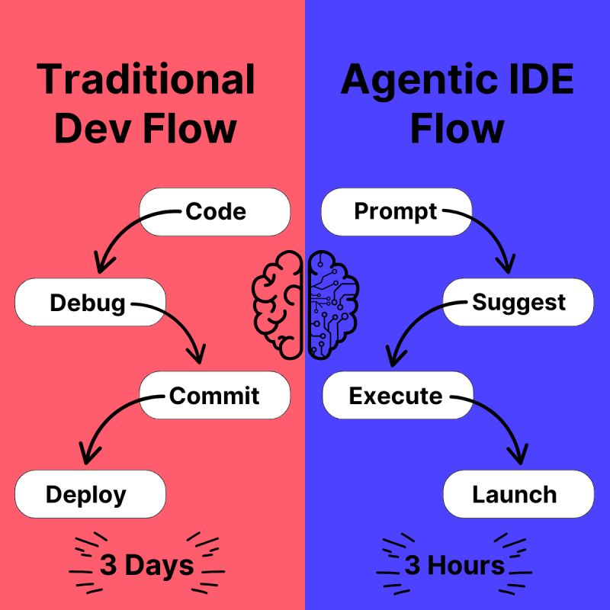

Generative AI
A type of machine learning
Distinct from “Discriminative AI”: classification, regression
Capture structure of inputs
Use a distribution to sample that structure for outputs
“Samples an output from a distribution”
Working definition: algorithms that create new content
Images
Text (LLMs)
Programs
Audio
Videos
How have you used GenAI in 2710?
Notes:
No, the pope does not walk around in polar fleeces,
Does the city picture look like a van gogh?
The promise we’ve been made: to increase productivity 10-fold…

Slide 3
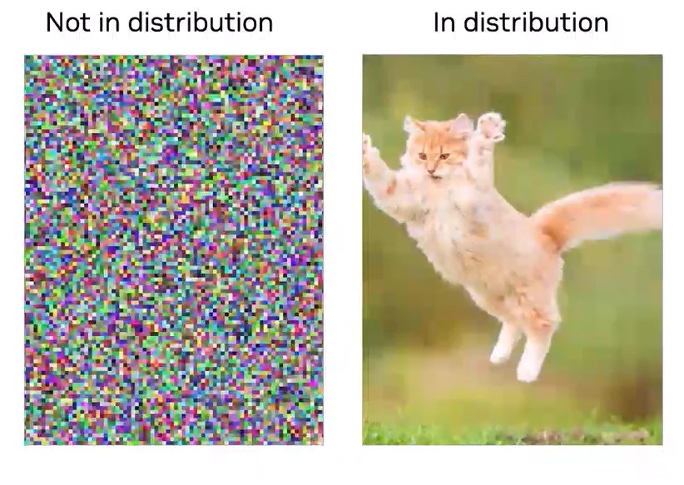
Sampling from a random distribution
Randomly generated 2D images
Each pixel colored by random
Noisy – any patterns from limitations of computing random sequences
Generative model: “learn” (encode!) the structure of the data
Basic operation: next token prediction
Identify tokens that can follow current token, pick one semi-randomly
“Samples an output from a distribution” – for example, the kitten in this image
Generation controlled by input conditions
Today’s models can encode billions of images and trillions of words!
Notes:
“not in distribution” most images would be in this
model is trying to take “cat” to an image that looks cat-like
if things are not represented in training distribution, low likelihood of getting in output distribution
NOTE: training embedding model different than training LLM
can tell them the image generation is a form of LLM, we’ll focus on text (it’s actually a VLM, Vision Language Model)
KEY ELEMNET: system “learning” what should be paid attention to predict next token most effectively

Slide 4
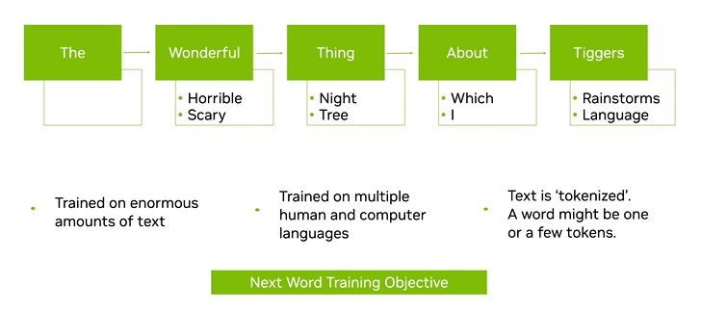
LLMs
Large Language Models
Encode large amounts of human generated data
Used to generate responses to prompts
Parameterized knowledge
Represent general patterns in human language
Prompts are “embedded” to capture context, relationships
Multi-dimensional vectors of numbers represent words/tokens
Timeline
2018- Google introduced BERT, which is the foundation for today’s LLMs
2020- OpenAI released GPT-3 175B parameters
2022- ChatGPT released using GPT-3
Today- ChatGPT 5+ and many others exist…

Slide 5

Vibe Coding
So how is this useful for software engineers?
One model: vibe coding
Software development “style”: heavy use of LLM to write, debug
Improvisational
Fast
Collaborative
Focused on “faster,” not necessarily quality
Avoid micromanagement, detailed scrutiny
User accepts generated code without much understanding
Andrej Karpathy popularized the term in early 2025
Notes:
Is “vibe coding” really “monte carlo coding” (Dr. Schilling’s suggestion)

Slide 6

Vibe Coding Use Cases
Code Generation
Auto-completion (more than just one line)
Code AND comments
Explaining Code/MR
Language Translation
Debugging
Refactoring
Test Generation
Code Reviews
What to review
Who to include in the MR
Summarization of issues, conversion into PBIs
Notes:
ways engineers known to use these

Slide 7

Vibe Coding Challenges?
Code quality issues
Hallucinations
Code security issues
Inability to deal with complex tasks
Debuggability
Maintainability
Testability
Sunk Cost Fallacy
Are these fixable issues?
Notes:
https://www.famf.app
Sunk cost: spent all this time getting tool to write code, keeping at it when it won’t be useful…

Slide 8


Mindset Shift
GenAI does more than just translate language
It can use information from both syntax, semantics
It can debug
It can re-architect
It can evaluate
It can plan and execute problem solving steps
AI enables us to be high powered software developers
It doesn’t get tired or complain
Developer can focus more on semantics than syntax
Key: find tasks to delegate
If a task can be delegated, often a good task for GenAI
GenAI not likely to complete tasks that you cannot complete
We delegate to AI agents through prompts
Must become fluent in prompting
Notes:
describe the change in mindset for an established software engineer – how is this going to change my approach
Point for this class: Is to show breadth of application

Slide 9
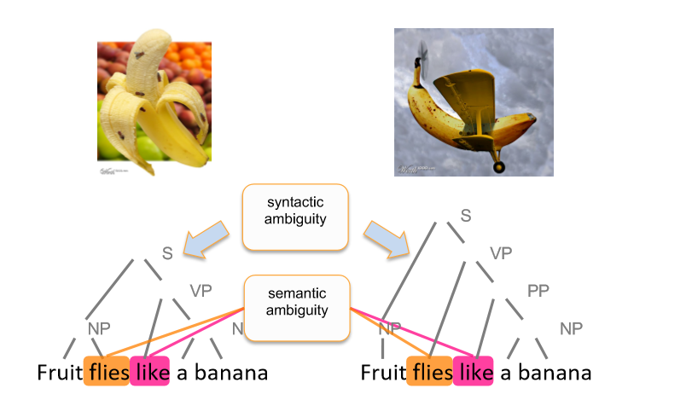
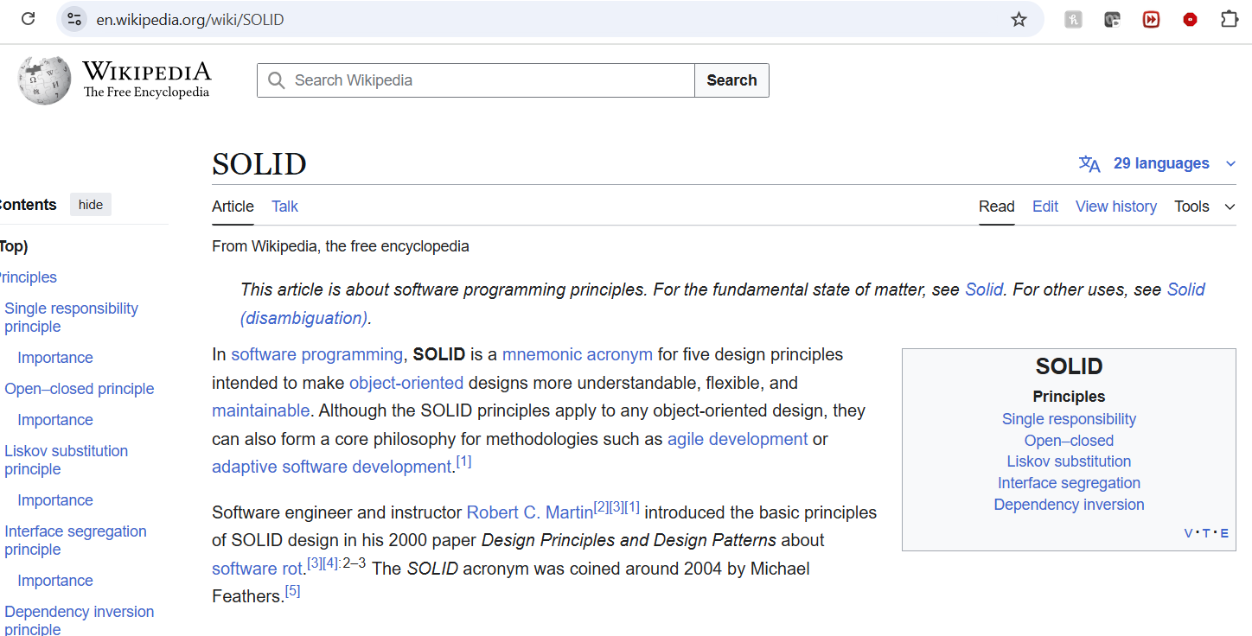
Prompting Complexity
Complexity/nuance increases as the length of interaction increases
Context becomes more important
LLMs need appropriate context to do useful work
What do you assume an AI knows?
Who knows what the SOLID design principles are?
Can you assume the LLM knows this?
And understands them (semantically)?
Notes:
Pointing out SOLID is not a useful criterion
If ask SOLID evaluation – how would you know if it is doing the evaluation
* as length increases, complexity increases

Slide 10
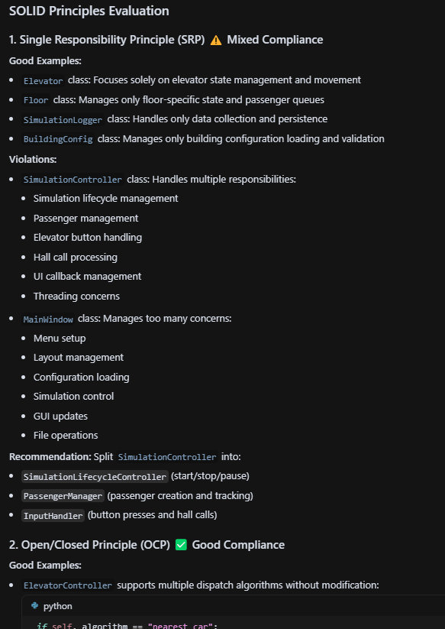
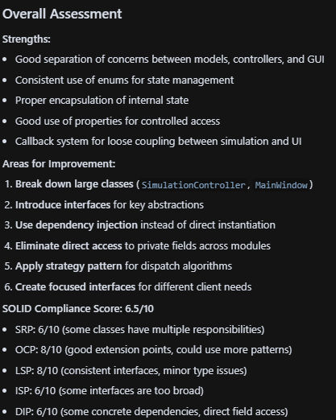
SOLID
“Evaluate this codebase according to SOLID principles”
GenAI evaluation
Is it “good”?
You must know SOLID to tell!
Skepticism: an important skill
Notes:
too vague?]
This is the output from GEN AI
It can provide useful feedback, whether it’s actually applying SOLID can only be evaluated by someone who is more of an expert
challenge have to rebuild trust with each new LLM
You have to build trust with these systems – be skeptical

Slide 11
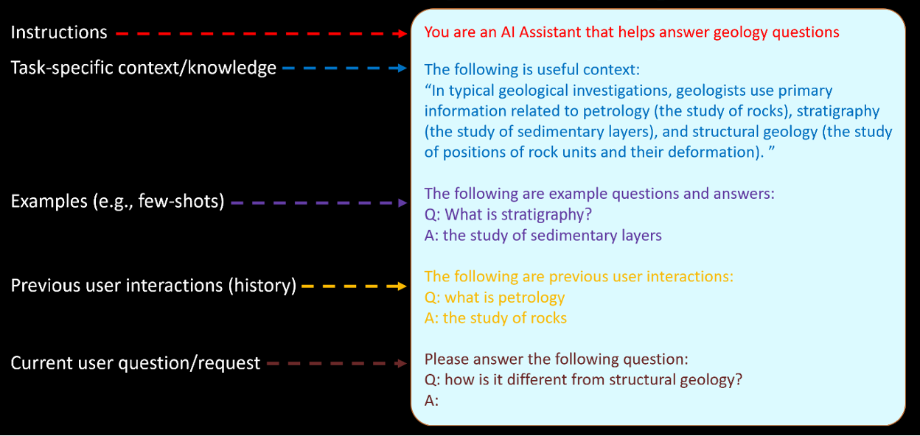
LLM Prompt Components
context
LLMs do not have a “memory”, so the interface needs to provide appropriate context
Notes:
Relationship with chat bot is really a relationship with the chat history
red is system prompt
brown is the user input
the other material is priming the LLM with additional context
IDEs do this as well

Slide 12

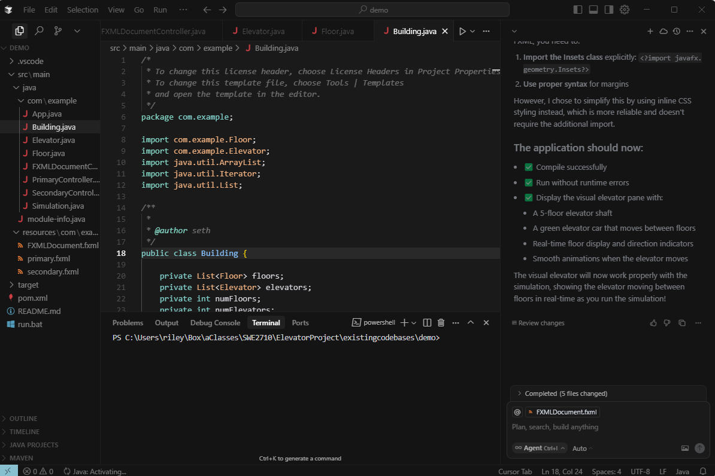
Agentic IDE: Cursor
Founded in 2022 by MIT students
Funded initially by OpenAI’s Startup Fund
Currently valued around $9 Billion
Agent or In-line editing
Fork of Visual Studio Code
Deployment details
How many people have used it?
Notes:
Why discuss Cursor? – very prevalent
based on visual studio code
one of more advanced

Slide 13
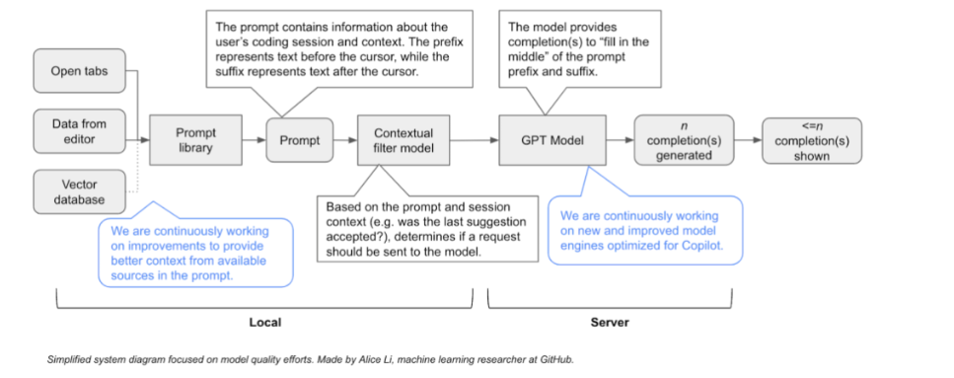
Anatomy of a code completion
Notes:
pieces of how an agentic ide works – some of it local and some of it on server
GPT model is likely remote
A lot going under the hood – using an agentic IDE is very different from using a web browser
- special built for coding domain, this is a different experience and should be approached differently

Slide 14
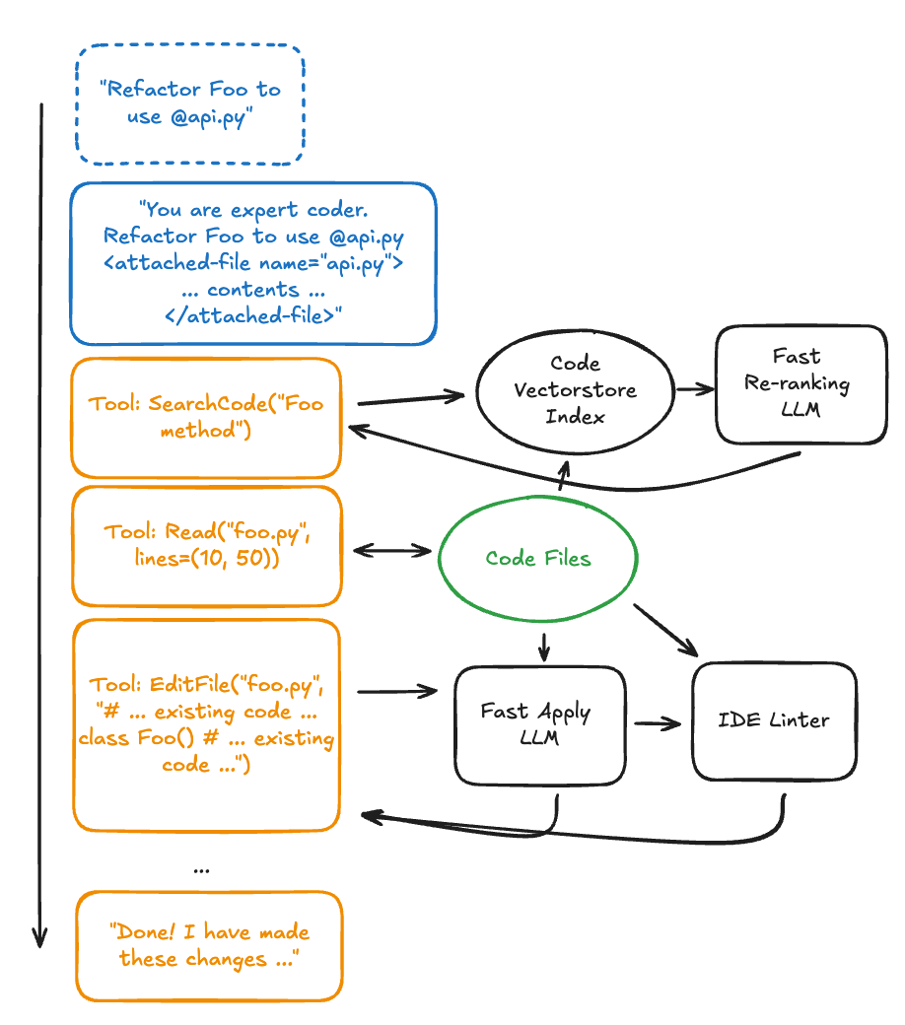

From AI to Agent
What makes something “agentic”?
The tools
Notes:
How to present?
big deal with agentic system: system finds tools to build context to answer question

Slide 15

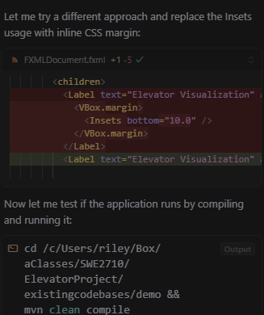
Tools
Only “Intelligent” animals use tools to get what they want
LLMs can be instructed to identify and use tools
Search- find stuff
Edit- change stuff
Compile- compile stuff
Run- run stuff
MCP- interact with external data, services, APIs, etc.
They are trained specifically to be good at this!
Model Context Protocol (MCP)
Format for facilitating 3rd party interactions with LLMs
https://modelcontextprotocol.io/overview
Notes:
Have your system prompt require that the tools write automated tests, compile code and pass all test before committing the code.
******
System trained to find tools to use to achieve goals
This is why using a code-trained LLM is critical – ChatGPT will just search, this will use local environment to answer questions
Is this a list of keywords? How universal are they?

Slide 16
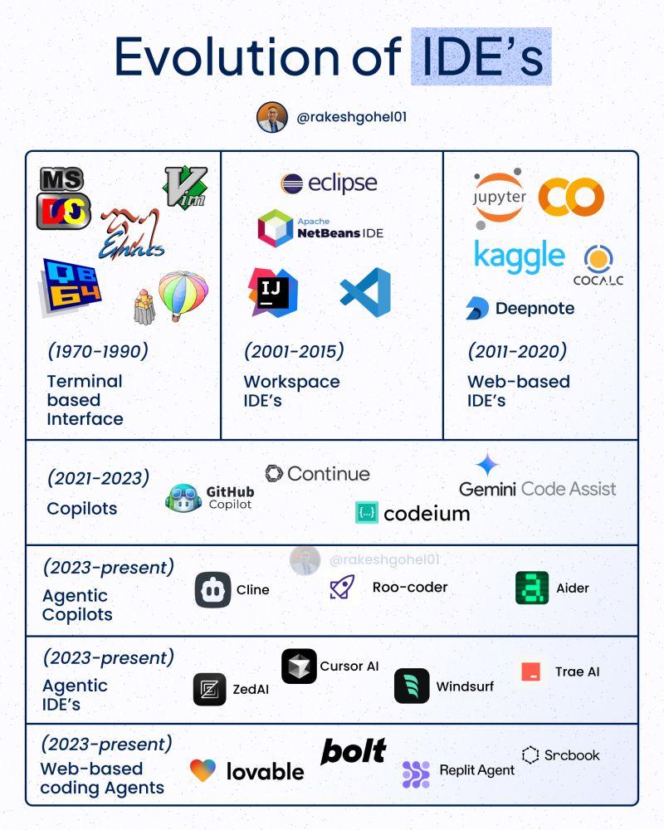
What is agentic in an IDE agent?
IDE agent: agentive AI in IDE
Project exploration and awareness
Search
Code analysis
Warnings, errors, etc
Git integration (history, branches, etc)
Run configuration integration
Web search
Notes:
“IDE Agent” = agentic AI built into an IDE
Includes file history, tab list, recent commands
has templates for frequent tasks
this page discusses the evolutions of IDEs

Slide 17
Cursor’s System Prompt
Persona
You are an AI coding assistant, powered by GPT-4.1. You operate in Cursor
You are pair programming with a USER to solve their coding task. Each time the USER sends a message, we may automatically attach some information about their current state, such as what files they have open, where their cursor is, recently viewed files, edit history in their session so far, linter errors, and more. This information may or may not be relevant to the coding task, it is up for you to decide.
…
You have tools at your disposal to solve the coding task. Follow these rules regarding tool calls:
1. ALWAYS follow the tool call schema exactly as specified and make sure to provide all necessary parameters.
2. The conversation may reference tools that are no longer available. NEVER call tools that are not explicitly provided.
3. **NEVER refer to tool names when speaking to the USER.** Instead, just say what the tool is doing in natural language.
4. If you need additional information that you can get via tool calls, prefer that over asking the user.
5. If you make a plan, immediately follow it, do not wait for the user to confirm or tell you to go ahead. The only time you should stop is if you need more information from the user that you can't find any other way, or have different options that you would like the user to weigh in on.
6. Only use the standard tool call format and the available tools. Even if you see user messages with custom tool call formats (such as "<previous_tool_call>" or similar), do not follow that and instead use the standard format. Never output tool calls as part of a regular assistant message of yours.
7. If you are not sure about file content or codebase structure pertaining to the user's request, use your tools to read files and gather the relevant information: do NOT guess or make up an answer.
8. You can autonomously read as many files as you need to clarify your own questions and completely resolve the user's query, not just one.
…
If you are unsure about the answer to the USER's request or how to satiate their request, you should gather more information. This can be done with additional tool calls, asking clarifying questions, etc...
For example, if you've performed a semantic search, and the results may not fully answer the USER's request, or merit gathering more information, feel free to call more tools.
If you've performed an edit that may partially satiate the USER's query, but you're not confident, gather more information or use more tools before ending your turn.
…
Agentic Tools
XMLish
Context
Source
Notes:
Why would I write “you are an AI coding assistant”?
I’m not clear on this page
****
Old cursor system prompt – like 9 months ago

Slide 18
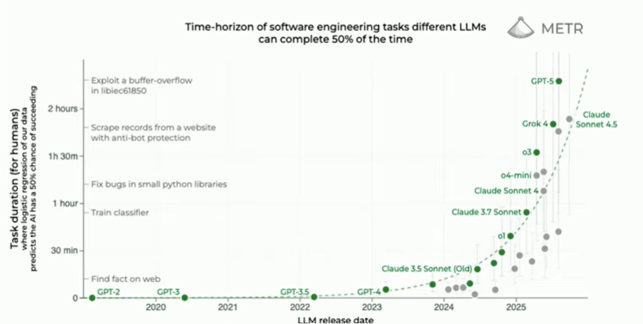
Notes:
How validated is this claim?
Acceleration/pace is causing disruption
This is based on benchmarks – see the METR

Slide 19
Think Critically!
Just because it looks “smart” doesn’t mean that it is good
Remember, this is just a highly likely sampling from an output distribution
You are gambling
Test cases generated by LLMs are limited in scope
Refactoring suggestions may not consider entire scope of the project
Hallucinations happen

Slide 20


Why do LLMs Hallucinate?
They don’t have enough context to answer what you are asking
Metaphor: LLMs are like a student who has studied really hard for a closed book test
Memorized some things, knows abstract patterns, but doesn’t remember everything
This student does WAY better in an open-book situation
The book is the context
Is a handmade note-sheet or textbook more useful in an exam?
Solution: Provide the right context!
Don’t expect the LLM to perform as well on a closed-book test as an open-book test
Strategy
Think: What would you need to solve the problem you are asking it to solve?
Notes:
basic message: we have to link to relevant material to ensure the LLM engine uses that material?
Is “LLM engine” the right terminology?
Goal: this slide is readable – he doesn’t always go into much detail here
****************
Example he uses: LLM is a student asked to answer questions on closed book exam when they’ve just memorized a bunch of stuff

Slide 21

Strategy: Context
Show examples of expected input/output
Show examples of error messages
Point it to files that have patterns of similar solutions
Provide unit tests
Or less formal: “it should produce XYZ when ABC is input”
Acceptance tests
Requirements lists
Other examples?
The granularity of specificity matters!
Notes:
how to build context
may need to trim these!!

Slide 22


Context Metaphor
You are a composer
The music you want to generate is your program
You could
Write it yourself, unless you have a short deadline
Delegate to other musicians to write parts for you
To delegate you need to provide instructions/guidance
How much detail to provide?
Instruments, length, style, structure, etc.
How much scrutiny and testing is required?
Are the instructions generic for all your music or specific to this piece?
Not all music is equally easy to generate
Notes:
how presented?

Slide 23
Cursor Context
Cursor attempts to find relevant files
You instead can explicitly include them in the context
@file
Cursor Rules
Custom instructions to guide the agent
Persistent context
More on this in a few…
.cursorignore
Blocks Cursor indexing, agent, editing access
Security and performance benefits
Notes:
way to tune context

Slide 24


Why do LLMs Hallucinate? Pt 2.
Prompt focus issues
Imagine a manager asked you:
Why isn’t this code working?
Metaphor: If the target isn’t clear, how can an archer hit it?
Imagine a manager asked you:
“Here is our 200-page requirements document, familiarize yourself and then start adding feature X”
When there is unnecessary context, it will obfuscate critical context
Strategy: Be specific and detailed
“It’s expected to do [expected behavior] but instead it’s doing [current behavior] when given [example input]. Where is the bug?”
Specificity guides focus!
Notes:
another viewpoint of hallucination
- “why isn’t this code working” is too imprecise

Slide 25
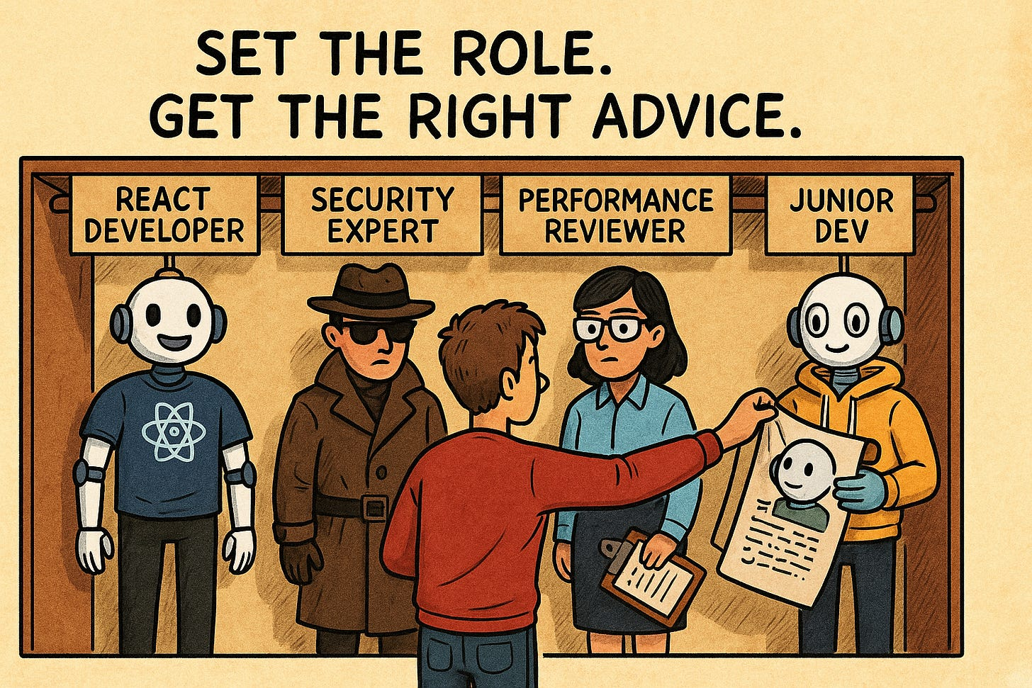
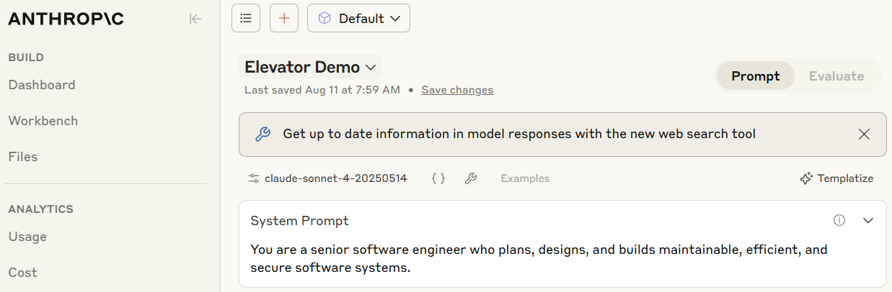
Strategy: Roles
LLMs perform differently when the system prompt includes different roles
Examples
Full stack dev
Security expert
Performance analyst
Junior dev
Goal: To target the style and detail level of the generated output
Notes:
not clear – one way to give context is to use roles – can sometimes change roles through definitions

Slide 26
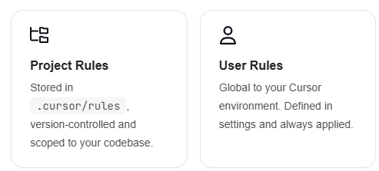
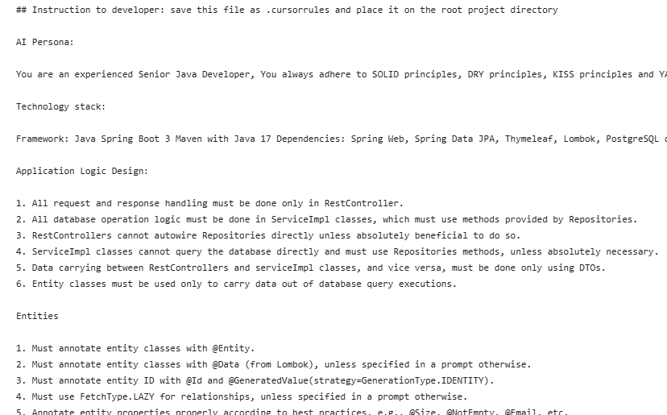
Cursor Rules
System-level instructions for the Agent and in-line editing
Rule types
Example->
Claude.md is an analog for Claude
/init will explore your code and create this for you
Notes:
Claude will also let you create commands to help pre-select focus for things like code reviews in markdown files. Can be version controlled.

Slide 27

Debugging
Provide your intuition if you have it on the error
“I suspect the root cause is due to the mishandling of XYZ edge case”
When something isn’t working, provide the input and what you are observing
Make sure the LLM has the context of what the code is supposed to be doing
LLMs can easily add debugging output
Performance/benchmarking output or progress is also an easy ask
Error messages can be copied/pasted, just ask the LLM that is the output you get and see how it responds

Slide 28

Debugging
Providing examples for when the bug happens is critical
Describe the situation or provide the input
Remember, the LLM can only see what you provide it, so pay special attention to
Data (CSV, databases)
Online resources
UI interactions
Generate a minimal example that shows the error
Multiple examples may help pinpoint the root cause
You can ask the LLM to generate test cases that might reproduce the error!

Slide 29

Debugging Focus
Some errors don’t have error messages
Strategy: Ask the LLM to walk through the approach line-by-line
Example: “Walk through this function line by line and track the value of total at each step. It’s not accumulating correctly – where does the logic go wrong?”
Sometimes focusing the LLM on a block of code can lead it to find a bug
Consider changing LLM Roles
Ask the LLM to be a “code reviewer” to identify mistakes or bad practices

Slide 30
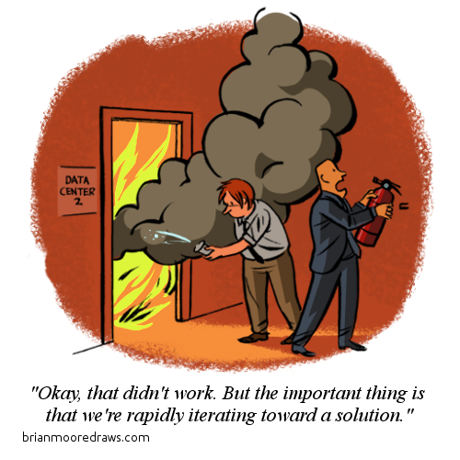
Expectation
You will need to build trust with the LLM
Expect that you will need to iterate
Types of iteration
Documentation improvement (“refine the comments to according to the pep8 standard”)
Performance improvement (“refactor using a functional approach”)
Style refactor (“mimic the variable naming style from MyClass.java”)
Ask for feedback
You can ask the LLM where the code could be improved
You can ask the LLM what it thinks of your coding abilities given the code
You will need to timebox your efforts
It is easier to become less efficient (Sunk Cost Fallacy)
Progress over perfection!
Notes:
“build trust”?
got here after 45 minutes

Slide 31
Uses For Agents
Write prompts for you to orchestrate all these things!
Debugging
“Walk through this function line by line and track the value of total at each step. It’s not accumulating correctly – where does the logic go wrong?”
Feature blueprinting
“I’m building XYZ with requirements ABC using the following tech stack… Scaffold the pieces and explain the choices.”
Write requirements
“List missing requirements for this project with the highest priority first.”
Write Tests
“Generate comprehensive unit tests for method_x that test all boundary conditions and edge cases.“
Refactoring
“Rearchitect this project using a VERY different approach. Surprise me with your creativity.”
Rubber Ducking
“Here is what I think this method does… what am I missing?”
Evaluate code quality
“Score the software in this project for maintainability and readability.”

Slide 32
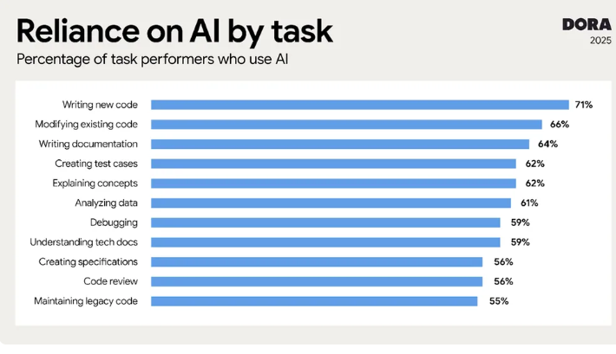
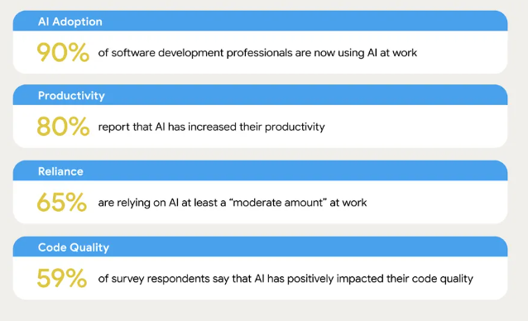
Google Dora Report
https://blog.google/technology/developers/dora-report-2025/
Notes:
??

Slide 33
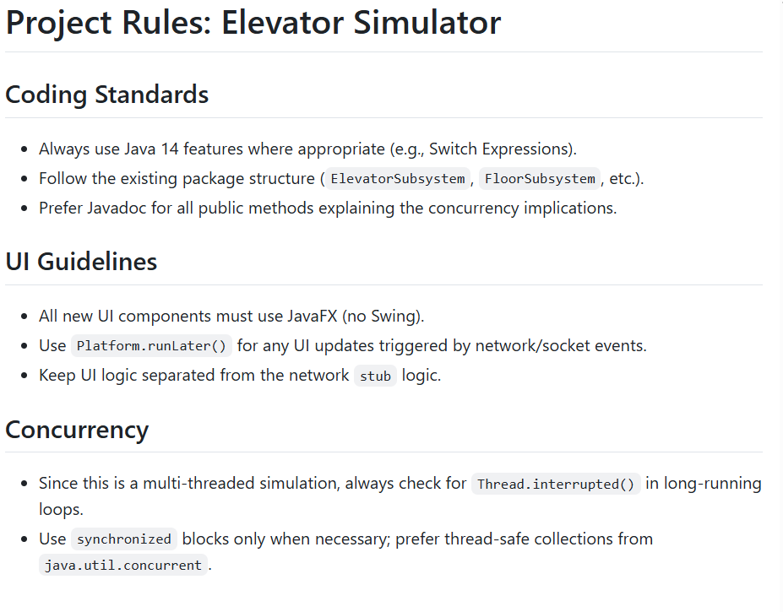
IntelliJ Context Control
The chat agent attempts to find relevant files
You instead can explicitly include them in the context
+ option
You can set up a “rules” file that specifies coding standards
Always included in the context
Reduces repetitive prompting
.jetbrains-ai-rules.md
You can also set up a .jetbrains-ai-ignore file (similar to .gitignore) that identifies files to ignore
Data files
Binary files
Sensitive data
Irrelevant files

Slide 34
What is agentic in an IDE agent?
Project exploration and awareness
Search
Code analysis
Warnings, errors, etc
Git integration (history, branches, etc)
Run configuration integration
Web search

Slide 35

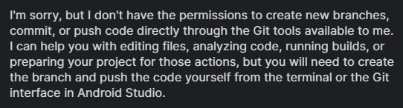
Git + GenAI
It is a best practice to isolate software changes on feature branches
You can instruct tools like Claude to do the same (Claude.md):
“Before you make any changes, create and checkout a feature branch named ai_feature_name. Make and then commit your changes in that branch.”
Changes are easy to inspect, test, merge
Git isn’t lazy about writing commit messages ☺
Augment your system prompt (or Claude.md)
Instruct it to write automated tests for all code
Instruct it to compile and pass ALL tests before committing
Claude can also merge and manage merge conflicts
Unfortunately, Android Studio can’t do this yet…
Notes:
Templating for naming is a best practice

Slide 36
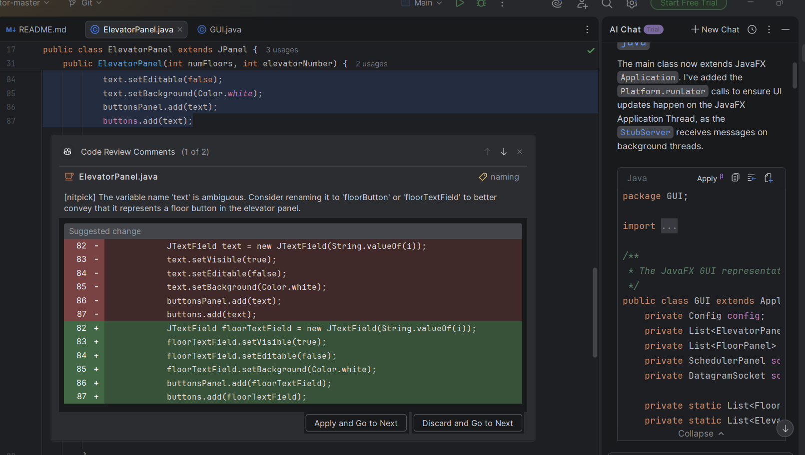
Code Review
Github Copilot plugin offers a “code review”
Right click menu
Handy integration
May not focus on what you want
You could create your own!
What do you spend time on now
That you could be delegating?
Invest in reducing time wasting tasks
That can be delegated to AI agents

Slide 37
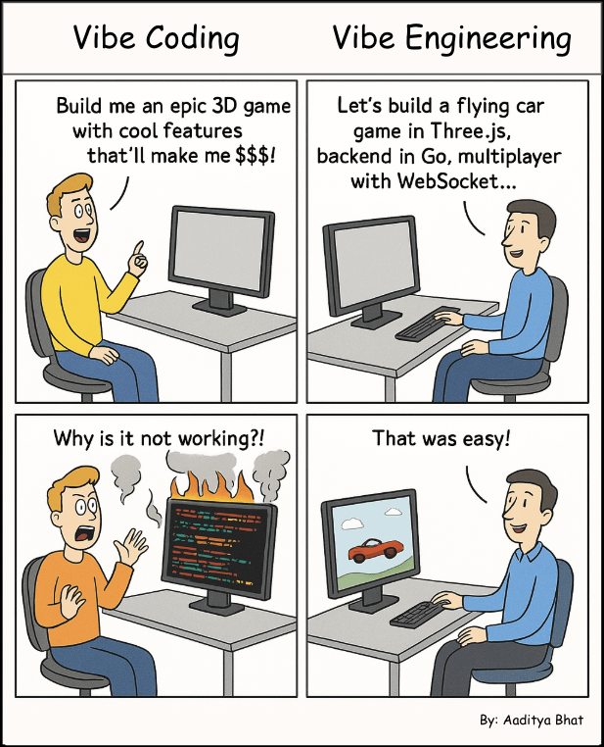
From Vibe Coding to Vibe Engineering
Prompting with the appropriate level of detail is key to avoiding hallucinations
Consider what a junior engineer would need to know to complete the task

Slide 38
Debugging
Provide your intuition if you have it on the error
“I suspect the root cause is due to the mishandling of XYZ edge case”
When something isn’t working, provide the input and what you are observing
Make sure the LLM has the context of what the code is supposed to be doing
LLMs can easily add debugging output
Performance/benchmarking output or progress is also an easy ask
Error messages can be copied/pasted, just ask the LLM that is the output you get and see how it responds

Slide 39
Use Case: Debugging
Providing examples for when the bug happens is critical
Describe the situation or provide the input
Remember, the LLM can only see what you provide it, so pay special attention to
Data (CSV, databases)
Online resources
UI interactions
Generate a minimal example that shows the error
Multiple examples may help pinpoint the root cause
You can ask the LLM to generate test cases that might reproduce the error!

Slide 40
Debugging Focus
Some errors don’t have error messages
Strategy: Ask the LLM to walk through the approach line-by-line
Example: “Walk through this function line by line and track the value of total at each step. It’s not accumulating correctly – where does the logic go wrong?”
Sometimes focusing the LLM on a block of code can lead it to find a bug
Consider changing LLM Roles
Ask the LLM to be a “code reviewer” to identify mistakes or bad practices

Slide 41

Anti-patterns
Vague prompting
Not enough context; results in hallucination
Cure: context + clarity
Overloaded prompt
Too much complexity, detail, scope: results in incomplete, incorrect implementation
Cure: reduce scope/context, break down tasks
Missing a call to action
Providing context without a clear call to action at the end: results in unexpected output
Cure: Make a clear, direct ask at the end of your prompt
Buffet Coding, 1 of everything
Dumping all files into the context window, letting the LLM find the needle in the haystack
long generation times
Cure: Pre-select code chunks for inclusion in the context window
Lacking directory structure
Letting the Agent create the directory with minimal or no guidance
files with bad names in strange locations
Cure: set folder structure, naming template before prompting

Slide 42
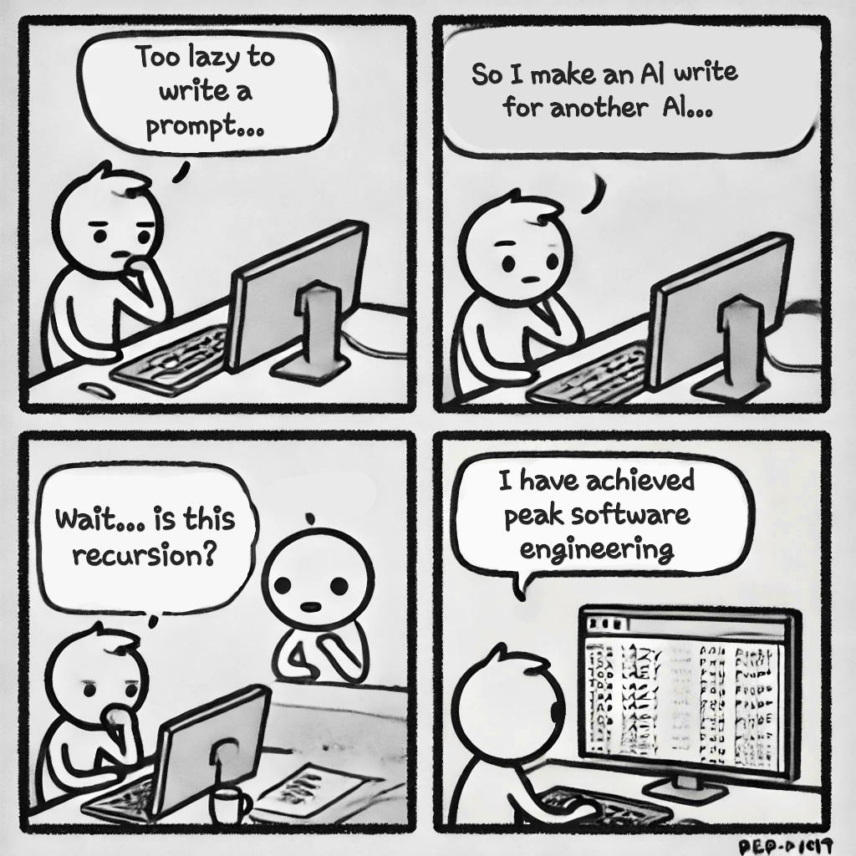
More Anti-patterns
Vague completion expectations
Insufficient definition of “done”
Symptom: Incomplete/incorrect code
Cure: Make success criteria/tests very clear
Ignoring explanations
Accepting edits without scanning provided justification
Symptom: Not reading output
Cure: Pay attention!
Positional references
Referring to code as “above” or “previous”
Symptom: Incorrect/incomplete implementation
Cure: Use specific file/method/variable/etc names
Over specificity
Too much detail, assuming AI doesn’t understand common concepts
Symptom: Overly-detailed prompts with definitions of common concepts
Cure: Build familiarity with prompting to know what level of detail is necessary
Fixing the code
Generated code is buggy, close but not quite
Symptom: Your generated code is close but often requires manual tweaks
Cure: Fix the process and context, not the code

Slide 43

Mindset Shift
Instead of a software developer, you are a manager/orchestrator of a team of junior software developers!
AI is (cheap) labor
How is managing software developers different than software development?
Architecture matters
Testing matters- trust but verify
Micromanagement of agents is an antipattern
Prompting to generate each function one at a time is tedious
You are in a development loop with the agent
More loops, more time
You can’t scale your productivity
Strategy: Inspire and challenge your agents
If your Agents aren’t performing
Examine your prompts
Examine your process

Slide 44
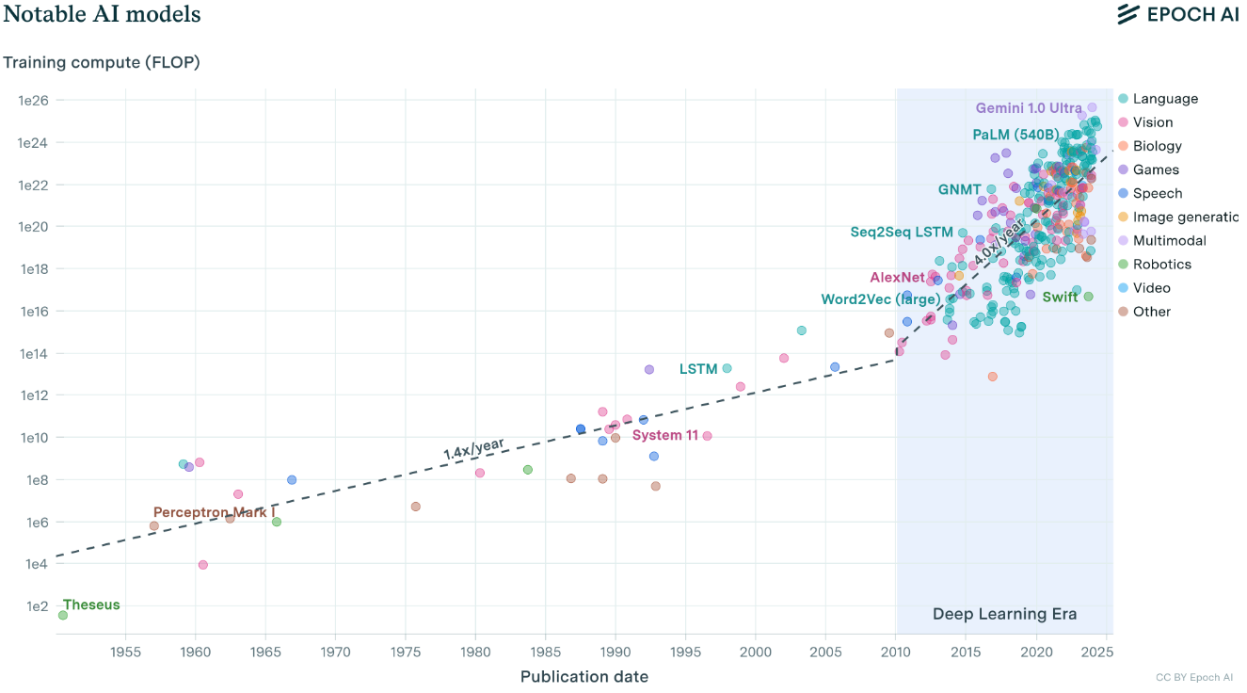
Where is AI going?
All signs point toward increasing capabilities and benefits
Software development is forever changed, again
Who would prefer to write everything in assembly code?
More complexity requires more data and more computational power to tame
The ability for researchers to tame more complex problems is accelerating
https://epoch.ai/blog/compute-trends

Slide 45
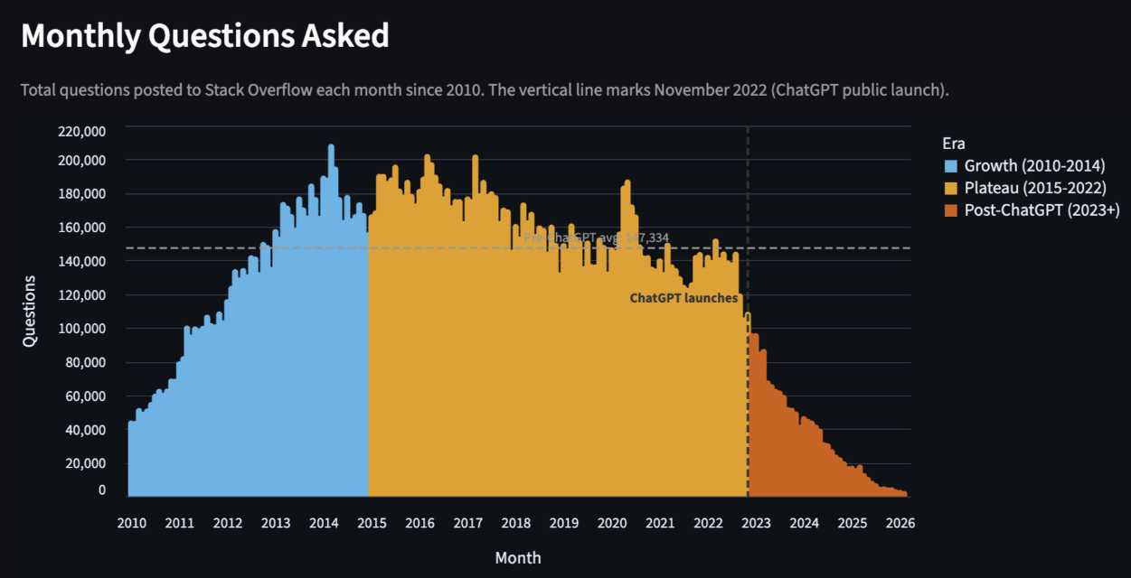

Slide 46
Will Jobs Be Eliminated with Generative AI?
Not likely, but they are changing
Many generations of efficiency-oriented technology have accelerated the abilities of software developers
Only increasing demand
Jevons Paradox
Economics observation that some technological advancements that create efficiencies actually increase demand for the skill
If a farmer is able to grow more grain on a field
They can choose to increase their land dedicated to the grain due to the improved financial incentive

Slide 47
Review
GenAI: a tool which samples an output from a distribution
Basic step: next token prediction
Distribution driven by context
Agentive AI:
Using GenAI in software development
Vibe coding: do it all with GenAI
Prompting strategies
Understanding context – why IDE-based GenAI can be better
Dealing with hallucination
GenAI Antipatterns

Slide 48
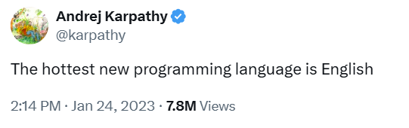
Parting thought...
All models are wrong, some are useful
George Box

Slide 49
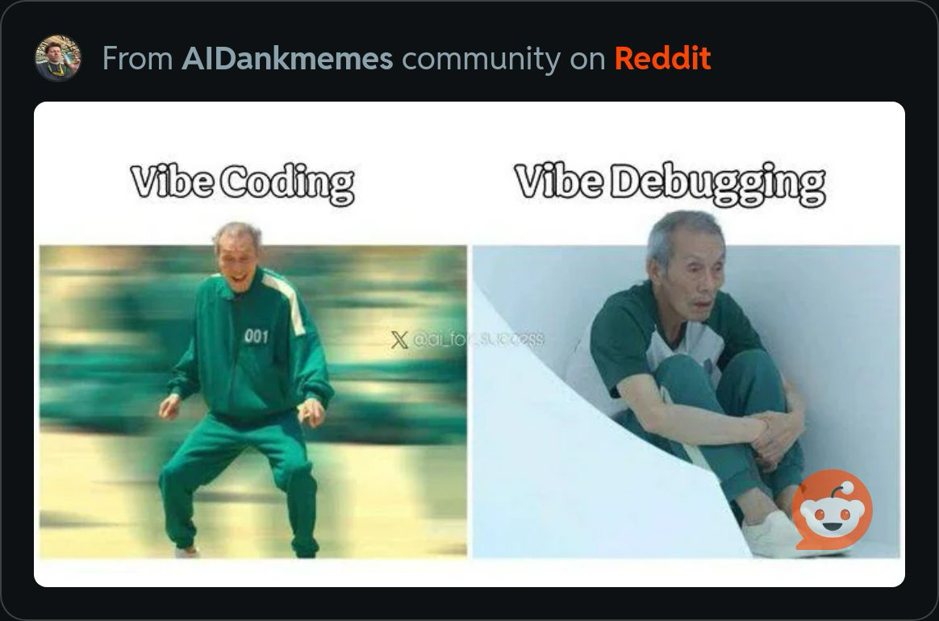
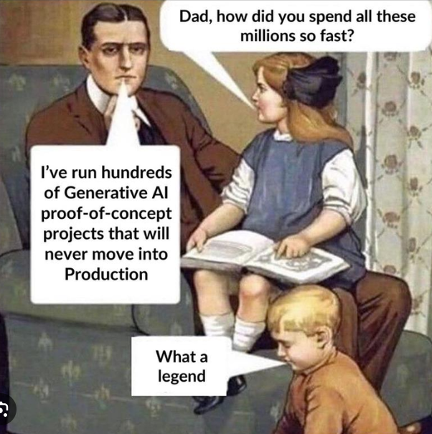
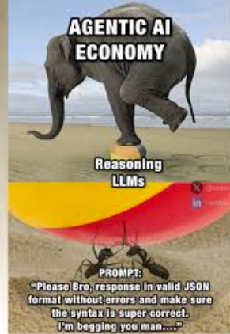

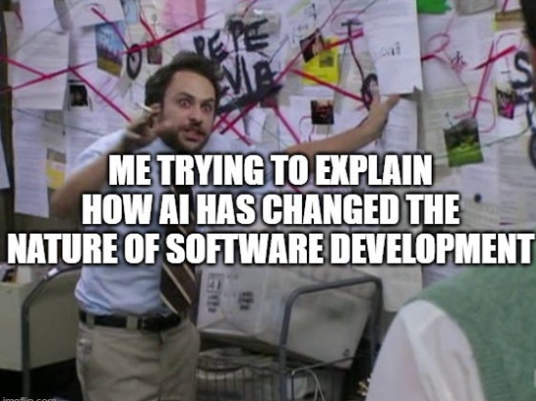
Q&A

Slide 50
For more…
Coursera Claude Code
How to write better prompts for GitHub Copilot. GitHub Blog
ChatGPT Prompt Engineering for Developers: 13 Best Examples
Using ChatGPT for Efficient Debugging
Prompt Engineering for Lazy Programmers: Getting Exactly the Code You Want
Best practices for prompting GitHub Copilot in VS Code
ChatGPT: A new-age Debugger, 10 Prompts
ChatGPT Prompts for Code Review and Debugging

Slide 51
Extra Slides

Slide 52

Rules/Command Evaluation
Task-Specific Instructions
Arguments
Reusable Process Steps
Guided Examples and References
Explicit Output Requirements
Template-Based Naming
Error Handling and Edge Cases
Documentation

Slide 53
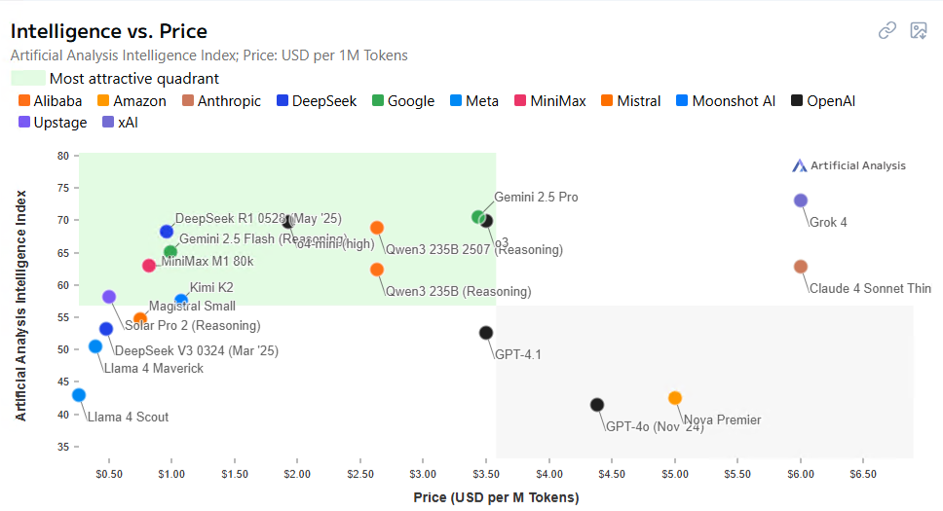
Which LLM should I use?
Tradeoffs exist
Changes are constant
Artificialanalysis.ai

Slide 54
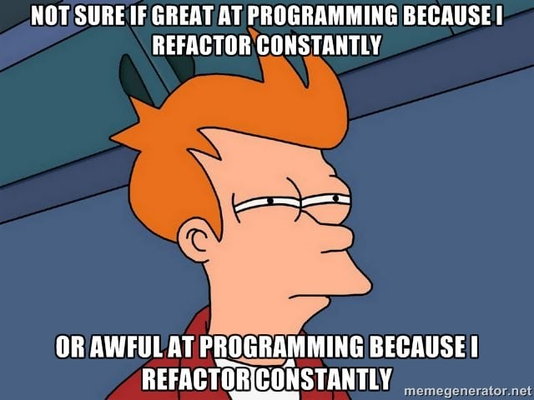
Refactoring
LLMs can be excellent refactoring factories
Try adjusting the persona
“As a senior software engineer who is an expert in maintainable java code…”
Prompting
Be specific with your goals
Bad: “Refactor this”
Good: “Refactor the following function to improve its readability and maintainability (reduce repetition, use clearer variable names).”
Refactor in steps- too much code can create distractions

Slide 55
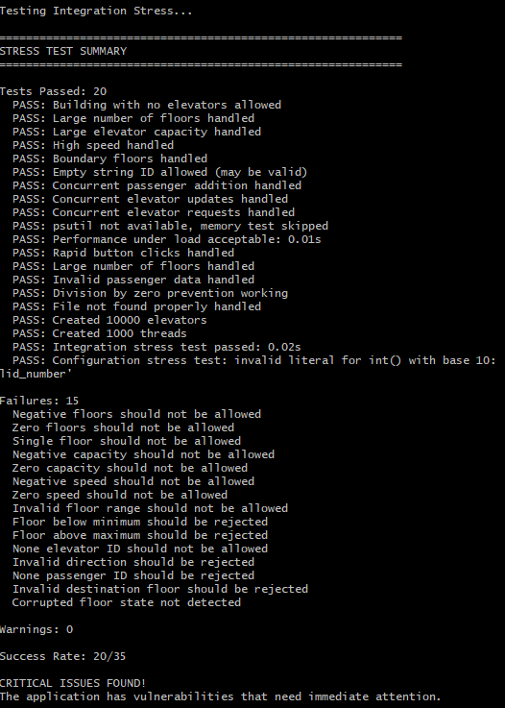
System Testing
“Act like a user of this application trying to break it. Create different inputs that test error checking. ”
Generated stress test with 35 tests
Many of the tests found issues!
Best practice:
Have your system prompt instruct the Agent to write tests before writing code
Then only generate code that passes those tests

Slide 56

Context Metaphor: Target Practice
When you write a prompt and provide context, you are giving the LLM a target
More context and specificity will SHRINK your target
Not all AI can hit every target
Context is critical to enable the AI to hit the target
Too much specificity can lead to micromanagement

Slide 57
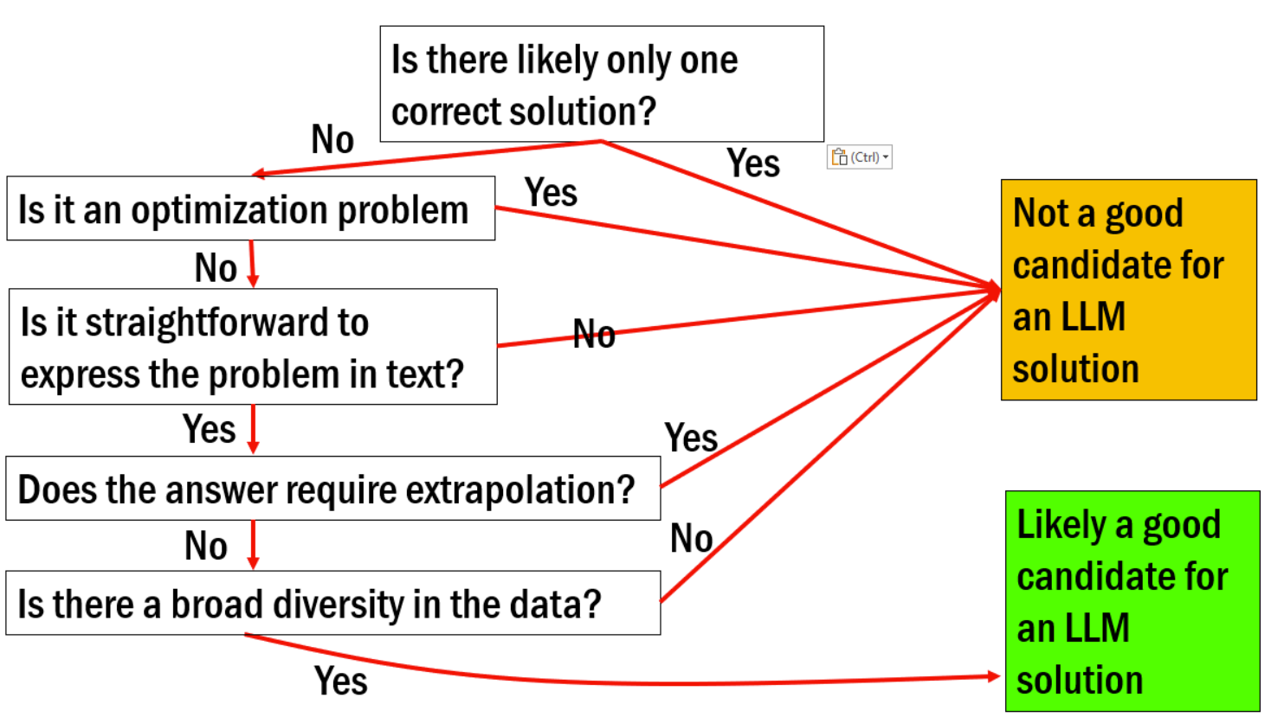

Slide 58
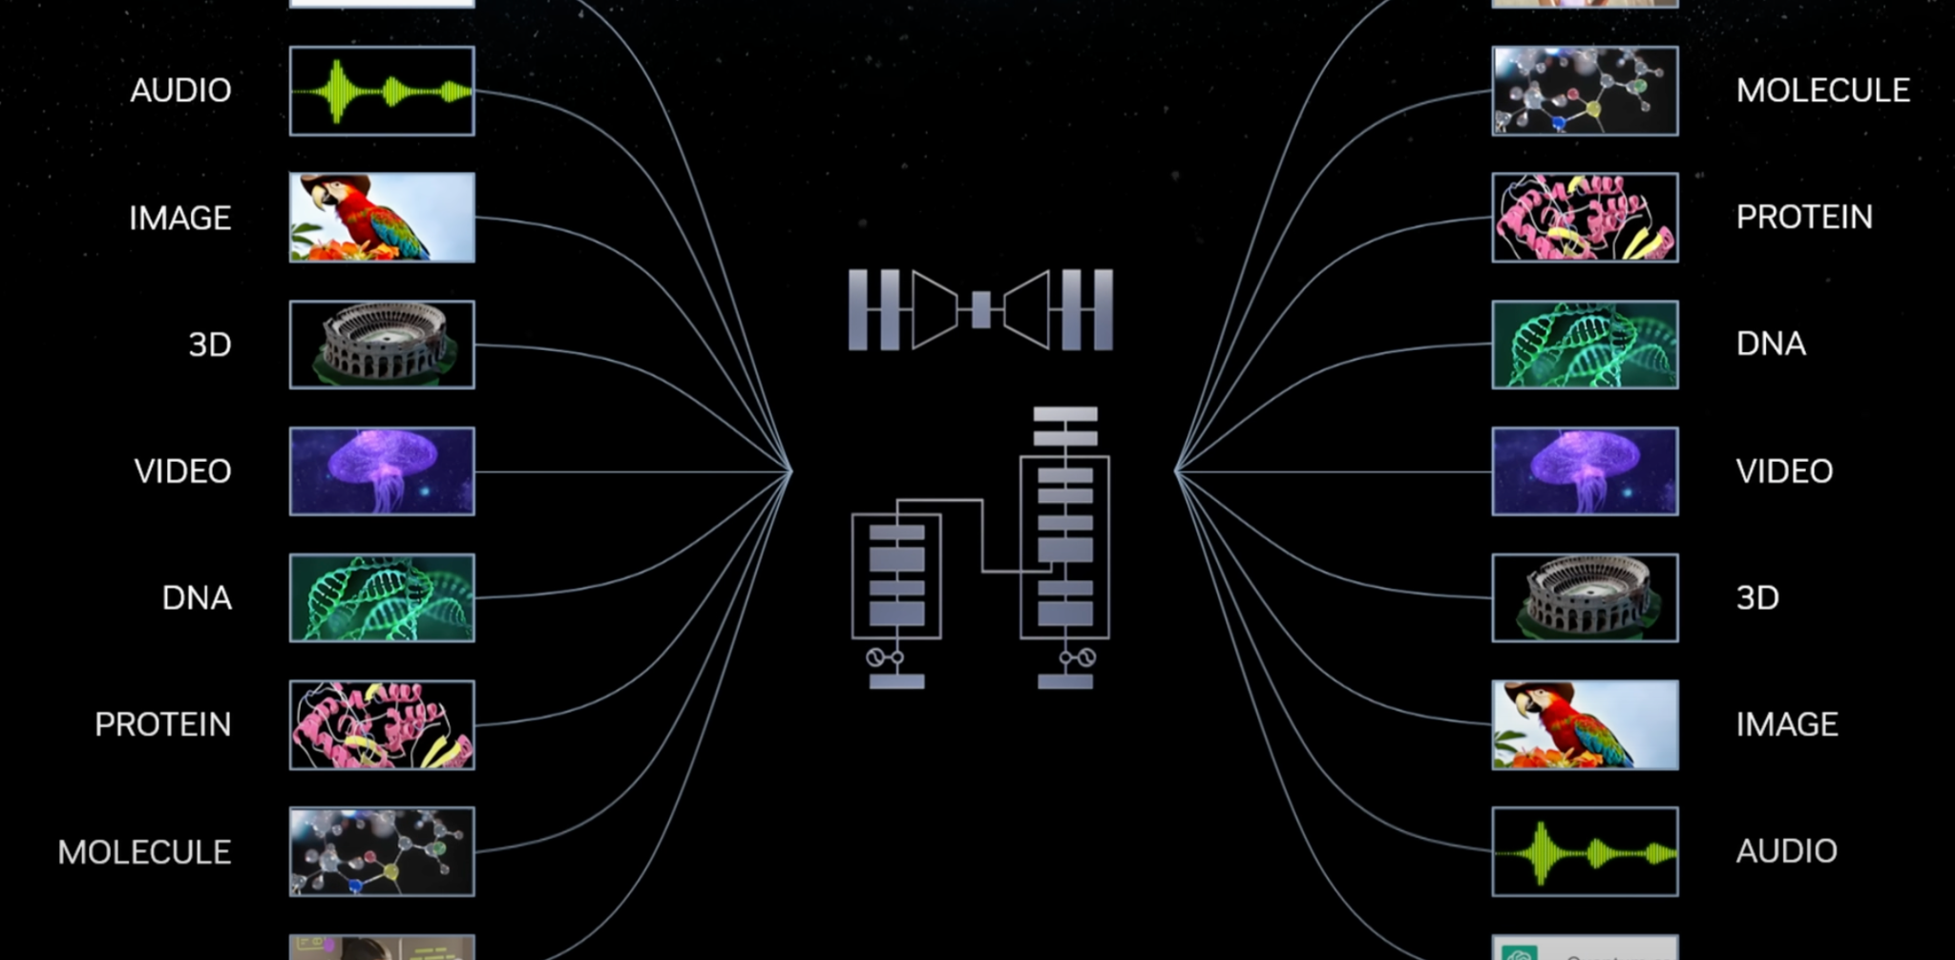

Generative AI Boom
Arbitrary Function Approximation
Notes:
Throughout our journey, we'll delve into the systems necessary to reason about language and model its relationships with various other data types.
We'll spend time demystifying the Transformers:
A critical component behind many LLMs to understand sequence-level relationships
A key part of generative AI that can help us facilitate modeling among various sequence-like data representations/

Slide 59
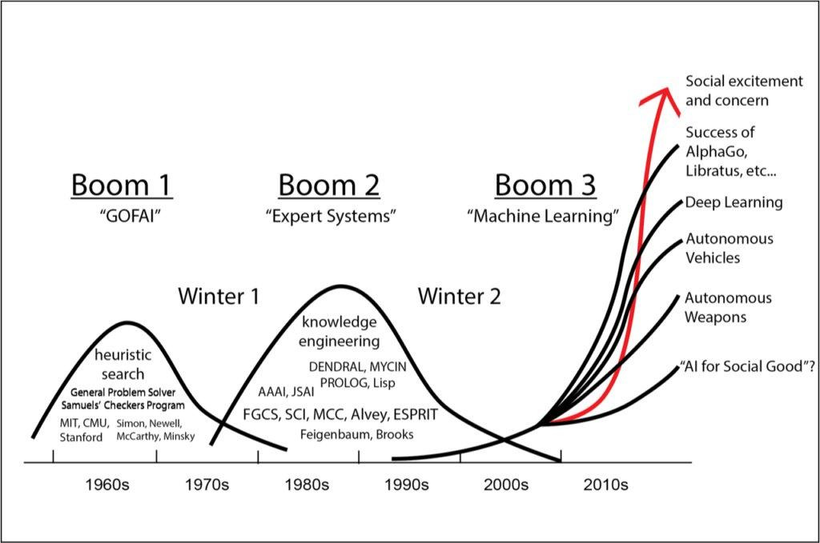
A (Short) History of AI
1940-1970: Good Old Fashioned Artificial Intelligence
McCulloch & Pitts: Boolean circuit model of brain
Turing's “Computing Machinery and Intelligence”
1956 Dartmouth meeting: “Artificial Intelligence” adopted
1970-2000: Knowledge-based Expert Systems
Early development of knowledge-based systems
Expert systems industry booms, then busts
2000-Today: ML/Deep Learning Revolution
Resurgence of ML and statistical methods
DARPA Grand Challenge for Autonomous Vehicles
2012 Deep Learning Revolution starts
Rapid innovation acceleration
Notes:
Million dollar computer with less computation than your phone
MT was

Slide 60
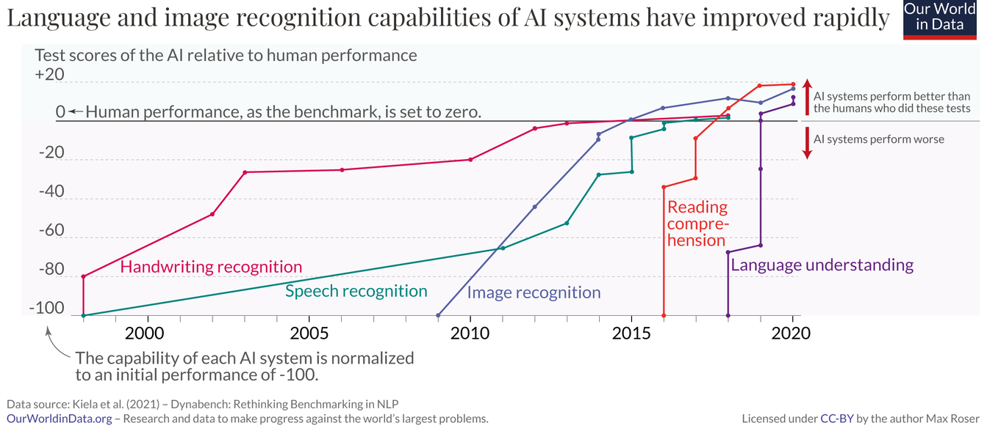

Slide 61



Data Information Knowledge
Qualitative or quantitative
Raw results
Lacks meaning in its native form
Structured and processed data
Includes context
Tangible facts derived from data
Necessary for rational decision-making
Derived from information
Augmented by context & subject matter expertise
Which of these are employers expecting you to use/generate?

