Slide 1
Agile Software Development
“Optimism is an occupational hazard of programming;
testing is the treatment.”
-- Kent Beck
Agile Process innovator

Slide 2
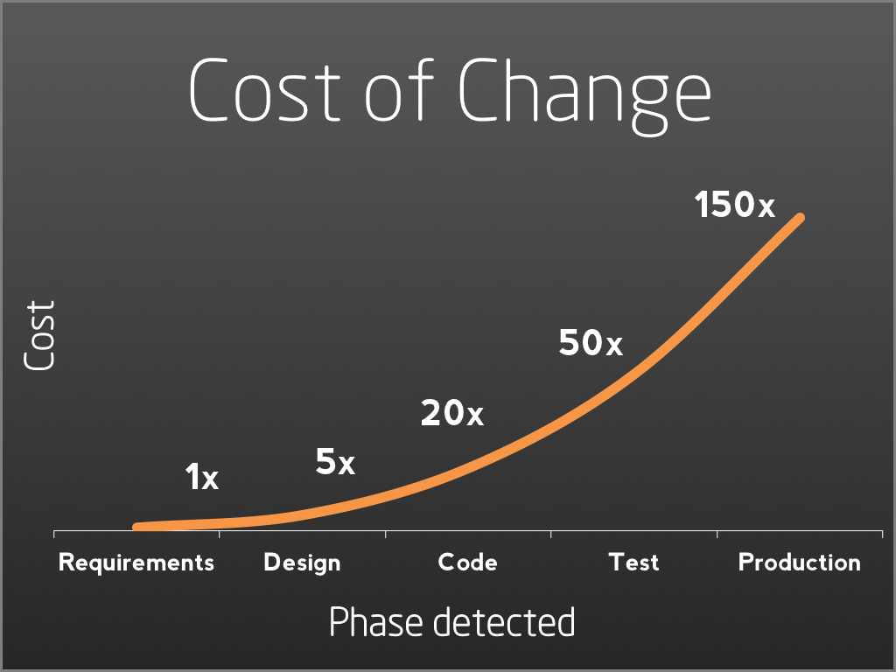
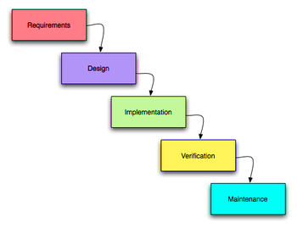
Traditional vs. Agile Development
Early software development: waterfall model
Key insight: have to capture requirements before can write anything!
Just writing code results in a mess; have to plan your design
Untested software just doesn’t work
We also discovered: fixing errors is expensive!
1 hr fix early becomes dozens of hours later
Solution? Put more time into requirements
... it didn’t work well

Slide 3
Traditional vs. Agile Development
This led to agile methods
Don’t try to find all requirements early
Instead, embrace change
Adaptive, light-weight
Minimize up-front planning
Many agile methods proposed
This led to debate on what ”agile” means
Early 2000’s: thought leaders develop the agile manifesto

Slide 4
Agile Manifesto
Core principles: get your priorities right
Careful! This does not say no processes, tools, documentation, etc.
Key: the second is pointless if don’t have the first
What is the impact of no documentation?
Future teams will simply rewrite your project!! – documentation is important
Individuals and interactions
over processes and tools
Working software
over comprehensive documentation
Customer collaboration
over contract negotiation
Responding to change
over following a plan
Notes:
Discuss each of these principles!!

Slide 5
Rapid software development motivation
Rapid development and delivery is now often the most important requirement for software systems
Businesses operate in a fast–changing environment
It is time consuming to produce a set of stable software requirements
Software has to evolve quickly to reflect changing business needs
Rapid software development
System is developed as a series of versions with stakeholders involved in version evaluation
User interfaces are often developed involving users

Slide 6

Agile Development
February 2001 –17 thought leaders met
To see if they had anything in common
Together they wrote the Agile Manifesto and its supporting principles
XP
DSDM
Lean
Crystal
Scrum
Kanban

Slide 7
12 Principles behind the Manifesto
Customer satisfaction through early and continuous software delivery – Customers are happier when they receive working product at regular intervals than waiting extended periods of time between releases.
Accommodate changing requirements throughout the development process – The ability to avoid delays when a requirement or feature request changes enhance competitiveness of customer.
Frequent delivery of working software – Team operates in regular sprints or iterations that ensure continuous delivery of working software.
Collaboration between the business stakeholders and developers throughout the project – Better decisions are made when the business and technical team are aligned.
Support, trust, and motivate the people involved – Motivated teams are more likely to deliver their best work than unhappy teams.
Enable face-to-face interactions – Communication is more successful when development teams work under the same virtual roof.

Slide 8
Agile Principles Cont’d
Working software is the primary measure of progress – Delivering functional software to the customer is the ultimate factor that measures progress.
Agile processes to support a consistent development pace – Teams establish a repeatable and maintainable speed at which they can deliver working software, and they repeat it with each release.
Attention to technical detail and design enhances agility – The right skills and good design ensures the team can maintain the pace, constantly improve the product, and sustain change.
Simplicity – Develop just enough to get the job done for right now.
Self-organizing teams encourage great architectures, requirements, and designs – Skilled and motivated team members who have decision-making power, take ownership, communicate regularly with other team members, and share ideas that deliver quality products.
Regular reflections on how to become more effective – Self-improvement, process improvement, advancing skills, and techniques help team members work more efficiently.
You won’t be expected to know these 12 principles
Just know they exist!
Focus on the four main points

Slide 9
Problems with agile methods
It can be difficult to keep the interest of customers who are involved in the process
Team members may be unsuited to the intense involvement that characterizes agile methods
Prioritizing changes can be difficult where there are multiple stakeholders
Maintaining simplicity requires extra work
Contracts may be a problem as with other approaches to iterative development

Slide 10
Problem: software maintenance
Most organizations spend more on maintaining existing software than they do on new software development!
So, if agile methods are to be successful, they have to support maintenance as well as original development
Two key issues:
Are systems that are developed using an agile approach maintainable, given the emphasis in the development process of minimizing formal documentation?
Can agile methods be used effectively for evolving a system in response to customer change requests?
Problems will arise if original development team cannot be retained

Slide 11
Technical, human, organizational issues
Most projects include elements of plan-driven and agile processes
Deciding on the balance depends on:
Is it important to have a very detailed specification and design before moving to implementation?
If so, you probably need to use a plan-driven approach.
Is an incremental delivery strategy, where you deliver the software to customers and get rapid feedback from them, realistic?
If so, consider using agile methods.
How large is the system that is being developed?
Agile methods are most effective when the system can be developed with a small co-located team who can communicate informally.
This may not be possible for large systems that require larger development teams so a plan-driven approach may have to be used.

Slide 12
Technical, human, organizational issues
What type of system is being developed?
Plan-driven approaches may be required for systems that require a lot of analysis before implementation (e.g. real-time system with complex timing requirements).
What is the expected system lifetime?
Long-lifetime systems may require more design documentation to communicate the original intentions of the system developers to the support team.
What technologies are available to support system development?
Agile methods rely on good tools to keep track of an evolving design
How is the development team organized?
If the development team is distributed or if part of the development is being outsourced, then you may need to develop design documents to communicate across the development teams.

Slide 13
Technical, human, organizational issues
Are there cultural or organizational issues that may affect the system development?
Traditional engineering organizations have a culture of plan-based development, as this is the norm in engineering.
How good are the designers and programmers in the development team?
It is sometimes argued that agile methods require higher skill levels than plan-based approaches in which programmers simply translate a detailed design into code
Is the system subject to external regulation?
If a system has to be approved by an external regulator (e.g. the FAA approve software that is critical to the operation of an aircraft) then you will probably be required to produce detailed documentation as part of the system safety case.

Slide 14
Agile Strategies

Slide 15
Test-first development
Writing tests before code clarifies the requirements to be implemented
Tests are written as programs rather than data so that they can be executed automatically
The test includes a check that it has executed correctly
Usually relies on a testing framework such as JUnit
All previous and new tests are run automatically when new functionality is added
Thus checking that the new functionality has not introduced errors

Slide 16
Pair programming
In pair programming, programmers sit together at the same workstation to develop the software
Pairs are created dynamically so that all team members work with each other during the development process
The sharing of knowledge that happens during pair programming is very important
It reduces the overall risks to a project when team members leave
Myth Debunked: Pair programming is not necessarily inefficient
There is evidence that a pair working together is more efficient than 2 programmers working separately
Why?

Slide 17
Advantages of pair programming
It supports the ideas of
collective ownership
responsibility for the system
It acts as an informal review process because each line of code is looked at by at least two people
It helps support refactoring, which is a process of software improvement
Where pair programming and collective ownership are used, others benefit immediately from the refactoring so they are likely to support the process.

Slide 18
Ch. 1: Why Scrum?
What does “SCRUM” stand for?
Software collaboration resulting in an undocumented mess?
Elevator pitch (Cohn, 2007):
Scrum is an agile framework that allows us to focus on delivering the highest business value in the shortest time.

Slide 19
Benefits
Project
Sponsors
Risk mitigation
Increased transparency
Continuous improvement
Change = opportunity
Quicker feedback
Observable progress
Retrospective
Just add it to the backlog
Scrum Team

Slide 20
Benefits
Less context switching
Sustainable pace
Team-based Commitments
No “us vs. them”
Dedicated shield/bulldozer
Protected sprints
Fewer late nights
No delegating dictator
Teams, not individuals
Customer part of team
Team decides
ScrumMaster as problem solver
Servant/leader
Project
Sponsors
Risk mitigation
Increased transparency
Continuous improvement
Change = opportunity
Quicker feedback
Observable progress
Retrospective
Just add it to the backlog
Scrum Team

Slide 21
Scrum as a framework
Shortcut 2
When is a team not following Scrum?
Are sprints, backlogs, standups, reviews, retros enough?
These are just the framework; need agility…
Core: Agile Manifesto (Beck et al., 2001):
So, no more documentation?
Individuals and interactions
over processes and tools
Working software
over comprehensive documentation
Customer collaboration
over contract negotiation
Responding to change
over following a plan
Notes:
How does it change the meaning to drop modifiers like “working”, “customer”, “comprehensive
(comprehensive: you can’t deliver without documentation at all, just avoid over-documentation)

Slide 22
Scrum anti-patterns
Shortcut 2
Include:
Form team
Organize physical environment
Create initial backlog
Avoid:
Technical spikes
Developing framework
Designing database
Anti-pattern: common response to a recurring problem that is ineffective, even highly counterproductive
What is a test sprint?
What is the danger of random-sized sprints?
Why not have a senior developer estimate all PBIs?
What happens if team begins to rely exclusively on the specification?
How to avoid 2-month Sprint Zeros?
These may need to be done; timebox!
Notes:
Where “specification” is the list of requirements for a project, including both the system’s functionality (what it does, such as display a list of classes a student has taken) and constraints (a requirement to use a database or information such as students having to be enrolled in an academic program).

Slide 23
Scrum as a framework
Shortcut 2
Individuals and interactions
over processes and tools
Working software
over comprehensive documentation
Customer collaboration
over contract negotiation
Responding to change
over following a plan
What has to change for SDL?
Is a daily meeting with the PO required?
Can the retrospective occur before the review?
Notes:
Discuss: Product Owner Proxy

