Slide 1
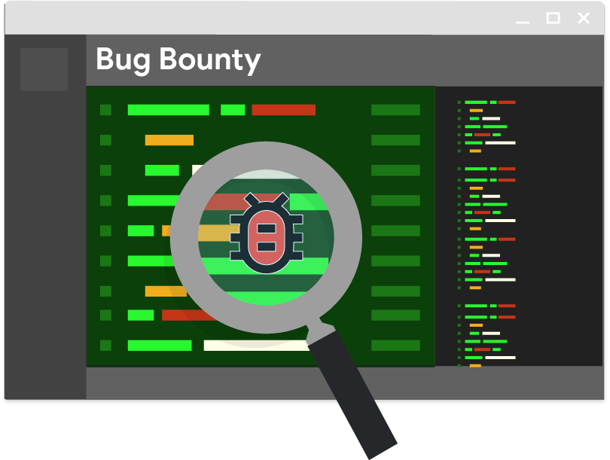
Bug Bounty Activity

Slide 2
Bug Bounties
Bugs (defects) exist in every non-trivial software system
Many organizations want to encourage users to report bugs
  So they offer rewards
https://bughunters.google.com/leaderboard
https://developer.apple.com/security-bounty/
https://www.facebook.com/whitehat
The first bug bounty programs were started by internet browser companies
  Netscape started in 1995
2018- Hacker Report tracked more than $23 Million paid out to 166,000 individuals who reported a total of 72,000 vulnerabilities

Slide 3
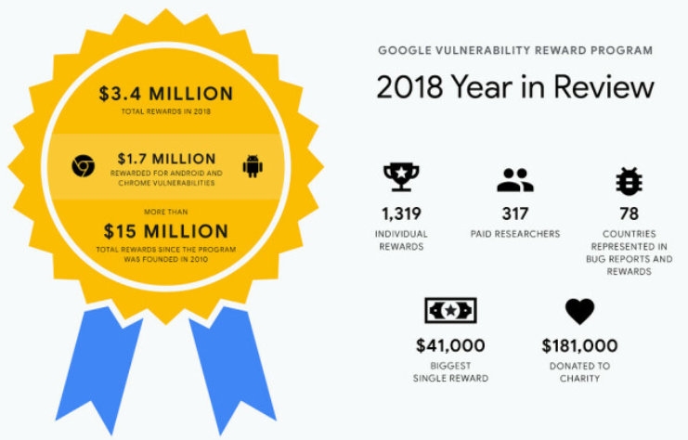

Slide 4
Our Bug Bounty Activity
Each team is given an initial bug (defect) budget in candy
  1 piece for each feature in “closed”
  Your goal is to maximize your budget
You are going to download and test other teams’ jars in this class
  Features completed and known defects are in the corresponding readme
  Only teams that are part of this section are part of this activity
When you discover an issue (potential bug/defect)
  Report it to the team by posting about it in the General channel and flagging the team (Team A New Issue:)
  You must include information that enables the team to recreate the issue
  The team will confirm your issue is reproducible and is an unknown defect (or not)
    The individual who reports an unknown defect earns a piece of their candy for their team
When someone reports an issue with your code
  Someone from your team must attempt to reproduce the issue using the Teams message description
  If you can’t reproduce the issue, reply to the message on Teams indicating as such
    No candy
  Else, if it a known defect that has been previously reported, reply to the Teams message indicating as such
    No candy
  Else it is a new defect, and you should respond the confirmation in Teams as such
    You also need to deliver one piece of candy to the individual and it will enter their team pool
Issue vs. defect?

Slide 5
What is a defect?
Not a defect for this exercise
Something that doesn’t operate according to the team’s interpretation of the user story
  Note that you need to describe how you interpreted the user story in Teams if you are rejecting a reported issue on these grounds
Typo
User error
A defect caused by an underlying condition related to another previously-confirmed issue
  i.e. data structure defect that creates two similar but distinct issues

