Slide 1
State Diagrams
swe2710

Slide 2
First: observations from bug bounty?
What did you learn?
What were the most frequent problems encountered?
What caused these?
How easy was it to get bug reports?
You believe it’s right, otherwise you wouldn’t create it!
Over time, you begin to realize bug reports are good
They mean your users care
Core challenge: words never mean quite the same thing to everyone
This is why so many developers spend most of their time on requirements...
Add PBIs to address defects

Slide 3
UML Diagrams
What two UML diagrams have we covered? How is each used?
Class diagram
Captures static relationships between classes
Key elements: is-a, has-a relationships
These are static relationships: they reflect declarations
Sequence diagram
Dynamic relationships: how one class uses another to get work done
Today: state diagrams
Capture how an object’s state changes based on messages
What do we mean by state?
This is also dynamic: how objects behave at run time
Especially useful for describing controllers

Slide 4
Basic structure of state diagram
Class starts in State 1 (which would have a name like “waiting for input”
On event, classes executes action and goes to State 2
State 2 would have a name such as “received input”
Actions can be
User interface or other events
Method calls
Time passing
Typically: many states
If just two, not adding much to the documentation

Slide 5
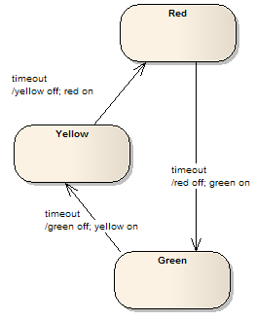
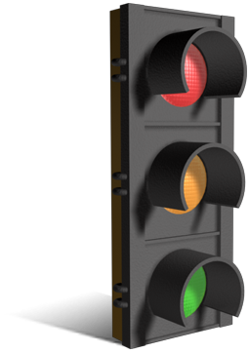
Traffic Light Example
Model red/green/yellow light
This version: switches based on time alone
No road sensors, etc.
Machine just cycles forever
timeout determines switch
Actions: turn lamps on/off

Slide 6
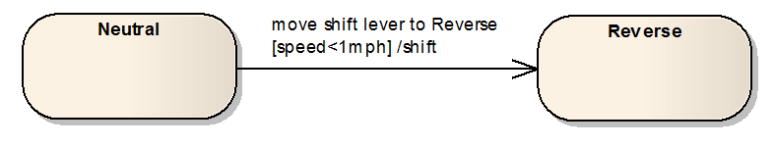
Guards
Modeling gear shift in class Car with just forward, backward
Other states not shown
Neutral: “park” in most cars
Blue: an event – driver moves shift lever, green: action – car shifts into reverse
Red: guard: car must be travelling less than 1 mph
General form of guard: [predicate]
Transition cannot occur unless guard is satisfied

Slide 7
Light bulb with toggle switch
Event: flip switch to 1: triggers current flow
Event: flip switch to 0: halts current flow

Slide 8
Light build with pushbutton switch
Note: same event for both: button pressed
Result depends on state of object
Implementation:
Class LightBulb contains boolean attribute isOn
Code for button pressed event: isOn = !isOn;

Slide 9
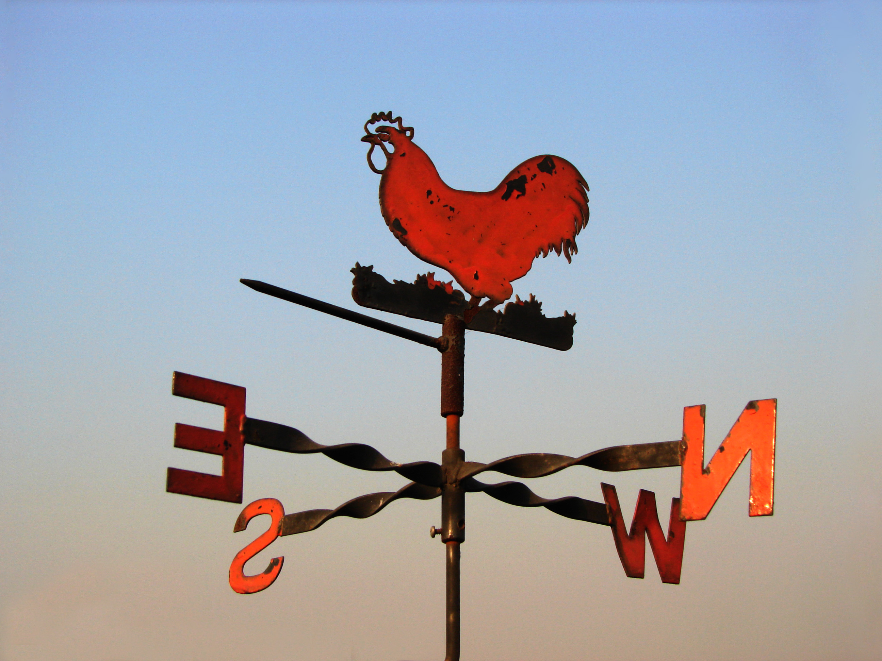

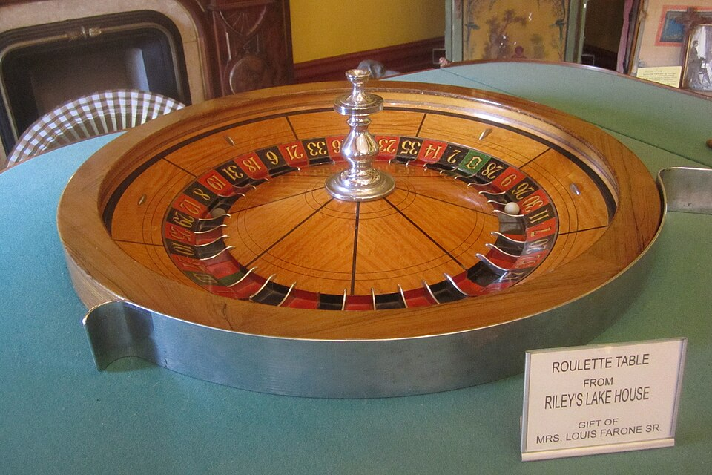
Nondeterminism
Important concept in modeling systems
Deterministic: state determined by input
Nondeterministic: possibly multiple states
Very difficult to know what will happen next
Which slot will ball fall into?
Will weather vane turn left or right in next minute?
Avoid non-deterministic machines
Hard to compute with!
Not allowed in state machine diagrams
Notes:
Challenge question: which is this machine: https://xkcd.com/2916/?
Cereal serving machine: https://www.sciencefocus.com/science/the-weirdest-inventions-ever-in-pictures
Weather vane: https://en.wikipedia.org/wiki/Weather_vane
Roulette wheel: Peter from USA, CC BY 2.0 <https://creativecommons.org/licenses/by/2.0>, via Wikimedia Commons. This image was originally posted to Flickr by P_R_F at https://flickr.com/photos/80340800@N05/14891733633. It was reviewed on 5 April 2024 by FlickreviewR 2 and was confirmed to be licensed under the terms of the cc-by-2.0.

Slide 10
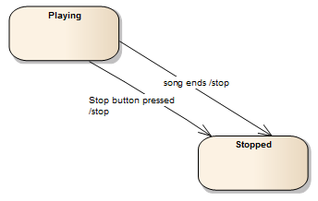

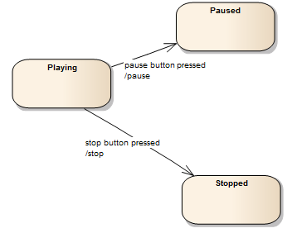

Multiple transitions
Two ways to transition to same state
These examples: song player controls
Allowed: multiple transitions to same state, transitions to different states
Not allowed: same event to two separate states
Unless a guard distinguishes the two events
That is, all state machines must be deterministic
Transitions to two different states
Notes:
check mark: https://commons.wikimedia.org/wiki/File:Crystal_Clear_app_clean.svg

Slide 11
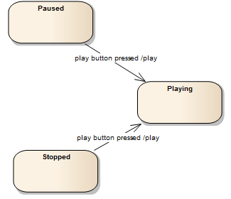
More on transitions
Same event, two transitions
Which executed depends on current state
Result: always in Playing state
Still deterministic: always end up in just one state

Slide 12
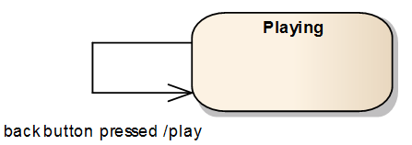
More on transitions
Transition back to self
Legal
Simply means “if Playing and press back button, will continue playing”
Though might rewind 10 seconds first!

Slide 13
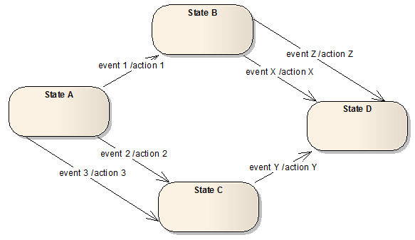
More complex example

Slide 14
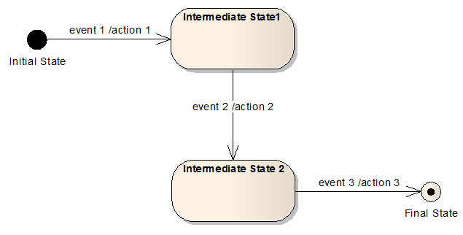
Initial, final states
Initial state: startup
Where class is right after creation
Cannot return once leave initial state
Final state:
Where class ends
Cannot leave final state
Typically: actions like closing files, exiting, complete transaction

Slide 15
Example: vending machine

