Slide 1
Code and Design Reviews
Ch. 4
SWE 2710

Slide 2
The Case for Code Reviews
https://en.wikipedia.org/wiki/XZ_Utils_backdoor
Notes:
https://www.theguardian.com/commentisfree/2024/apr/06/xz-utils-linux-malware-open-source-software-cyber-attack-andres-Freund

Slide 3
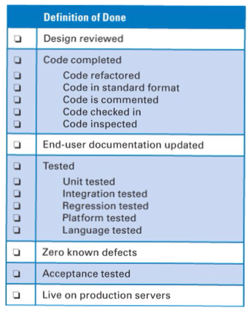
Success in Scrum
What is the goal of each sprint?
  Potentially shippable product
  Why “potentially”?
Issue: what makes a feature shippable?
  Must have: completeness
  “Mostly works” is not shippable!
  Are there other criteria you would want?
    maintainable, efficient, documented, etc…
How to ensure?
  Team establishes a definition of done
  Checklist that must be completed before declaring work is potentially shippable
Textbook, Table 4.1

Slide 4
Definition of Done
Assumed: all features work
  Criteria on this card would be minimal
  Note careful list of testing methods
  “Live on production servers” might be “live on staging servers”
What else might be included?
  scalability, portability, maintainability, extensibility
  security, interoperabilty
  Could be a long list! Pick what’s important
Question: what is meant by highlighted items?
  How to review design?
  How to inspect code?
Textbook, Table 4.1

Slide 5
First: Code Reviews
For a merge request how have you reviewed code previously?
How effective are these reviews?
What problems did you have?
Common issues:
  Difficulty in maintaining attention/focus
  Knowing what to look for

Slide 6

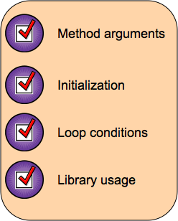

Code Review Checklists
What is a pre-flight airplane checklist?
  Why?
For code:
  Based on historical defects
  Used to guide review
More extensive, realistic checklist:
  www.liberty.edu/
Typically: focus list on key defects
  Too many: too easy to miss one
Design review
  Checklist covers design elements
  Eg: appropriate class structure
  Eg: minimal coupling, maximal cohesion
stock.adobe.com
minimal interconnectivity
all elements contribute to same goals
Notes:
coupling: measure interconnectivity; cohesion: all elements contribute to the same goals

Slide 7
Types of Code Reviews
Personal review
  Code author reviews their own work at their desk
  Light-weight, difficult to ensure completeness
Peer review
  Review by another team member
  Basic model for merge requests in GitLab (“pull requests” in others)
  Minimally necessary
Formal Inspection/Formal Review
  Review by large group, done against a checklist
  Can involve customers, people outside team
  Typically: members will review individually, log findings before the inspection
Notes:
The days of people having their first look at the code during the review meeting are over... Meetings are too expensive to watch people reading documents for the first time.

Slide 8
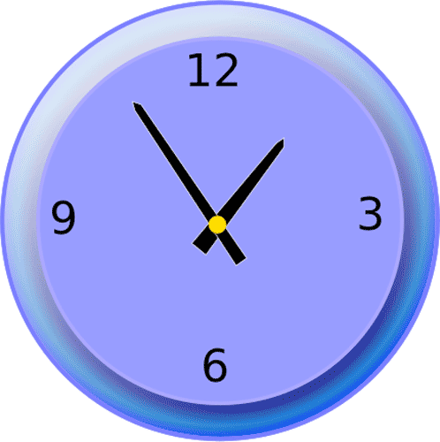
Review Timing
Research: review before even compiling!
  More likely to find logic errors if everyone knows there are syntax errors
  Hard sell to developers today…
Formal inspection when merging to dev?
  Could slow getting code into dev branch
  Developers not as likely to examine closely
Formal inspection as separate activity?
  Must be scheduled
  Cannot be the only review…
Design review
  Often done before any code written
  If no separate design review, combined with code review
Key: establish maintainable pattern
Notes:
Research found that code reviews done before compilation results in more logic findings, but this was before folks had IDEs that indicated compilation errors in real time

Slide 9
Formal Inspection Roles
Review leader
  Invites reviewers, possibly including customer
  Ensures materials published before review
  Ensures review session stays on track
Producer
  Person(s) who created document
Recorder
  Record notes from review so issues not lost
  Not the producer, probably one of the reviewers
    a non-technical person probably won't be able to follow the discussion adequately
Reviewers
  More than half a dozen: review will not be as effective

Slide 10
Effective Reviews
Review the product, not the producer
  Constructive tone, not an inquisition
  Producer likely the one to find the most problems!
  Not an opportunity to evaluate people
Set an agenda, limit debate
  Include checklist(s) in the announcement
  If there’s disagreement, record the issue and move on
  Further discussion can happen off-line
  Reviews are expensive!
Identify problems, don’t try to solve them
  Short discussion can be fine, but don’t let it bog down the review
  Very few good decisions are developed during meetings!
  A review is not a brain-storming session

Slide 11

Effective Reviews
Take written notes
  Can’t rely on people’s memories for important decisions
Limit the number of participants
  Need $≥$ 3, but > 7 or so makes it harder to find problems
Use a checklist
  Helps keep review focused
Allocate, schedule time for reviews
  They don’t happen if just “slide them in” to other work

Slide 12
Effective Reviews
Limit review sessions to ~1 hour
  Longer: review loses effectiveness quickly
  Difficult to schedule long meetings
  Large documents: break into pieces, review separately
Train for reviews
  Ensure engineers know how to conduct a review
  Key issue: review product, not producer
Review early reviews
  Make sure your reviews are effective!

Slide 13
Review
Definition of Done
  Caution: start small, extend as needed
  “Tested” is too vague; give coverage metric
  Specify any review checklist
  Interesting definition of done used at Rockwell Collins: “All tests pass”
    Requires testing include checklist items, executable checks of nonfunctional requirements
Code reviews: personal, peer, formal
Effective reviews:
  Review product, not producer
  Limit debate
  Identify problems, don’t try to solve them
Notes:
Focusing on identifying problems is hard for engineers: we want to solve problems!

Slide 14
Activity
Let’s look at Canvas

