Slide 1
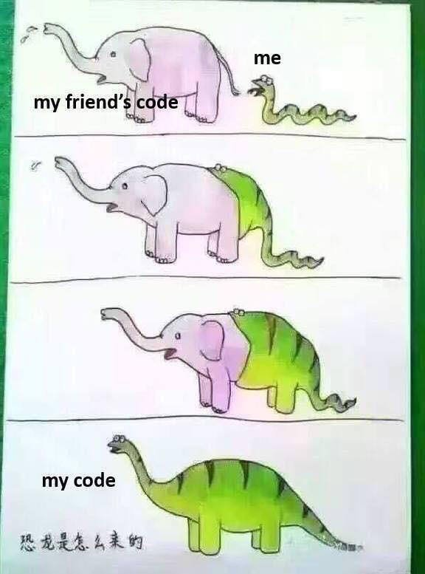
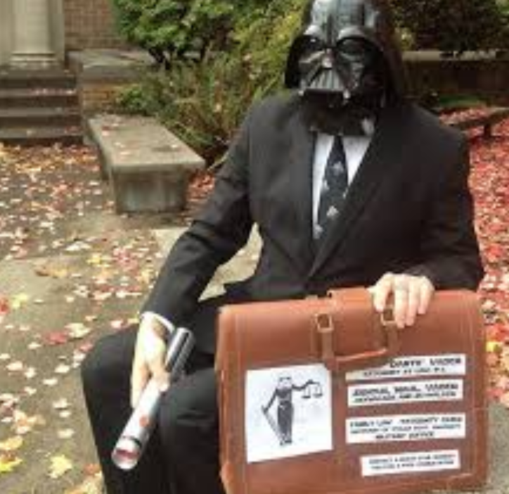
Legal Aspects of Software Engineering

Slide 2
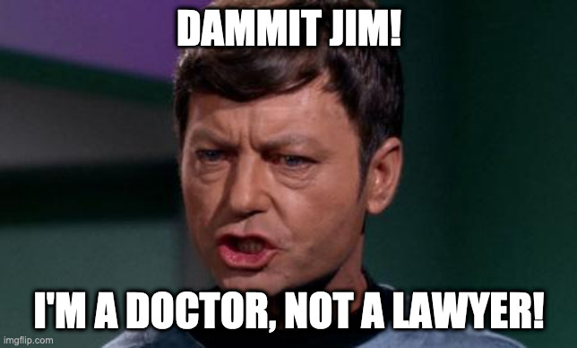
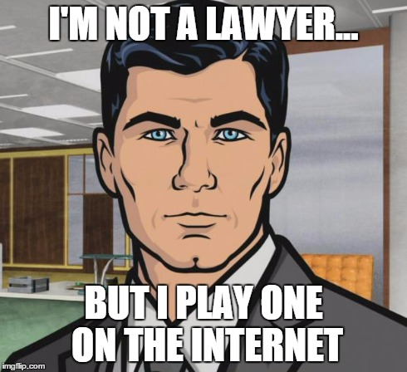
Some important questions
How do I protect my intellectual property?
What can we do to protect privacy?
What other legal issues affect computing & software development?
A disclaimer:
You may be surprised to know we aren’t lawyers
  Or if you’re a fan of Star Trek
And different countries have different rules
Our goal: make you aware of issues

Slide 3
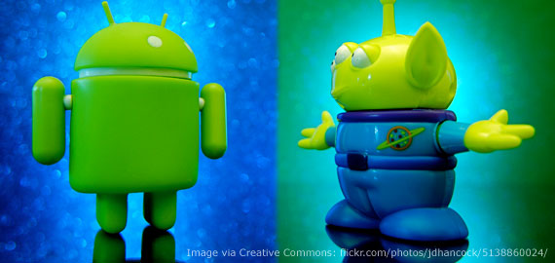
Legal Topics in Software
• Jurisdiction (international, federal, state laws)
• Intellectual property (copyright, patent, trademark, trade secrets)
• Contracts and licenses
• Privacy
• Free speech and its limitations (government secrets, obscenity)
• Commerce (ISPs, e-commerce)
• Employment (personnel, your next job, etc.)

Slide 4
Statues and Precedents
The United States follows Common Law.
The law is a combination of:
• Statutes (bills) passed by Congress and the 50 states.
Examples?
• Regulations issued by the government
Examples?
• Precedents (judgments) made by courts.
Examples?
HIPAA
What ISPs can/cannot do
IP (what is copyright infringement)

Slide 5
Basic protections
What is copyright?
  Right to publish, distribute work created by people
What is a patent?
  Right to exclude others from making, using, or selling an invention
What is a trademark?
  Symbol, phrase that identifies goods or services
Basic goal: provide value for producers so they produce more
  Generally known as intellectual property
What is public domain?
  Creative work which is not intellectual property
  Example: cannot claim copyright on Shakespeare, Einsteinian physics, food recipes
Notes:
copyright: https://www.copyright.gov/what-is-copyright/
patent: https://www.uspto.gov/patents/basics
Trademark: https://www.uspto.gov/trademarks/basics/what-trademark
intellectual property: https://www.wipo.int/en/web/about-ip/

Slide 6
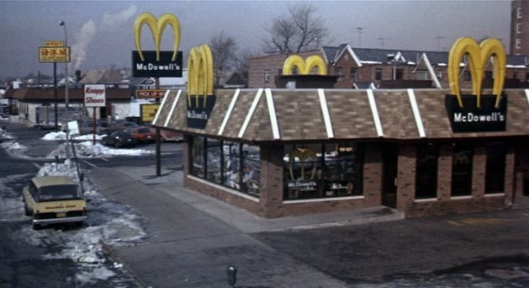

Trademark
... consider these in reverse order
Trademark
  Symbol that identifies a product or company
    Cannot pretend to be another company...
  Must be registered and approved to be internationally recognized
  Must be “active” in the last 5 years
Interesting issue: what does “Apple” refer to?
  You might think of a computer, a Beatle’s fan might think of Apple Records
  Apple Records: 1967, Apple Computer: 1976-1977
Apple Computer: can’t produce music
  So what about their system alert?, Sosumi
Basic goal: minimize confusion for general public
  This area keeps plenty of lawyers employed...
Notes:
As mentioned in the Wikipedia article, “Sosumi” is derived from “So sue me!” – a reference to the court battles around the trademark

Slide 7
Patents
Inventions (as opposed to creative works)
  Copyright applies to the expression of ideas, patents to the ideas themselves
Strong protections: can control how others use a patent
  A copyright holder cannot say who can or cannot read a book!
  Shorter limit: 17 years (20 years from filing)
  Must be non-obvious, novel, useful
In software
  Seen by courts as similar to factory processes – transforming inputs into products
  IBM: granted 2000-5000 patents per year
  Samsung: 80,000 active patents
Notes:
IBM: https://insights.greyb.com/ibm-patents/

Slide 8
Patents
Examples
  Online shopping checkout (Amazon.com)
  Creating a single file from multiple source files
  Automatic answering of email
  Sending messages to players in an online game
  Image/audio formats (tiff, mp3, gif, etc.)
Technically, algorithms are not patentable
  Most companies circumvent this by using the terminology “system and method”
Every Tuesday, USPTO releases 3000+ new patents
  http://en.wikipedia.org/wiki/List_of_top_United_States_patent_recipients
US Patent & Trademark Office
Notes:
USPTO: US Patent and Trademark Office

Slide 9
“Stupid Patents” - EFF
Identified by Electronic Frontier Foundation (EFF)
https://www.eff.org/deeplinks/2015/08/stupid-patent-month-drink-mixer-attacks-internet-things
  Patent from 2006: “The system and method of the present disclosure enables a user, e.g., a consumer, to customize products containing solids and fluids by allowing a server communicating over the global computer network, e.g., the Internet, to provide product preferences of a user to a product or a mixing device, e.g., a product or beverage dispenser.”
  This is remote server configuration!
https://www.eff.org/document/united-states-patent-no-9715680
  A patent on “reminder messages”, filed in 2012!
For more examples:
  https://www.eff.org/issues/stupid-patent-month
Some software patents valuable, but patent office process inadequate
  Ultimately, a patent is only valuable if you can defend it in court...

Slide 10
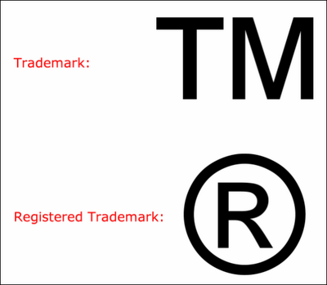
Other IP
Trade secrets
  Protected non-public devices or technologies that a company uses for business advantages

Slide 11


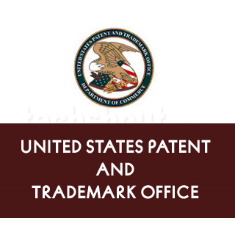

IP types
Copyright
  Protects creative work (1 of a kind)
  Protection is inherent when the work is created
  Last for a limited time (lifetime +70 yrs)
  Facts, ideas, concepts, processes, and methods of operation are not copyrightable
Patent
  Legally protects inventions of devices or processes
  Apply through the patent office
  Provides the holder a monopoly
  Last for a limited time

Slide 12
Intellectual Property
Intangible creative works (the expression of ideas)
  Books
  Songs
  Art
  Movies
  Software
  Inventions
  Brands
IP has value
  IP laws allow a creator to profit from their creation
  Can be bought and sold
Each country has their own laws regarding IP
  Enforcement is up to the “owner(s)” of the work
Public domain
  Once legal protection runs out a work enters the public domain
  Examples?

Slide 13
Copyright
Right to publish, distribute work created by people
Applies to work created by anyone
  Originally text, but extended over time to images, music, designs
  Registering copyright enhances protections, but not required
Applies to the expression of ideas,
  not the ideas or the physical representation
Limitation: life of author + 70 years
  Corporations: 90 years
Copyright can be sold, licensed
Application to software: writing code is like writing a book

Slide 14
Copyright
Special exceptions
Work performed for hire: employer owns copyright
  Your use is limited even if you wrote the code
Copyright is limited to first sale
  Owner of object (such as a book) can sell it without permission of copyright owner
  Software typically licensed, not sold, to limit resell
Works are subject to fair use
  Limited use is permitted without permission
  Example: in a review or short quotation

Slide 15
Copyrights - Fair Use
Fair Use Criteria
  No “bright line” definitions – ultimately determined in court
More likely to be fair use if...
  the use is non-commercial, transformative – purpose
  the copywritten work is factual or unpublished – nature
  usage is small in relation to the original work – amount
  it does not reduce the value of the original work – effect
Notes:
Material from https://copyrightalliance.org/faqs/what-is-fair-use/

Slide 16
Copyright issues for software
Developer includes software X when writing new software Y
  Developer only own the new parts: Y - X
  To publish: must have permission to distribute X
  Need to document this right
Closed vs open source
  Closed source: developer owns all IP rights – traditional model
  Open source: others allowed to modify, use the software
Important question on open source: can derived works be closed?
  One solution: included software (X) must be made available for free
Another important question: who has liability for errors?
  Limiting liability is important – make people pay for guarantees!

Slide 17
Copyright and GenAI
Open question: can we copyright code written by GenAI?
Issues
  Copyright is based on works created by human beings
  Non-human authors cannot hold copyright
  Simple prompts not protected
Maximizing protection:
  Add meaningful human creativity
  Curate, review AI output
  Review AI tool’s terms
Notes:
See Software and IP (MSOE 2025 Presentation) deck for more information – much of this slide came from that source

Slide 18
Copyright: Derivative Software
When software is derived from other software:
• Copyright in new code only is owned by new developer
• Conditions that apply to old code apply to derived work
If you write S, which includes code derived from A and B, you cannot copy, use, distribute or license S unless the copyright owners of both A and B give permission.
When creating a software product, you should have documented rights to use everything from which it is derived.
Example: Python distribution

Slide 19
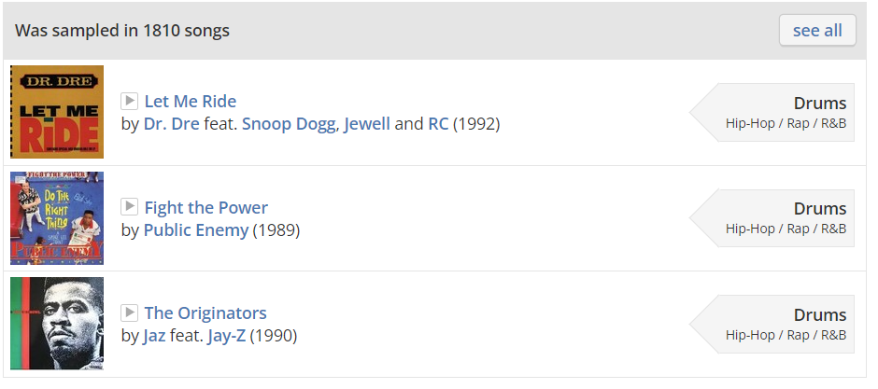
Fair Use Cases- Fair or not?
Videotaping TV broadcasts at home (or DVR)
Google displays thumbnail images of photos from a subscription-only website
Funky Drummer (Clyde Stubbelfield)
  https://www.youtube.com/watch?v=8L4gITE3nUc
  https://www.youtube.com/watch?v=X3hu0dhiBxg
  https://www.youtube.com/watch?v=UoKr_pc5gvQ
  https://www.youtube.com/watch?v=0xMJZHrG_94
  https://www.whosampled.com/James-Brown/Funky-Drummer/
How does this relate to CS?
  What software can you “sample”?

Slide 20
Intellectual Property Law: Copyright
Copyright is Federal law, which applies to literary works.
Originally applied to textual materials, but gradually extended to cover text, music, photographs, designs, software, ...
Copyright applies to the expression of ideas (e.g., the words used), not to the ideas themselves, nor to physical items.
Software
Copyright applies to the program instructions, but not to
the concepts behind the instructions, nor to the files on disk
or on paper where the programs instructions are stored.
Similar to book protections

Slide 21
Ownership of Copyright (USA)
At creation
• Copyright is automatically owned by the creator.
You don’t even need to register it! (although you can)
• Except works for hire, where the employer owns the copyright.
Transfer of copyright
• In the USA, copyright is property that can be sold or licensed.
The agreement is written as a contract.

Slide 22
Ownership of Software
• If you are employed, copyright for the code that you write belongs to your employer
• If you work free lance, have a contract with the organization that you are working for that is explicit about who owns the copyright in work that you do.
• If you do not own the copyright, you need a license to copy, or use the software, even if you wrote the code
(e.g., you cannot make a copy for your personal use).

Slide 23
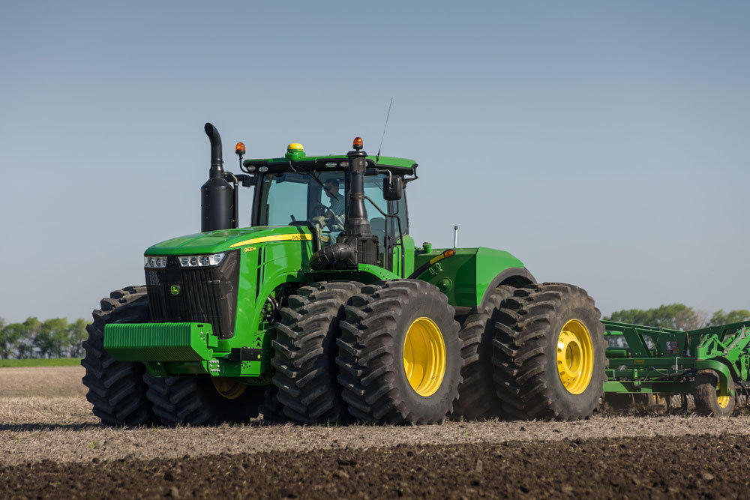
Intellectual Property (IP)
Copyright
Patent
Trade secret
Trademark
Why do we have IP laws?
  What do you own?
Imagine you are a farmer and the tractor you bought requires service
  Do you have the right to install 3rd party software on the ECU?
  https://www.forbes.com/sites/jasonbloomberg/2017/04/30/john-deeres-digital-transformation-runs-afoul-of-right-to-repair-movement/#68eeefee5ab9
  Emissions compliance?
  John Deere required its customers to sign an updated EULA that restricted the ability of equipment owners to repair or modify their equipment

Slide 24
Software IP
Copyright
  Creative, 1 of a kind work
  Long protection
Patent
  Invention
  Short protection
Where should software fall?
  Invention vs. writing
  Expression of ideas or an algorithm?
  Patents are not supposed to be granted for “obvious” or in common use when patent is filed
    How can this be determined with software patents?

Slide 25
Licensing your software
You will need to choose what license you will associate with your software
Closed source
  You own the IP rights
Open source
  You allow anyone else to modify and use the software
  Any users of it cannot make it closed source*
How can money be made from open source software?
But we diverge…

Slide 26
Example licenses
ADOBE CONFIDENTIAL
Copyright [2002] - [2007] Adobe Systems Incorporated
All Rights Reserved.
NOTICE: All information contained herein is, and remains
the property of Adobe Systems Incorporated and its suppliers,
if any. The intellectual and technical concepts contained
herein are proprietary to Adobe Systems Incorporated
and its suppliers and may be covered by U.S. and Foreign Patents,
patents in process, and are protected by trade secret or copyright law.
Dissemination of this information or reproduction of this material
is strictly forbidden unless prior written permission is obtained
from Adobe Systems Incorporated.

Slide 27
Example licenses
This program is free software: you can redistribute it and/or modify it under the terms
of the GNU General Public License as published by the Free Software Foundation,
either version 3 of the License, or (at your option) any later version. This program is
distributed in the hope that it will be useful, but WITHOUT ANY WARRANTY; without
even the implied warranty of MERCHANTABILITY or FITNESS FOR A PARTICULAR PURPOSE.
See the GNU General Public License for more details. You should have received a copy
of the GNU General Public License along with this program. If not, see
<http://www.gnu.org/licenses/>.

Slide 28
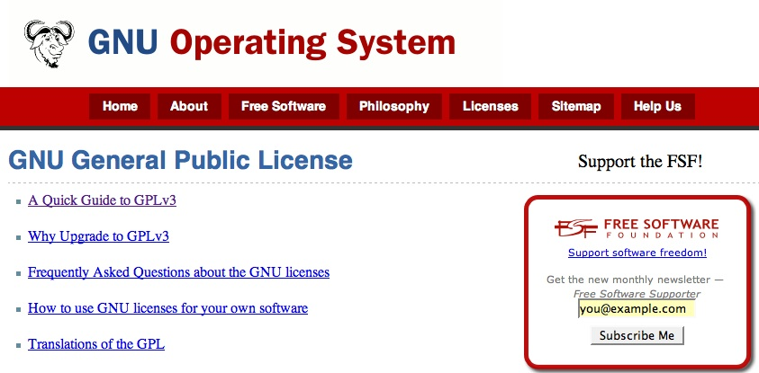
GNU Public License
Open sources software is an important part of modern computing that does not fit well into traditional contract law.

Slide 29
Open Source Software – Main Features
Non-proprietary software which may or may not be used commercially;
Typically licensed under an Open Source license (not given away)
  License terms differ from proprietary software license terms
Source code is generally made available
  Legal restriction on reverse engineering (under the DMCA) do not apply.

Slide 30
Open Source Software License - Licensees
Original software owner or developer chooses to limit the rights that he asserts over licensees
Licensees, subject to license terms, can:
  make and distribute copies of software;
  build upon software to create modifications or other works.

Slide 31
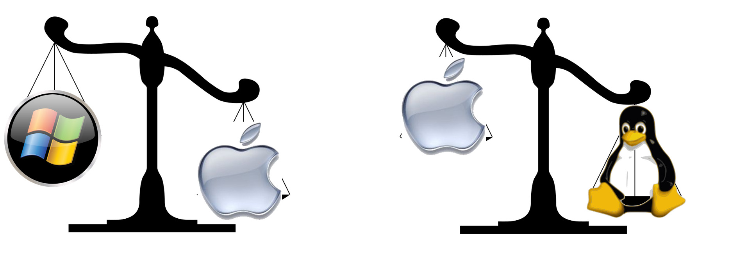
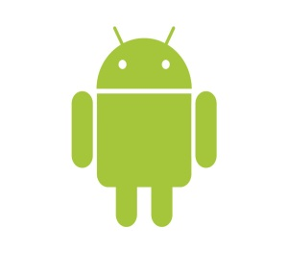
Is Mac OSX Open Source?
Major components of Mac OS X, including the UNIX core, are made available under Apple’s Open Source license. But not the whole operating system.
The Android operating system is open source. Except for version 3.0. The Apps such as Gmail, the Market, and Google Maps are not open source.
What about me?

Slide 32
Open Source Software Licenses - Source Code
Source code to original product always provided;
Licensee can modify or enhance source code
  create “derivative works”
Licensee can include source code with other license types
  create “larger works”
Licensee may be required to share modifications with the world (in source and/or binary form)
  but not necessarily
Licensee may be prohibited from charging royalties for derivative and larger works
  but not necessarily

Slide 33
Open Source Software License – Warranties and Support
Generally, software provided “AS-IS” with no warranties, warranties excluded;
No indemnification;
  User cannot sue creator for liability reasons
No maintenance or support.

Slide 34
The GNU “General Public License” (GPL)
No standard open source license, but GPL most widely used
  Roughly 85% of open source software
Terms include:
  User freedom to distribute and/or modify;
  Requirement that original and modified source code be always made available to the world under the terms of the original license;
  Must retain copyright notices and warranty disclaimers;
  Does not include grant of patent licenses
  Extremely viral license – derived works must be open source as well
Sometimes called “copyleft”
http://www.gnu.org/copyleft/gpl.html

Slide 35
The Apache Software License
Governs the Apache web-server software
Terms include:
  User freedom to distribute and/or modify;
  No requirement for source code to be made available to the world in downstream distribution;
  Must retain all copyright notices and warranty disclaimers;
  Not a viral license
http://www.apache.org/licenses/LICENSE-2.0.html
Comparison of licenses: Wikipedia comparison chart

Slide 36
Summary: Existing open source licenses
Terms will always include preservation of copyright notices and warranty disclaimers;
Some licenses will be extremely viral: thus prohibiting any other type of downstream licensing apart from under the terms of the original license;
Some with permit inclusion of code within proprietized programs;
In some instances, provision of additional warranties and support will trigger indemnification provisions to the original developer.

Slide 37
Online resources
For a comprehensive chart describing and comparing open source licenses see http://en.wikipedia.org/wiki/Comparison_of_free_software_licenses
For full open source license texts see http://opensource.org/licenses

Slide 38
Advantages: Open Source License
PRICE: Generally no or low license fees;
Availability of source code coupled with permission to make modifications;
Access open source development community, which may be very active with respect to code used. Continuing improvement; outstanding development;
More likely to be built to open standards, so interoperable with other open standards systems.

Slide 39
Disadvantages: Open Source Licensing
No indemnification; if a third party claims that licensee is using code that the third party developed, the licensee has no one to pay his legal fees and damage award
No maintenance and support (unless purchased separately);
No warranties regarding media, viruses, and performance;
Staff must be open source savvy;
License terms are NOT standard: thus important to pay close attention to terms.

Slide 40
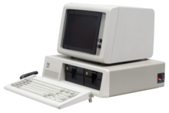
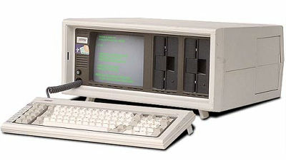
What is reverse engineering?
1981 IBM PC
1982 Compaq Portable
“Clean Room” process was developed to legally reverse engineer
Silicon Cowboys Movie
  https://www.imdb.com/title/tt4938484/

Slide 41
Privacy
Many industries have standards
  Medical: protected health information (PHI), controlled by HIPAA
    Strikes balance between health professionals needing to be able to consult on cases and not disclosing sensitive information unnecessarily
  Educational: FERPA: Family Educational Rights and Privacy Act
    Controls disclosure of educational records
  Payments: PCI: Payment Card Industry
    Processing, storing, transmitting credit and other payment card information
Is this enough?
  Should companies be able to amass unrestricted data about us?
    There’s enough memory to store everything everyone does!
  Is the European solution more appropriate – ability to be erased?
Should we have new laws?
  Maybe it would be good to listen to people who grew up using cell phones...

Slide 42
Review
Intellectual property rights
  Trademarks, patents, copyright
Copyright considerations
  Especially, open source
Privacy
  Standards: HIPAA, FERPA, PCI

