Slide 1
Release Planning
Ch. 18

Slide 2
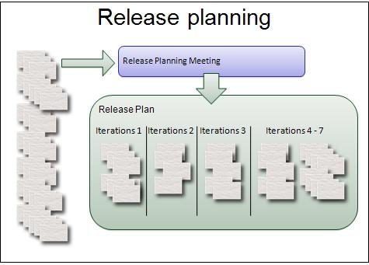
What we’ll cover today
What is release planning
  that is, long-term planning
Basic strategy: iterations
  Don’t wait until all done!
  That was a mistake of the waterfall processes...
When to do release planning
How to do release planning

Slide 3
Release Planning Objectives
Fundamental goal:
  identify features to be implemented, completion dates
Ongoing:
  resolve discrepancies between commitment and actual delivery
Larger goals:
  Help product owner set priorities
  Give team understanding of project directions
    Critical for motivation
    Helps ensure good design decisions
    Critical for stakeholder planning on budget, schedule

Slide 4
Planning levels (Ch. 15)
Product Vision
Roadmap
Release Plan
Sprint Plan
Day Plan
Frequency of Review
Quarterly: themes of each release
Every 1-2 months: user stories/features for upcoming releases
Every 1-3 weeks: tasks for stories
Every day (standup): that day’s activities
Hubert Smits – Five levels of planning
Notes:
Hasker: modified the frequency discussion to be more consistent with Scrum

Slide 5

Product Roadmap Example: NVIDIA (2026)
Copyright 1999-2026 Tweak Town Pty Ltd.
Notes:
Sample roadmap illustrating how companies use this information at large scale. This is an example of a roadmap.

Slide 6
Planning levels (Ch. 15)
Product Vision
Roadmap
Release Plan
Sprint Plan
Day Plan
Frequency of Review
Strategic
Annually
Quarterly: themes of each release
Tactical
Every 1-2 months: user stories/features for upcoming releases
Every 1-3 weeks: tasks for stories
Every day (standup): that day’s activities
Hubert Smits – Five levels of planning
Notes:
when return to this, reiterate the other elements

Slide 7
Planning inputs
To create a plan, you need
  Prioritized and estimated Product Backlog
  Estimate velocity of the team
  Review and update release constraints of scope, date and budget
Key decision:
  Fixed Scope vs Fixed Date vs Fixed Budget
Vision
Roadmap
Release 1
Release 2
Sprint 1
Sprint 2
Story 1
Story 2
Story 1
Story 3

Slide 8
How to do release planning
Sketch a preliminary road map
Include dates and adjust as needed
Review and update the plan at the end of every sprint
Vision
Roadmap
Release 1
Release 2
Sprint 1
Sprint 2
Story 1
Story 2
Story 1
Story 3

Slide 9
Output
Release schedule shows epics/high level features with timelines of delivery
 | Date | Sprints | Status | Description
Build 1 | 3/3/2020 | 1-5 | Installed | Features 1, 2, 3, 5, 6, 7
Patch 1.2 | 5/5/2020 | 6 | On track | Security patch and fixes for Feature 2
Build 2 | 5/26/2020 | 6-7 | Off track | Features 4, 8, 9
Build 3 | 6/9/2020 | 8-10 | In Progress | Features 10,11, 12

Slide 10
Review: Release Planning
goal: identify features to be implemented, completion dates
Benefits
  Help product owner set priorities
  Project direction helps team with motivation, design
  Basis for planning budget, schedule across teams
Road map, vision: long-term thinking
Relevance to your project: release planning in the small
  Planning release sprint, including determining what will be released
  Create a punch list of items to complete before release

Slide 11
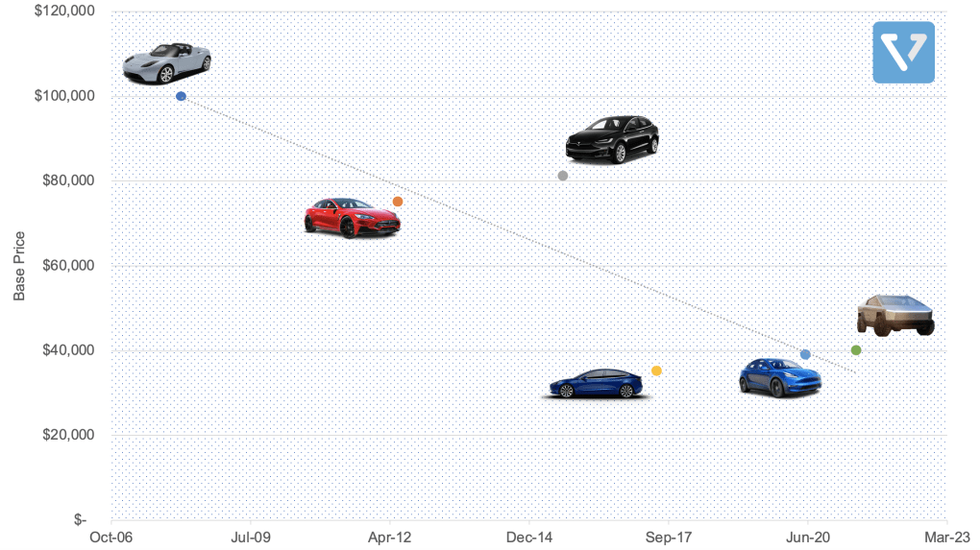
Product Roadmap Example: Tesla

