Slide 1
Real Time Systems
SWE4211, Fall 2026
Copyright W. Schilling 2025, modified by R. Hasker

Slide 2
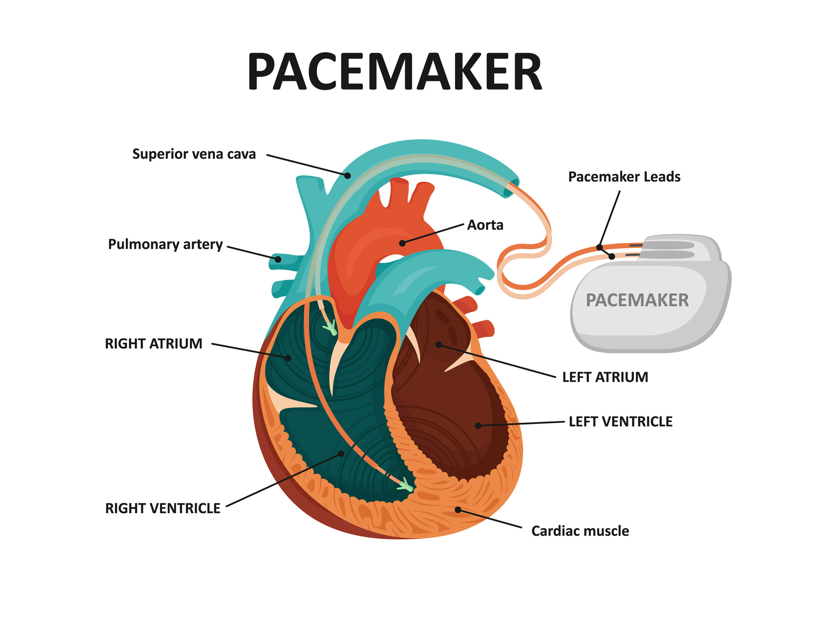


Starting point
What do I mean by “real-time systems”?
  Examples?
3rd ward
Notes:
Bridge opening picture (in 3rd ward): https://www.youtube.com/watch?v=9oJJqx4Mims&themeRefresh=1
Pacemaker: https://asktheman.xyz/

Slide 3
Starting point
What do I mean by “real-time systems”?
  Examples?
Key elements:
  Often, high performance – but not always
  Correctness depends not just on getting the right answer, but getting it on time
  That is, system reacting to inputs in time-constrained environment
Examples:
  Planes: all the flaps in place, right power; stay in flight envelope
  Pacemaker: monitor, deliver treatment on time
  Bridge: smooth raise, smooth lower, stop if blocked
Notes:
Bridge opening picture (in 3rd ward): https://www.youtube.com/watch?v=9oJJqx4Mims&themeRefresh=1
Pacemaker: https://asktheman.xyz/
Bridge: definitely not speed, but need consistency, reliability

Slide 4
Catalog Description
This course introduces students to software design and development of real time distributed systems. Real-time applications include flight control systems, vehicle control systems, industrial processes, life-support systems, robotic manipulators, and multimedia applications. Special attention is paid to scheduling, latency minimization, bandwidth constraints, and other design issues that impact the design of these systems. Team based laboratory assignments provide experience in the design and implementation of realistic applications using a real-time operating system, cross compilation, and embedded development boards. (prereq: CSC 2210, CSC 3210)
Breaking that down:
Design, development of real-time systems
Scheduling, latency minimization, bandwidth constraints
Using real-time operating systems
Embedded development
Team-based projects
See hasker/swe4211/syllabus

Slide 5
Pre-requisite Topics
Operating systems concepts
  Scheduling, including round robin scheduling, priority scheduling, FCFS scheduling
  Synchronization and concurrent programming concepts (semaphores, mutexes, etc.)
  Interprocess communications using pipes and sockets
  Multithreading
  Linking
C and C++ programming topics:
  The C/C++ compilation model
  Structures
  Memory management
  Usage of pointers
  Arrays
  Enumerations
  Preprocessor operations
  Rudimentary file IO
  Usage of a debugger to debug C/C++ code

Slide 6
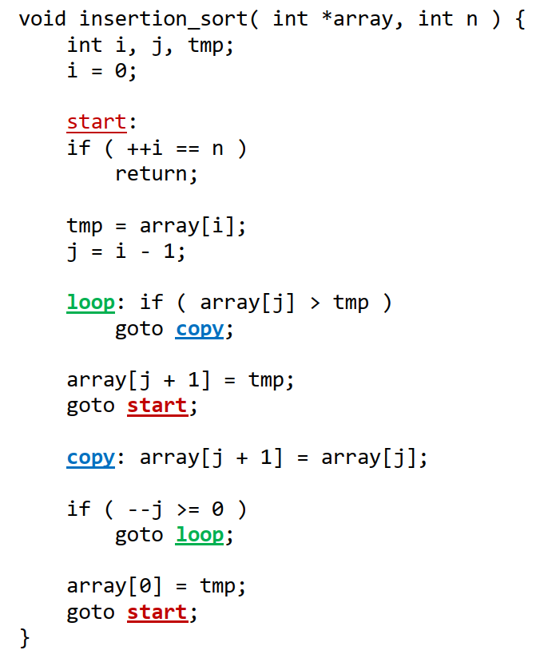
Notes
Teams: note can change notification rules
Assignments: on Canvas
  Track the Canvas calendar
Textbook
  The authors have very antiquated views of programming!
  Example: claim that this version of insertion sort is faster than structured
    Claim is that overhead of structured solution can make code run slow
    Optimized will be nearly the same for both; if not optimizing, don’t care about speed
    Often, there is no concern about speed in embedded systems, so that can be ok...
    But no, C is not inherently more efficient than C++
  Probably should skip Ch. 2...
Notes:
and why using insertion sort if care about speed?

Slide 7
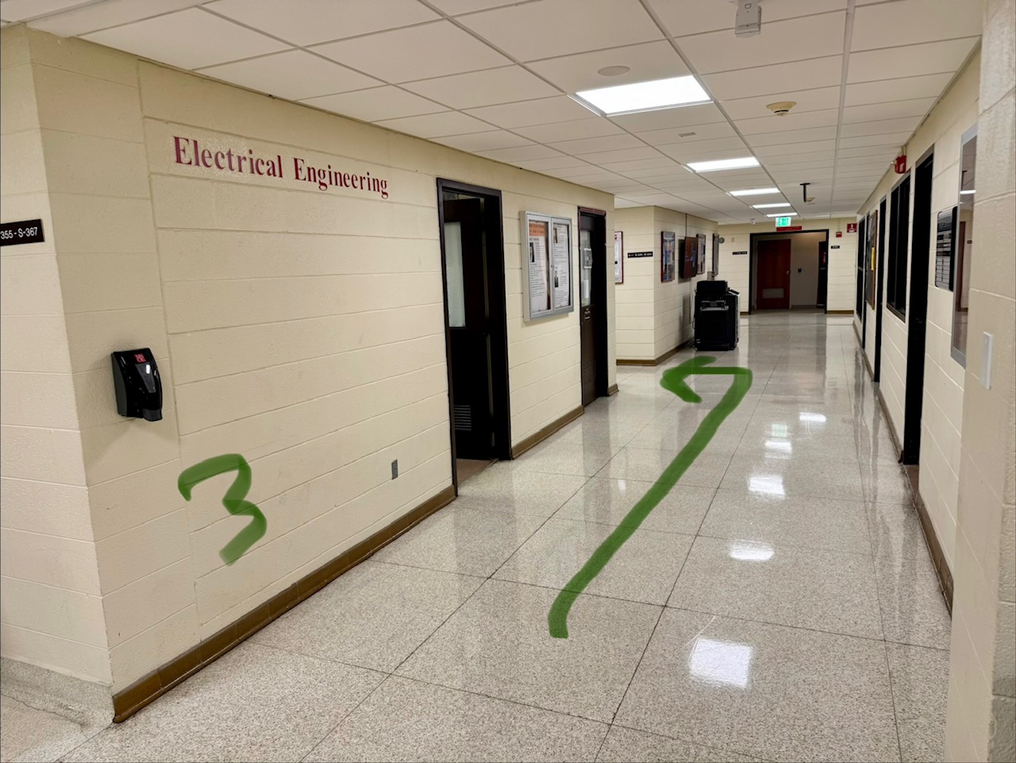
Equipment
For lab, you will need to pick up a kit
  Electrical Engineering technical support
  3rd floor, Science Building (go up center stairway to 3rd floor)
  Raspberry Pi kit
  We will use this for the first few weeks
  One per lab partner pair
Each person will need a micro SD card to program Raspberry PI OS onto
  Can be any size > 8GB, though 32GB is pretty much the defacto size now
  Must be able to be completely overwritten and erased
Roster
  Need to form teams

Slide 8
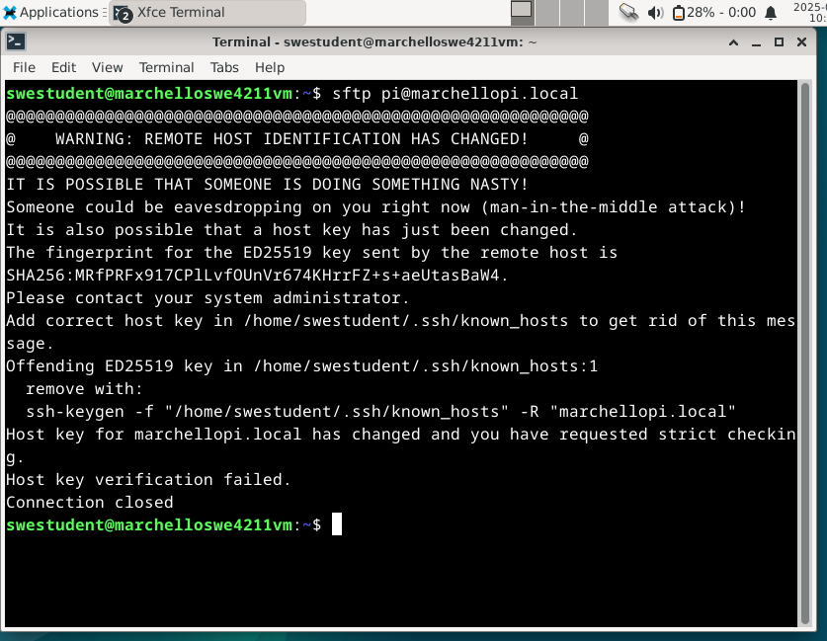
Common Issue with Raspberry Pi:
Will use ssh to access
known_hosts: which hosts can connect
Common issue with connection: remote gets new IP address
Need to update known_hosts at times

Slide 9
Lecture Objectives
Define real time systems – already done
Define embedded system
  Compare and contrast embedded systems with general purpose systems
The growth in embedded systems

Slide 10
What is an Embedded System

Slide 11
What is an Embedded System
a combination of hardware & software (a “computational engine”) to perform a specific function
is part of a larger system, say a real-time system, that may not be a “computer”
works in a reactive and time-constrained environment

Slide 12

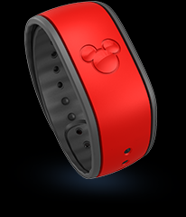
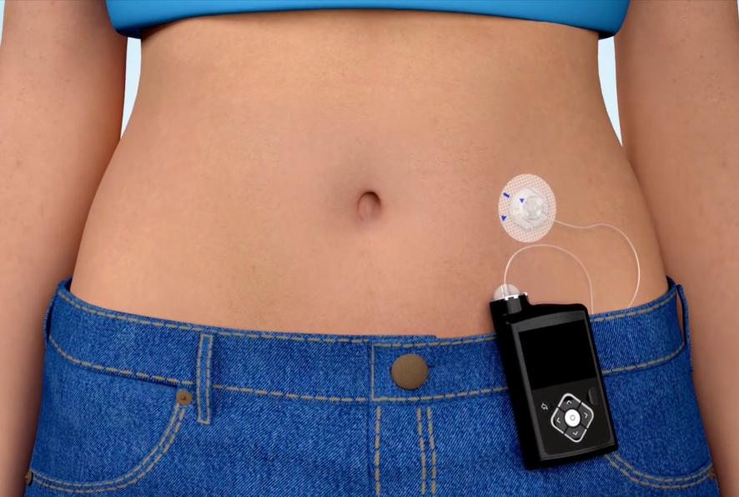
Examples of Embedded Systems
Appliances:
  Dishwashers
  Refrigerators
  Furnaces
  Clocks
Medical devices:
  Hearing aids
  Pacemakers
  Insulin pump
  Blood sugar monitor
Car systems:
  antilock brakes
  engine timing and monitoring
  seat/mirror positioner

Slide 13
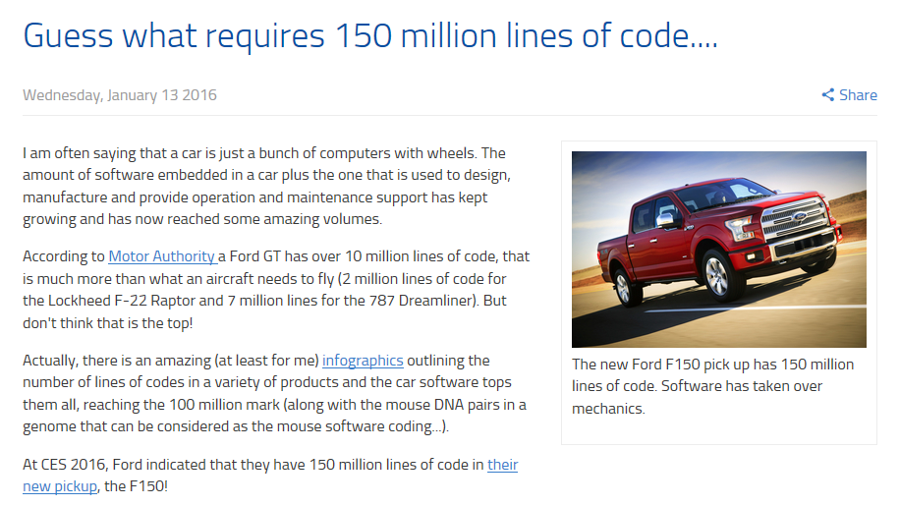
Automobiles
300-million+ lines for automated vehicles…
Notes:
Cars of Today
(https://www.eitdigital.eu/news-events/blog/article/guess-what-requires-150-million-lines-of-code/)

Slide 14
Some Embedded System Stats
https://electroiq.com/stats/embedded-systems-statistics/
Worth nearly $180 billion in 2024, $280 billion by 2034
39% of devices: Raspberry Pi
Roughly equally-sized areas:
  automation, IoT, communication, auto

Slide 15
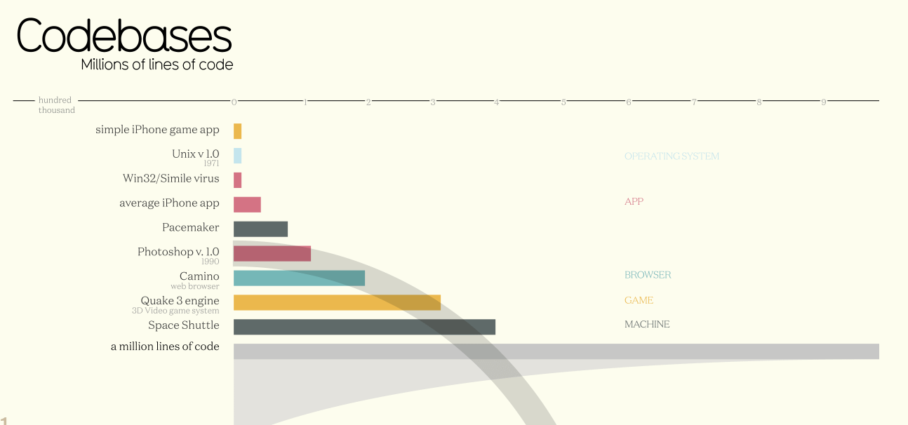
Notes:
Codebase Sizes
(https://informationisbeautiful.net/visualizations/million-lines-of-code/)

Slide 16
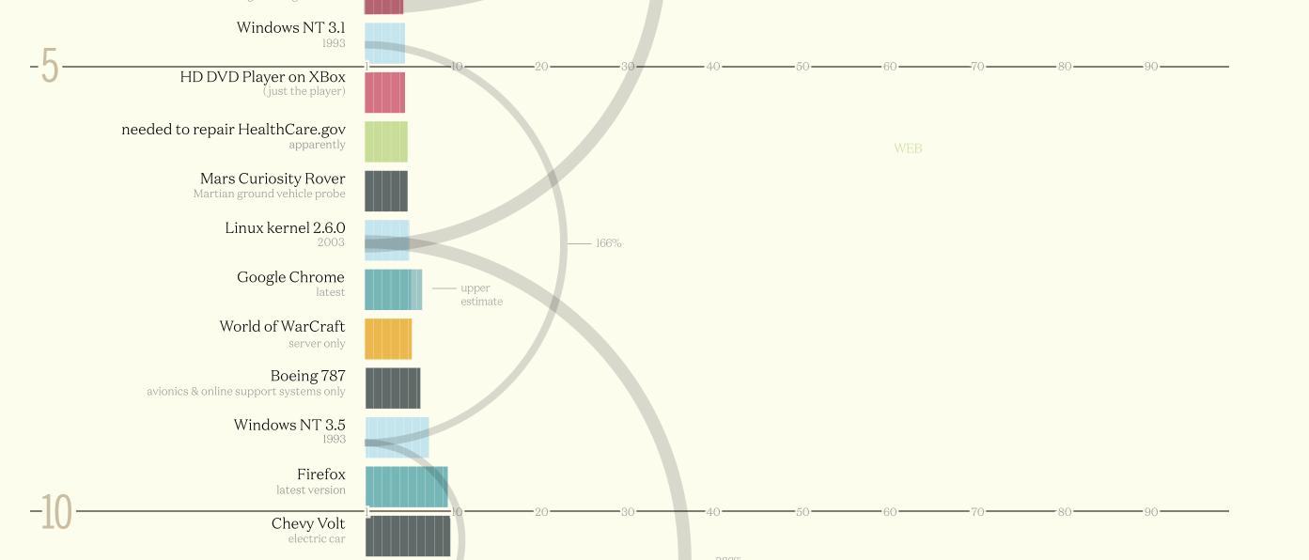
Codebase Sizes
(https://informationisbeautiful.net/visualizations/million-lines-of-code/)

Slide 17
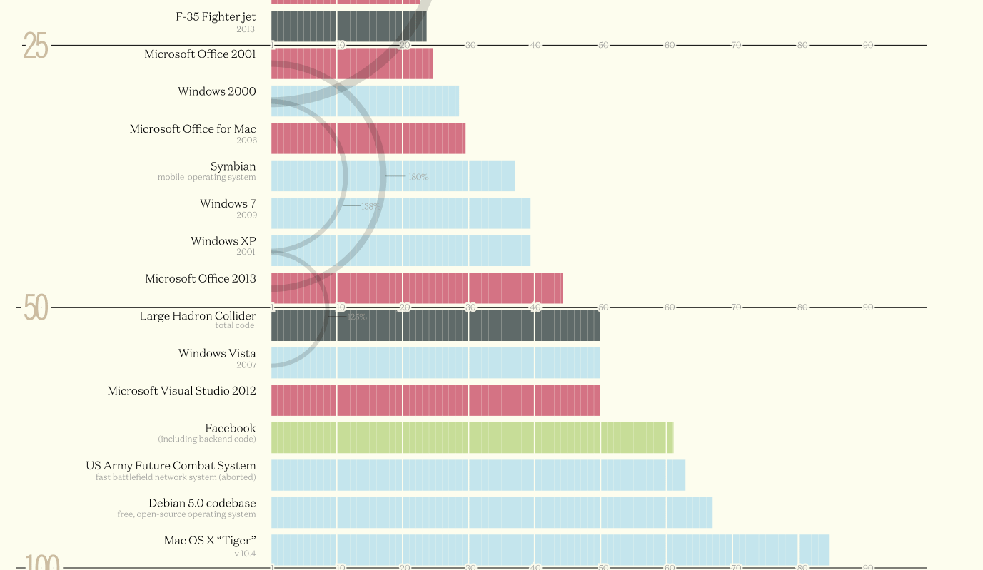

Slide 18
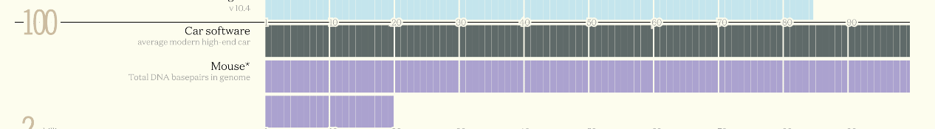
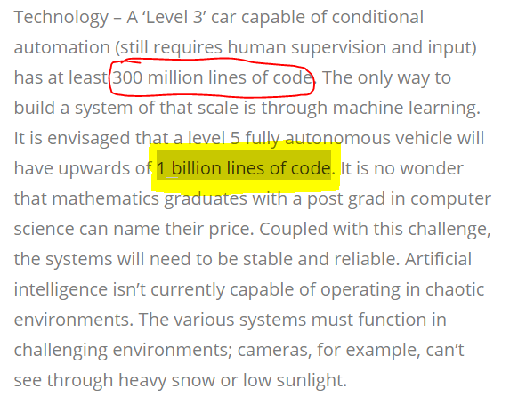
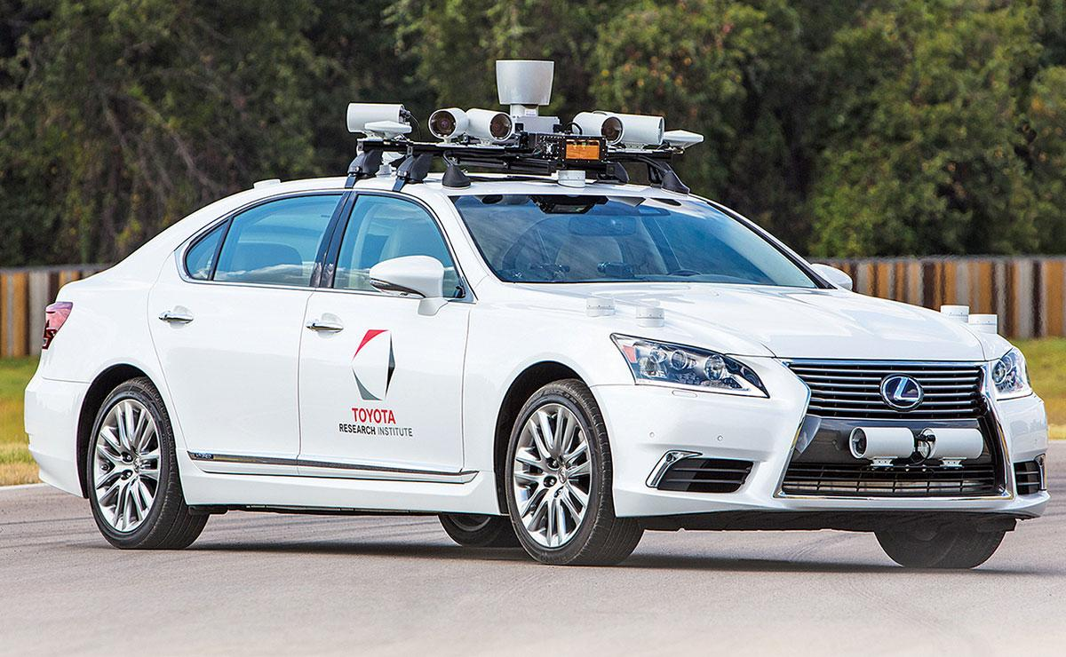
Fully autonomous vehicle: 1 Billion Lines of code!
https://www.talismanexecutive.com/blog/needs-happen-make-autonomous-vehicles-reality

Slide 19
Wrapup
Reading assignment in Canvas
Small set of HW questions to answer from reading.
Review:
  Real-time systems: correct result, on time
  Embedded systems: computer systems with no keyboard, monitor
Next: GPIO

