Slide 1
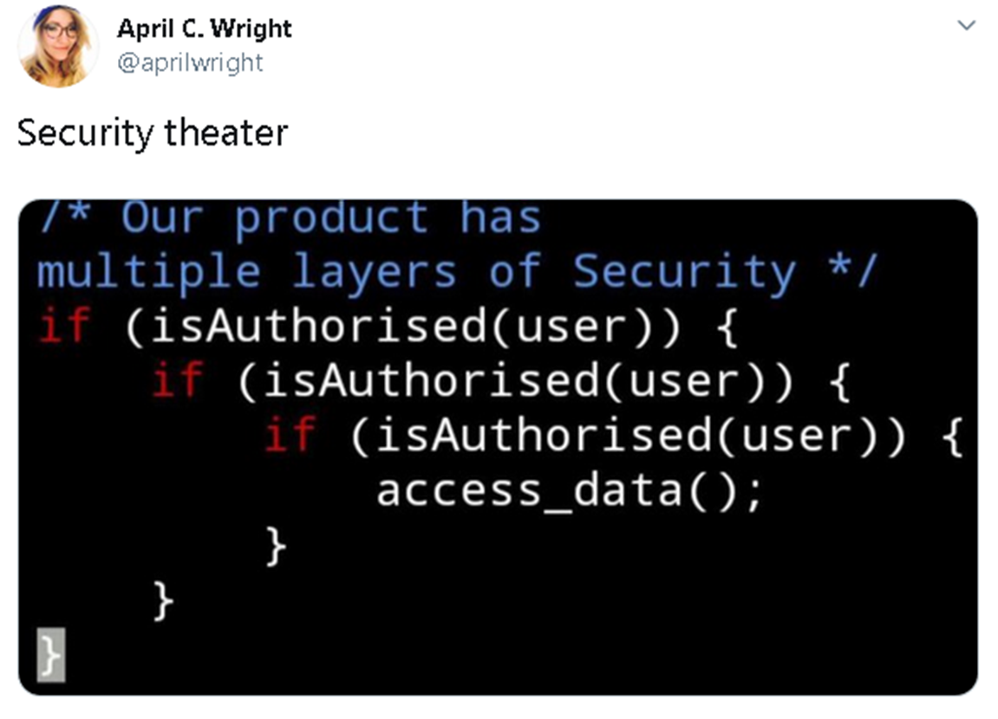
GPIO Hardware
Explain the difference between a microcontroller and a microprocessor
Identify the key components of the Raspberry PI Platform
Understand how to read a basic schematic
Identify switches, LEDS, resistors, and ground on a schematic
Explain the concept of a dropping resistor
Explain the concept of a pull up and a pull down resistor
Explain how one can use the GPIO Libraries to access GPIO devices in C
SWE 4211

Slide 2
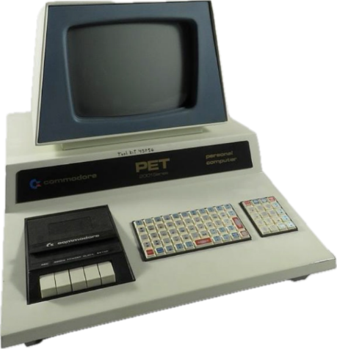
Response Time
Response time
  The time between the presentation of a set of inputs to a system and the realization of the required behavior, including the ability of all associated outputs

Slide 3
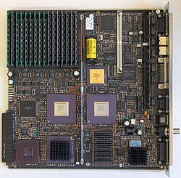
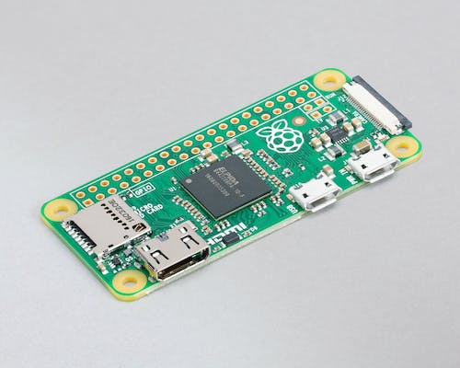
2 classes of computational devices
RAM
Motherboard: full computer w/o IO devices
Raspberry Pi Zero Microcontroller
CPU: microprocessor
Notes:
Motherboard: By Autopilot - Own work, CC BY-SA 4.0, https://commons.wikimedia.org/w/index.php?curid=39693335
The CPU has a heat sink to control temperature

Slide 4
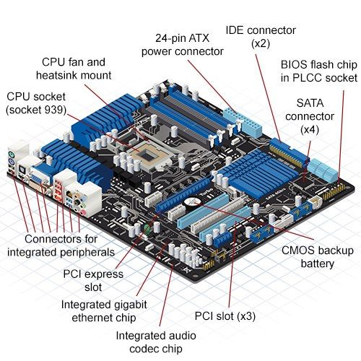
Parts of a GP Computer (Microcomputer)
*https://www.anigma.com/blogs/education/top-5-components-when-building-your-gaming-pc?srsltid=AfmBOoq9b5cDu-FK5HJNF2T_qbeXVUweJj9ICYqWPGnuDFjqfjDiNtGB

Slide 5
Raspberry Pi Zero Microcontroller
*https://www.raspberrypi.com/products/raspberry-pi-zero/

Slide 6
Microcontroller vs. Microprocessor
Microcontroller: heart of an embedded system.
  Processor includes internal memory, I/O components
  Small circuit
  Low cost, power
  Typically: more registers
I/O: often via GPIOs
  General Purpose Input/Output
  Rasberry Pi: pins
Part of standard computer
  Just processor
  memory, I/O separate
  Larger circuit
  More power
Input/Output:
  Special instructions + registers
  Memory-mapped I/O: read/write specific memory locations
Notes:
https://www.electronicsforu.com/resources/difference-between-microprocessor-and-microcontroller

Slide 7
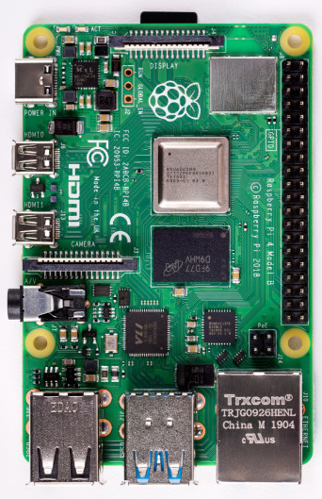
Rasbperry Pi 4B
Model | Model 4B
Chip | Broadcom BCM2711 64-bit
Processor | ARM Cortex-A72 Quad core
Processor Speed | 1.5 GHz
Voltage and current draw | 600mA @ 5V
GPU | Dual Core VideoCore VI Multimedia Co-Processor
Memory | 2, 4, 8 GB SDRAM @ 900 MHz
Storage | Micro SD Card
GPIO | 40
USB | 2x USB 2, 2x USB 3
Ethernet | 10/100/1000mb Ethernet RJ45 Jack
Wireless LAN | Integrated 2.4GHz and 5GHz 802.11 b/g/n/ac
Bluetooth | Bluetooth 5.0, Bluetooth Low Energy (BLE)
Audio | Multi-Channel HD Audio over HDMI, Analog Stereo from 3.5mm Headphone Jack
Video | 2x micro HDMI ports

Slide 8
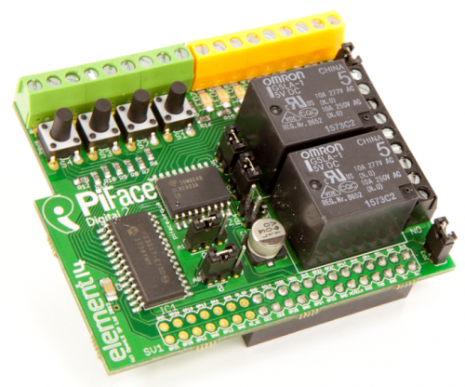
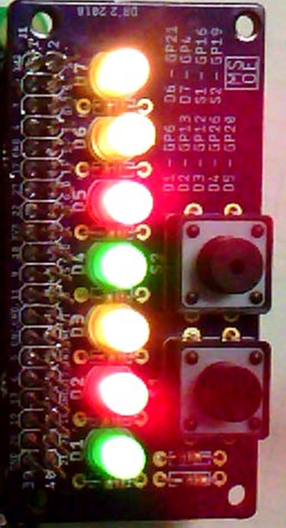
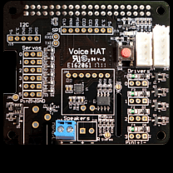
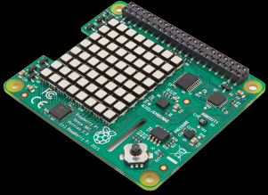
PI HAT
“Hardware Attached on Top”
  A HAT is an add-on board for pi that conforms to a specific set of rules that will make life easier for users.
    Voice Recognition / Voice Processing
    Basic GPIO
    Accelerometer sensing
    GPS Sensing

Slide 9
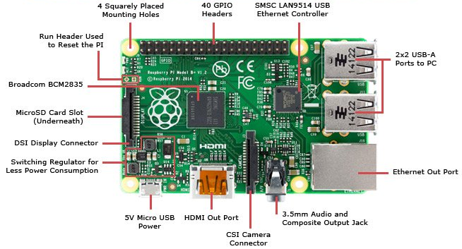

Raspberry Pi Components
Note: NEVER connect a voltage greater than 3.3V to any GPIO pin on the Raspberry Pi! It will damage the hardware!
Notes:
Pinout (https://www.jameco.com/Jameco/workshop/circuitnotes/raspberry-pi-circuit-note.html)

Slide 10

Balloons
Imagine a balloon filled with water
Imagine a balloon filled with hydrogen

Slide 11





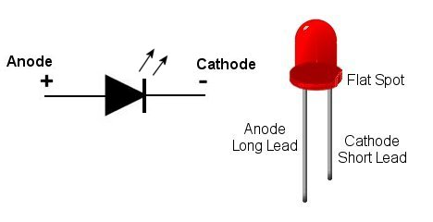
Introduction to schematics
Language of circuits
Helpful to understand GPIO communication
Resistor
Switch
Ground
LED

Slide 12
Definitions: common resister uses
Pull up resistor
  Ensures wire is pulled to high logical level (“1”) if no input signal
Pull down Resistor
  Wire pulled to low logical level (“0”) if no input signal
Dropping resistor
  In series with device to reduce the current flow
  Imagine it as “burning off” the extra current
Notes:
http://www.resistorguide.com/pull-up-resistor_pull-down-resistor/

Slide 13
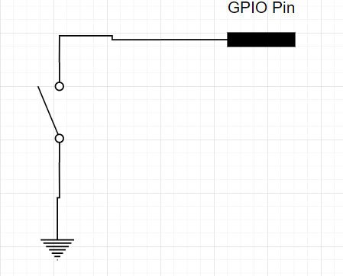
A simple input circuit

Slide 14
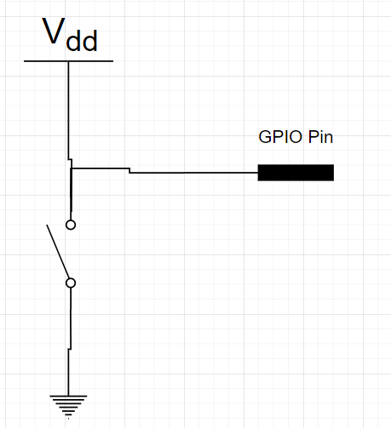
A solution?

Slide 15
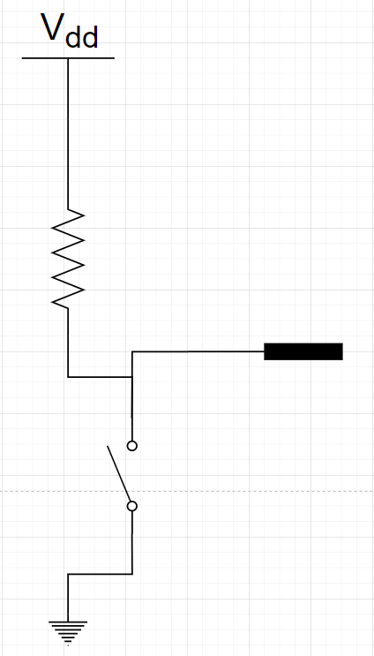
A good solution

Slide 16
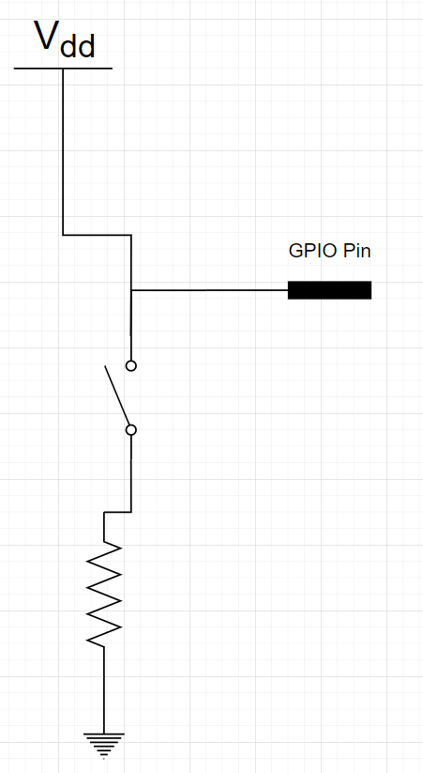
Another good solution

Slide 17
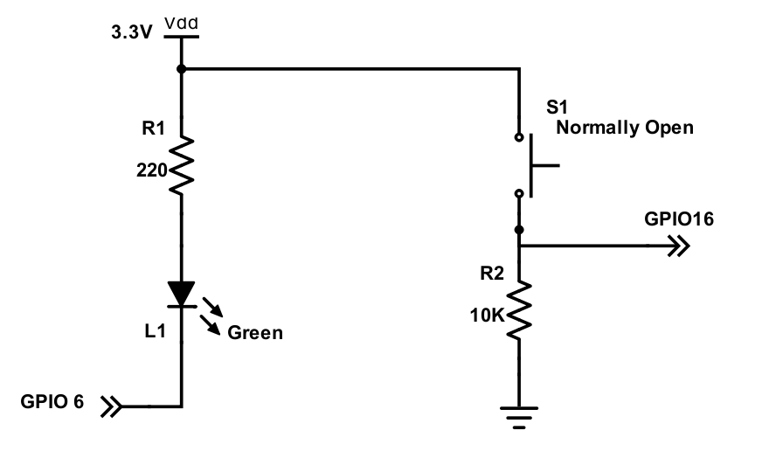
Example – Think about these questions for a moment
What will be the input value if the switch is pressed?
What will be the input value if the switch is released?
What type of resistor (R2) is this?
How would you make the light turn on?

Slide 18
Answers
What will be the input value if the switch is pressed?
  The value on GPIO16 will be a 1 if the switch is pressed
What will be the input value if the switch is released?
  The value on GPIO 16 will be a 0 if the switch is released
What type of resistor (R2) is this?
  Resistor R2 is a pull-down resistor, because it “pulls” the input pin down to ground when the switch is not pressed
How would you make the light turn on?
  To turn on L1, the software would write a value of 0 to GPIO 6’s value file

Slide 19
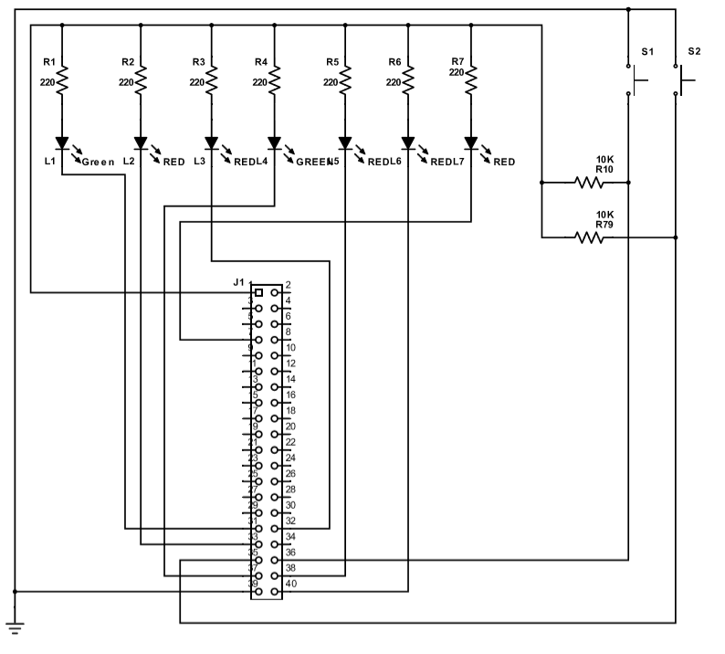
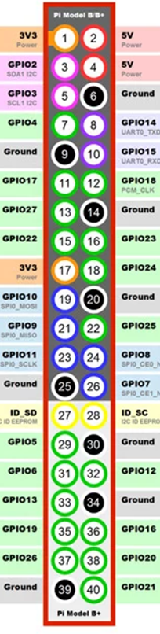
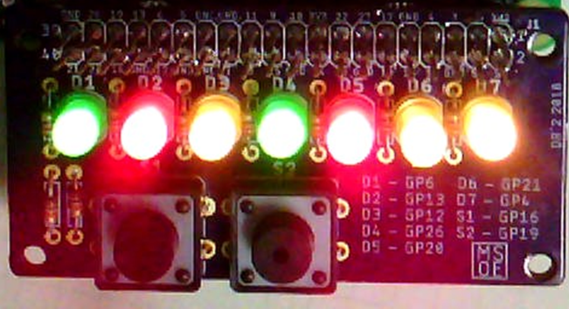
Pi HAT Design

Slide 20
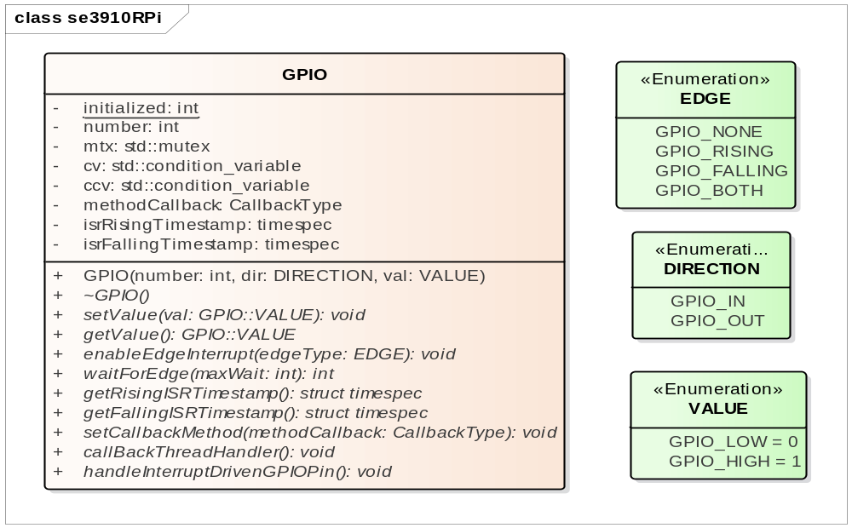
Our GPIO Library

Slide 21
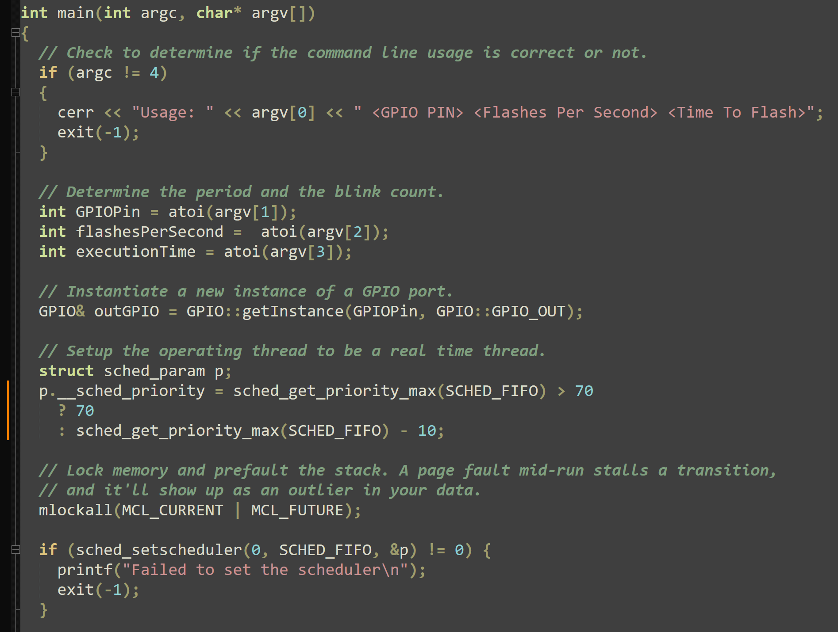
Startup code
Parse arguments
Set priority for timer
Ensure no page faults at runtime
Set scheduler type

Slide 22
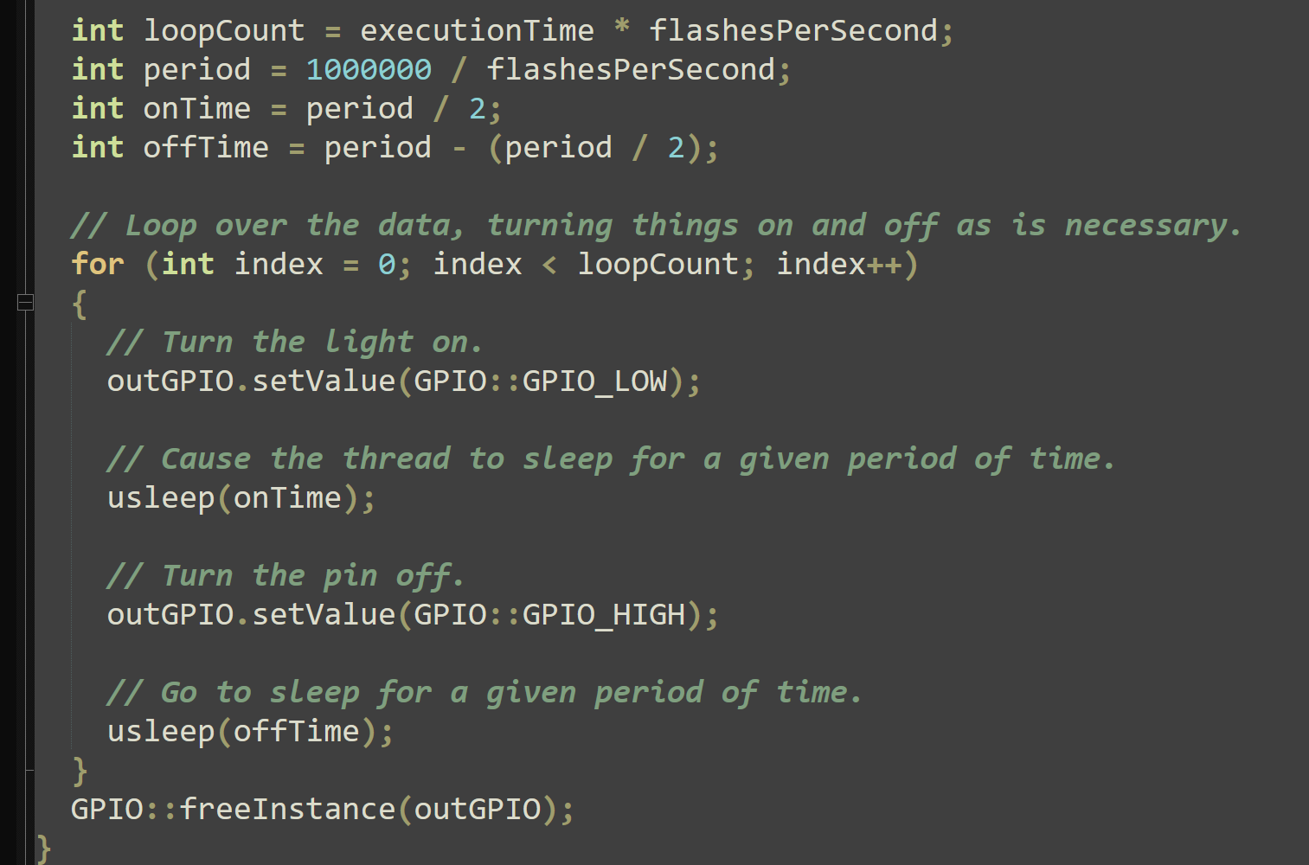
Work out number of passes
Main loop:
light on
pause
light off
pause
Repeat
Would want to create domain operations to do this…

Slide 23
Review
Microprocessor vs. microcontroller
  Microcontrollers have simpler design, lower power, cheaper
  Microprocessor: heart of standard computer
Elements of Rasbery Pi with the HAT
Circuit-level explanation of why PiHAT diodes use 0 for light on
Code to flash a light

