Slide 1
Oscilloscopes
Explain the meaning of horizontal scaling on an oscilloscope.
Understand the meaning of vertical scaling on an oscilloscope.
Understand the relationship between frequency and period.
Use an oscilloscope to measure the period and frequency of a signal
Use an oscilloscope to measure the offset between two signals
Use an oscilloscope to measure latency.
SWE4211

Slide 2
Objectives
Explain how to blink an LED using a shell script
Explain the meaning of horizontal scaling on an oscilloscope.
Understand the meaning of vertical scaling on an oscilloscope.
Understand the relationship between frequency and period.
Explain how to measure the CPU utilization of task on your raspberry PI.

Slide 3
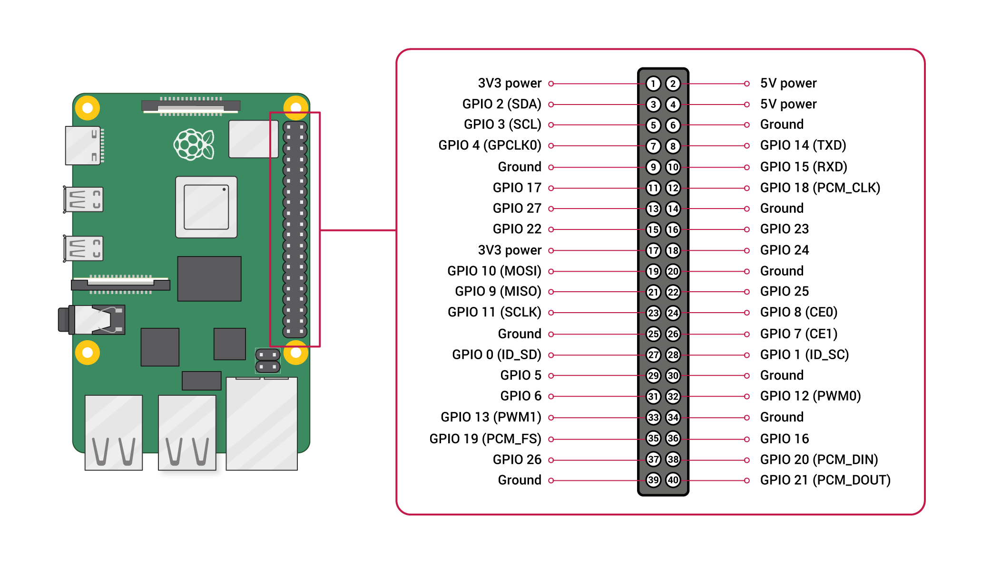
GPIO Pinouts
Notes:
GPIO Pinouts
(https://www.raspberrypi.org/documentation/usage/gpio/)

Slide 4
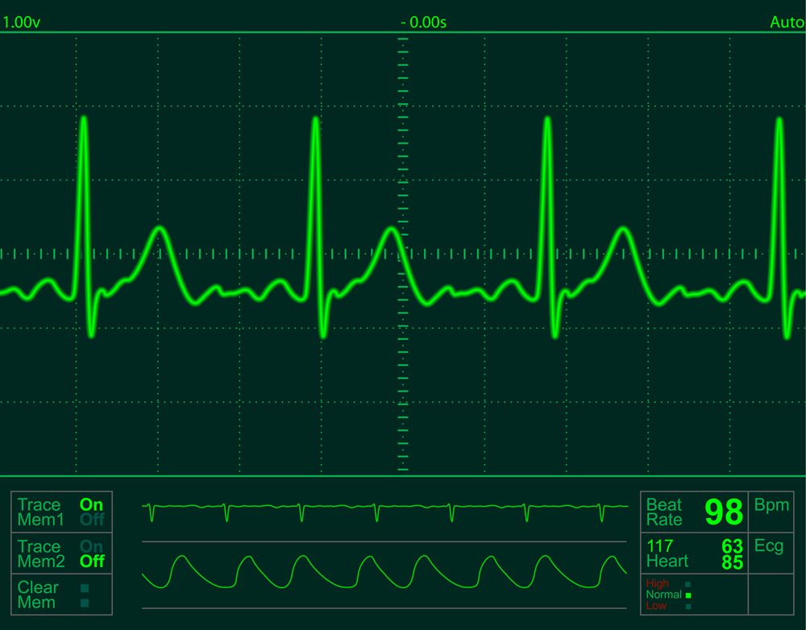
What is this?
qrs complex
(ventricular contraction)
p wave
(start)
atrial contraction
t wave: repolarizing
Notes:
ecg
start: p wave, atrial contraction is the peak
the large spike is the “qrs” complex: q is the start, r is the peak, s is the end: this is the electrical impulse that drives ventricular contraction
theis is followed by the t wave, which is the heart repolarizing (its an electrical signal, it has to go back to neutral to allow the next pulse)

Slide 5
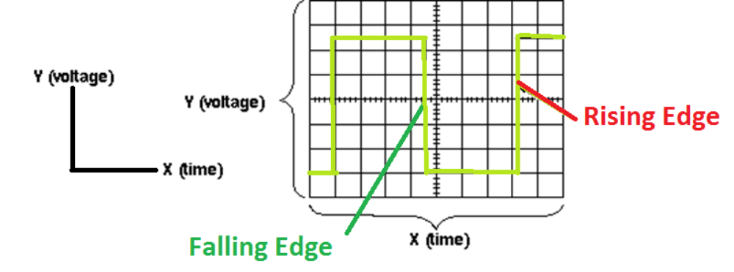
What is an oscilloscope?
A graph-displaying device of electrical signal
  X axis: Time
  Y axis: Voltage

Slide 6
Frequency Versus Period
Frequency
  The number of times a signal completes a loop of rising and falling in a given unit of time, typically 1 second
    Measured in Hertz (hz): cycles per second
Period
  The length of time it takes for a signal to complete on complete transition start to finish, returning to where the signal started
    Measured in units of time (s, ms, etc.)

Slide 7

Review
The scale is 20ms / division. What is the period and frequency?
If the scale is 5V per division, what is the peak-to-peak voltage of the signal?

Slide 8
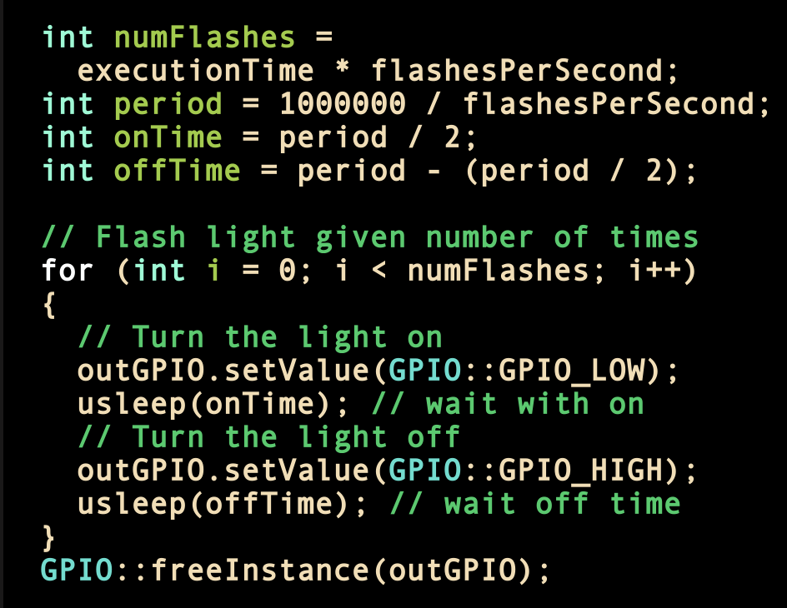
Consider the code to flash a light:
Oscilloscope
red: input line
yellow: light (output)
Why the difference?

Slide 9
Measuring Time Differences
Horizontal scale:
  50 ms per division
What is the latency?
  Time between red signal drop, light coming on

Slide 10
Demonstration
How accurate is GPIO blink rates on the Raspberry PI?

Slide 11
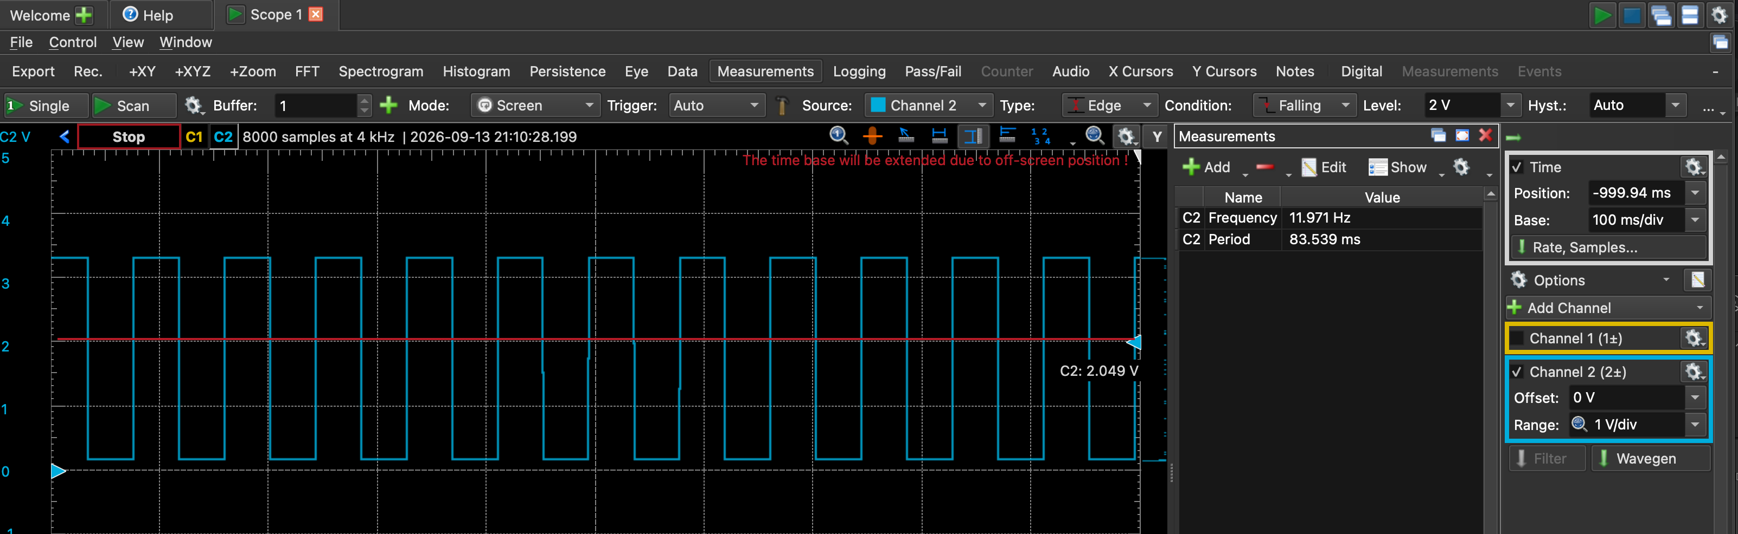
Notes:
What it looks like without any extra load on the PI

Slide 12
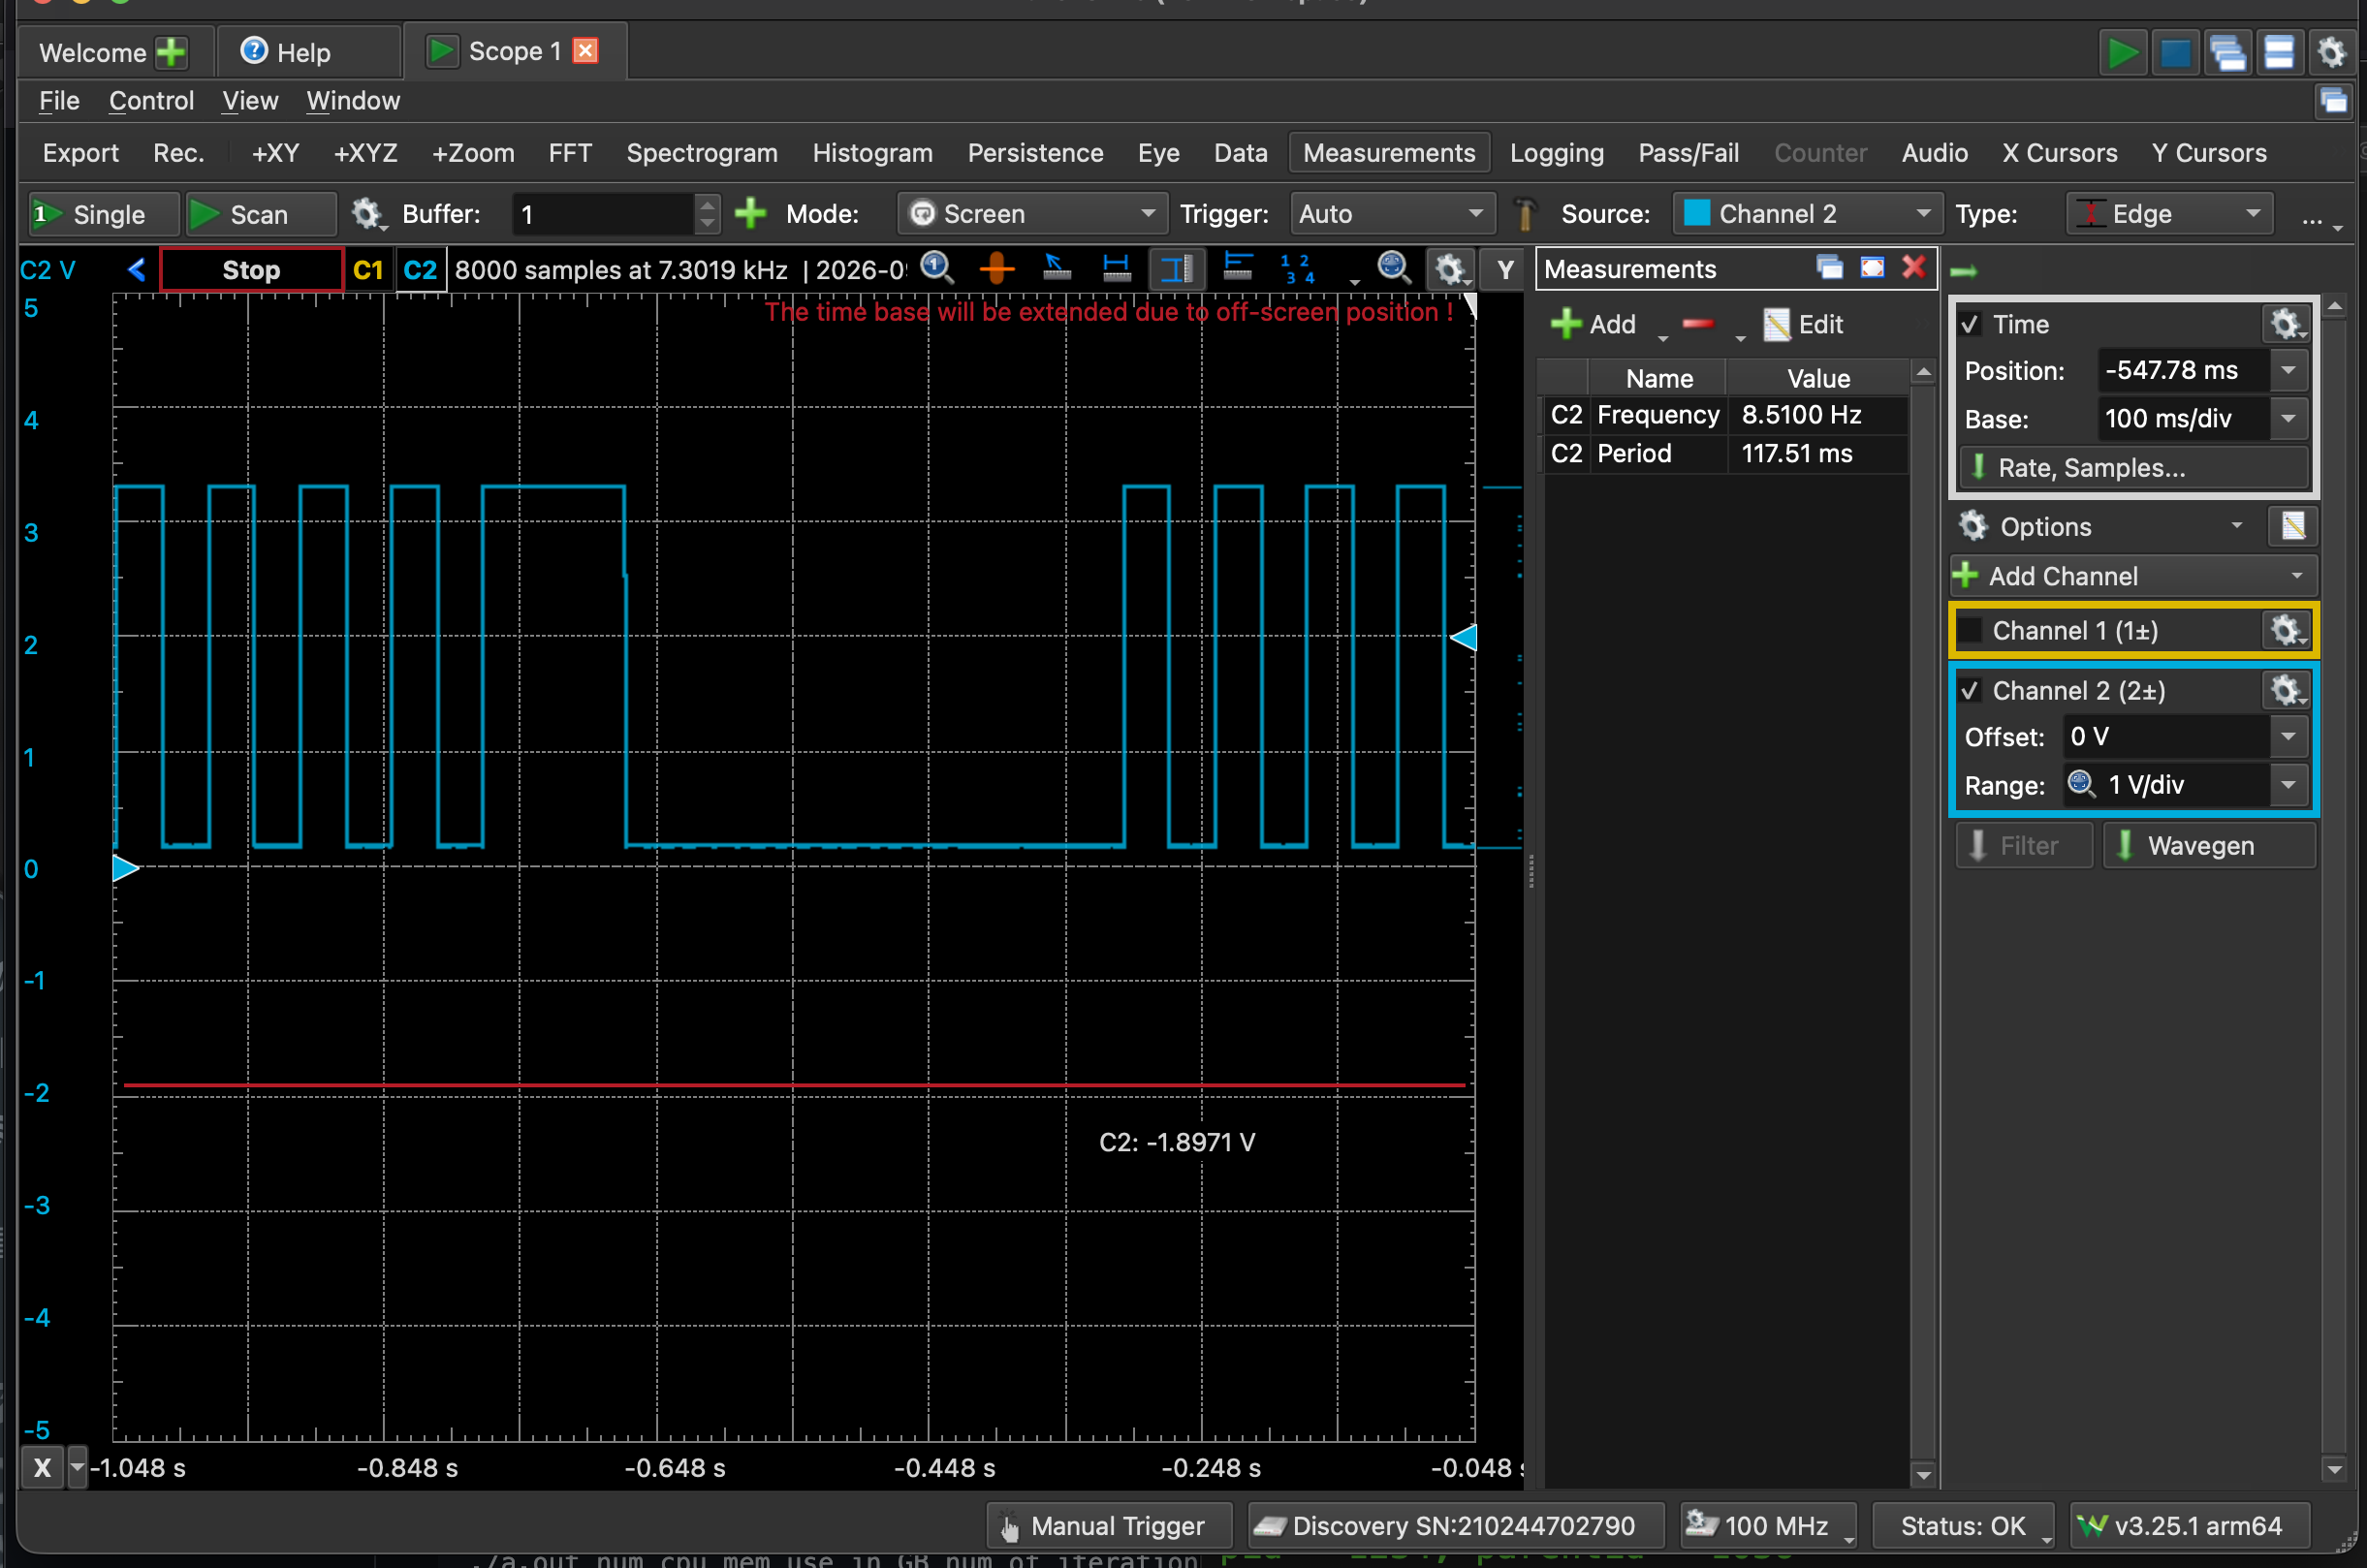
Pi with
application running to make cpu, memory busy
python used to blink light at 15hz for 300 seconds
Notes:
Software making cpu busy: https://github.com/astrophys/busy-cpu-and-mem
(installed using README steps; did not need more libraries)
with arguments 4 5 500 (4 cpus, 5 gig RAM, 500 seconds)
Command to blink lights: python blinkLight.py 6 15 300

Slide 13
Latency
What is the latency between a button press and release? How would we measure this?

