Slide 1
Multithreading
SWE4211

Slide 2
Objectives
Review: explain the concept of a C++ namespace
Review: construct code that properly uses namespaces in C++ class management
Explain why one might want to multithread a simple application
Review POSIX multithreading APIs
Construct a simple C++11 multithreaded application
Explain the relationship between thread IDs and process IDs
Use htop to analyze system behavior
Stretch goal: demonstrate remote execution with the Raspberry Pi and Eclipse

Slide 3
C++ Review
What do you recall about C++ namespaces?
  How to create a namespace?
  How to use identifiers from namespaces?
  What does using accomplish?
  Where is it appropriate to use using statements? Explain.
Notes:
file:///Users/rob/a/2210/f25/web/notes/n09-inheritance.html
* Don’t use using statements in header files – why?

Slide 4
What is a namespace?
A declarative region that scopes identifiers — types, functions, variables, etc.
Organizes code into logical groups and prevents name collisions, especially across multiple libraries
All identifiers inside a namespace are visible to one another without qualification
Code outside the namespace can reach its members three ways:
  Fully qualified name: std::vector<std::string> vec;
  A using declaration for a single identifier: using std::string;
  A using directive for the whole namespace: using namespace std;
Header files should always use fully qualified names
learn.microsoft.com — C++ namespaces

Slide 5

59. Don’t write namespace usings in a header file or before an #include
Rule: never write a using declaration or directive before an #include directive
Namespace usings are for your own convenience — not for you to inflict on others
Corollary: in header files, don’t write namespace-level usings — explicitly namespace-qualify all names instead
  Headers can never know what other headers might #include them afterward

Slide 6
Question
How do you start designing a multithreaded application in C using POSIX?

Slide 7
Posix Threads (Pthreads) Interface
Pthreads: Standard interface for ~60 functions that manipulate threads from C programs
  Creating and reaping threads
    pthread_create, pthread_join
  Determining your thread ID
    pthread_self
  Terminating threads
    pthread_cancel, pthread_exit
    exit [terminates all threads] , return [terminates current thread]
  Synchronizing access to shared variables
    pthread_mutex_init, pthread_mutex_[un]lock
    pthread_cond_init, pthread_cond_[timed]wait

Slide 8
The pthreads "hello, world" Program
/*
* hello.c - Pthreads "hello, world" program
*/
#include "csapp.h"
void *howdy(void *vargp);
int main() {
pthread_t tid;
pthread_create(&tid, NULL, howdy, NULL);
pthread_join(tid, NULL);
exit(0);
}
/* thread routine */
void *howdy(void *vargp) {
printf("Hello, world!\n");
return NULL;
}
Thread attributes
(usually NULL)
One attribute: joinable?
  Alternative: detached
  Useful for daemons
Join return:
  Int: 0 = success
  2nd arg: pointer to value passed to pthread_exit
Note void*: must cast!
Thread arguments
(void *p)
return value
(void **p)

Slide 9
Execution of Threaded “hello, world”
main thread
call pthread_create()
pthread_create() returns
peer thread
call pthread_join()
printf()
main thread waits for
peer thread to terminate
return NULL;
(peer thread
terminates)
pthread_join() returns
int main() {
pthread_t tid;
pthread_create(&tid, NULL, howdy, NULL);
pthread_join(tid, NULL);
exit(0);
}
/* thread routine */
void *howdy(void *vargp) {
printf("Hello, world!\n");
return NULL;
}
exit()
terminates
main thread and
any peer threads

Slide 10
Pop Quiz #2
How do we use multithreading in Java?

Slide 11
Java Threads Example
public class Main {
public static void main(String [] args) {
System.out.println("Starting thread_1...");
//create a thread class instance
Thread thread_1 = new ThreadClassDemo(15);
//start the thread thread_1
thread_1.start();
try {
//wait for thread_1 to die
thread_1.join();
} catch (InterruptedException e) {
System.out.println("Thread interrupted.");
}
System.out.println("Starting thread_2...");
Thread thread_2 = new ThreadClassDemo(20);
//start thread_2
thread_2.start();
System.out.println("main() is ending...");
}
}
//class inherited from "Thread"
class ThreadClassDemo extends Thread {
private int number;
//class constructor
public ThreadClassDemo(int number) {
this.number = number;
}
//run method => execution code for thread
public void run() {
int counter = 0;
int numInt = 0;
//prints the number till specified number is reached, starting from 10
do {
numInt = (int) (counter + 10);
System.out.println(this.getName() + " prints " + numInt);
counter++;
} while(numInt != number);
System.out.println("** Correct! " + this.getName() + "printed " + counter + " times.**");
}
}
softwaretestinghelp.com/multithreading-in-java

Slide 12
C++ threads
C++11 threads: the new kid on the block
std::thread class now part of standard C++ library
std::thread is an abstraction ─ maps to local platform threads
  (POSIX, Windows, etc.)

Slide 13
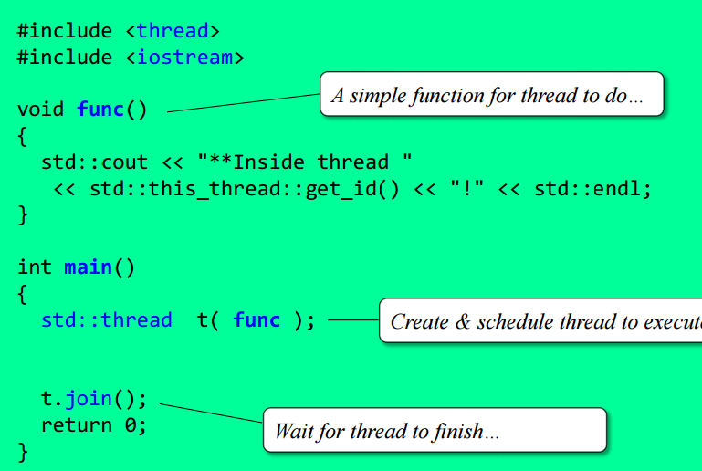
C++11 thread example

Slide 14
C++11 std::thread constructors, =
class thread
{
  thread(); // creates new thread object that does *not* // represent a thread (i.e. not joinable)
  thread(std::Function&& f, Args&&... args);
  // creates new thread to execute function f
  thread(thread&& other); // *move* constructor, assignment
  thread& operator=(const thread&& other);
  thread(thread& other) = delete; // no copy – why?
  thread& operator=(const thread& other) = delete;

Slide 15
Thread IDs and Process IDs
Process ID
  Unique numeric id (pid_t) assigned when a process is created
  IDs get reused over time — only guaranteed unique while the process is still running
  A process’s lifetime ends once its parent waits on it after it terminates
Thread ID (Linux-specific)
  Threads created with pthread_create also get a thread ID, from the same numbering space as process IDs
  Main thread’s ID = the process ID; other threads get distinct IDs
  Threads are never explicitly waited on, so an ID is eligible for reuse as soon as that thread exits or is canceled
Methods
  pid_t getpid(void) — process ID of the calling process
  pid_t gettid(void) — thread ID of the calling thread (Linux-specific; not cached)
gnu.org/software/libc/manual/html_node/Process-Identification.html

Slide 16
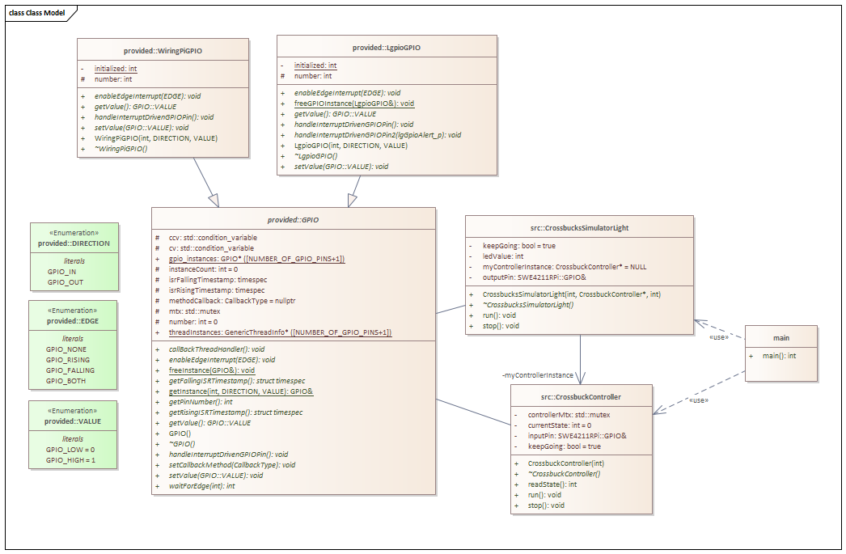

CrossBucks
Signal on button press
See video in samples
Notes:
https://faculty-web.msoe.edu/hasker/swe4211/samples/wk03-crossbucks-video.mov

Slide 17
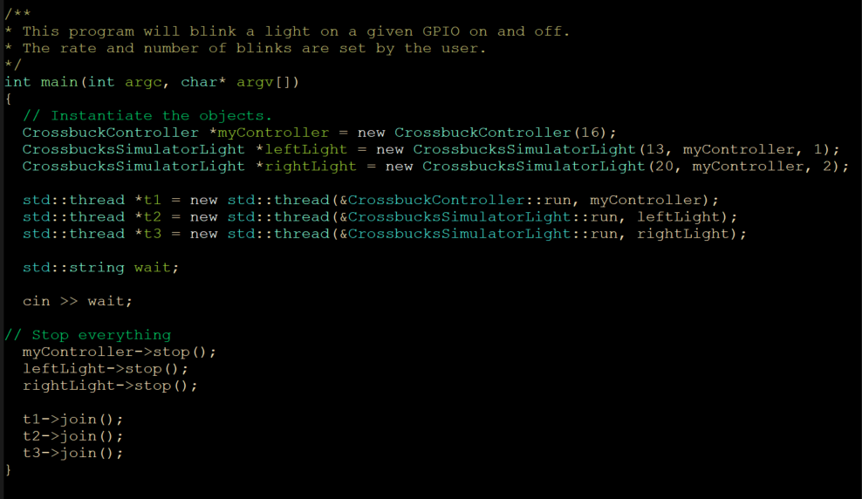

Slide 18
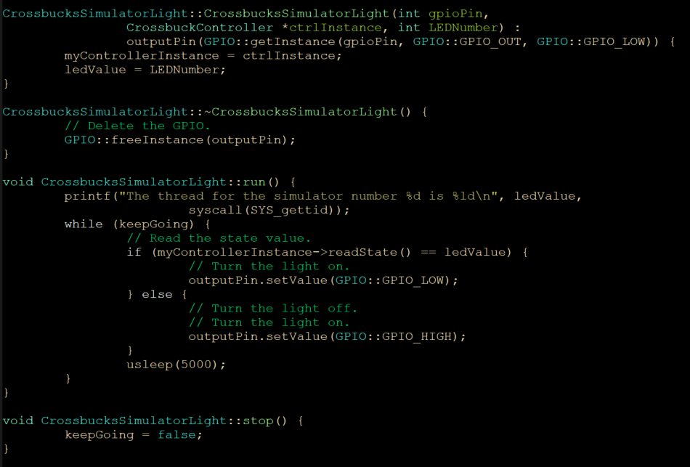

Slide 19
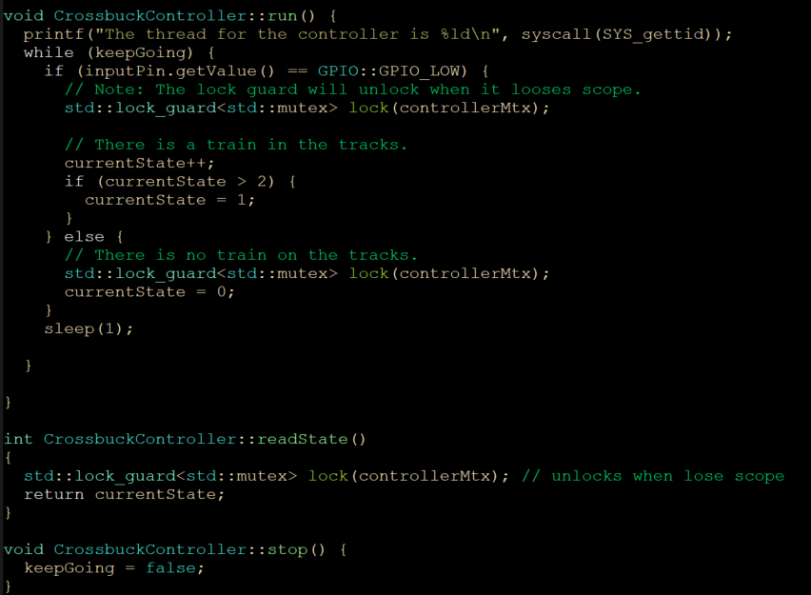

Slide 20
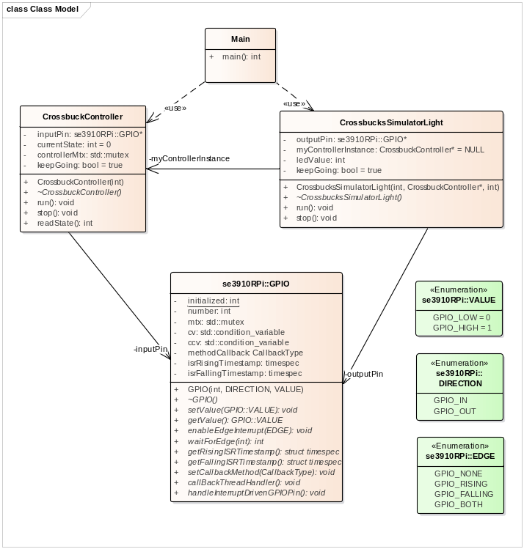

Example on the Raspberry Pi

