Slide 1

Polling, Blocking, Periodic, and Aperiodic Tasks
SWE 4211
*https://www.facebook.com/wesoftwarengineers/photos/a.161429497358109/1284860741681640/?type=3&theater
Notes:
Link to Simpsons image: https://archive.org/details/tvtunes_4780

Slide 2
Objectives
Blocking vs. polling I/O
  Impact to scalability, CPU usage
  Impact on OS
Periodic vs. aperiodic tasks
  Periodic tasks in real-time systems
Polling, event-driven, and aperiodic servers
Critique the design of a periodic, task-based system
Just in case: ensure you are registered for the career fair...
Notes:
(Note: How many of your other classes have used Bart Simpson as an example?)

Slide 3

Consider a long car ride (or long line…)

Slide 4
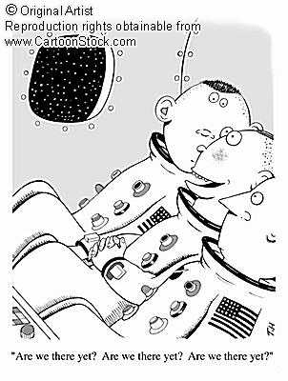
Solution 1: Polling
Routinely checking to see if something has happened

Slide 5

Solution 2: Blocking
No! Shut up and I’ll tell you when we are there!
Stop doing anything until event happens
That is, wait on event

Slide 6
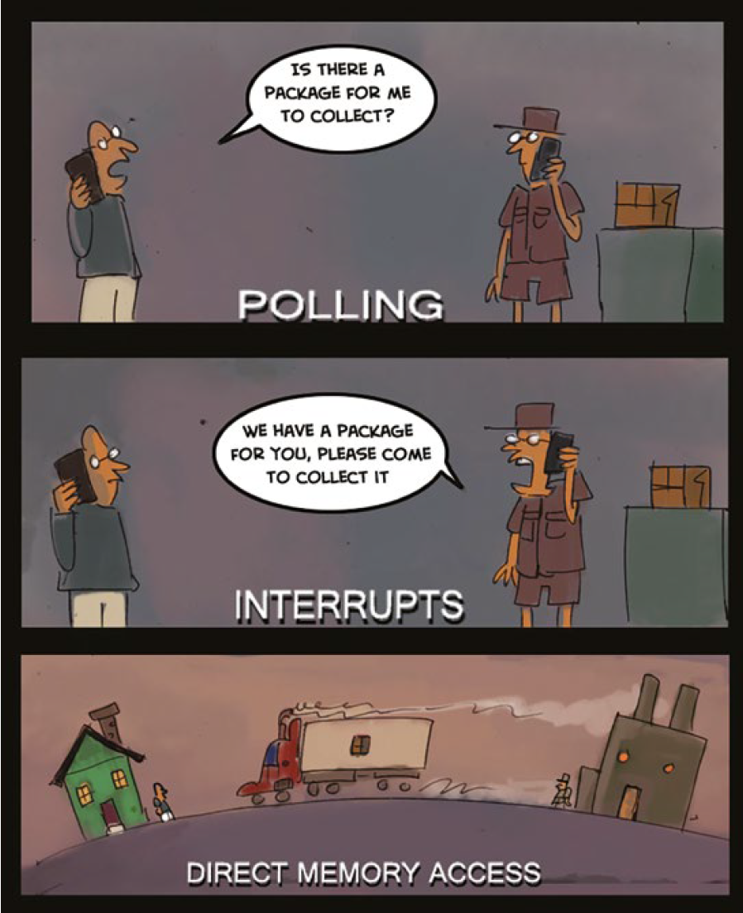
Polling versus interrupts
Polling I/O System
  Status checked periodically (regularly)
  All I/O is software controlled
    Software decides when to read, write
  Hardware: status + data
    Status: is data available?
    Data: information to transmit
  Issue: checking takes cpu cycles!
Blocking I/O System
  Aka interrupt driven
  Hardware calls routine when data ready
    No CPU cycles spent during wait
    Typically reduces latency w/o increasing load
  What if different channels have data at same time?
    That is, multiple interrupts at same time
Notes:
Anobvious advantage of such an approach is its simplicity, but, on the other hand,it loads the CPU due to possibly unnecessary status requests. Typically, only aminority of status requests leads to either input or output transactions withthe data register. This unnecessary loading could be reduced by less frequentpolling of the I/O status. However, that would increase the worst - case I/Olatency. Hence, an appropriate polling interval is an application - specifi c compromisebetween the desired CPU utilization factor and allowed I/O latency.

Slide 7

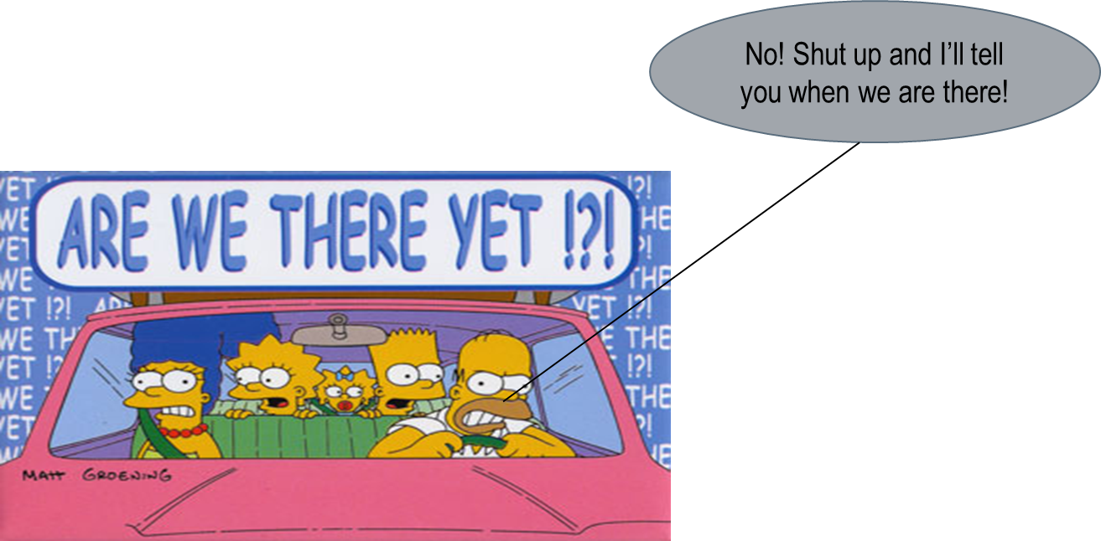
Polling versus interrupts
Polling
  What if new data arrives between checking, capturing data?
  Reading data takes multiple steps
Interrupts
  Changes are rare
  The device can be setup to interrupt easily
  You only need to know when the data changes
  State changes very quickly and may not be stable all the time

Slide 8
Code Handout
The code handout starts with 3 versions of a program.
  Each version allows one to control two lights with two buttons
    OK, yeah, not the most exciting problem…
  With your neighbor, compare the implementations and look at how they differ
    We’ll be answering some questions in a moment.
  We also will be looking at some performance data for the code
    HTOP, cpu usage, etc.
The code is also available at https://faculty-web.msoe.edu/hasker/swe4211/samples/
  Review TwoLightControllerDemoSolution[A,B,C].cpp
Notes:
THE SETUP
Three programs, identical behavior: two buttons, two lights, hold a button and its light comes on. That is the whole spec. Deliberately boring - when the requirements are trivial, the only thing left to compare is the structure.
Everything outside the one main file is identical in all three: same GPIO class, same build, same toolchain. Only TwoLightControllerDemoSolutionA/B/C.cpp changes. Tell them to go straight there and ignore the rest.
THE QUESTION TO ASK WHILE READING
Not "what does it do" - they already know. It is "how does this program wait?" That is the only real difference between the three. A and B wait by asking over and over. C waits by being told.
PLAN
Five minutes with a neighbor. Then fill in the grid on the next slide together. Then run all three on the Pi under htop and let them watch the CPU column.
WATCH FOR
A and B look nearly identical at a glance. Students will say "B is just A with threads" and stop there. That is the trap - the grid is what breaks them out of it.
CODE
samples/wk04a/demo1 - light1 = A, light2 = B, light3 = C. README.md in that folder has the full comparison.

Slide 9
Discussion: Talk with your neighbor about the solutions
I would like to control two lights with two push buttons. Which is better?
Solution | Number of Threads | CPU Utilization / Performance | Ability to control latency of different lights | Scalability (ie adding lights)
A (Polled)
B (Polled)
C (Interrupt)
Notes:
See samples folder for the three
Threads: A = 1, B = 2, C = 2
CPU / performance: A = one core pinned at 100%. B = TWO cores pinned at 100%. C = ~0% while idle.
Per-light latency control: A = none, one loop and one rate, shared. B = per-thread rate AND priority, passed as parameters. C = per-thread priority; latency is interrupt latency, not a poll period.
Scalability: A = edit the loop, and every new light slows the existing ones. B = add a thread per light, but each new thread burns another core. C = add a thread per light, and each one is blocked rather than spinning.
THREADS - the easy column
One, two, two. Get it on the board and move on. Least interesting row.
CPU - where the surprise is
Everybody expects A to be bad. Watch what happens with B: it is WORSE. A pins one core, B pins two. We added threads and doubled the waste, because both threads are still spinning on usleep(1).
That is the headline of the whole exercise: THREADING IS NOT A FIX FOR POLLING. They are orthogonal. You can have a beautifully structured concurrent program that is still burning every cycle you own asking "are we there yet."
And it is worse than the CPU number looks, because both threads run at max SCHED_FIFO priority - the highest-priority thing in the box, busy-waiting. On a single-core Pi that starves real work.
LATENCY CONTROL - where B earns its keep
In A the two lights share one loop and one rate. There is no knob to turn; you cannot give one light a tighter deadline than the other, period.
In B, rate and priority are parameters of the thread function. main happens to pass the same values to both, but it does not have to. That is the hook for rate monotonic analysis in a couple of weeks: the light that needs a faster response gets a shorter period and a higher priority.
So B is not worthless. It buys real structure. It just does not buy efficiency.
SCALABILITY
A scales by editing the loop, and every edit changes the timing of the lights that were already working - the cyclic executive problem from the taxonomy slides. Fragile, breaks when you touch it.
B and C both scale by adding a thread. The difference: B's new thread costs a core, C's costs almost nothing.
SO WHICH IS BETTER?
C - but be precise about why. Not "because threads," because B has the same threads. Because of HOW IT WAITS. waitForEdge is a blocking wait: zero CPU while nothing is happening, immediate response when something does. Reduced latency without increased load - that is the line from the polling-versus-interrupts slide, and this is what it looks like in code.
The deeper point: a button press is an APERIODIC event. It happens whenever someone decides to press it, with no minimum spacing. A and B impose a period on something that does not have one - answering a question nobody asked, 250,000 times a second. C is the only version that models the event as what it actually is.
BACK POCKET - "C is not free" (use if the room converges on C too fast)
Debugging is harder. Nothing in the source tells you when that thread resumes; the dispatch is a 29-case switch over per-pin handlers in GPIO.cpp.
Shutdown is broken, and it LOOKS like B's. Both threads sit in waitForEdge with an 11.5-day timeout, so keepGoing = false does not wake them. You type your character, main calls join(), and it hangs until somebody physically presses each button one more time. Good exercise: fix it - short timeout in a loop, or a separate wake mechanism.
SLEEPLENGTH is dead code in C. Bumped to 250000, still passed in as rate, and the thread body never touches it. Leftover from B. Nice thing for students to spot themselves - evidence that the concept of a rate stopped applying.
Open question from the polling slide: what happens when both buttons are pressed at the same instant? Two interrupts, two threads, same priority. C hands that to the OS. A and B never had to think about it - which is the one thing polling is genuinely good at.
TWO THINGS SOMEBODY WILL ASK
keepGoing is a plain bool shared across threads in both B and C, not std::atomic<bool>. Works in practice, but it is a data race as written.
All three need root on the Pi, or sched_setscheduler fails and the program exits immediately.

Slide 10
Discussion: Talk with your neighbor about the solutions
I would like to control two lights with two push buttons. Which is better?
Solution | Number of Threads | CPU Utilization / Performance | Ability to control latency of different lights | Scalability (ie adding lights)
A (Polled) | 1 | High (100%) | None – both at same rate | Poor: every light added slows others
B (Polled) | 3 | High (100%) | Yes – priority passed as parameters | Moderate: thread count grows with lights, each spinning
C (Interrupt) | 3 | Very low | No – almost no latency | Good: thread counts grow with lights, but each blocked until needed
Notes:
Gen AI says 2 threads for B, C (each)
Threads: A = 1, B = 2, C = 2
CPU / performance: A = one core pinned at 100%. B = TWO cores pinned at 100%. C = ~0% while idle.
Per-light latency control: A = none, one loop and one rate, shared. B = per-thread rate AND priority, passed as parameters. C = per-thread priority; latency is interrupt latency, not a poll period.
Scalability: A = edit the loop, and every new light slows the existing ones. B = add a thread per light, but each new thread burns another core. C = add a thread per light, and each one is blocked rather than spinning.
THREADS - the easy column
One, two, two. Get it on the board and move on. Least interesting row.
CPU - where the surprise is
Everybody expects A to be bad. Watch what happens with B: it is WORSE. A pins one core, B pins two. We added threads and doubled the waste, because both threads are still spinning on usleep(1).
That is the headline of the whole exercise: THREADING IS NOT A FIX FOR POLLING. They are orthogonal. You can have a beautifully structured concurrent program that is still burning every cycle you own asking "are we there yet."
And it is worse than the CPU number looks, because both threads run at max SCHED_FIFO priority - the highest-priority thing in the box, busy-waiting. On a single-core Pi that starves real work.
LATENCY CONTROL - where B earns its keep
In A the two lights share one loop and one rate. There is no knob to turn; you cannot give one light a tighter deadline than the other, period.
In B, rate and priority are parameters of the thread function. main happens to pass the same values to both, but it does not have to. That is the hook for rate monotonic analysis in a couple of weeks: the light that needs a faster response gets a shorter period and a higher priority.
So B is not worthless. It buys real structure. It just does not buy efficiency.
SCALABILITY
A scales by editing the loop, and every edit changes the timing of the lights that were already working - the cyclic executive problem from the taxonomy slides. Fragile, breaks when you touch it.
B and C both scale by adding a thread. The difference: B's new thread costs a core, C's costs almost nothing.
SO WHICH IS BETTER?
C - but be precise about why. Not "because threads," because B has the same threads. Because of HOW IT WAITS. waitForEdge is a blocking wait: zero CPU while nothing is happening, immediate response when something does. Reduced latency without increased load - that is the line from the polling-versus-interrupts slide, and this is what it looks like in code.
The deeper point: a button press is an APERIODIC event. It happens whenever someone decides to press it, with no minimum spacing. A and B impose a period on something that does not have one - answering a question nobody asked, 250,000 times a second. C is the only version that models the event as what it actually is.
BACK POCKET - "C is not free" (use if the room converges on C too fast)
Debugging is harder. Nothing in the source tells you when that thread resumes; the dispatch is a 29-case switch over per-pin handlers in GPIO.cpp.
Shutdown is broken, and it LOOKS like B's. Both threads sit in waitForEdge with an 11.5-day timeout, so keepGoing = false does not wake them. You type your character, main calls join(), and it hangs until somebody physically presses each button one more time. Good exercise: fix it - short timeout in a loop, or a separate wake mechanism.
SLEEPLENGTH is dead code in C. Bumped to 250000, still passed in as rate, and the thread body never touches it. Leftover from B. Nice thing for students to spot themselves - evidence that the concept of a rate stopped applying.
Open question from the polling slide: what happens when both buttons are pressed at the same instant? Two interrupts, two threads, same priority. C hands that to the OS. A and B never had to think about it - which is the one thing polling is genuinely good at.
TWO THINGS SOMEBODY WILL ASK
keepGoing is a plain bool shared across threads in both B and C, not std::atomic<bool>. Works in practice, but it is a data race as written.
All three need root on the Pi, or sched_setscheduler fails and the program exits immediately.

Slide 11
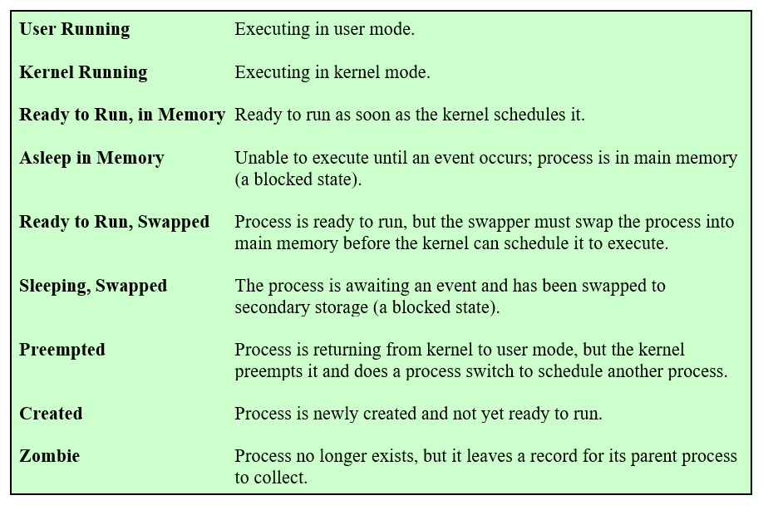
OS States (Review)

Slide 12
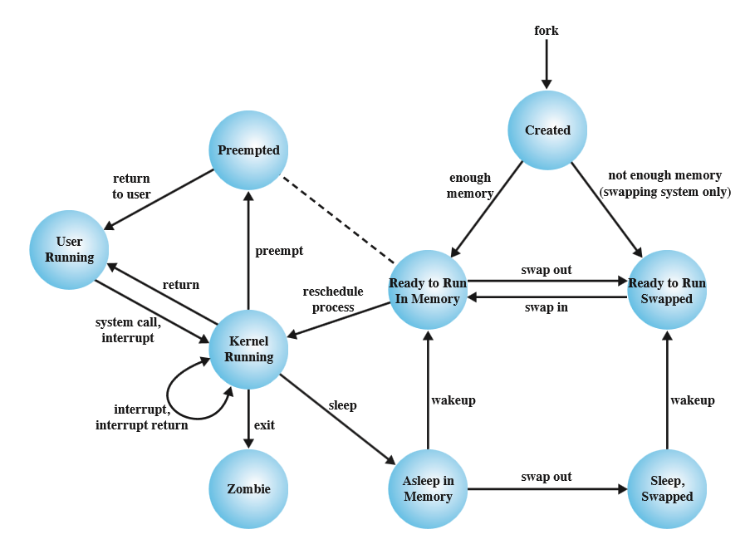
State machine
“Active”
States of process/job from OS perspective
“Loaded, not running”

Slide 13
Taxonomy of Real Time Systems Architectures
Virtually all real-time applications use elements from at least one of five architectural patterns
  Will discuss each in following slides
Cyclic executives – polling in a loop (see next slide)
  also called “timelines” or frame-based systems
Event-driven systems – waits (see below)
  with both periodic and aperiodic activities
Pipelined systems
Client-server systems
State machine systems
Closely related
Pipelined/client-server/
state machine: distributed approaches

Slide 14
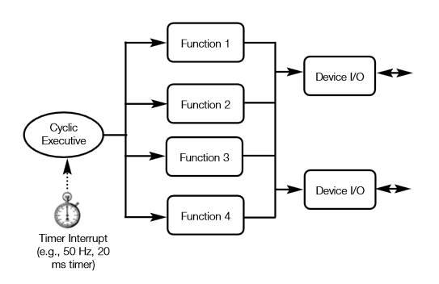
Cyclic Executive
Executive run periodically
  Possibly loops with wait()
  May be run from timer
Each function checks status, responds

Slide 15
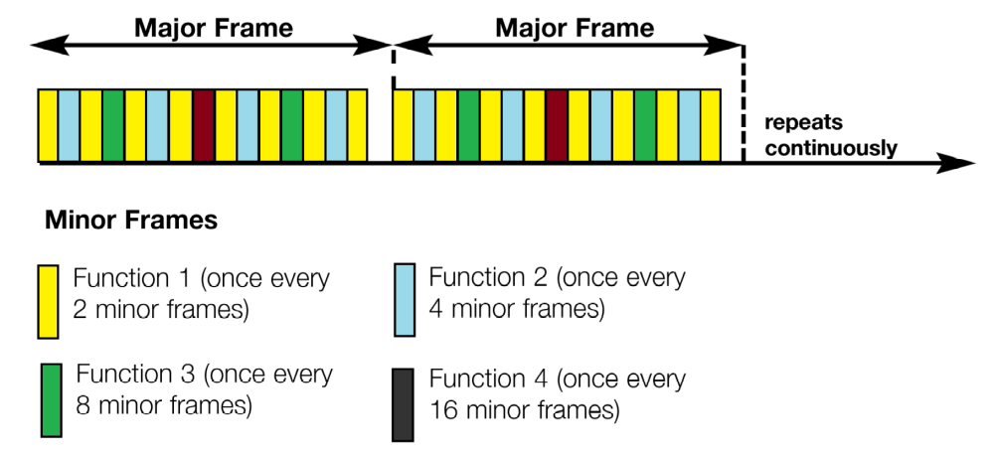
Cyclic Executive Detail
Major frame: a set of tasks
Minor frame: a slice of time within a major frame
  Minor frame may run every time or every n major frames
No usage of concurrency
  Though could run each function in its own thread

Slide 16
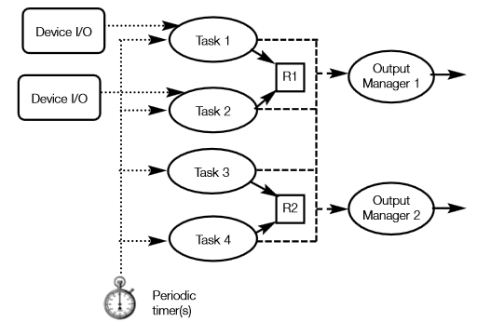
Event-Driven System
Uses real-time I/O completion or timer events to trigger schedulable tasks
Uses priorities to weight different tasks
  Priorities should be determined by time constraints
  Sometimes: prioritize user – slow, so respond as soon as take action
  Priorities need careful review!

Slide 17
Architecture Comparisons
 | Benefits | Drawbacks
Cyclic Executive | Simple/easy to understand Deterministic Repeatable Common approach for very simple systems | Fragile! Adding, changing procedures can break the system Very complex to maintain Only good for very small systems
Event-Driven | Priority driven – well suited to RMA (Rate Monotonic Analysis) Relatively simple Good for systems that are statically analyzable (not dynamically changing load) | Not as well suited to distributed environments as some other systems. Debugging may be more challenging.
Notes:
RMA: an analysis technique for static-priority scheduling

Slide 18
Task Classification
Fixed-instance: executes a fixed number of times, often just once
  Often for initialization, shut down
  Little impact to analysis; generally, only care about steady state
Periodic: run with a fixed cycle
  Matches well with real-time: often require periodic operation of various tasks
  Eg: video streaming, ensuring new image at 24 Hz (24 times per second)
Aperiodic: respond to events at irregular intervals
  Even if two events with same response occur at about the same time!
  Challenging to meet hard real-time constraints
    Must ensure responding to aperiodic tasks does not result missed deadlines for hard real-time tasks
Sporadic: aperiodic tasks requiring a firm (or hard) real-time response
  Sporadic tasks, by their nature, may overload the system.
From: A practical introduction to real-time systems for undergraduate engineering, Harder, Zarnett, et all., V 2018.07.31

Slide 19
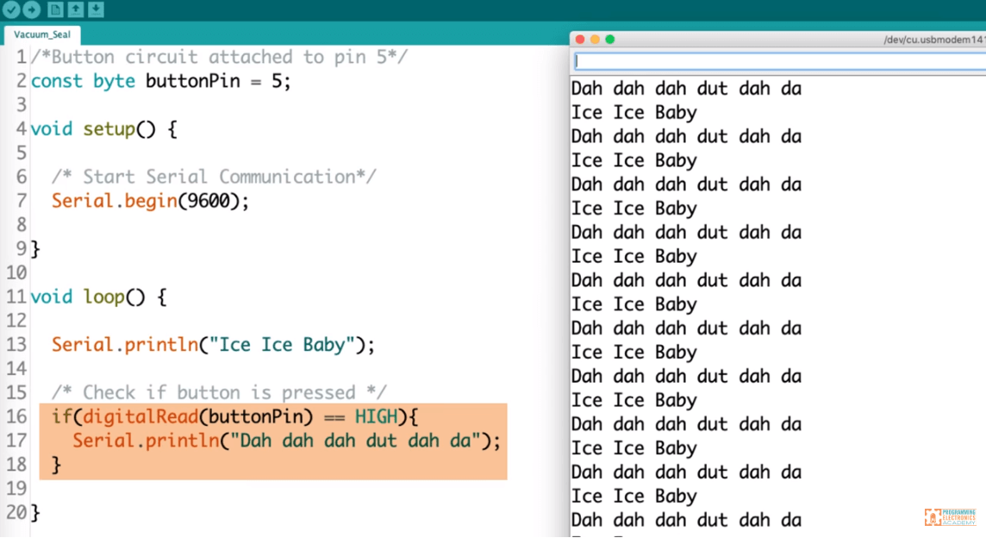
Arduino Example – What to avoid!
Loop has no timer
Frequency depends on processor
  In particular, speed is 1.6e7 divided by cycles per loop
  If empty loop: 16MHz
  If 3.2e7 instruction cycles in loop: 0.5 Hz
Not robust!
from https://www.engineersgarage.com/bluetooth-controlled-home-automation-system/
Notes:
This is the structure of the code from the engineer’s garage; it’s service frequency depends strongly on the machine you use…

Slide 20
Runnable Class vs. Periodic Task Class
Runnable Class
  Mimics a C++ runnable class
  Provides an interface to allow the construction of a “run” method
  Run represents a thread
Periodic Task
  Mimics a task that runs every x ms
  Requires a single taskMethod which returns when task complete
    That is, don’t loop on multiple events
  Automatically invoked every x milliseconds

Slide 21
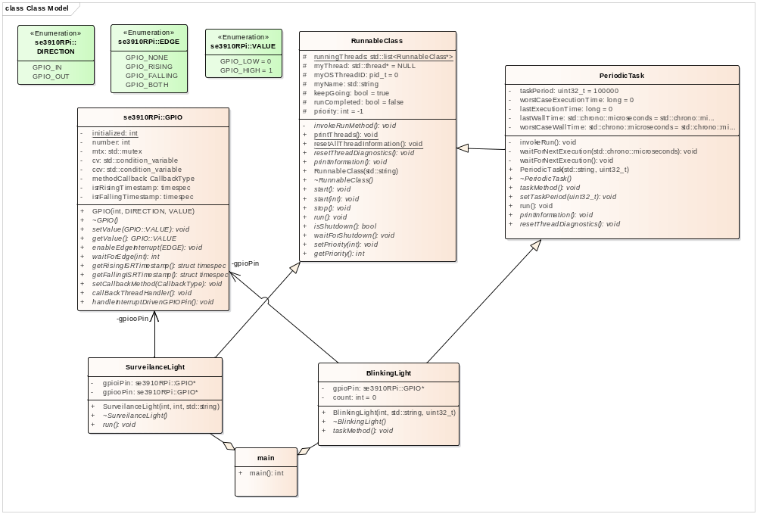
Software Example…

Slide 22
Why does this matter?
Some tasks run routinely
  E.g., a furnace thermostat checking air temperature once/minute
Some tasks run only once
  E.g., computer doing disk check on boot to verify file system validity
Some tasks run rarely
  E.g., motion sensor triggers and turns on an outdoor light
Some tasks are real-time dependent for non-repeatable events
  E.g., trail cam used to record deer running in woods
  Unlike motion sensor, “catching it on the next cycle” does not work

Slide 23
Review
Blocking vs. polling I/O
  Impact to scalability, CPU usage
  Impact on OS
Periodic vs. aperiodic tasks
  Periodic tasks in real-time systems
Polling, event-driven, and aperiodic servers
Classifications for periodic, task-based systems

