Slide 1

Basics of Network Communication
SWE 4211
Notes:
demo: pwmDemo

Slide 2
Objectives
Core issue: how to transfer data over networks
Will use this in Lab 5
Detail:
Representing numeric data: big vs. little endian
UDP vs. TCP Sockets
Pointer types and buffers
chroot
Casting data types
Construct code which uses a TCP client-Server structure

Slide 3
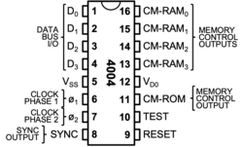
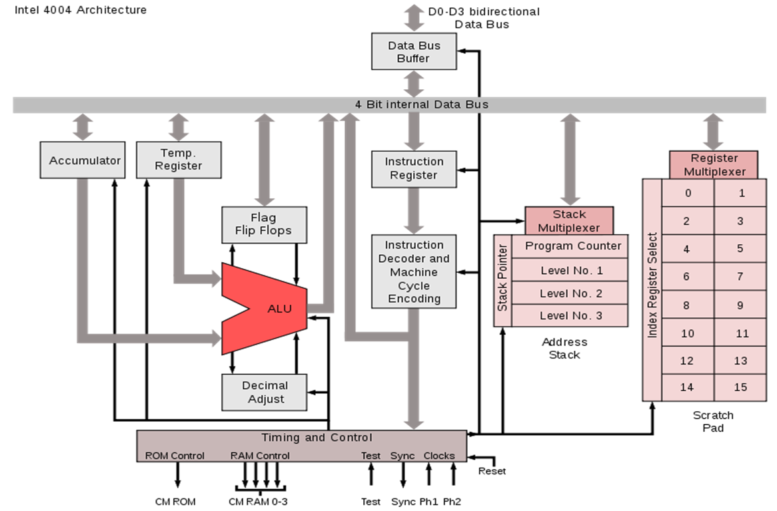
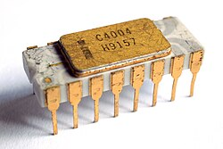
In the beginning
Intel 4004
    First Intel CPU
  1971, $60
    ~$500 today
    Initial goal: develop a calculator
4-bit processor
    17 4-bit registers
  RAM: 640 bytes
Wikipedia article
Notes:
Intel 4004
Highlight that this was a 4 bit processor
Highlight that ram was very limited
Highlight hardware stack

Slide 4
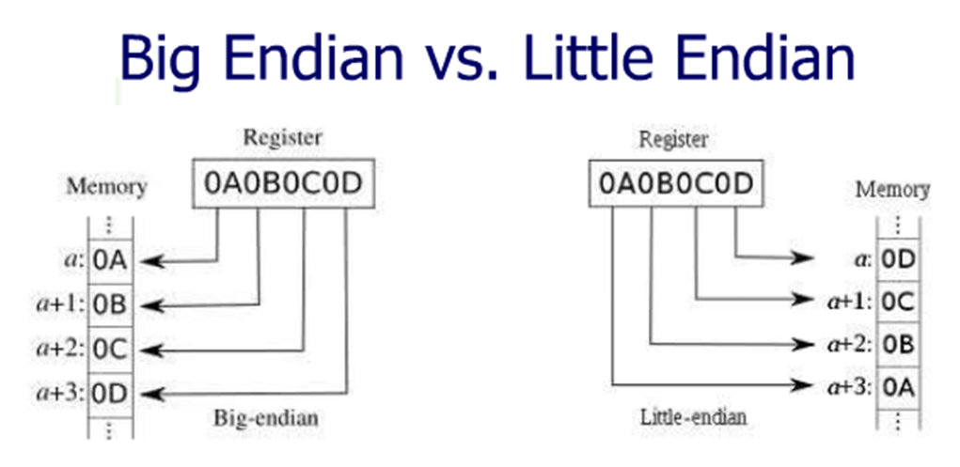
Big Endian vs. Little Endian
Little Endian
  low-order byte at the lowest address/
  high-order byte at the highest
  “the little end comes first” – the source of the name
  32-bit value (eg, int): stored as +0 Byte0, +1 Byte1, +2 Byte2, +3 Byte3
  Used by Intel processors (PCs)
Big Endian
  high-order byte at the lowest address
  the big end comes first
  The same LongInt is stored as +0 Byte3, +1 Byte2, +2 Byte1, +3 Byte0
  Used by Motorola processors (Macs)
Gulliver’s Travels: two groups at war
Group 1 breaks their boiled eggs at the little end
Group 2 breaks them at the big end
address
Notes:
"Little Endian" means that the low-order byte of the number is stored in memory at the lowest address, and the high-order byte at the highest address. (The little end comes first.) For example, a 4 byte LongInt
Byte3 Byte2 Byte1 Byte0 will be arranged in memory as follows: Base Address+0 Byte0 Base Address+1 Byte1 Base Address+2 Byte2 Base Address+3 Byte3 Intel processors (those used in PC's) use "Little Endian" byte order."Big Endian" means that the high-order byte of the number is stored in memory at the lowest address, and the low-order byte at the highest address. (The big end comes first.) Our LongInt, would then be stored as:
Base Address+0 Byte3 Base Address+1 Byte2 Base Address+2 Byte1 Base Address+3 Byte0 Motorola processors (those used in Mac's) use "Big Endian" byte order.
You may see a lot of discussion about the relative merits of the two formats, mostly religious arguments based on the relative merits of the PC versus the Mac. Both formats have their advantages and disadvantages.
In "Little Endian" form, assembly language instructions for picking up a 1, 2, 4, or longer byte number proceed in exactly the same way for all formats: first pick up the lowest order byte at offset 0. Also, because of the 1:1 relationship between address offset and byte number (offset 0 is byte 0), multiple precision math routines are correspondingly easy to write.
In "Big Endian" form, by having the high-order byte come first, you can always test whether the number is positive or negative by looking at the byte at offset zero. You don't have to know how long the number is, nor do you have to skip over any bytes to find the byte containing the sign information. The numbers are also stored in the order in which they are printed out, so binary to decimal routines are particularly efficient.

Slide 5
Big Endian vs. Little Endian
Little Endian:
  Loading data from memory into register works the same for all register sizes (1-byte, 2-byte, 4-byte, etc.)
    Always load lowest-order byte first
  Offset = byte number, making multple-precision math simpler to implement
Big Endian
  Sign always at offset 0, regardless of length
  Efficient for binary-to-decimal routines since bytes stored in printed order
Note order of bits in byte same for all
Traditionally: Mac vs Windows
Macs originally big-endian
Apple silicon: little-endian...
Yawn...
address
Notes:
"Little Endian" means that the low-order byte of the number is stored in memory at the lowest address, and the high-order byte at the highest address. (The little end comes first.) For example, a 4 byte LongInt
Byte3 Byte2 Byte1 Byte0 will be arranged in memory as follows: Base Address+0 Byte0 Base Address+1 Byte1 Base Address+2 Byte2 Base Address+3 Byte3 Intel processors (those used in PC's) use "Little Endian" byte order."Big Endian" means that the high-order byte of the number is stored in memory at the lowest address, and the low-order byte at the highest address. (The big end comes first.) Our LongInt, would then be stored as:
Base Address+0 Byte3 Base Address+1 Byte2 Base Address+2 Byte1 Base Address+3 Byte0 Motorola processors (those used in Mac's) use "Big Endian" byte order.
You may see a lot of discussion about the relative merits of the two formats, mostly religious arguments based on the relative merits of the PC versus the Mac. Both formats have their advantages and disadvantages.
In "Little Endian" form, assembly language instructions for picking up a 1, 2, 4, or longer byte number proceed in exactly the same way for all formats: first pick up the lowest order byte at offset 0. Also, because of the 1:1 relationship between address offset and byte number (offset 0 is byte 0), multiple precision math routines are correspondingly easy to write.
In "Big Endian" form, by having the high-order byte come first, you can always test whether the number is positive or negative by looking at the byte at offset zero. You don't have to know how long the number is, nor do you have to skip over any bytes to find the byte containing the sign information. The numbers are also stored in the order in which they are printed out, so binary to decimal routines are particularly efficient.

Slide 6
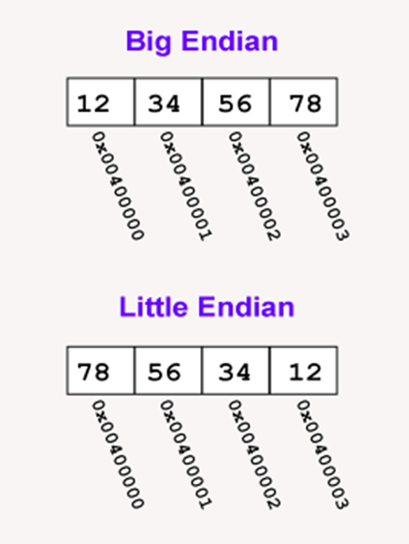
A load word or store word instruction uses only one memory address
  The lowest address of the four bytes is used for the address of a block of four contiguous bytes
Two orderings are commonly used to hold a 32-bit pattern in four bytes:
  Big Endian: the most significant byte (the "big end") is placed at the byte with the lowest address; the rest follows in order
  Little Endian: the least significant byte (the "little end") is placed at the byte with the lowest address; the rest follows in order
"Most significant" is the byte for the largest powers of two (2^31 ... 2^24); "least significant" is the byte for the smallest (2^7 ... 2^0)
Example: the pattern 0x12345678 stored at address 0x00400000 has most significant byte 0x12 and least significant byte 0x78
Within a byte the order of the bits is the same for all computers, however the bytes themselves are arranged
Source: https://chortle.ccsu.edu/AssemblyTutorial/Chapter-15/ass15_3.html

Slide 7
Endianess
Big-endian
  Most common format in data networking
  Internet protocol suite, such as IPv4, IPv6, TCP, and UDP
  Also referred to as network byte order
Little-endian
  Popular for microprocessors, especially Intel
Mixed forms Exist
  VAX floating point: byte order was different between 16-bit and 32-bit values
Bi-endian
  Processors that operate in either little-endian or big-endian mode
https://en.wikipedia.org/wiki/Endianness

Slide 8
Endianess of common architectures
Processor | Endianness
Motorola 68000 | Big Endian
PowerPC (PPC) | Big Endian
Sun Sparc | Big Endian
IBM S/390 | Big Endian
Intel x86 (32 bit) | Little Endian
Intel x86_64 (64 bit) | Little Endian
Dec VAX | Little Endian
Alpha | Bi (Big/Little) Endian
ARM | Bi (Big/Little) Endian
IA-64 (64 bit) | Bi (Big/Little) Endian
MIPS | Bi (Big/Little) Endian
Java | Big Endian
Android | BI (Big/Little) Endian, depending on compiler options
Ethernet | Big Endian
Don’t memorize this list!
Key: common difference
Worth knowing:
  Intel: little
  ARM: bi
  Java: big
Raspberry Pi
Even on Intel machines
http://www.yolinux.com/TUTORIALS/Endian-Byte-Order.html
Notes:
I don’t expect you to memorize this list, just know there are ma

Slide 9
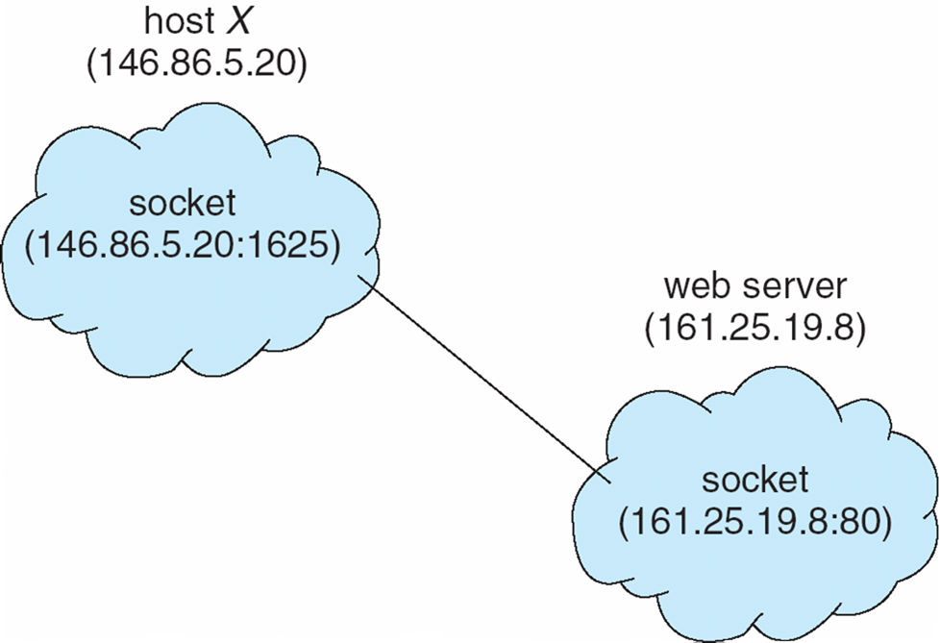
Sockets
Big vs little endianness: key transport issue
  Character data: in order, low to high
  We’ll stick to ASCII; Unicode much more complex
But how do we form the connection?
  Most common answer: sockets
Socket: an endpoint for communication
  Specifier: IP address + port
  Eg: Socket 161.25.19.8:1625
    Port 1625
    Host 161.25.19.8
Communication: between a pair of sockets

Slide 10
TCP Versus UDP: breaking up data
UDP
  User Datagram Protocol
  Simple protocol
  No connection
  Message not guaranteed to arrive
    No repeating, no ACK
  Packets not guaranteed to be in order
  Has a max length
TCP
  Transmission Control Protocol
  Complex protocol
  Connection-oriented protocol
  Automatically retransmits data if not received
  Order of packets retained - FIFO
  No bound on length
Faster, if don’t mind dropped packets
Guaranteed communication
Notes:
Note: if you do need guaranteed delivery, you’re going to do the work of TCP anyways.

Slide 11
Creating a new socket
The socket() system call: creates a new socket
  That is, set up communications
  See https://linux.die.net/man/2/socket
3 arguments:
  Address domain of the socket
    AF_UNIX or AF_INET
  Type of socket
    SOCK_STREAM (TCP) or SOCK_DGRAM (UDP)
  Protocol
    Usually zero
Notes:
The socket() system call creates a new socket. It takes three arguments. The first is the address domain of the socket.Recall that there are two possible address domains, the unix domain for two processes which share a common file system, and the Internet domain for any two hosts on the Internet. The symbol constant AF_UNIX is used for the former, and AF_INETfor the latter (there are actually many other options which can be used here for specialized purposes).
The second argument is the type of socket. Recall that there are two choices here, a stream socket in which characters are read in a continuous stream as if from a file or pipe, and a datagram socket, in which messages are read in chunks. The two symbolic constants are SOCK_STREAM and SOCK_DGRAM.
The third argument is the protocol. If this argument is zero (and it always should be except for unusual circumstances), the operating system will choose the most appropriate protocol. It will choose TCP for stream sockets and UDP for datagram sockets.

Slide 12
Binding to a socket
bind(): system call – binds a socket to an address
  https://linux.die.net/man/2/bind
Takes 3 arguments:
  socket file descriptor
  address to which is bound
  size of the address to which it is bound
See code on the man page
Typically a server-side operation

Slide 13
Listening for data
listen() - https://linux.die.net/man/2/listen
  Waits for a socket connection
    Allows the process to listen for connections to a given socket
  Two arguments:
    Socket file descriptor
    Number of queues that can be waiting
  Server-side
accept() - https://linux.die.net/man/2/accept
  Blocks until a client connects to a server
  That is, blocks until there is a connection
Notes:
Note this is a blocking call

Slide 14
Reading and writing data
send, sendto, sendmsg: send a message on a socket
  ssize_t sendto(int sockfd, const void *buf, size_t len,
  int flags, const struct sockaddr *dest_addr, socklen_t addrlen);
All three transmit a message to another socket
send(): works only when the socket is connected
  i.e., the intended recipient is already known
send() vs. write(): the only difference is flags
  When flags == 0, send() is equivalent to write() on a given socket descriptor
send(sockfd, buf, len, flags): equivalent to
  sendto(sockfd, buf, len, flags, NULL, 0);
Source: send(2) man page, https://linux.die.net/man/2/send

Slide 15
Reading and writing data
recv, recvfrom, recvmsg: receive a message from a socket
  ssize_t recv(int sockfd, void *buf, size_t len, int flags);
  ssize_t recvfrom(int sockfd, void *buf, size_t len, int flags,
  struct sockaddr *src_addr, socklen_t *addrlen);
  ssize_t recvmsg(int sockfd, struct msghdr *msg, int flags);
recvfrom() and recvmsg() work whether or not the socket is connection-oriented
src_addr (if not NULL) is filled in with the source address, when the protocol provides one
  If src_addr is NULL, nothing is filled in; addrlen is unused and should also be NULL
addrlen is a value-result argument
  Before the call: set it to the size of the src_addr buffer
  On return: the actual size of the source address
  Buffer too small: the address is truncated and addrlen returns a larger value than was supplied
recv() is normally used only on a connected socket (see connect(2))
  Identical to recvfrom() with a NULL src_addr
Source: recv(2) man page, https://linux.die.net/man/2/recv

Slide 16
chroot
This alters the apparent root directory for a process (that is, /) to refer to a particular directory
  Applies to all children processes as well
  Known as the “chroot jail”
  No application in this process tree can write outside /
  Provides hardware-level checked security!
  Must have super user permissions to run chroot (e.g., sudo)
Use for us: compile code for the Raspberry PI on the local machine!
  Power of a Linux workstation
  Emulating the arm architecture
Allows us full flexibility of all libraries that are available on the vm
  Can install packages, uninstall, etc.
Can easily transfer build products to the final machine

Slide 17
Determining Endianess
echo -n 1 | od -to2 | head -n1 | cut -f2 -d" " | cut -c6
  If it return 0, machine is using Big Endian representation for ints
  If it returns 1, machine is using Little Endian for ints
Another method:
  lscpu | grep Endian
*https://mfcoding.wordpress.com/2012/12/11/linux-big-endian-little-endian-test-from-command-line/

Slide 18
Lets look at an example
We’ll look at a program which has two pieces
  Server
    Received a structure from the client and prints it out
  Client
    Sends a structure to the server.
    Waits 1 second and repeats.

Slide 19
What is wrong?

Slide 20
Conversion Routines
host to network short
  htons()
host to network long
  htonl()
network to host short
  ntohs()
network to host long
  ntohl()

Slide 21
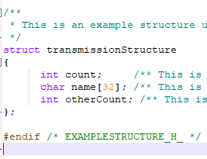
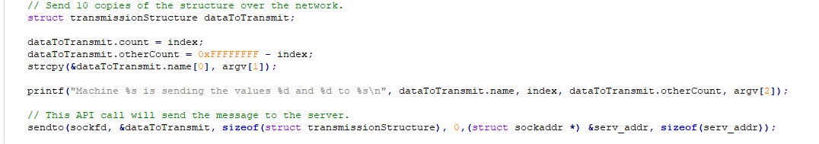
Issues to address - Send
On send
  Each element of a structure must be converted to correct endianness
  Problem:
    If structure is passed by reference, can we just make the changes?

Slide 22
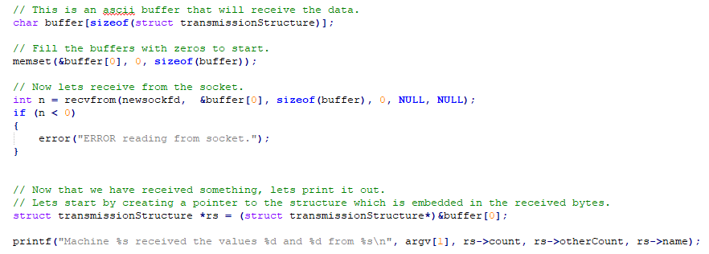
Issues to address - Receive
On send
  Each element of a structure must be converted to correct endianness
  Problem:
    If destination is passed by reference, can we just make the changes?

Slide 23
Lets look at the solution

