Slide 1
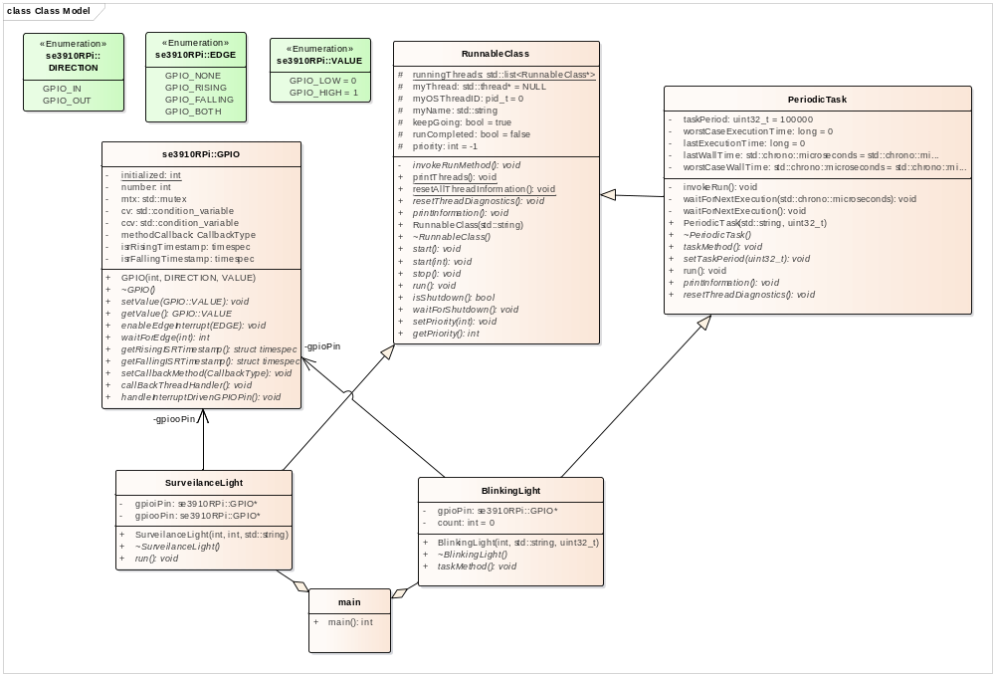
Software Example…

Slide 2
Why does this matter?
Some tasks run routinely
  I.e. Once per minute, your thermostat may measure the temperature of the air in your house
Some tasks run only once
  The computer running a disk check on boot to verify the validity of the file system
Some tasks happen rarely
  A motion sensor triggers to turn on an outdoor light
Some tasks are real time dependent but not repeatable
  An outdoor camera begins recording video when a deer is detected

Slide 3

Polling, Blocking, Periodic and Aperiodic
SWE 4211

Slide 4
Objectives
Explain the difference between big and little endian.
Explain the difference between UDP and TCP Sockets.
Explain the relationship between pointer types and buffers.
Explain the concept of a chroot.
Perform casting to convert data types from one type to another.
Construct code which uses a TCP client-Server structure

Slide 5
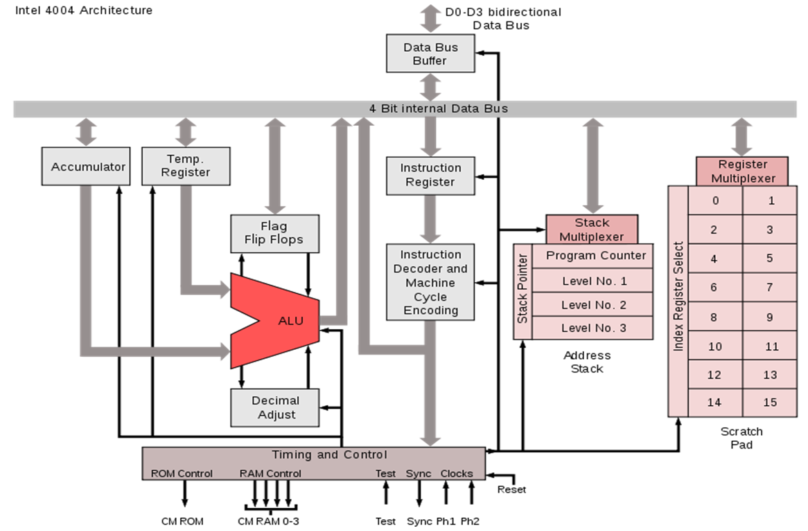
In the beginning
Notes:
Intel 4004
Highlight that this was a 4 bit processor
Highlight that ram was very limited
Highlight hardware stack

Slide 6
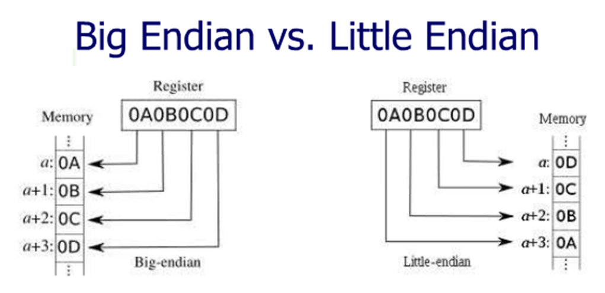
Big Endian Versus Little Endian
"Little Endian": the low-order byte is stored at the lowest address, the high-order byte at the highest (the little end comes first)
  A 4-byte LongInt Byte3 Byte2 Byte1 Byte0 is stored as: +0 Byte0, +1 Byte1, +2 Byte2, +3 Byte3
  Intel processors (those used in PCs) use "Little Endian" byte order
"Big Endian": the high-order byte is stored at the lowest address, the low-order byte at the highest (the big end comes first)
  The same LongInt is stored as: +0 Byte3, +1 Byte2, +2 Byte1, +3 Byte0
  Motorola processors (those used in Macs) use "Big Endian" byte order
You may see a lot of discussion about the relative merits of the two formats — both have advantages and disadvantages
  Little Endian: instructions for picking up a 1, 2, 4, or longer byte number all proceed the same way — first pick up the lowest-order byte at offset 0
  Little Endian: the 1:1 relationship between address offset and byte number makes multiple-precision math routines easy to write
  Big Endian: you can always test whether the number is positive or negative by looking at the byte at offset zero, without knowing how long the number is
  Big Endian: numbers are stored in the order in which they are printed, so binary-to-decimal routines are particularly efficient
Notes:
"Little Endian" means that the low-order byte of the number is stored in memory at the lowest address, and the high-order byte at the highest address. (The little end comes first.) For example, a 4 byte LongInt
Byte3 Byte2 Byte1 Byte0 will be arranged in memory as follows: Base Address+0 Byte0 Base Address+1 Byte1 Base Address+2 Byte2 Base Address+3 Byte3 Intel processors (those used in PC's) use "Little Endian" byte order."Big Endian" means that the high-order byte of the number is stored in memory at the lowest address, and the low-order byte at the highest address. (The big end comes first.) Our LongInt, would then be stored as:
Base Address+0 Byte3 Base Address+1 Byte2 Base Address+2 Byte1 Base Address+3 Byte0 Motorola processors (those used in Mac's) use "Big Endian" byte order.
You may see a lot of discussion about the relative merits of the two formats, mostly religious arguments based on the relative merits of the PC versus the Mac. Both formats have their advantages and disadvantages.
In "Little Endian" form, assembly language instructions for picking up a 1, 2, 4, or longer byte number proceed in exactly the same way for all formats: first pick up the lowest order byte at offset 0. Also, because of the 1:1 relationship between address offset and byte number (offset 0 is byte 0), multiple precision math routines are correspondingly easy to write.
In "Big Endian" form, by having the high-order byte come first, you can always test whether the number is positive or negative by looking at the byte at offset zero. You don't have to know how long the number is, nor do you have to skip over any bytes to find the byte containing the sign information. The numbers are also stored in the order in which they are printed out, so binary to decimal routines are particularly efficient.

Slide 7
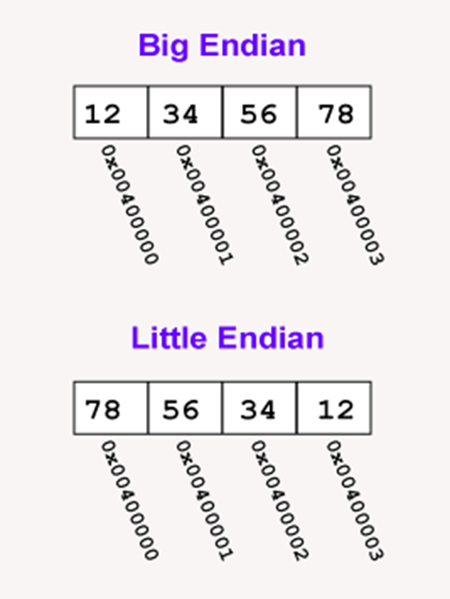
A load word or store word instruction uses only one memory address
  The lowest address of the four bytes is used for the address of a block of four contiguous bytes
Two orderings are commonly used to hold a 32-bit pattern in four bytes:
  Big Endian: the most significant byte (the "big end") is placed at the byte with the lowest address; the rest follows in order
  Little Endian: the least significant byte (the "little end") is placed at the byte with the lowest address; the rest follows in order
"Most significant" is the byte for the largest powers of two (2^31 ... 2^24); "least significant" is the byte for the smallest (2^7 ... 2^0)
Example: the pattern 0x12345678 stored at address 0x00400000 has most significant byte 0x12 and least significant byte 0x78
Within a byte the order of the bits is the same for all computers, however the bytes themselves are arranged
Source: https://chortle.ccsu.edu/AssemblyTutorial/Chapter-15/ass15_3.html

Slide 8
Endianess
Big-endian
  Most common format in data networking
  Internet protocol suite, such as IPv4, IPv6, TCP, and UDP
  Also referred to as network byte order.
Little-endian
  Popular for microprocessors,
  Significant influence on microprocessor designs by Intel Corporation.
Mixed forms Exist
  VAX floating point, the ordering of bytes in a 16-bit word differs from the ordering of 16-bit words within a 32-bit word
Bi-endian
  Processors that operate in either little-endian or big-endian mode.
https://en.wikipedia.org/wiki/Endianness

Slide 9
Endianess of common architectures
http://www.yolinux.com/TUTORIALS/Endian-Byte-Order.html

Slide 10
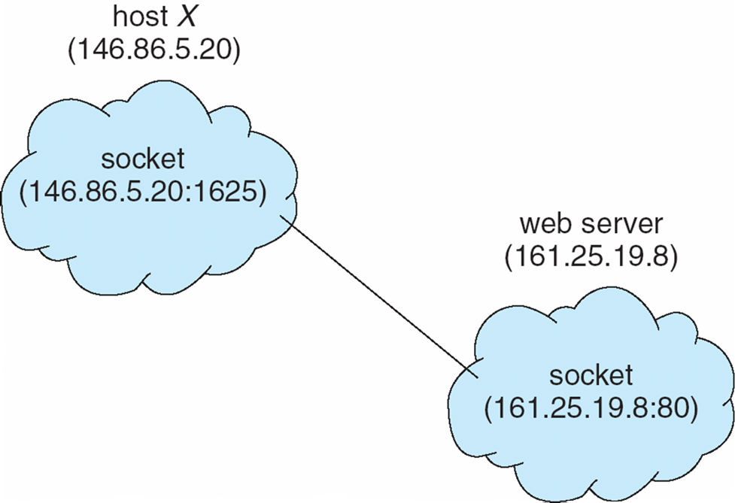
Sockets
A socket is defined as an endpoint for communication
Concatenation of IP address and port
  Socket 161.25.19.8:1625
  Port 1625
  Host 161.25.19.8
Communication consists between a pair of sockets

Slide 11
TCP Versus UDP
UDP
  User Datagram Protocol
  Simple protocol
  No connection
  No guarantee message will reach destination
  No guarantee that the order of messages will be retained
  Has a max length
TCP
  Transmission Control Protocol
  Complex protocol
  Connection Oriented Protocol
  Automatically retransmits data if not received
  Order of messages is retained
  No boundaries in length

Slide 12
Creating a new socket
The socket() system call creates a new socket.
  3 arguments
    Address domain of the socket.
      AF_UNIX or AF_INET
    Type of socket.
      SOCK_STREAM or SOCK_DGRAM.
    Protocol.
      Usually 0
Notes:
The socket() system call creates a new socket. It takes three arguments. The first is the address domain of the socket.Recall that there are two possible address domains, the unix domain for two processes which share a common file system, and the Internet domain for any two hosts on the Internet. The symbol constant AF_UNIX is used for the former, and AF_INETfor the latter (there are actually many other options which can be used here for specialized purposes).
The second argument is the type of socket. Recall that there are two choices here, a stream socket in which characters are read in a continuous stream as if from a file or pipe, and a datagram socket, in which messages are read in chunks. The two symbolic constants are SOCK_STREAM and SOCK_DGRAM.
The third argument is the protocol. If this argument is zero (and it always should be except for unusual circumstances), the operating system will choose the most appropriate protocol. It will choose TCP for stream sockets and UDP for datagram sockets.

Slide 13
Binding to a socket
bind() system call binds a socket to an address
Takes three arguments
  socket file descriptor
  address to which is bound
  size of the address to which it is bound.
Used on servers

Slide 14
Listening for data
Listen()
  Allows the process to listen for connections to a given socket
  Two arguments
    Socket file descriptor
    Number of queues that can be waiting
  Used on servers
Accept()
  Blocks until a client connects to a server
Notes:
Note this is a blocking call

Slide 15
Reading and writing data
send, sendto, sendmsg
  send a message on a socket
  ssize_t sendto(int sockfd, const void *buf, size_t len, int flags,
  const struct sockaddr *dest_addr, socklen_t addrlen);
The system calls send(), sendto(), and sendmsg() are used to transmit a message to another socket.
The send() call may be used only when the socket is in a connected state (so that the intended recipient is known). The only difference between send() and write(2) is the presence of flags. With a zero flags argument, send() is equivalent to write(2). Also, the following call
  send(sockfd, buf, len, flags);
    is equivalent to sendto(sockfd, buf, len, flags, NULL, 0);

Slide 16
Reading and writing data
  recv, recvfrom, recvmsg - receive a message from a socket
  ssize_t recv(int sockfd, void *buf, size_t len, int flags);
  ssize_t recvfrom(int sockfd, void *buf, size_t len, int flags,
  struct sockaddr *src_addr, socklen_t *addrlen);
  ssize_t recvmsg(int sockfd, struct msghdr *msg, int flags); The recvfrom() and recvmsg() calls are used to receive messages from a socket, and may be used to receive data on a socket whether or not it is connection-oriented.
  If src_addr is not NULL, and the underlying protocol provides the source address, this source address is filled in. When src_addr is NULL, nothing is filled in; in this case, addrlen is not used, and should also be NULL. The argument addrlen is a value-result argument, which the caller should initialize before the call to the size of the buffer associated with src_addr, and modified on return to indicate the actual size of the source address. The returned address is truncated if the buffer provided is too small; in this case, addrlen will return a value greater than was supplied to the call.
  The recv() call is normally used only on a connected socket (see connect(2)) and is identical to recvfrom() with a NULL src_addr argument.

Slide 17
What is Chroot
Chroot is a command that was introduced into Unix in 1979
Changes the apparent root file system for the calling process and its children
Used for development and testing when the target O/S release is different from the development host
Once running in Chroot, applications can’t typically get to files outside of the chroot
Only root user can execute the chroot command

Slide 18
What can we do with Chroot
Compile code for the Raspberry PI on the local machine!
  Power of a Linux workstation
  Emulating the arm architecture
Allows us full flexibility of all libraries that are available on the vm
  Can install packages, uninstall, etc.
Can easily transfer output to the final machine.

Slide 19
Determining Endianess
echo -n 1 | od -to2 | head -n1 | cut -f2 -d" " | cut -c6
  If it return 0, it’s Big Endian
  If it returns 1, it’s Little Endian
lscpu | grep Endian
*https://mfcoding.wordpress.com/2012/12/11/linux-big-endian-little-endian-test-from-command-line/

Slide 20
Lets look at an example
We’ll look at a program which has two pieces
  Server
    Received a structure from the client and prints it out
  Client
    Sends a structure to the server.
    Waits 1 second and repeats.

Slide 21
What is wrong?

Slide 22
Conversion Routines
host to network short
  htons()
host to network long
  htonl()
network to host short
  ntohs()
network to host long
  ntohl()

Slide 23
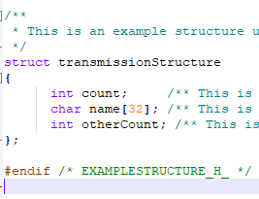
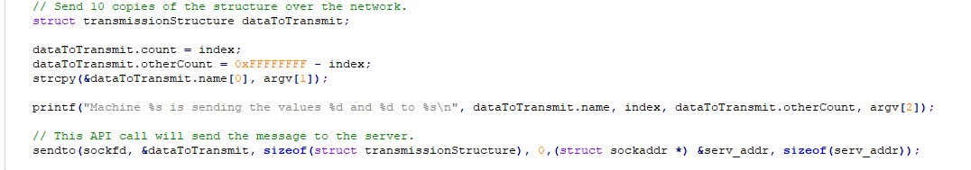
Issues to address - Send
On send
  Each element of a structure must be converted to correct endianness
  Problem:
    If structure is passed by reference, can we just make the changes?

Slide 24
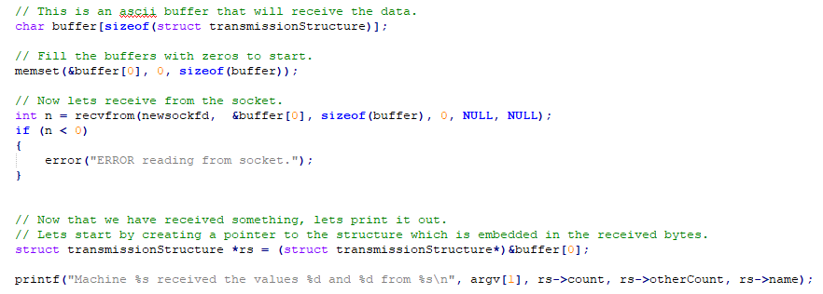
Issues to address - Receive
On send
  Each element of a structure must be converted to correct endianness
  Problem:
    If destination is passed by reference, can we just make the changes?

Slide 25
Lets look at the solution

