Slide 1
Pulse-Width Modulation
SWE4211

Slide 2
Outcomes
Explain the concept of PWM.
Explain how PWM can be used to control a motor.
From a waveform, calculate the duty-cycle for a PWM signal.
Measure the PWM duty cycle with an oscilloscope.
Compare and Contrast software and hardware driven PWM.

Slide 3

Today’s thought of the day…

Slide 4
Lab Study
What did we see in our lab 3 assignments?

Slide 5
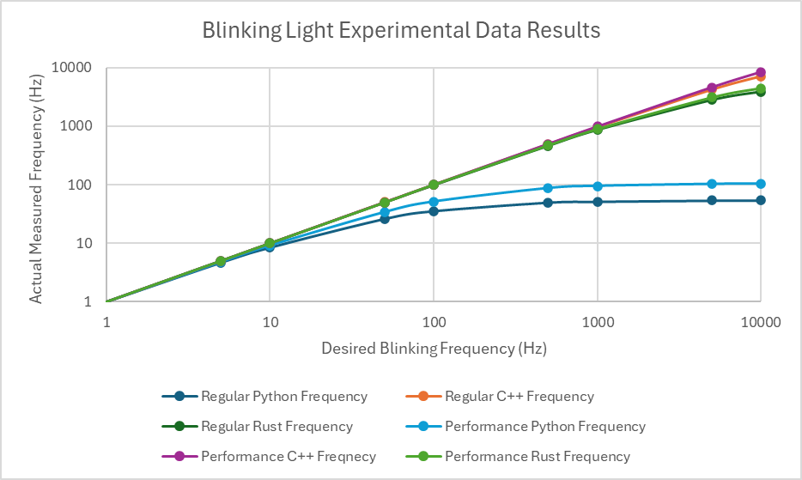
Blinking Light

Slide 6
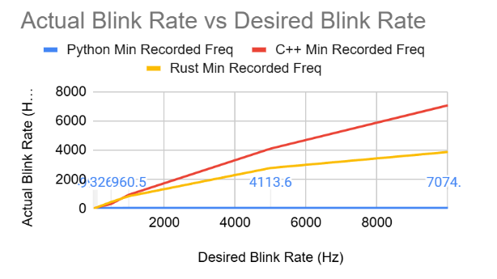
What is wrong with this graph?
What number goes with what line?
Do we need to see these numbers to the nearest tenth?
Can users see the difference between 2000 Hz and 8000 Hz?
  Critical data is 0-60 Hz, maybe up to 200 Hz
  Use log scale!
How can the Python minimum be zero?

Slide 7
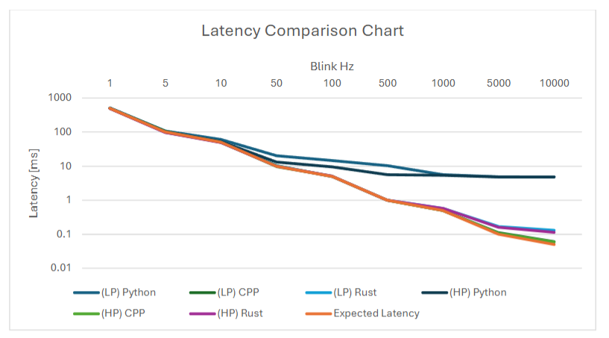
What is wrong with this graph?
Graph should show period, not frequency
Graph goes down rather than up

Slide 8
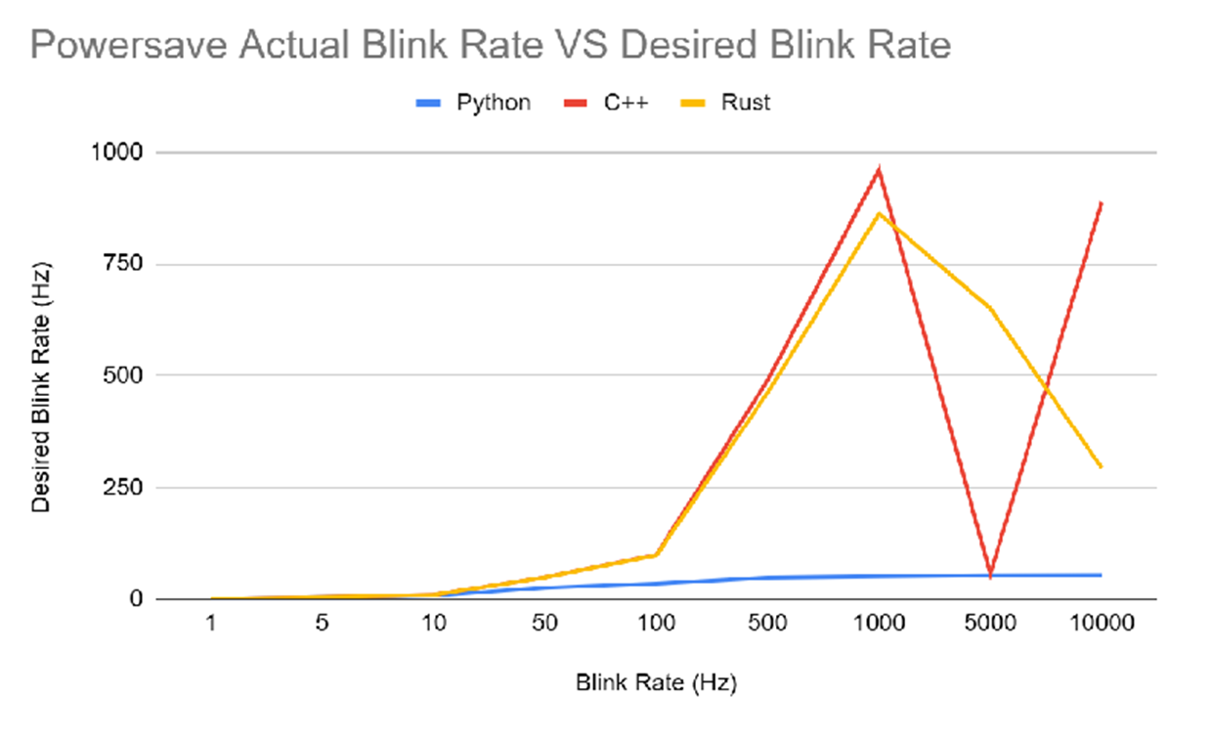
What is wrong with this graph?
What type of blink rate on the bottom?
What is going on at 1000 Hz?
  These sorts of jumps are unlikely to be physical – suggest incorrect data collection or analysis

Slide 9
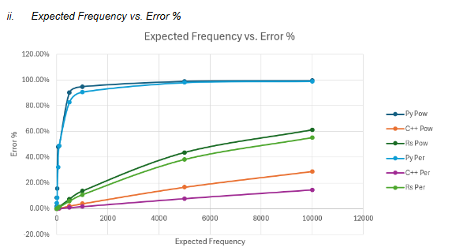
What is wrong with this graph?

Slide 10
Error Plots

Slide 11
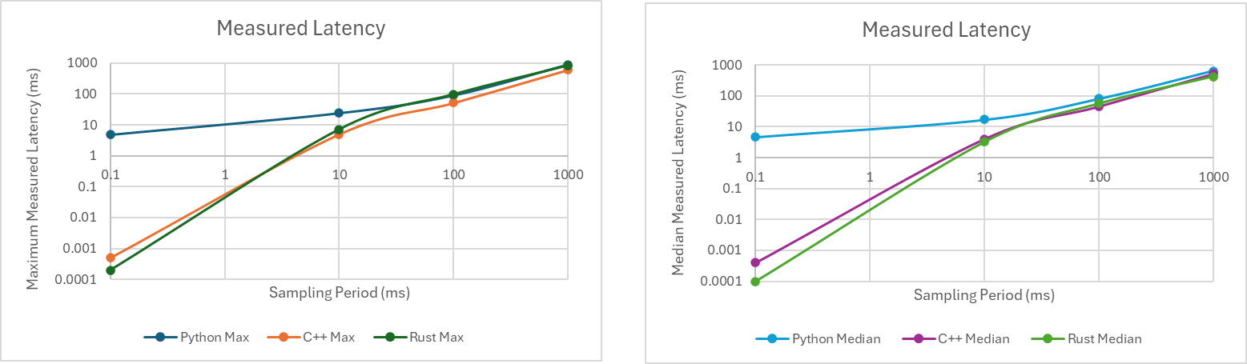
Latency Plots
Delay (ms) | Python 1 | Python 2 | Python 3 | C++1 | C++2 | C++3 | Rust 1 | Rust 2 | Rust 3 | Delay2 | Python Max | C++ Max | Rust Max | Python Median (ms) | C++ Median (ms) | Rust Median (ms)
0 | 4.7 | 0 | 4.8 | 0.0003 | 0.0005 | 0.0004 | 0.0001 | 0.0001 | 0.0002 | 0.1 | 4.8 | 0.0005 | 0.0002 | 4.7 | 0.0004 | 0.0001
10 | 17 | 24 | 8.5 | 5 | 1 | 4 | 0.5 | 3.2 | 7.2 | 10 | 24 | 5 | 7.2 | 17 | 4 | 3.2
100 | 90 | 30 | 80 | 45 | 52 | 45 | 98 | 46 | 56 | 100 | 90 | 52 | 98 | 80 | 45 | 56
1000 | 640 | 260 | 900 | 510 | 500 | 610 | 420 | 260 | 840 | 1000 | 900 | 610 | 840 | 640 | 510 | 420
Units?

Slide 12
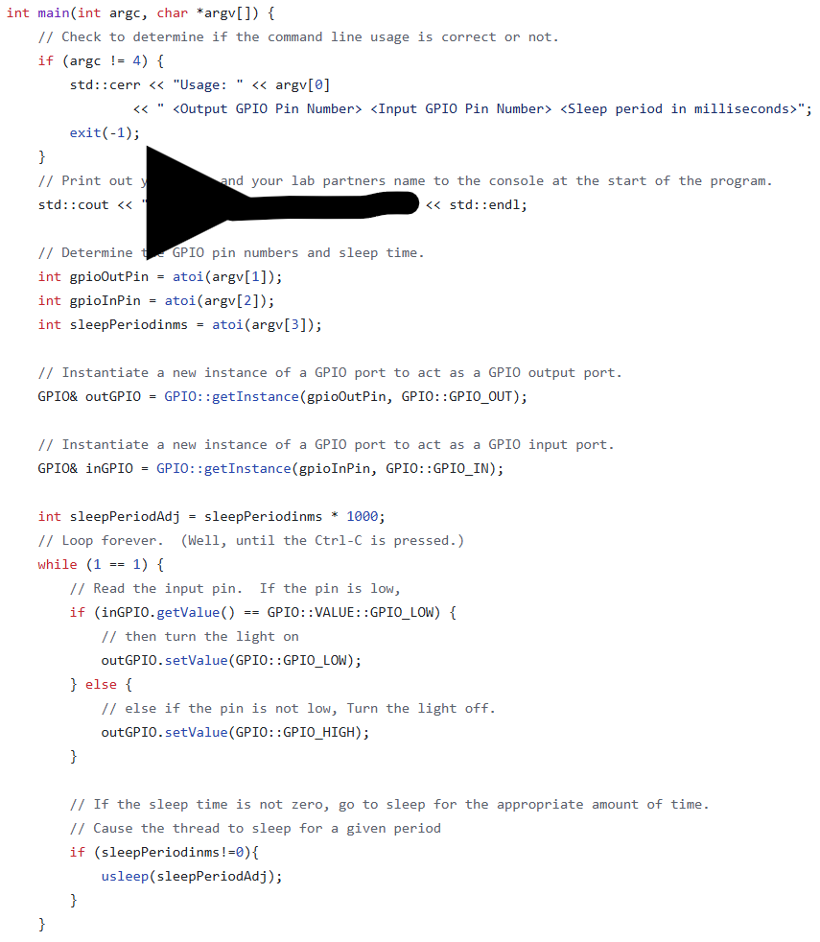
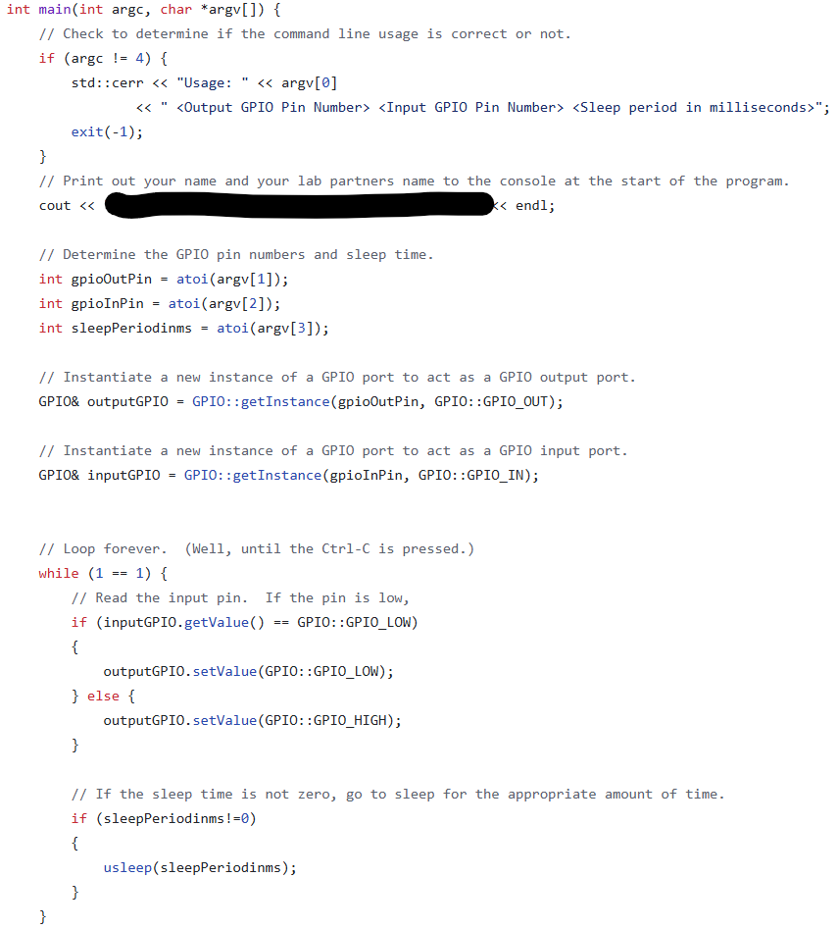
What is different?

Slide 13
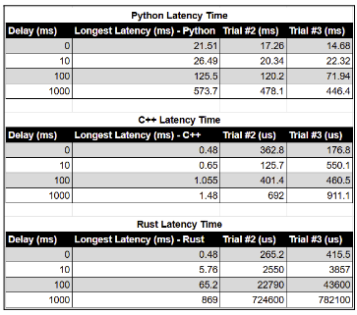
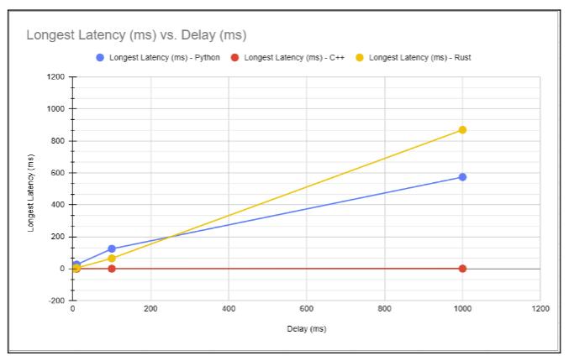

Slide 14
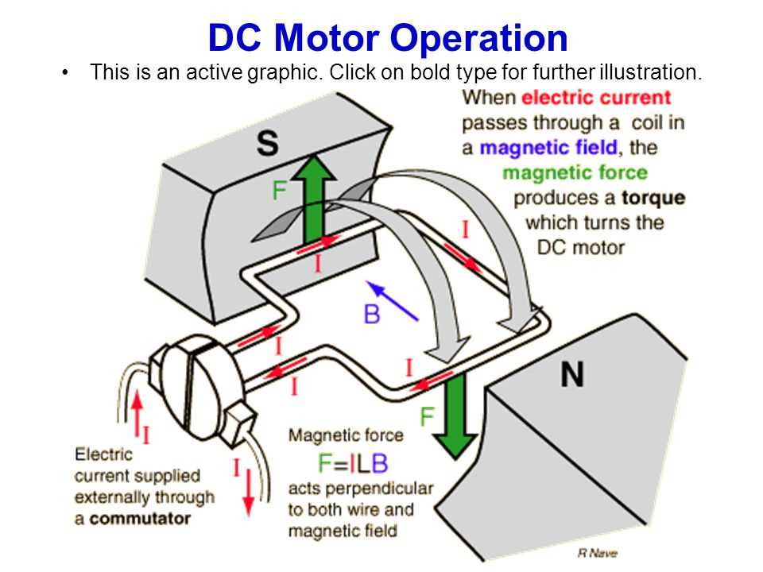
How it works:
DC Motors
When reach halfway point, electromagnet switches
Result is spin
  May have 3 (or more?) magnets
  Uses brushes: wear
AC motor: ring of sequenced magnets
How can the Pi drive a motor?
GPIO Pins: direct current
Adding an alternator wastes power
Maybe we could simulate an AC wave...
Notes:
Image from https://www.caretxdigital.com/electric-stove-connection-diagram/

Slide 15
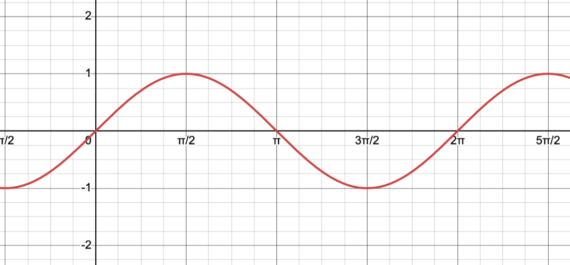
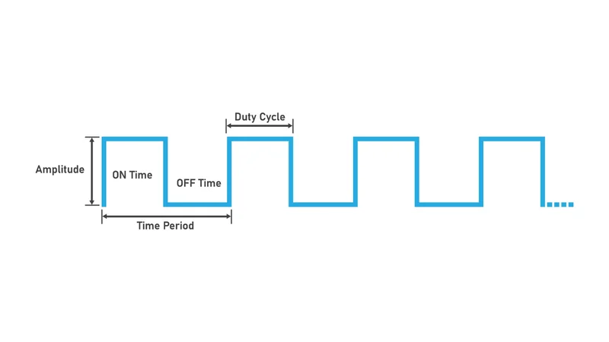
PWM
Goal, emulate a sine wave using a DC output pin
Don’t need the curve, just the change in direction
Solution: pulse-width modulation (PWM)
Essentially, fake it!
Also used for dimmers, sound, etc.
Notes:
sine wave Graphic from https://www.desmos.com/calculator/w9jrdpvsmk
PWM material at https://www.wevolver.com/article/what-is-a-pwm-signal-fundamentals-and-practical-applications-for-engineers among other places
PWM graphic from this page

Slide 16
Contemplation
How does one control the speed of a motor?
How does one change the brightness of a light bulb?

Slide 17


PWM Personified

Slide 18
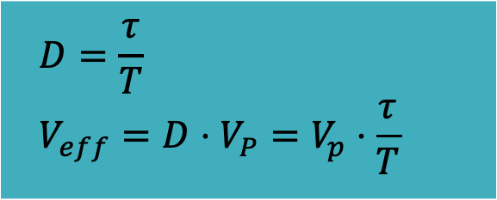
Effective Voltage provided by PWM
Determine the duty cycle (D): “tau over tee”
  Fraction of period where signal is high
  tau: time on, T: time period
Compute the effective voltage (V_{eff}):
  Multiply the duty cycle by the peak voltage
  V_{p}: peak voltage – how high the signal goes
$$D=\frac{τ}{T} \\ V_{eff}=D⋅V_{P}=V_{p}⋅\frac{τ}{T}$$

Slide 19
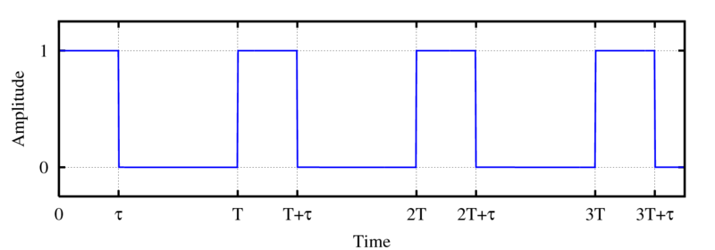

Calculating the Effective Voltage with PWM
Example
Tau = .1 s
T = 1 second
Duty cycle = 10%
If vP = 5 volts, effective voltage is .5 V
Tau = .25 s
T = .75s
Duty cycle = 33%
If vP=5 volts, effective voltage = 1.65 v
High voltage on this graph: 5 V
$D=\frac{τ}{T}$ = ¼
V_{eff} = 1.25
Notes:
Example
Tau = .1 s
T = 1 second
Duty cycle = 10%
If vP = 5 volts, effective voltage is .5 V
Tau = .25 s
T = .75s
Duty cycle = 33%
If vP=5 volts, effective voltage = 1.65 v

Slide 20
PWM Measurement
Let's look at some PWM with the Raspberry PI and an LED.

Slide 21
Hardware versus software PWM
How would hardware PWM works?
  Typically: PLC
Software PWM – what do you think are the advantages?
What are the advantages of hardware?

Slide 22
Lets look at the code for the project we just ran

Slide 23
Discussion
What happens to CPU utilization as the period of the PWM signal changes?
What happens to CPU utilization as the duty cycle of the PWM signal changes?
What happens if the PWM signal period gets too long?
What does the oscilloscope show as we change period, duty cycle?

Slide 24
Hardware Versus Software PWM

