Slide 1
Messaging Patterns
SWE 4211

Slide 2
Objectives
Review the Observer pattern, Pub/Sub
Compare the two patterns
Compare and contrast Unicast and Broadcast patterns for communications
Explain the concept of a message translator
Explain the concept of a recipient list
Critique a system architecture using some of these patterns

Slide 3
Question:
What is bad about our current network design?
Monolithic: all communication through one channel
  Strongly coupled
  Not scalable

Slide 4
Review: how many design patterns can you name?
SWE 2410
  Strategy
  Decorator
  Observer
  MVC
  Command
  Singleton
  Adapter
  Façade
  Composite
  Factory
What 5 things does each pattern need?
  Name
  Problem to solve
  Description, typically start with UML
  Advantages
  Disadvantages

Slide 5
Observer Pattern
What problem being solved?
Advantages?
Disadvantages?

Slide 6
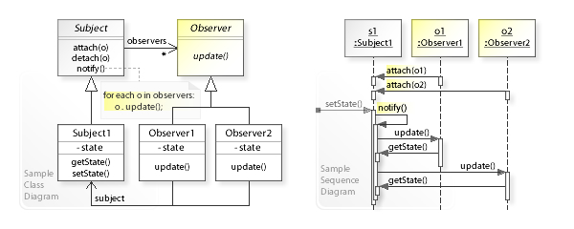
Observer Pattern
Recall state may be a parameter to update()
https://codedocs.org/what-is/observer-pattern

Slide 7
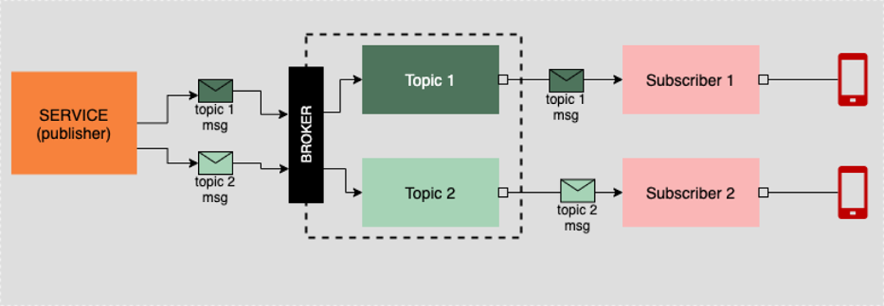
Pub/Sub Pattern
https://www.redhat.com/architect/architectural-messaging-patterns

Slide 8
Pub/Sub Pattern – our application
Could be on
robot or external
Some subscribers:
Horn control
Direction control
Distance sensor
https://www.redhat.com/architect/architectural-messaging-patterns

Slide 9
Differences
Observer pattern:
  Generally synchronous
  subject calls the appropriate method on all observers when event occurs
  Observers are aware of the subject
Publish/Subscribe
  Meant to be asynchronous
    Messages/events go on queue, when clients process them is nondeterministic
  publishers and subscribers don't need to have references to each other
    communicate with the help of brokers/message queues

Slide 10
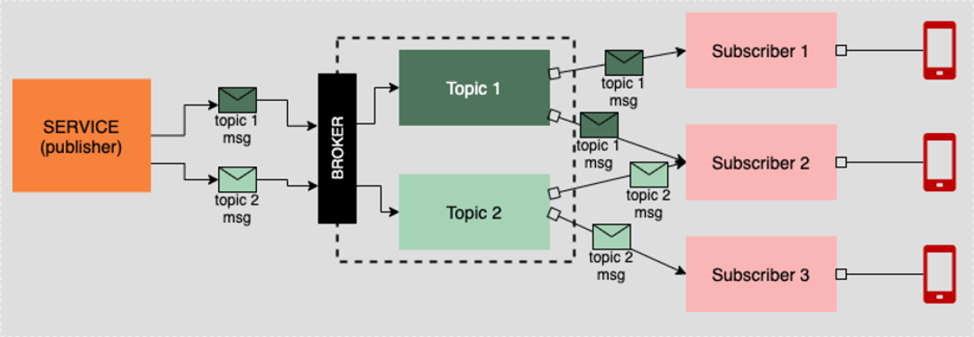
Fanout – number of subscribers
Interested party binds to a topic
  Many interested parties will bind (a.k.a, subscribe) to a given topic
When a message is sent to the topic, all subscribers will receive a copy
https://www.redhat.com/architect/architectural-messaging-patterns

Slide 11
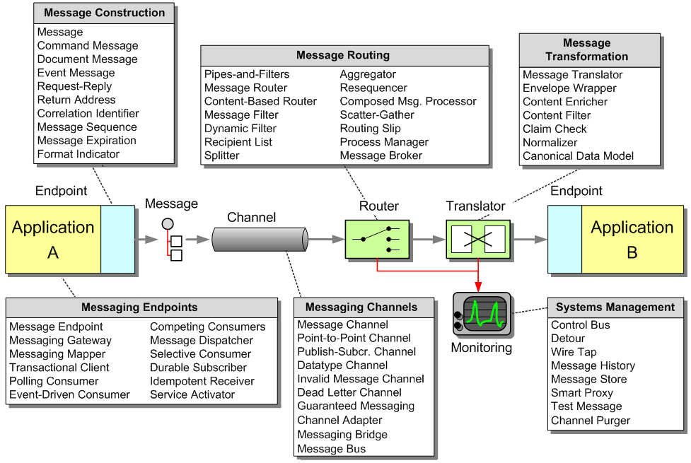
Java, laptop
Robot
Notes:
https://www.enterpriseintegrationpatterns.com/patterns/messaging/

Slide 12
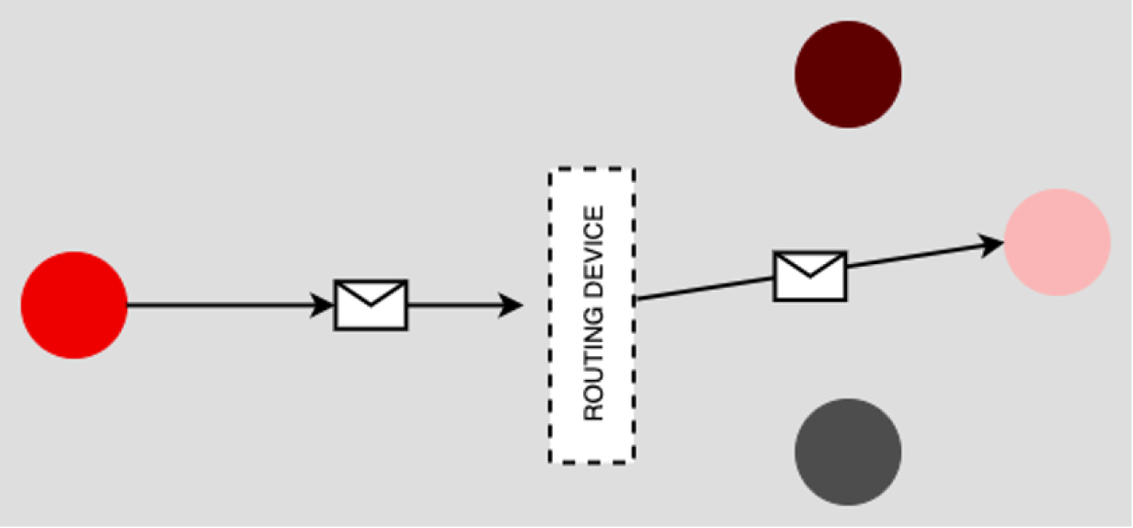
Unicast: Single sender, single receiver
In the Unicast pattern, a message gets routed from a sender to a designated receiver.
https://www.redhat.com/architect/architectural-messaging-patterns

Slide 13
What would we use Unicast for?
Fast: no broker, just transmit data
No locking: message has just one recipient

Slide 14
How is Unicast used?
Some ideas:
  Sending commands to an IOT device
  Sending targeted parameters to a device
    Configuration Parameters
    Setpoints, etc.

Slide 15
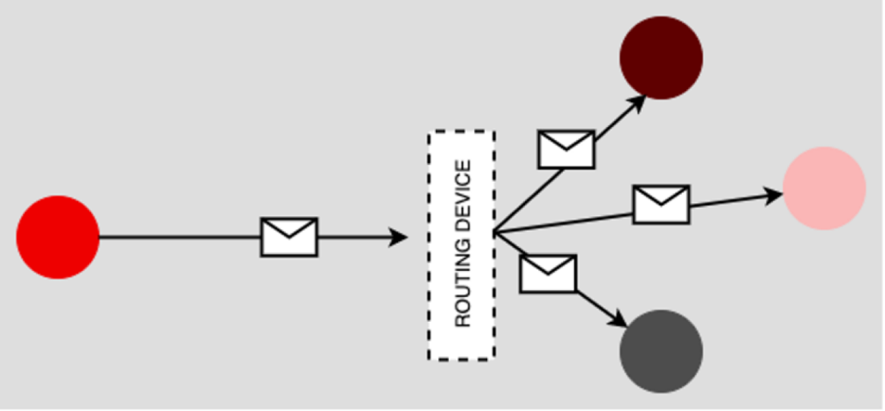
Broadcast
A sender emits a message to all receivers on the network
  The network router does the work of discovering devices on the network and forwarding the message accordingly

Slide 16
What can we use broadcast for?
Shutdown events
Emergency notification of all clients

Slide 17
What can we use broadcast for?
Ideas:
  Reporting status
    Connection status
    Distances
    States
  Sending emergency commands
  Determining if components are “healthy”
    Health: known as a heartbeat check
    Also known as a watchdog timer
      If system fails to respond on set period, reboot

Slide 18
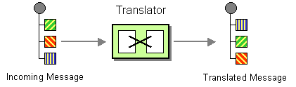
Message Translator
The Message Translator is the messaging equivalent of the Adapter pattern described in [GoF]
  An adapter converts the interface of a component into a another interface so it can be used in a different context.

Slide 19
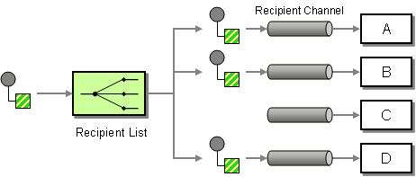
Recipient List
Define a channel for each recipient.
  “queue”
Recipient List inspects a incoming message
  Determine the list of desired recipients
  Forward the message to all channels associated.
https://www.enterpriseintegrationpatterns.com/patterns/messaging/RecipientList.html

Slide 20
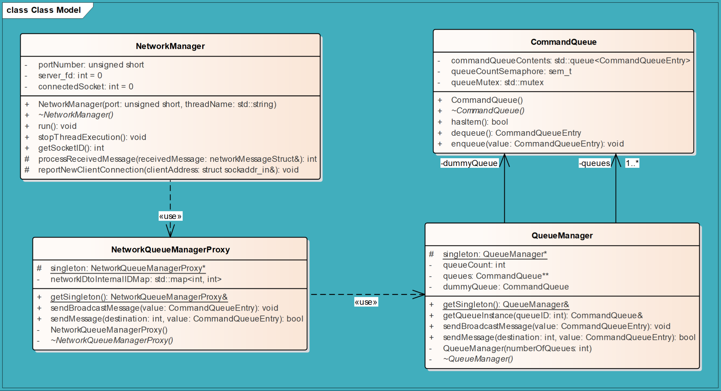
Existing
Existing
Translate queue id’s
Manage creating queues

Slide 21
