Slide 1
Concurrency Examples
SWE 4211

Slide 2
Outcomes
Identify common mistakes in source code implementation
Identify root causes of problems within source code.

Slide 3
Review
mutex.

Slide 4

Types of Headaches
facebook software engineering group

Slide 5
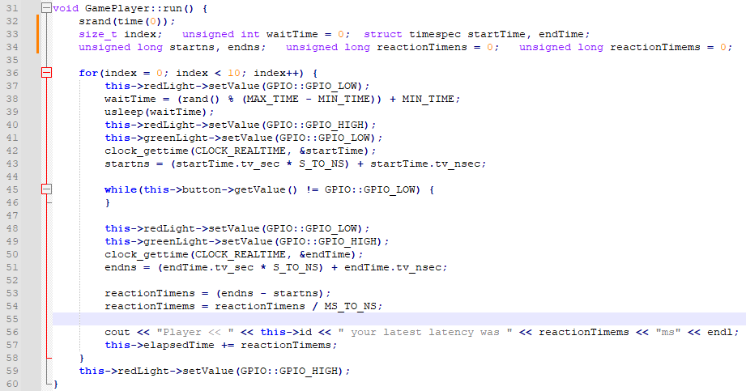
Issues?
Find the busy-wait
usleep replaced by nanosleep
Notes:
Aside: usleep on DOS does busywait

Slide 6
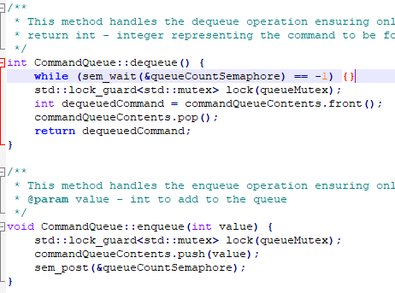
What is wrong with this code?
Real issue:
Why mix POSIX & std::mutex?
std::condition_variable works
If queueCountSemaphore is unnamed, sem_wait returns an error but doesn’t release
Infinite loop with 100% CPU usage!
  Particularly true for macOS
Ok?
Should have {}s around lines 1,2
Else don’t release lock before notifying dequeue
Ok?
Notes:
Note: first is ok since sem_wait releases the CPU (even if just one CPU)

Slide 7
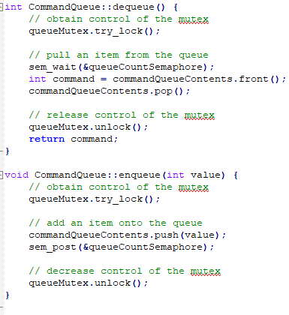
What is wrong with this code?
What could go wrong?
try_lock: does not wait
Drops through even if not locked
Just call lock()
Same

Slide 8


Slide 9
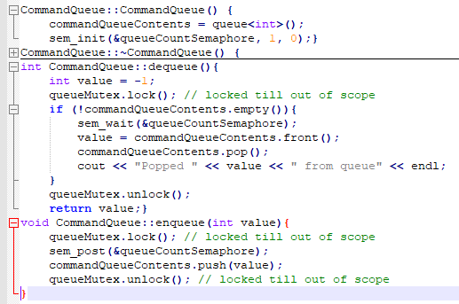
What is wrong with this code?
Rewrite!
Don’t take lock until receive post
But what if another thread gets post first…
Do check not empty
Switch!
Notes:
Better code:
bool received = false;
while ( !received ) {
sem_wait(&queueCountSemaphore);
queueMutex.lock();
if ( (received = !commandQueueContents.empty()) ) {
value = commandQueueContents.front();
commandQueueContents.pop();
cout << “Popped “ << value << “ from queue” << endl;
}
queueMutex.unlock();
}
return value;

Slide 10
